Slide 1
WebDriver & Selenium
Matt Smith
February 7, 2014

Slide 2
History
Jason Huggins started Selenium in 2004
JavaScript library that would drive a web page
Had limitations due to different browser restrictions on JavaScript
Simon Stewart started WebDriver in 2006 at Google
Got tired of doing workarounds for the pitfalls with Selenium
He wanted native communication with the browser, thus bypassing JavaScript restrictions
The two projects merged in 2008
The both address shortcomings in each other

Slide 3
History
2013 Started submissions to the W3C for a WebDriver API standard
Attempting to offload the native communication work to the browser’s original authors following a standard API
Authors:
Simon Stewart – Google
Facebook
David Burns – Mozilla

Slide 4
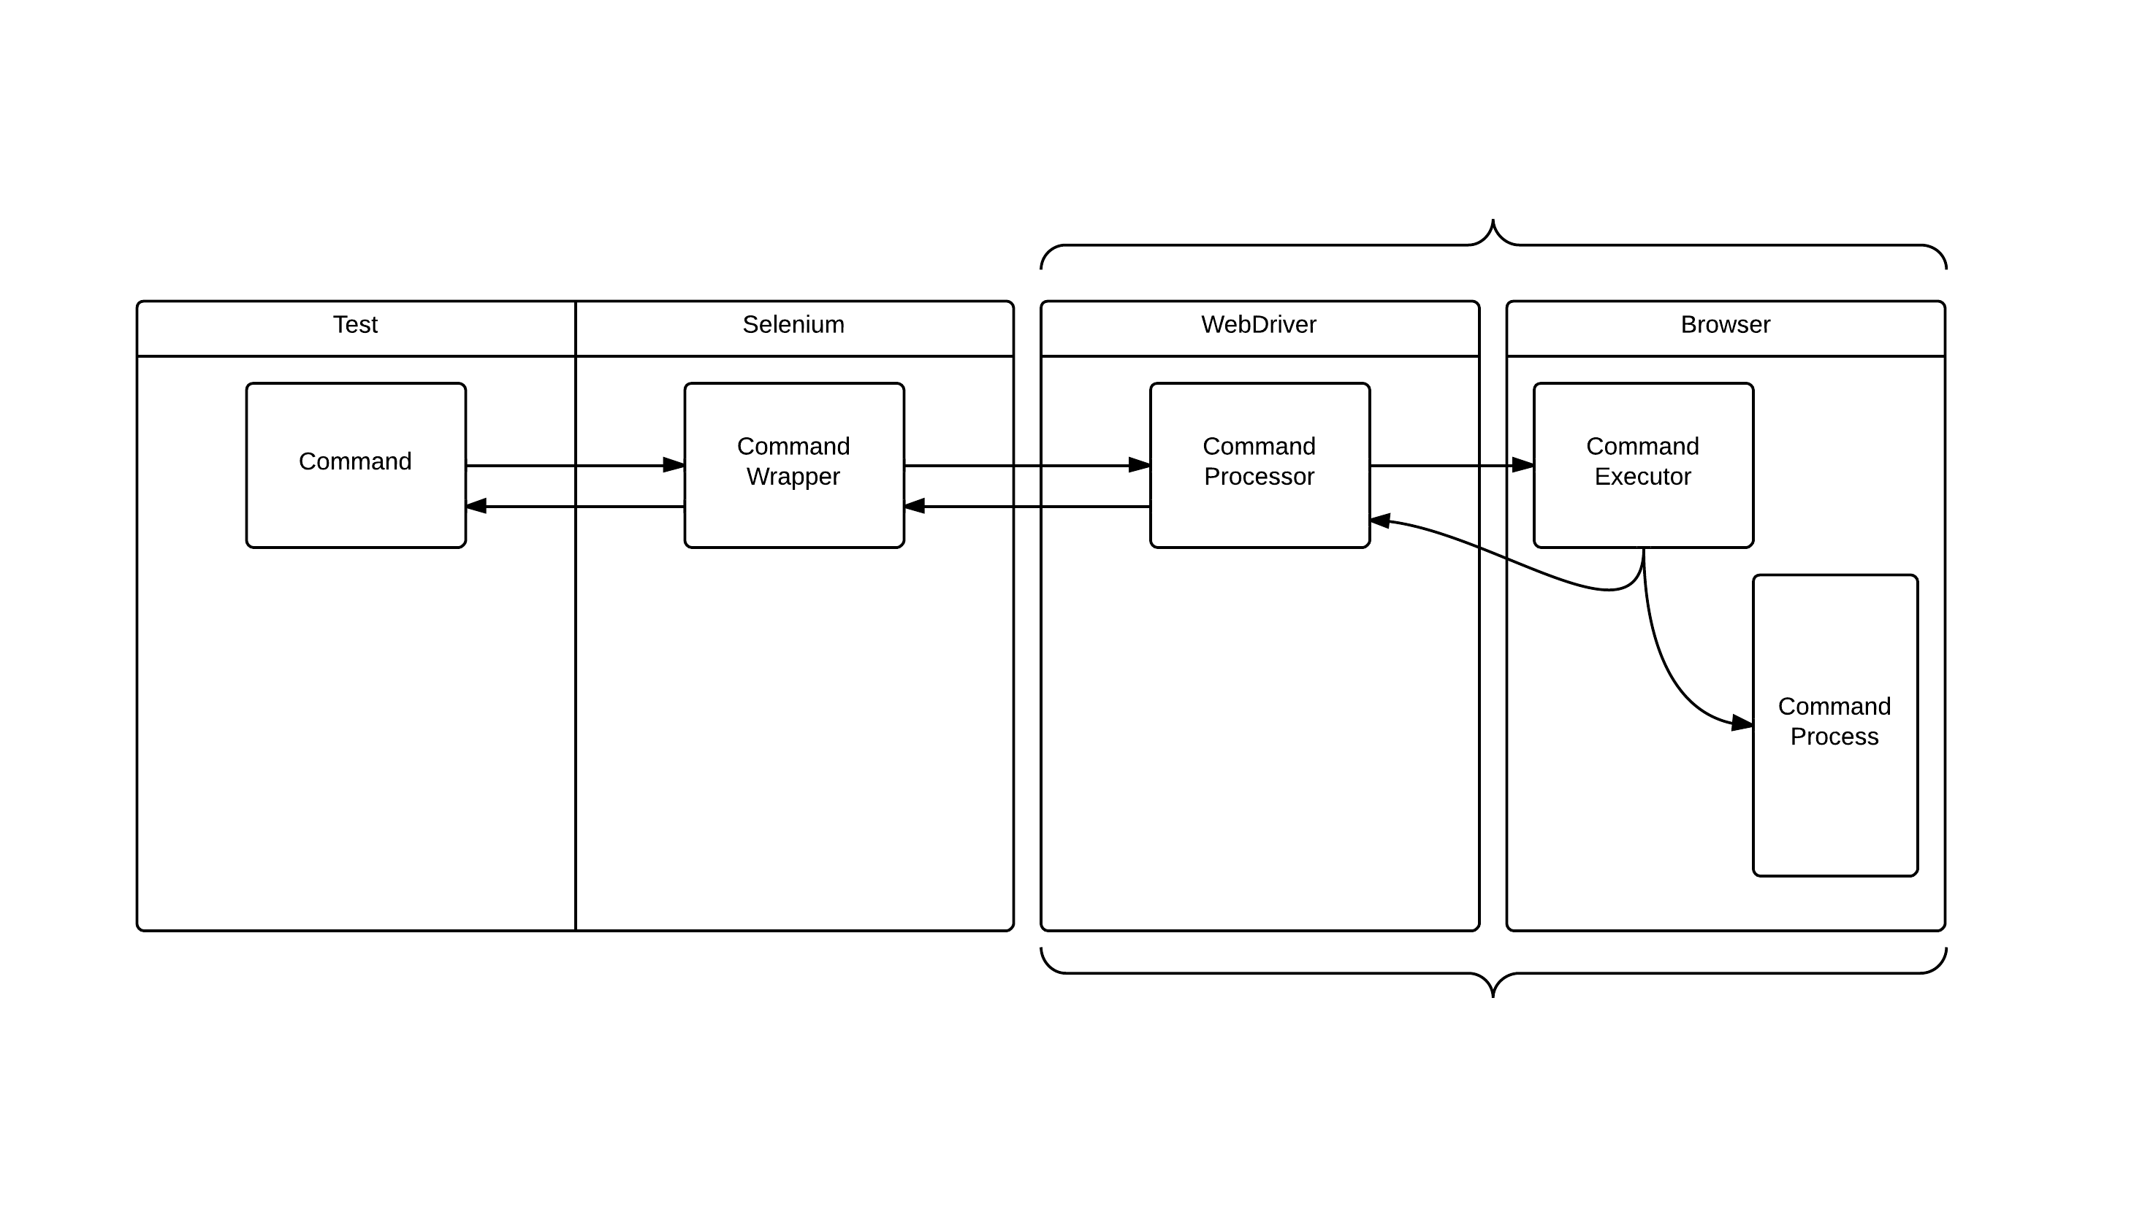
Basic Flow

Slide 5
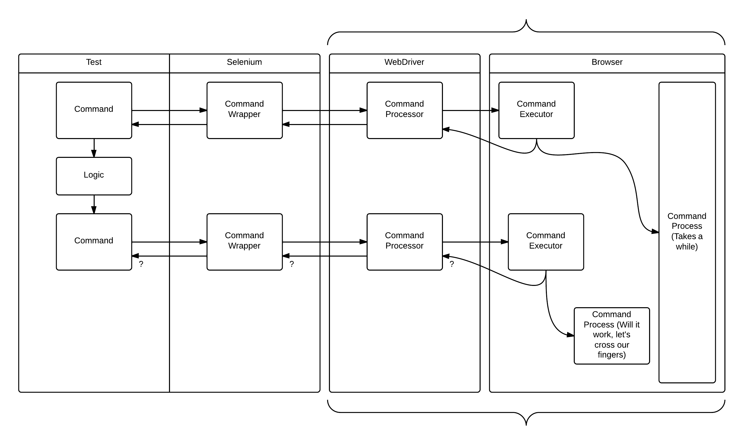
Where things can go wrong

