Slide 1
WebDriver & Selenium
Matt Smith
February 7, 2014

Slide 2
History
Jason Huggins started Selenium in 2004
JavaScript library that would drive a web page
Had limitations due to different browser restrictions on JavaScript
Simon Stewart started WebDriver in 2006 at Google
Got tired of doing workarounds for the pitfalls with Selenium
He wanted native communication with the browser, thus bypassing JavaScript restrictions
The two projects merged in 2008
The both address shortcomings in each other

Slide 3
History
2013 Started submissions to the W3C for a WebDriver API standard
Attempting to offload the native communication work to the browser’s original authors following a standard API
Authors:
Simon Stewart – Google
Facebook
David Burns – Mozilla
Firefox already does this
Notice there is not console window launched when testing with Firefox

Slide 4
Broad Community Connections
Java
C#
Python
Ruby
Perl
PHP

Slide 5
Supported Operations
Page Navigation
User Input
Keyboard
Ctrl
Alt
Shift
Any key you can press on the keyboard, and even some you can’t
Mouse
Click
Double Click
Right Click
Scroll
Drag and Drop

Slide 6
Supported Operations
Manage multiple Windows (Tabs) and Frames
Popup Dialogs
Navigation History and Location
Cookies
Must be on the domain that the cookie will be valid for

Slide 7
Supported Browsers
HtmlUnit (Headless browser)
Fastest and most light weight driver.
Does not run JavaScript by default
Firefox
Targeted Versions
3.6
10
latest – 1
latest
Windows, Mac, Linux
Runs with no installed plugins
IE
Targeted Versions: 6, 7, 8, 9, 10, (Not 11) on appropriate combinations of XP, Vista, and Windows 7
Be cautious of 32 vs 64 bit machines
Some setup required…. read the docs
XPath selector does not work
CSS Selectors not support in 6 and 7, Sizzle is injected instead
CSS Selectors in 8 and 9 are native, but those browsers don’t fully support CSS3

Slide 8
Supported Browsers
Chrome
Maintained by Chromium
Like IE the driver is a process outside the browser
Since Chrome is a Webkit-based browser, the ChromeDriver may allow you to run Safari, but JavaScript may differ.
Opera – See the docs
iOS – See the docs
Android – See the docs

Slide 9
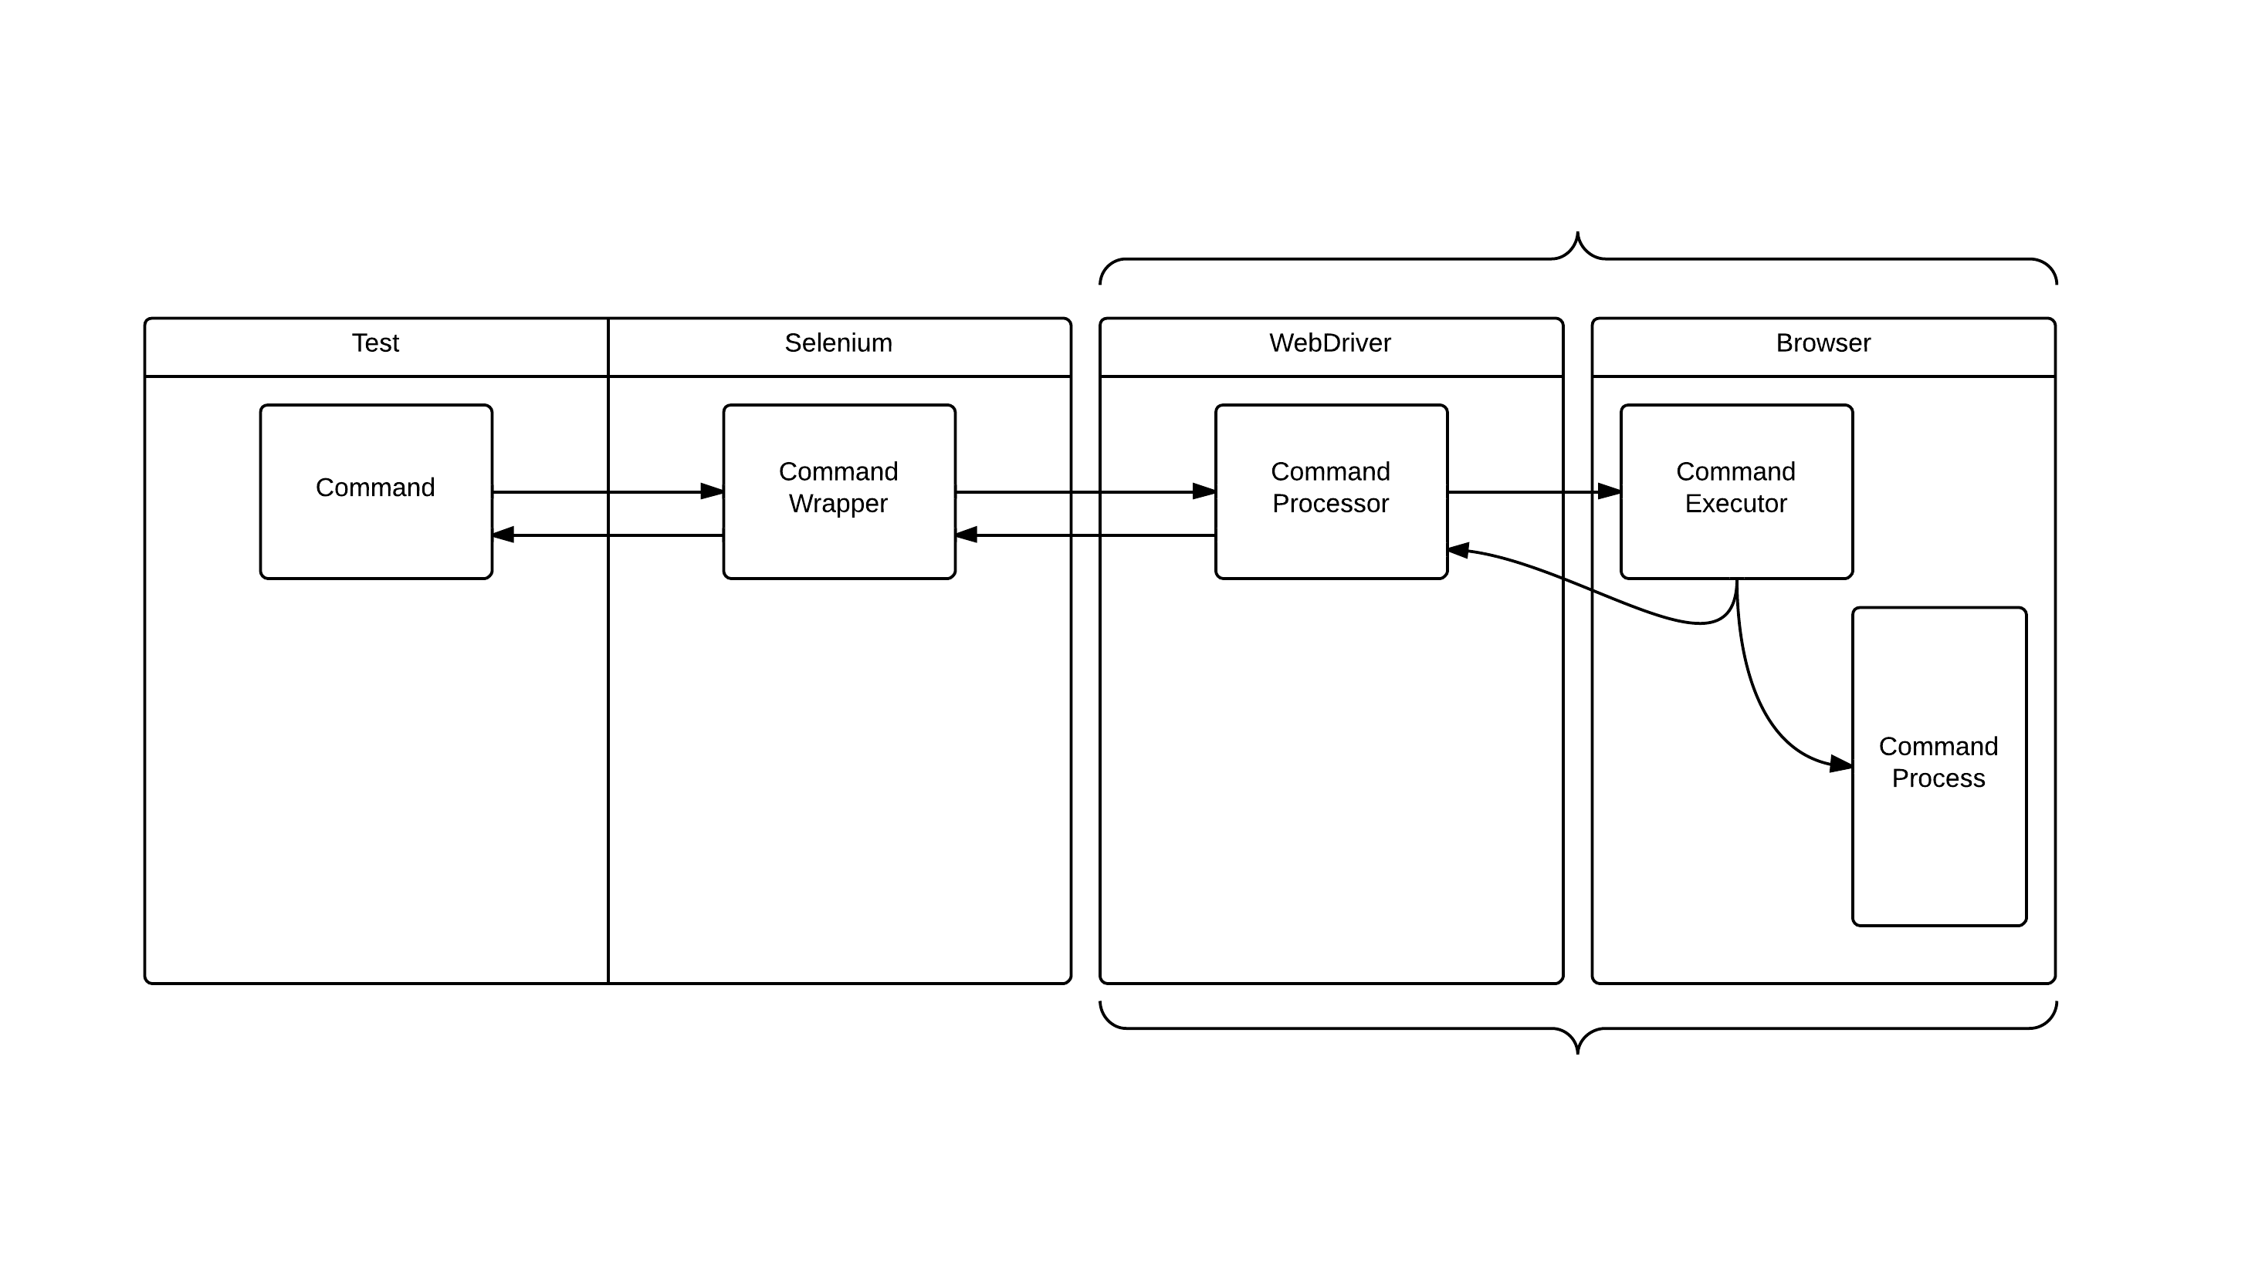
Basic Flow
Firefox runs both of these in the same process
Chrome and IE run in separate processes

Slide 10
Element Location

Slide 11
Element Location
ID
Class Name
Tag Name
Name
Link Text
CSS Selector
Xpath (ick!)
JavaScript
In Serenity there is By.jQuery now! (As of last week)

Slide 12
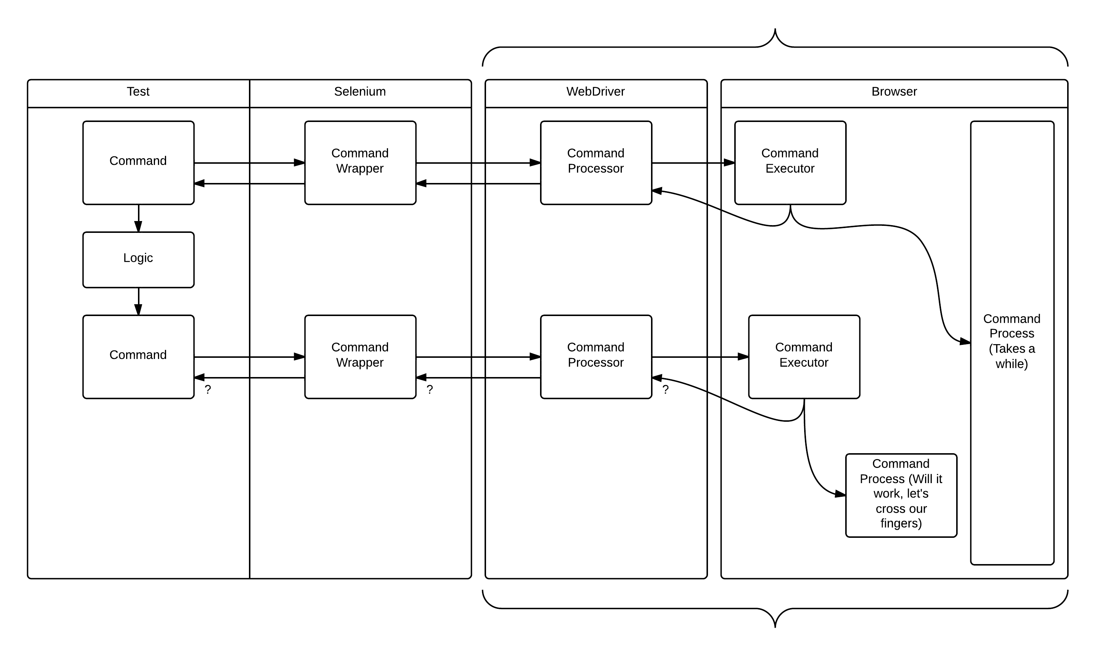
Where things can go wrong

