Slide 1
Learning to Play the Puzzle Grid
VAE → GAN → Transformer ranking: three tetromino solvers trained on heuristic self-play
VAE v2
0 lines
GAN
6 lines
Transformer ranker
157 lines
Solver overview & notebook walkthrough · puzzle-grid-tetramino-solvers · write-up: medium.com/@mtshomsky/6a0b847a522f
Notes:
Welcome. This deck is the spine of the walkthrough; the three notebooks in notebooks/ are the hands-on part. The arc: imitate (VAE) -> add a value head (GAN) -> evaluate every legal move (transformer). Headline numbers are on the next slide.

Slide 2
The headline
Same engine, same clean data, four solvers
Approach | Core idea | Max lines (mixed) | Verdict
VAE v2 | Reconstruct the demonstrated placement; rank legal moves by posterior | 0 | Fails: covariate shift
GAN | Generator proposes; discriminator w/ line-clear head judges | 6 | Works, weak & high variance
Transformer direct policy | Distill the ranker into a (rotation, column) generator | 5 | Confirms ranking > generation
Transformer ranking | Score every legal candidate, play the best | 157 (move cap) | Solves the task
Thesis: framing beats capacity. Reframing play as ranking legal candidates instead of generating a move is what moved the needle, not a bigger network.
Notes:
Everything trains on the same clean dataset and plays on the same engine, so this is apples-to-apples. The fourth row (direct policy) is a postscript: distilling the winning ranker back into a generator. It plateaus with the other generators, which is the sharpest evidence for the thesis.

Slide 3
Agenda & how to use this deck
• Foundations: the game, the API, the reachability engine
• The teacher: heuristic player & clean training data
• Solver 1: VAE v2 → notebook 01
• Solver 2: GAN → notebook 02
• Solver 3: Transformer ranker → notebook 03
• Postscript: distillation & agent placement
• Head-to-head, conclusions, next steps
# one-time setup (package root)
uv sync --group notebooks
notebooks/
01_vae_training_and_solver.ipynb
02_gan_training_and_solver.ipynb
03_transformer_training_and_solver.ipynb
nb_setup.py # paths, scenarios, drawing
• Notebooks load shipped weights; training cells are off by default (RUN_SHORT_TRAINING = False)
• Each has a lab cell: set PIECE and SCENARIO, re-run below
Notes:
Suggested pacing: ~10 min foundations, then ~15 min per solver with the matching notebook open, 10 min wrap-up. Each solver section ends with a 'notebook guide' slide naming the cells to run live.

Slide 4
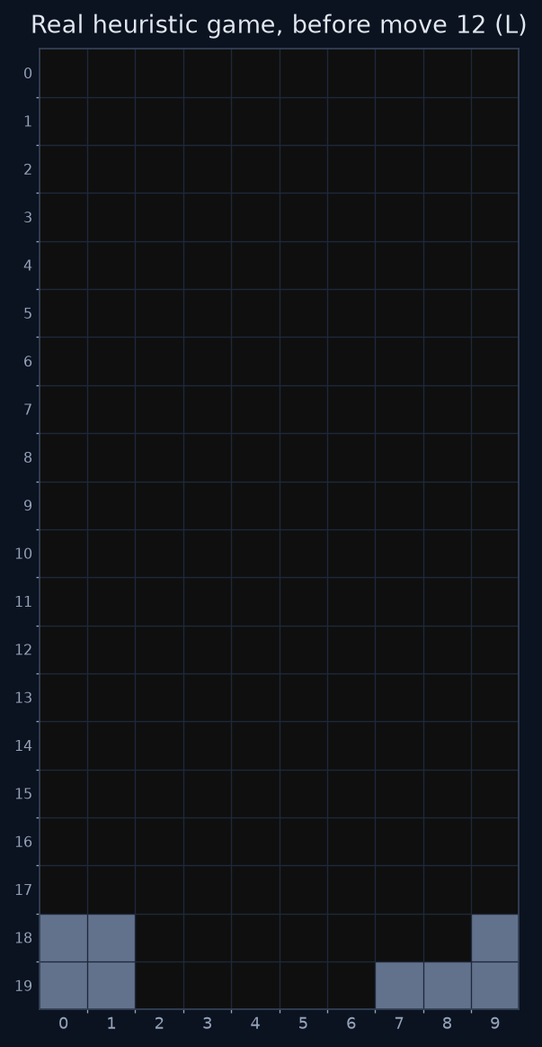
The problem
Can a model learn to clear lines purely from heuristic demonstrations?
• 20 × 10 grid, pieces I O T S Z J L, goal: clear lines without topping out
• AI action = final pose (row, col, rotation), not a key sequence
  – Engine enumerates the legal poses; a solver picks one
• Supervision comes only from a hand-written heuristic player (~18 lines/game median)
• Question for each model: does it learn to imitate or to evaluate?
  – Imitation can look perfect on held-out data and still fail in play
Notes:
The board is a 20x10 occupancy grid, 7 tetrominoes. A 'move' for the AI interface is a final resting pose (row, col, rotation); the engine validates it. No model ever saw a human game: the heuristic player is the only teacher.

Slide 5
System architecture
The API server is authoritative; everything else is a client
Heuristic generator
heuristic-data-generator.py
Game engine + API
puzzlegrid/ (FastAPI)
Replay clients
replay_vae_v2 / replay_gan /
replay_transformers
JSON game logs
training_data_clean/
Training
VAE · GAN · Transformer
Shipped weights
models/…
POST /games create game (allowed pieces)
GET /games/{id} board + current piece
GET /games/{id}/potential-placements legal reachable poses (BFS + filter_low_stack)
POST /games/{id}/place final (row, col, rotation) ← the RL / AI interface
Notes:
Three parts talk over HTTP. The FastAPI server is authoritative for rules. The generator and every replay client are just clients, so data is generated under exactly the rules the models are evaluated under. Some replays also run in-process (GANFriendlyGame / --inprocess) for speed.

Slide 6
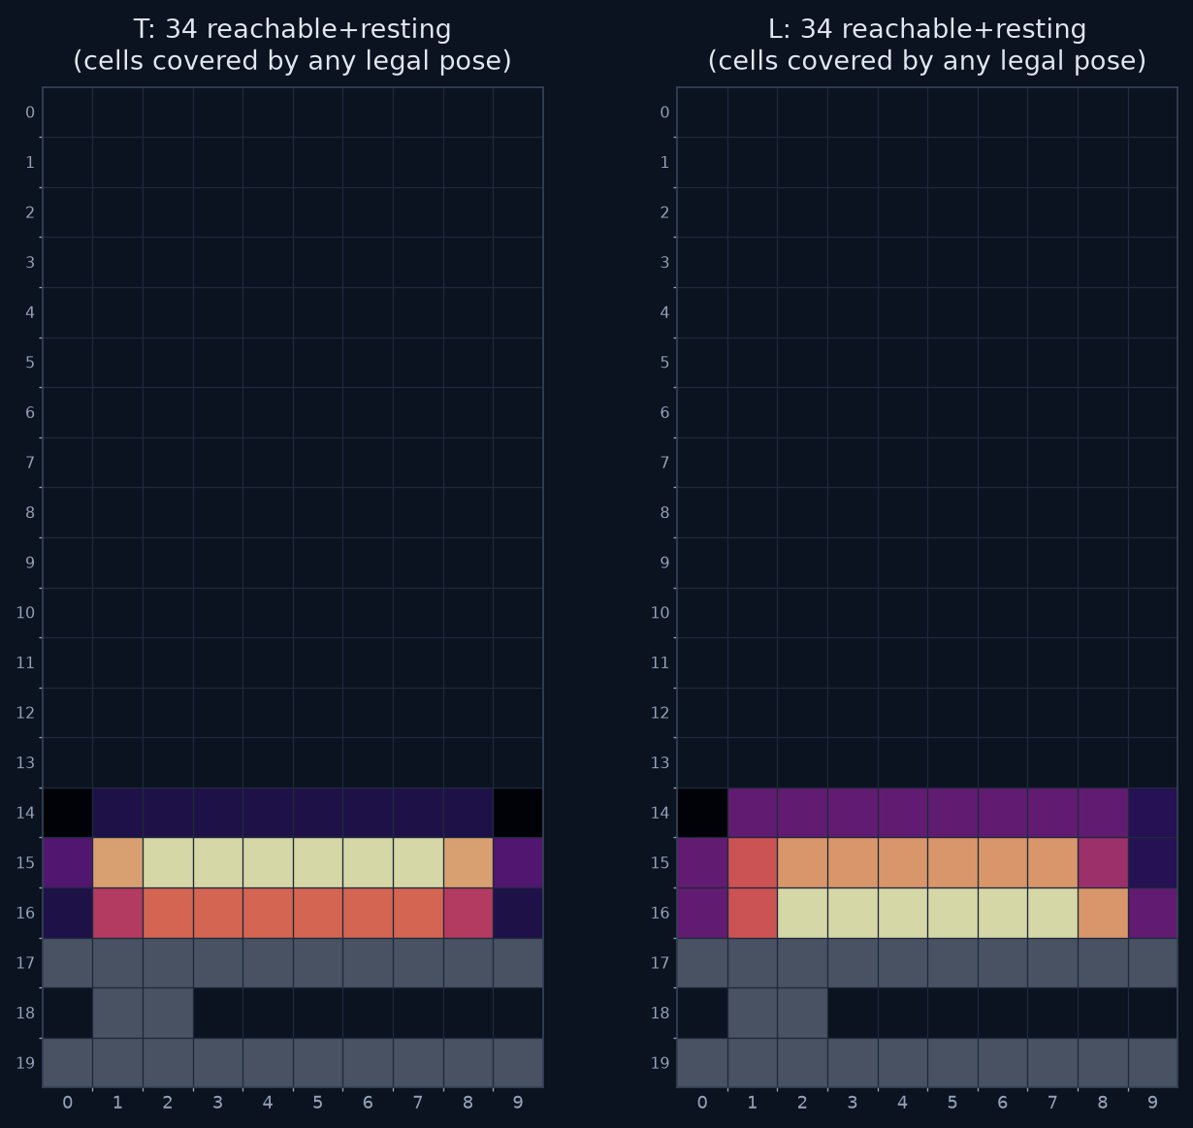
Foundation: a correct reachability engine
puzzlegrid/placement.py: the single source of truth
• Bug: old engine only checked that the column corridor above a target was empty
  – Offered placements inside enclosed pockets: pieces "teleported" under overhangs
  – Polluted training data with physically impossible moves
• Fix: BFS over piece states from spawn
  – Moves: left, right, clockwise rotate, soft-drop (mirrors game.py exactly)
  – A placement is legal iff reachable AND resting
• Used by the API, the generator, every solver, and the notebooks
• Covered by test_placement.py (enclosed pocket, slide-under-overhang, rotate-to-fit)
• filter_low_stack is a separate opt-in policy, not reachability
Notes:
Prerequisite #1. The old engine checked only whether the column corridor above a target was empty, so it offered placements inside enclosed pockets: pieces teleported under overhangs. placement.py does a BFS from spawn over left/right/rotate/soft-drop. Legal = reachable AND resting. In the figure, the pocket at row 18 is never covered by any legal pose. Shown live: SCENARIO='overhang_pocket' in any notebook.

Slide 7
The teacher: a greedy heuristic player
Score every legal placement, play the best (no look-ahead, deterministic)
Term | Weight / effect
Line clears | +lines × (10000 + height urgency); +50000 for a Tetris
Row-completion shaping | bonus for rows with 5–8+ filled cells
Holes | −10 × holes
Aggregate height | −0.5 × Σ column heights
Bumpiness | −0.2 × Σ |adjacent height diffs|
Surface variance | −0.5 × variance of heights
Tall column | −10 × overflow above height 10
Isolated cells / orientation | −5 per isolated cell; +100 horizontal
• Candidates come from the BFS engine, so it never invents an illegal move
• I-piece special case: reward horizontal row-fills, cap column height ~12
• Coverage knobs: --placement-direction, --preferred-rotation
• Limitations: greedy, deterministic, hand-tuned weights, which is the thing we want to learn
Notes:
Prerequisite #2: the teacher. A greedy one-ply scorer over every legal placement. The magnitudes are deliberately lopsided: line clears are worth tens of thousands, shaping terms fractions to hundreds, so it clears whenever it can. The I-piece has its own evaluator. This hand-written evaluate_placement is exactly what the transformer later learns to replace.

Slide 8
Clean training data
training_data_clean/: generated with the reachability-fixed engine
Metric | Value
Games | 191
Pruning floor | ≥ 5 lines
Median lines | 18
Mean / max lines | ~21 / 76
Unreachable / floating | 0 (by construction)
{
"move_type": "place",
"piece_type": "T",
"piece_position": {"row": 19, "col": 1,
"rotation": 0},
"lines_cleared": 0,
"board_state": [[0,0,0, ...], ...]
}
• state = board, action = (piece, row, col, rotation), reward = lines_cleared
• VAE reconstructs the action · GAN's discriminator judges it · transformer contrasts it with all other legal moves
• API_URL=… GAMES=200 MAX_LINES=80 ./generate_clean_data.sh
Notes:
Every learner consumes the same (state, action, reward) triple. Because the data is clean and strong, a model that fails to play is failing at generalization, not starved of examples. validate_training_data.py replays each game via the API and checks recorded vs actual clears.

Slide 9
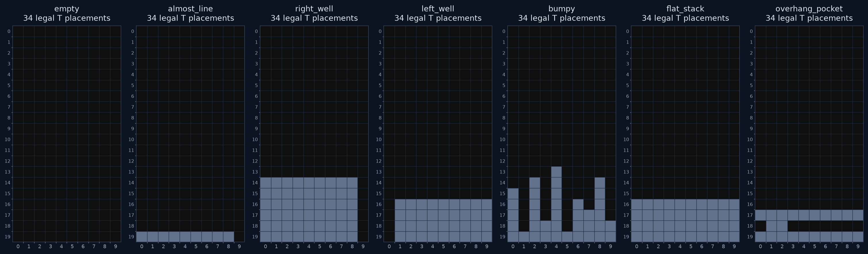
Notebook lab scenarios
nb_setup.SCENARIOS: set PIECE and SCENARIO in each notebook's lab cell
• almost_line + I: a free line clear. right_well + I: the Tetris well. bumpy + T: off-distribution surface. overhang_pocket: only BFS-reachable poses exist.
Notes:
These are the lab scenarios defined in nb_setup.py. Every notebook has a cell with PIECE and SCENARIO: change them and re-run downward. Good contrasts: almost_line + I (free clear), right_well + I (Tetris well), bumpy + T (off-distribution surface), overhang_pocket (reachability).

Slide 10
SOLVER 1
VAE v2: learn to imitate
Conditional VAE trained to reconstruct the teacher's placement; plays by posterior ranking
Notebook: notebooks/01_vae_training_and_solver.ipynb
Notes:
The first approach and the canonical model in the original codebase. Training looks great; play does not.

Slide 11
VAE architecture
Encode (board, action) → z, decode (board, z, piece) → action
board (20×10×1)
Conv 32 → 64 → 96 (stride) → 128 (stride)
→ flatten → Dense 256 = board_feat
action = piece(7) | rot(4) | (row/H, col/W) 13-d
encoder: (board_feat, action) → z_mean, z_log_var
decoder: (board_feat, z, piece_embed)
→ piece / rotation / position heads
loss = piece CE + rot CE + 10·pos MSE + β·KL
 | v1 | v2
Board CNN | 2 conv + GAP | 4 conv, strided + flatten
Latent | 32 | 64–256
Decoder | shared 256→128 | residual, split heads
Logit loss | bug (no from_logits) | fixed
Play | sample z ~ N(0,I) | posterior ranking
• Trained on training_data_clean/, 50 epochs: val piece-acc ≈ 1.0, rotation-acc ≈ 0.98
• It reconstructs demonstrated moves almost perfectly. That is necessary, and not sufficient.
Notes:
Training: encode (board, true action) into z, decode back to the action, loss = recon + beta*KL. v2 vs v1: strided convs + flatten instead of global average pooling (keeps holes/wells/near-full rows), wider residual MLPs, separate decoder heads, and the from_logits=True loss fix. Notebook 01 section 3 prints the board encoder summary; section 7 shows conv activations.

Slide 12
Inference: prior sampling vs posterior ranking
The v1 bug was a train/inference mismatch
 | Training | v1 replay | v2 replay
Source of z | q(z | board, true action) | random N(0, I) | q(z | board, candidate) mean
Action encoder | used | not loaded | used
Selection | supervised target | sample → decode → snap → recon err | enumerate every legal pose → lowest recon loss
for cand in get_valid_placements(board, piece):
z_mean = encode(board_feat, action(cand))
pred = decode(board_feat, z_mean, piece)
score = recon_loss(pred, cand) # lower = teacher-like
play argmin(score) # optional −line-clear bonus
v2's inference is correct, but it answers "which move looks most like the teacher?", not "which move is good?"
Notes:
This is the v1 root cause from vae_explaination_and_improvement_plan.md. Training learns 'given this board and this exact placement, what z explains it?' but v1 asked 'given a random z, where should the piece go?'. v2 fixes the mismatch by scoring every legal move with its posterior mean. Notebook 01 section 8 implements this ranking inline (vae_score_candidates).

Slide 13
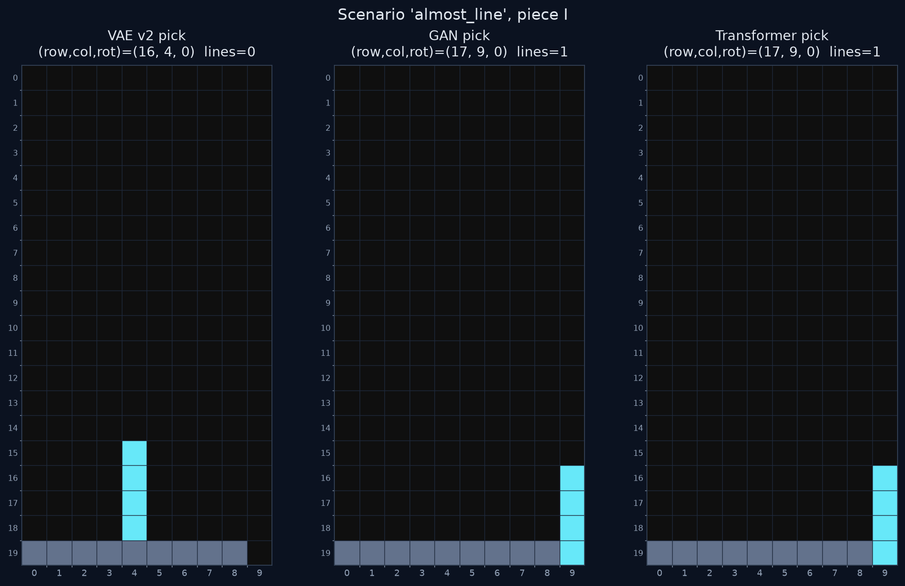
VAE in action: it misses a free line clear
Shipped models, scenario almost_line, piece I
• VAE picks a centered vertical I: 0 lines
• GAN and transformer drop into column 9: 1 line
• The teacher's *typical* I-placement (flat, centered) outvotes the rare, correct one
• On right_well all three find the Tetris; the gap shows on boards where the right move is unusual
Notes:
Generated with the shipped models on scenario almost_line, piece I. The VAE's lowest-reconstruction pick is a centered vertical I: the teacher's typical placement outvotes the rare-but-correct clear in column 9. The GAN and transformer both take the free line. Reproduce in notebook 01 section 6 (PIECE='I', SCENARIO='almost_line') and section 11 (VAE pick vs line-clear oracle).

Slide 14
Result: 0 lines, behavioral-cloning covariate shift
• Near-perfect reconstruction, 0 lines in play
• Imitation has no notion of board value
  – Small deviations push the board off the training distribution (center stacking, holes)
  – Off-distribution, placements degrade further: a compounding loop
• Instrumented: at every step, the best achievable clear over all legal moves was 0
  – No reward knob can help when no clearable row ever forms
  – Line-clear bonus 3 → 15 and removing the low-stack filter: no change
Reconstruction accuracy ≠ good play
What's missing is a value signal: something that knows a line clear is good and a hole is bad. → the GAN
Notes:
Diagnosis from VAE_to_GAN_to_TransformerRanking.md section 3. Instrumentation showed that across all legal placements at every step, the best achievable line clear was 0: the board is driven into a shape where no piece can complete a row, so no replay knob (line-clear bonus 3 to 15, removing the low-stack filter) can help.

Slide 15
Notebook 01 guide: VAE
notebooks/01_vae_training_and_solver.ipynb
Section | What to show | Talking point
2. Teaching data | Real game board before move 12; label histograms | Data is strong and clean
3. Architecture | board_encoder.summary() | Strided convs keep spatial layout
6. Lab | PIECE / SCENARIO; count of legal placements | BFS candidate set
7. CNN activations | Feature maps per conv layer | The CNN does see occupancy, wells, rows
8. Posterior ranking | Ranked table + recon-loss heatmap | Is the lowest recon the line clear? Often not
9–10. Latent z | z grid, std per dim, PCA by column; 1-D sweep | Latent organizes *where*, not *how good*
11. Solver step | VAE pick vs line-clear oracle | Same move? On almost_line, no
Notes:
Run these cells live. With shipped weights the whole notebook runs in seconds on CPU. Point out in section 8 whether the lowest recon loss is actually the clear; often it is not. Section 10's latent sweep shows which z dimensions are alive.

Slide 16
SOLVER 2
GAN: add a value signal
Generator proposes a placement; discriminator judges realism and predicts line clears
Notebook: notebooks/02_gan_training_and_solver.ipynb
Notes:
Chosen precisely because it adds what the VAE lacked: an explicit line-clear objective.

Slide 17
GAN architecture
The first model with an explicit line-clear objective
Generator
board → CNN 256 piece → Dense 64 noise (32)
concat → MLP 512 + 2× residual
→ rotation logits (4), position sigmoid (2)
Discriminator
pre-board → CNN 256
post-board → same CNN 256
action (13)
concat → MLP 512 + 2× residual
→ realism logit (1), line-clear logits (5: 0–4)
• Warmup: supervised rotation CE + position MSE on demos
• Adversarial: alternate D / G steps
• Generator loss = adversarial + line-clear reward (D's predicted class) + supervised mix + snap penalty
• D's line-clear head trained on real clears; fakes labeled 0
• Generator emits a raw pose, then snapped to the nearest legal placement
• Shipped: models/gan_clean_v2 (60 epochs, line-clear-reward-weight 6.0)
Notes:
Both networks reuse the VAE v2 board encoder recipe. Discriminator sees pre-board, post-board (simulated), and the 13-d action vector. Training: supervised generator warmup, then alternating D/G steps with a line-clear reward. VAE v2 used line clears only as sample weights; the GAN makes them a direct objective. Notebook 02 section 3 prints the generator summary.

Slide 18
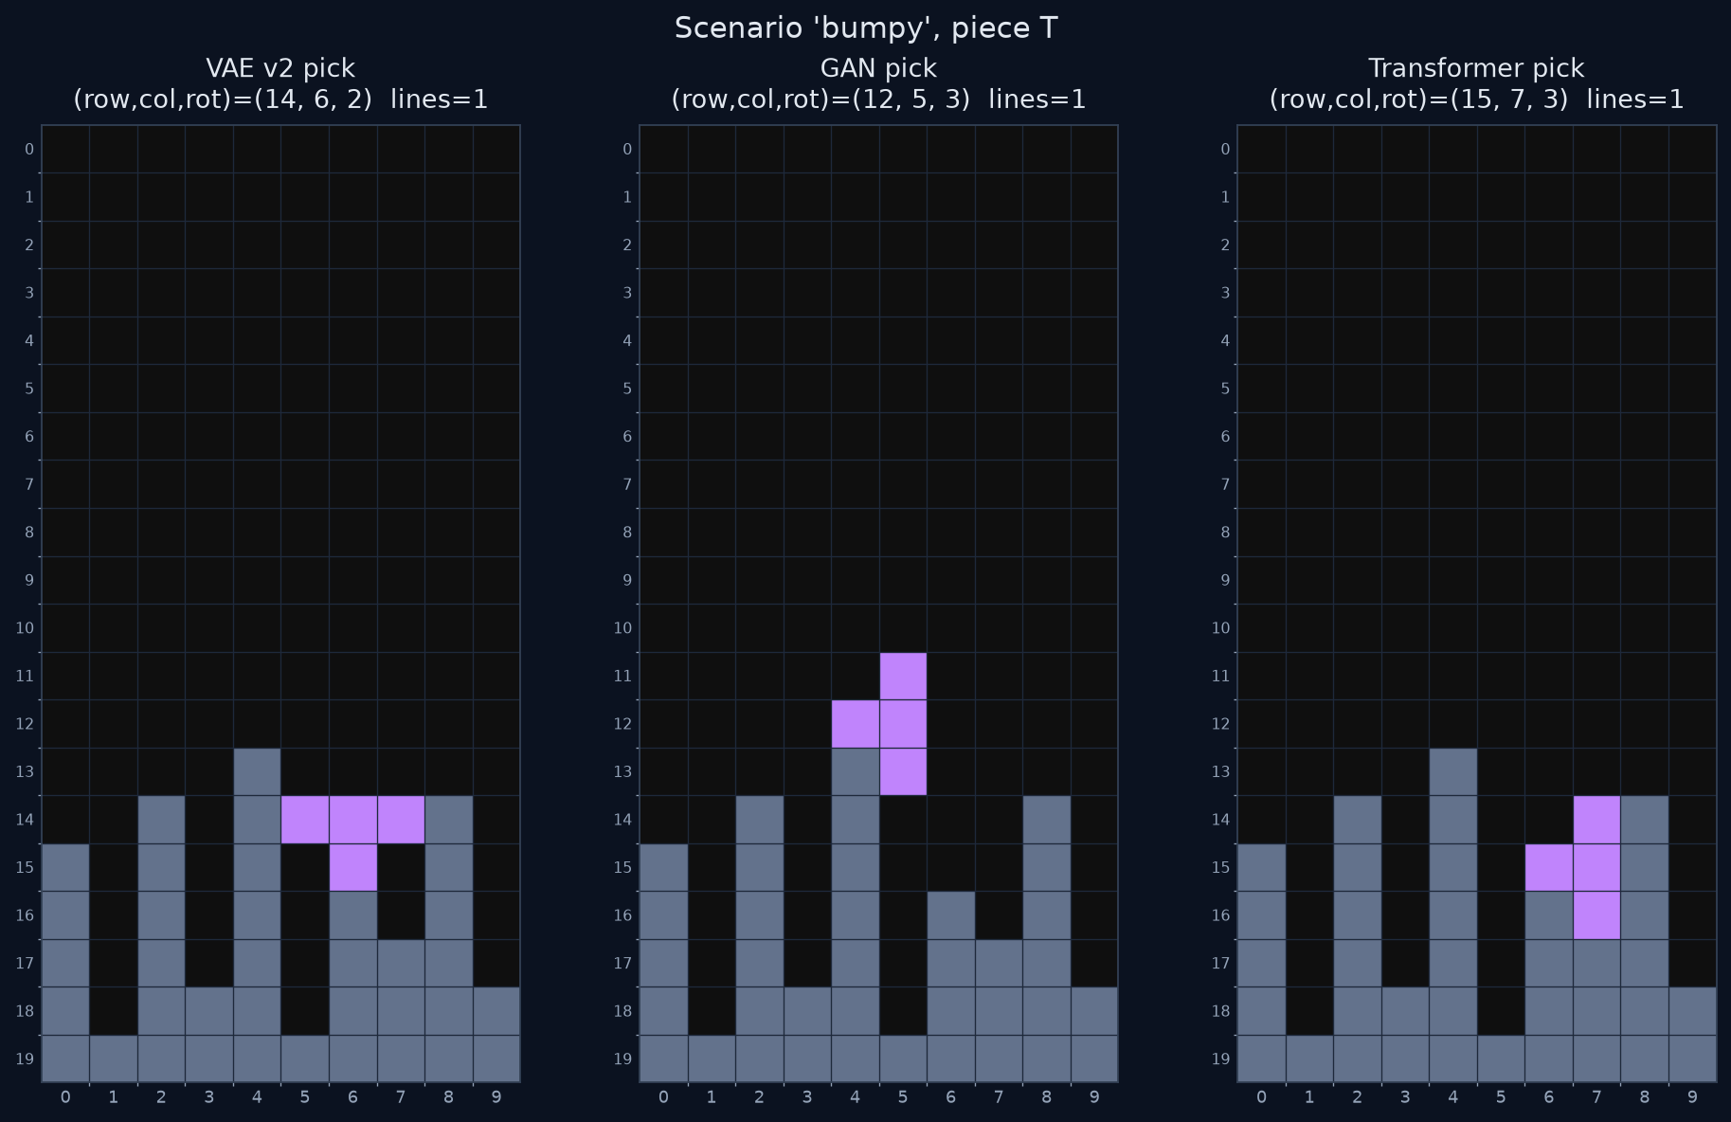
GAN play and results
Generator explores, discriminator (plus snap-to-legal) chooses
combined = realism − λ·sim_lines − 0.3·argmax p(lines)
pick: most simulated lines, then lowest combined
Model | Lines / game
gan_clean (25 ep) | best 4
gan_clean_v2 (60 ep, lcw 6.0) | 0, 6, 2, 5, 0 (best 6, mean ~2.6)
greedier: 20 samples, bonus 5.0 | 0, 1, 0 (worse)
• Real line clears where the VAE got none, but high variance, never double digits
• More search ≠ better: over-weighting immediate clears creates holes
bumpy + T: each solver clears 1 line here, but from different poses. On messy boards, realism and clears pull against each other (notebook 02 §9).
Notes:
At play time the generator explores (noise samples) and the discriminator plus simulated line clears choose. Note the 'greedier search hurt' negative result: over-weighting immediate clears creates holes. Single-piece play was more reliable (never 0) but not stronger.

Slide 19
Notebook 02 guide: GAN
notebooks/02_gan_training_and_solver.ipynb
Section | What to show | Talking point
2. Features | Real pre/post board pair; line-clear histogram | D sees the consequence (post-board)
6. Lab | PIECE, SCENARIO, LINE_CLEAR_BONUS (try 0.0 vs 6.0) | How much does the bonus steer?
7. Proposals | 64 noise samples → snapped proposal density | Collapse? Does it find the well?
8. Discriminator scoring | Realism, p(lines), simulated lines per candidate | The selection rule is a linear mix
9. Which feature decided? | Bar charts of realism / lines / combined | Realism dominating = VAE failure mode
10. CNN pre vs post | Feature maps before/after the pick | Did it notice the completed row?
11. Solver | 12 in-process moves from the scenario | Ceiling in this study: ~6 lines
Notes:
The GAN is still a generator, so it still suffers covariate shift, just milder. Single-piece games top out at 29 to 40 pieces: the policy is locally competent and the failure is cumulative board management. The notebook's section 9 decomposes the ranking terms: if flipping LINE_CLEAR_BONUS changes the pick, the line-clear signal is doing the work.

Slide 20
SOLVER 3
Transformer: stop generating, start ranking
Score every legal reachable candidate with a learned evaluate_placement; play the argmax
Notebook: notebooks/03_transformer_training_and_solver.ipynb
Notes:
The key shift. The transformer never proposes a move.

Slide 21
Transformer scorer: tokens and heads
One forward pass per legal candidate; play = argmax score
Token | Meaning
0–199 cells | row-major occupancy + positional embedding
200 piece | piece one-hot ⊕ rotation one-hot
201 position | normalized (row, col) of this candidate
202 surface | 10 column heights of the current stack
203 holefit | 5-d: holes created/filled, roughness Δ, clean landing
(B, 204, 64)
×2 MultiHeadAttention (4 heads) + LN + FFN
global avg pool → MLP
→ score | lines_cleared | holes_created
• Shipped: d_model=64, 4 heads, 2 layers (small)
• Aux heads point attention at the two things that matter: clears and holes
• Every candidate comes from the BFS engine, so every move is legal by construction
Notes:
Each candidate becomes a 204-token sequence: 200 board cells plus four designed tokens. Surface and hole-fit are inductive biases that make 'is it paying attention to the right things' checkable. Shipped model is small: d_model 64, 4 heads, 2 layers (CLI defaults are larger). Three heads: shaped score plus auxiliary lines_cleared and holes_created.

Slide 22
Contrastive training: the crucial change
Label every legal candidate, good and bad, on the same board
Board from a
clean game
Enumerate ALL
legal candidates
Simulate each;
shaped reward label
Train scorer on
all of them
• Label: shaped score where line clears dominate, holes punished, near-full rows rewarded
• 60 clean games → 51,812 candidate examples; 20 epochs
• The model learns the difference between moves, not an average of demonstrations
• A learned version of the heuristic's evaluate_placement
VAE: "what would the teacher do?"
Transformer: "how good is each option?"
Notes:
This is the crucial change versus the legacy transformer, which saw only the one demonstrated move per board. Contrastive labels over all candidates teach the difference between a good and a bad move on the same board: an actual value function. 51,812 examples from 60 clean games, 20 epochs.

Slide 23
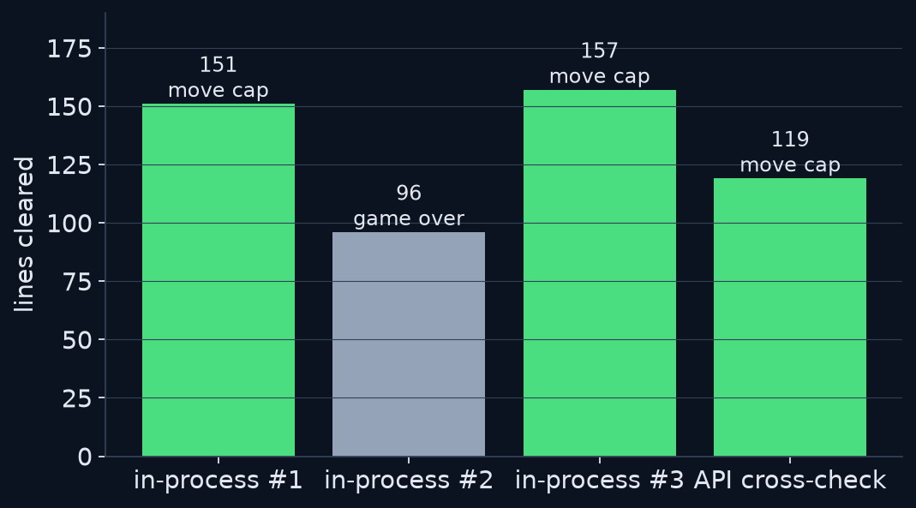
Result: 96–157 lines
Mixed all-piece games; ~94% of placed cells end in cleared lines
• 3 of 4 runs hit the move cap still playing
• API cross-check (119 lines / 300 pieces) confirms it's real
• Why it works:
  – No covariate shift by construction: judges each legal option, stays valid on weird boards
  – Contrastive supervision teaches a real value function
  – Right features: surface + hole-fit + clear/hole heads
Notes:
Two of three in-process games and the API cross-check were stopped by the move cap, not by topping out, so the true ceiling is higher. About 94% of all placed cells end up in cleared lines, i.e. near-hole-free play. The API cross-check confirms the count isn't an in-process artifact.

Slide 24
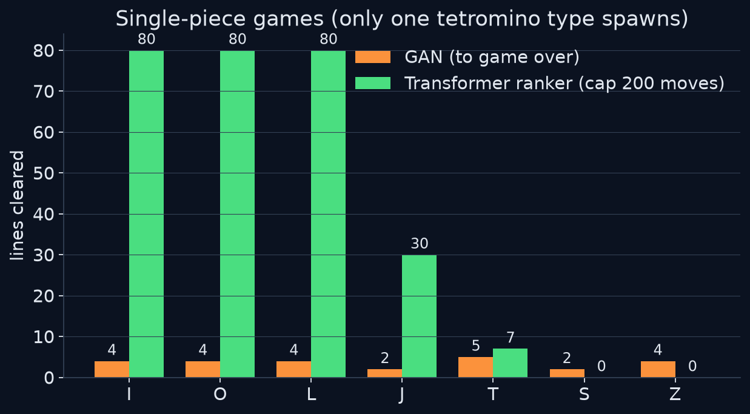
Single-piece games: GAN vs transformer
• I / O / L solved: 80 lines at the cap, ≈2.5 pieces/line (optimal)
• S / Z = 0 is a property of the pieces: a single S or Z stream can't fill a flat row without overhangs
• GAN: more reliable single-piece than mixed (never 0) but tops out at 29–40 pieces
• The per-piece profile inverts (GAN best on T)
Notes:
Single-piece study, cap 200 moves. I/O/L effectively solved (about 2.5 pieces per line, the optimum). S/Z = 0 is a property of the pieces: an S-only or Z-only stream cannot fill a flat 10-wide row without an overhang. Interesting: this inverts the GAN's per-piece profile, where T was best.

Slide 25
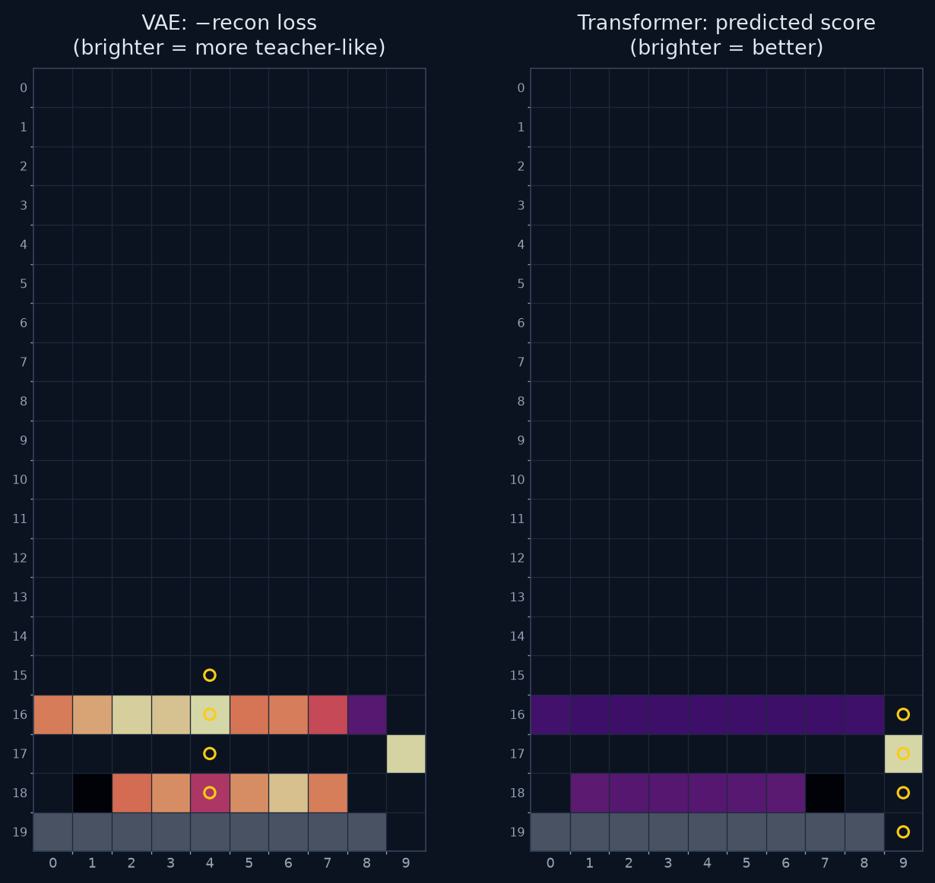
Same candidates, different question
almost_line + I: what each model prefers at every resting cell (brighter = preferred)
• Both models see the same BFS candidate list
• VAE: lowest loss = most *teacher-like*, so it picks the center
• Transformer: highest score = best *outcome*, so it picks column 9 and clears the line
• Ranking legal moves isn't enough by itself: what you rank by is what matters
Notes:
Left: VAE negative reconstruction loss at each resting cell (best over rotations); right: transformer predicted score (best over rotations). Brighter = preferred in both. Same board, same candidate set, opposite questions. The transformer's best cell is the line-clearing column; the VAE's is the teacher-typical center. Notebook 03 section 6 produces the score heatmap; notebook 01 section 8 the recon heatmap.

Slide 26
Notebook 03 guide: Transformer
notebooks/03_transformer_training_and_solver.ipynb
Section | What to show | Talking point
2. Feature design | candidate_features / candidate_labels for one board | Designed tokens, not raw pixels only
6. Score candidates | Model score vs teacher label vs simulated lines | Agreement on the argmax is what matters
7a. Special → board | piece / position / surface / holefit attention, 20×10 | holefit should hit the landing site
7b. Per-head maps | Layer-1 cell attention + entropy per head | Uniform head = unused head
8. Is attention right? | Landing-site mass; ablate holefit / surface | Pick flips → the token is used
9. Probes | right_well+I, bumpy+T, overhang_pocket, real board | Re-run on any scenario
10. Solver | 40 in-process moves from the scenario | Compare with notebook 02 §11
Notes:
Notebook 03 is aimed at researchers: does attention go to the right cells and tokens? Suggested eval suite whenever you retrain: special-token->board maps, per-head entropy (very high = uniform = unused head), landing-site mass, and ablating holefit/surface to see if the argmax flips. Probes table is in section 9 of the notebook.

Slide 27
POSTSCRIPT
Can we distill the ranker into a generator?
And how the ranker drives the human-style move interface
Notes:
Two follow-ups: a direct-policy student taught by the ranker, and agent-based placement.

Slide 28
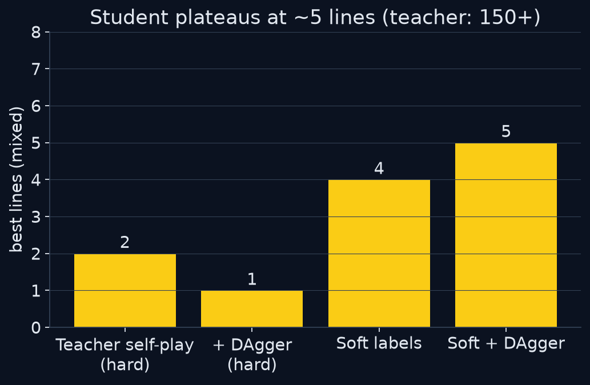
Distilled direct policy: plateaus at 5 lines
Student transformer → (rotation, column), taught by the 150-line ranker
• Teacher self-play: on-policy states
• DAgger: student drives, teacher labels its mistake states
• Soft labels (Hinton): KL to the teacher's full column/rotation preference
• Each helped a little (2 → 5); tops out at ~30–45 pieces
• Why: column accuracy is only 17–26%. The teacher *compares* ~30 candidates; a single softmax can't compress that
Generators cluster low (0 · 6 · 5) even when taught by the ranker
Notes:
The student takes board+surface+piece and directly predicts rotation (4-way) and column (10-way), snapped to the nearest legal pose. Teacher self-play gives on-policy data; DAgger lets the student drive while the teacher labels; soft labels transfer the teacher's whole preference distribution. Column accuracy stayed at 17 to 26%: the teacher decides by comparing ~30 candidates, which a single softmax can't reproduce.

Slide 29
Ranker + agents: the human-style interface
replay_using_agents.py: choose a pose, then navigate there with /move
Game-state
agent
GET /games/{id}
Final-placement
agent
ranker argmax
Movement
agent
BFS path → /move
Validation
agent
locked == target?
• Same ranker and same legal set, but submitted as left / right / rotate / down / drop instead of teleporting via /place
• Path BFS mirrors placement.py; refuses soft-drops that would lock early on the wrong resting pose
• On a miss, a one-shot LLM assist (gpt-4o-mini) picks the *next* piece from the enumerated legal list, then the scorer resumes
• Use replay_transformers.py to measure ranking quality; use the agent replay to test reachable execution
Notes:
replay_using_agents.py: a LangGraph of four agents. The scorer chooses the target pose; a BFS with parent pointers reconstructs a path of /move commands, refusing soft-drop edges that would lock early at the wrong place. On a miss, a one-shot LLM assist picks the next piece's placement from the enumerated legal list, then the scorer takes over again. Normal play never calls the LLM.

Slide 30
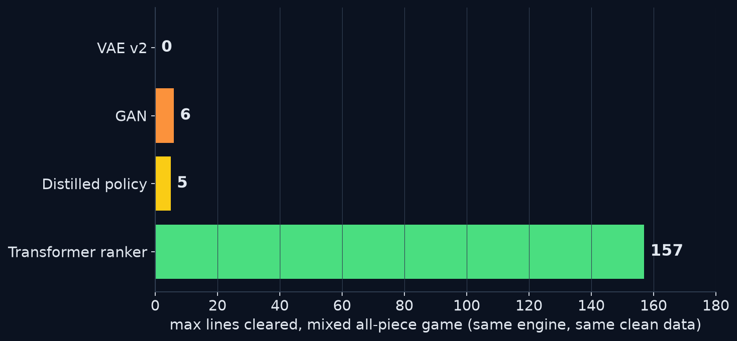
Head-to-head
Mixed all-piece games, same engine, same clean data
Solver | Fails how
VAE v2 | never forms a clearable row
GAN | tops out early, high variance
Direct policy | tops out at ~30–45 pieces
Ranker | (move cap, not topping out)
• Shipped weights: models/vae_clean, models/gan_clean_v2, models/transformer_policy_soft, models/transformer_scorer
Notes:
The summary chart. Every generator clusters low; the ranker is alone at 150+, capped by the move limit rather than by topping out.

Slide 31
Conclusions
Framing beats model capacity
Ranking legal candidates instead of generating a move sidesteps the covariate shift that sank the VAE and limited the GAN.
A value signal is necessary but not sufficient
The GAN's line-clear head beat the VAE (6 vs 0), but as a generator it still drifts and varies.
Ranking > generation, even by distillation
Distilling the 150-line ranker into a direct policy plateaued at 5 lines despite soft labels and DAgger.
A correct engine and clean data come first
BFS reachability and hole-free demonstrations were prerequisites; otherwise failures are uninterpretable.
Notes:
Four lessons. The order matters: without the engine fix and clean data none of the comparisons mean anything.

Slide 32
Next steps & reproduce
• Scale the ranker: all 191 games, more candidates/board, larger model, likely lifting T
• One-piece lookahead using the known next piece
• Make the ranker the project's default player
• Re-run the notebook-03 attention eval suite after each retrain
# API server
uv run uvicorn puzzlegrid.api:app --port 8123
# VAE v2 (0 lines)
uv run python replay_vae_v2.py \
--model ./models/vae_clean/tetris_vae_v2_best.keras \
--api-url http://localhost:8123 --pieces I O T S Z J L
# GAN (best ~6)
uv run python replay_gan.py --model-dir ./models/gan_clean_v2 \
--inprocess --mode search --num-samples 10 \
--line-clear-bonus 3.0
# Transformer ranker (150+)
uv run python replay_transformers.py \
--inprocess --max-moves 400 --model \
./models/transformer_scorer/transformer_scorer_best.keras
# Distilled direct policy (~5)
uv run python replay_transformer_policy.py \
--inprocess --max-moves 400 --model \
./models/transformer_policy_soft/transformer_policy_best.keras
Notes:
Next steps from the progress report, plus the commands to reproduce each headline number. The API server must be running for the API-based replays; --inprocess runs need no server.

