Slide 1
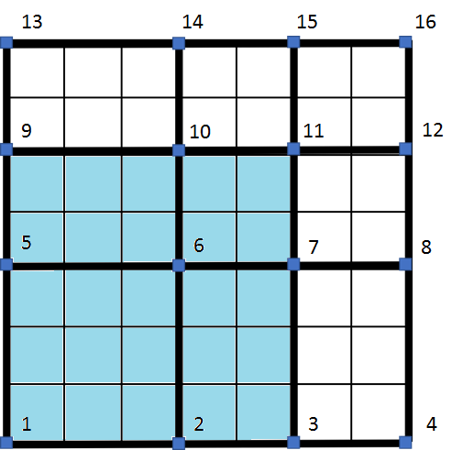
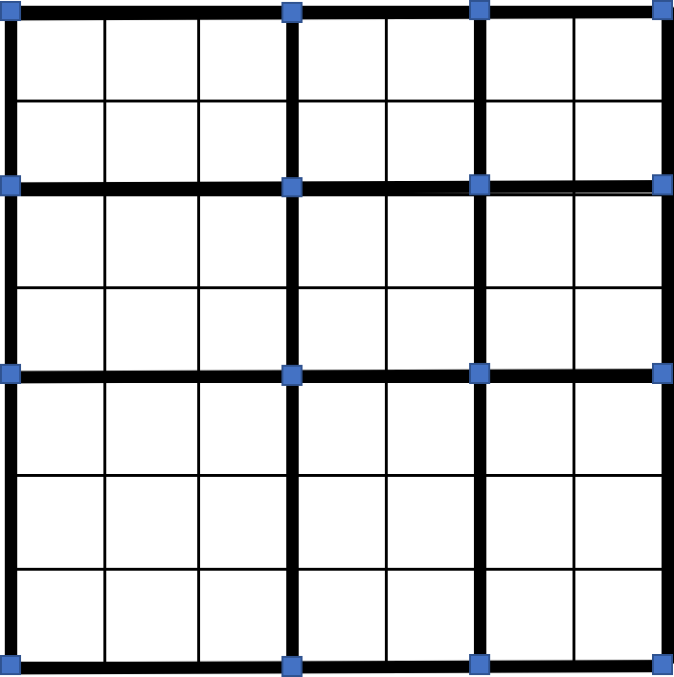









13
14
15
16
$$T_{7}$$
$$T_{8}$$
$$T_{9}$$
9
10
11
12
$$T_{4}$$
$$T_{5}$$
$$T_{6}$$
5
6
7
8
$$T_{1}$$
$$T_{2}$$
$$T_{3}$$
1
2
3
4

Slide 2
13
14
15
16
$$T_{7}$$
$$T_{8}$$
$$T_{9}$$
9
10
11
12
$$T_{4}$$
$$T_{5}$$
$$T_{6}$$
5
6
7
8
$$T_{1}$$
$$T_{2}$$
$$T_{3}$$
1
2
3
4

