Slide 1
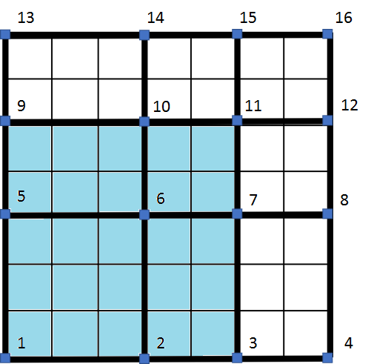
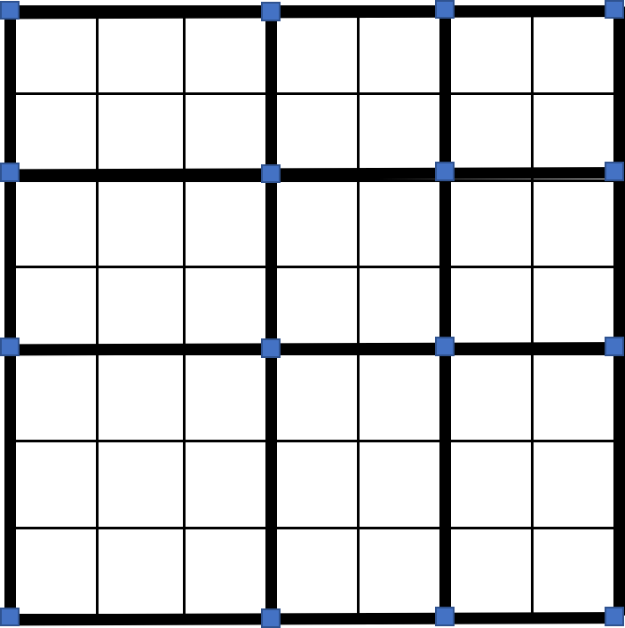









13
14
15
16
$$T_{7}$$
$$T_{8}$$
$$T_{9}$$
9
10
11
12
$$T_{4}$$
$$T_{5}$$
$$T_{6}$$
5
6
7
8
$$T_{1}$$
$$T_{2}$$
$$T_{3}$$
1
2
3
4

Slide 2
13
14
15
16
$$T_{7}$$
$$T_{8}$$
$$T_{9}$$
9
10
11
12
$$T_{4}$$
$$T_{5}$$
$$T_{6}$$
5
6
7
8
$$T_{1}$$
$$T_{2}$$
$$T_{3}$$
1
2
3
4

Slide 3

Sent from my iPhone
17
18
19
20
1
$$Ω$$
13
14
15
16
1
9
10
11
12
1
5
6
7
8
1
1
2
3
4
5
13
14
15
16
17,18
19,20
21,22
23,24
9
10
11
12
9,10
11,12
13,14
15,16
5
6
7
8
1,2
3,4
5,6
7,8
1
2
3
4
25,26
27,28
29,30
31,32

Slide 4













$$σ_{xx}$$
$$σ_{xz}$$
y
$$σ_{xy}$$
x
z
y
y
x
$$σ_{yx}+Δσ_{yx}$$
$$σ_{yy}+Δσ_{yy}$$
$$σ_{zx}$$
$$σ_{xx}$$
$$σ_{xx}+Δσ_{xx}$$
$$σ_{zx}+Δσ_{zx}$$
$$σ_{xx}$$
$$σ_{xx}+Δσ_{xx }$$
x
$σ_{yx}$
z
$$σ_{yy}$$

Slide 6






y
x
$$N_{e_{5}}^{H},N_{e_{6}}^{H}$$
$$N_{e5}^{H},N_{e6}^{H}$$
$$N_{e_{7}}^{H},N_{e_{8}}^{H}$$
$$N_{e7}^{H},N_{e8}^{H}$$
$$N_{e_{3}}^{H},N_{e_{4}}^{H}$$
$$N_{e3}^{H},N_{e4}^{H}$$
y
$$N_{e_{1}}^{H},N_{e_{2}}^{H}$$
y
$$N_{e1}^{H},N_{e2}^{H}$$
x
x

Slide 7
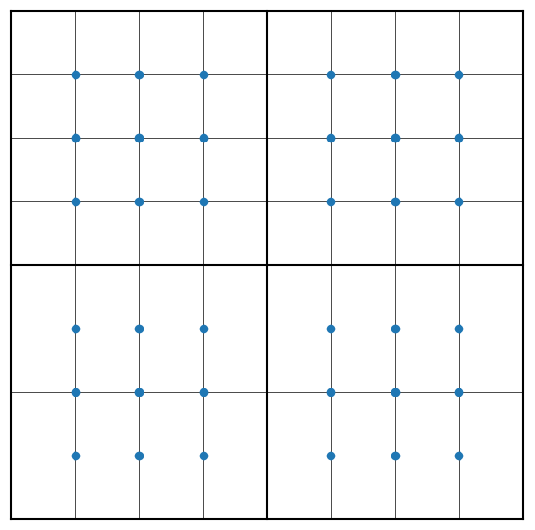




$$n_{e_{y}}^{h}$$
$$C_{r_{y}}$$
$$C_{r_{x}}$$
$$n_{e_{x}}^{h}$$

Slide 8




$$\hat{y}$$
$$θ$$
$$\hat{x}$$
$$T^{K}$$
y
x

Slide 9
B | x | ... | x | x | ... | x | x
x | B |  | x | x |  | x | x
... |  |  | ... |  |  | ...
x | x |  | x | x
x | x |  | x | x
... |  |  | ...
x | x |  | x | x |  | x | x
x | x |  | x | x |  | x | x
1 | 0 | ... | 0 | 0 | ... | 0 | 0
0 | 1 |  | 0 | 0 |  | 0 | 0
... |  |  | ... |  |  | ...
x | x |  | x | x
x | x |  | x | x
... |  |  | ...
x | x |  | x | x |  | x | x
x | x |  | x | x |  | x | x
Nó Dirichlet
Nó Dirichlet

Slide 10







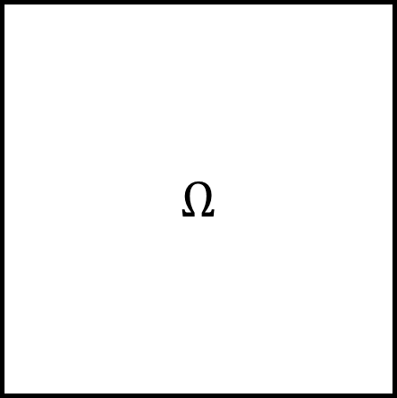
$$Ω$$
$$N_{i}^{h}$$
$$x_{i−1}$$
$$x_{i}$$
$$x_{i+1}$$
$$Ω$$

Slide 11




$$Ω$$
$$Ω$$

Slide 12
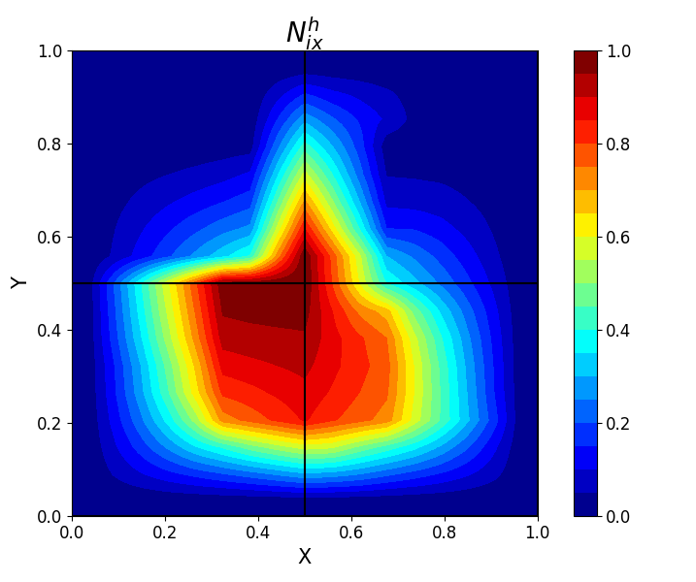
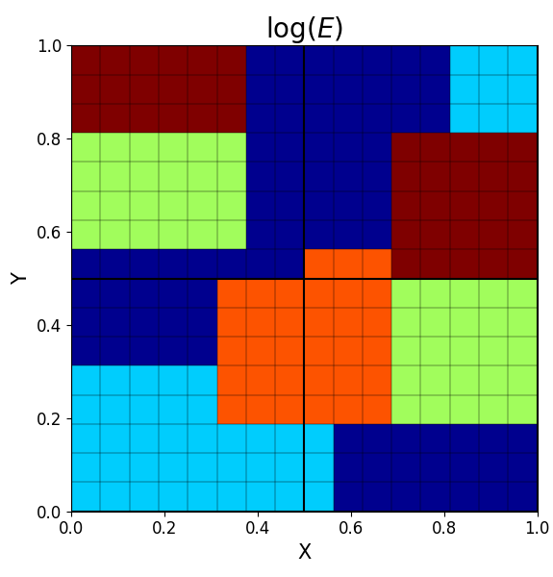
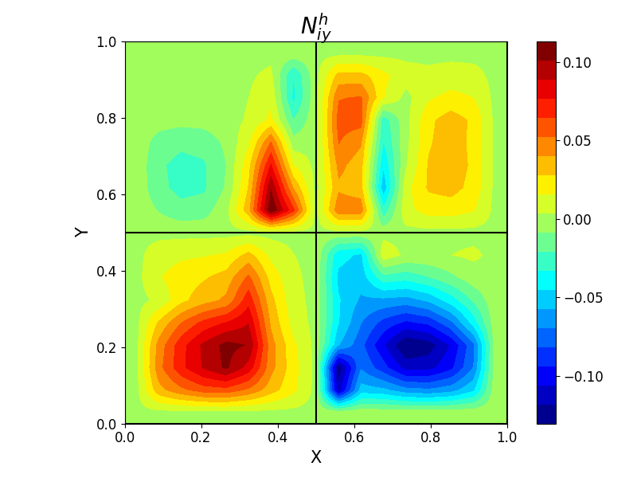

Slide 22

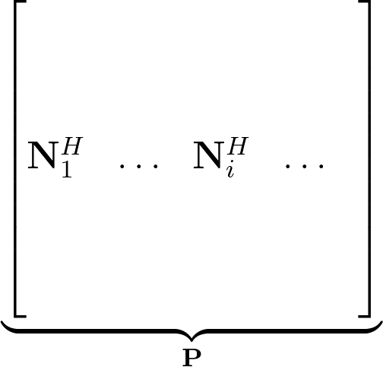
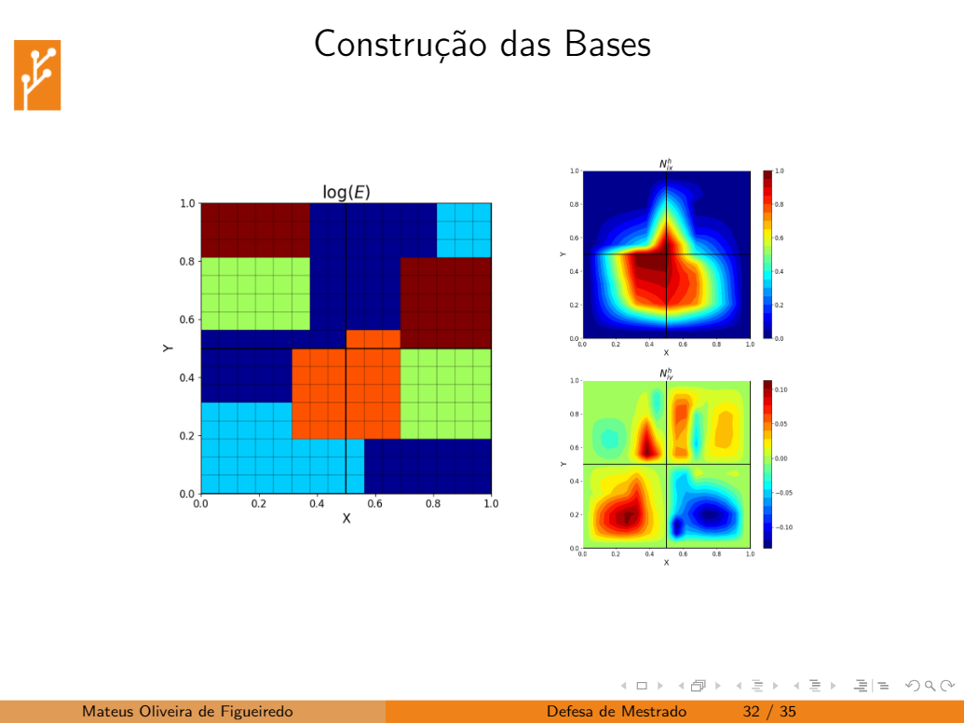

Slide 23





Slide 24
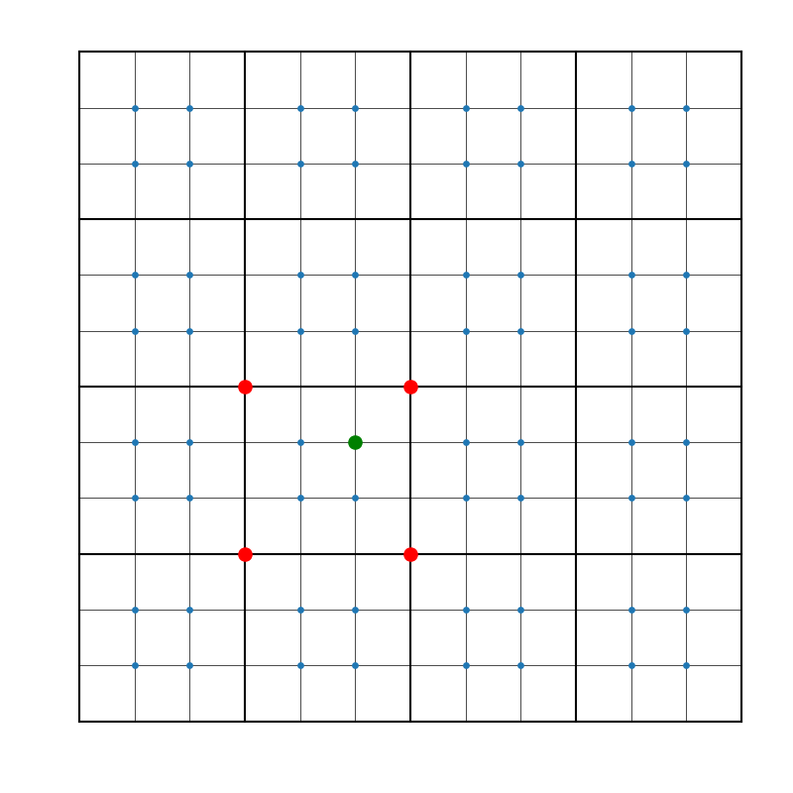
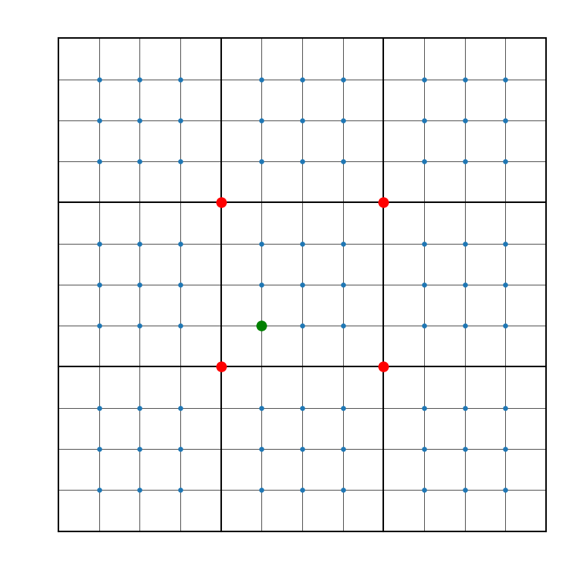
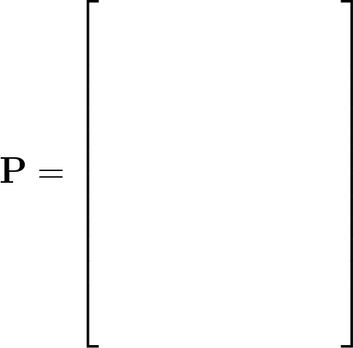

Slide 25
x
x
x
x
x
x
x
x

Slide 26
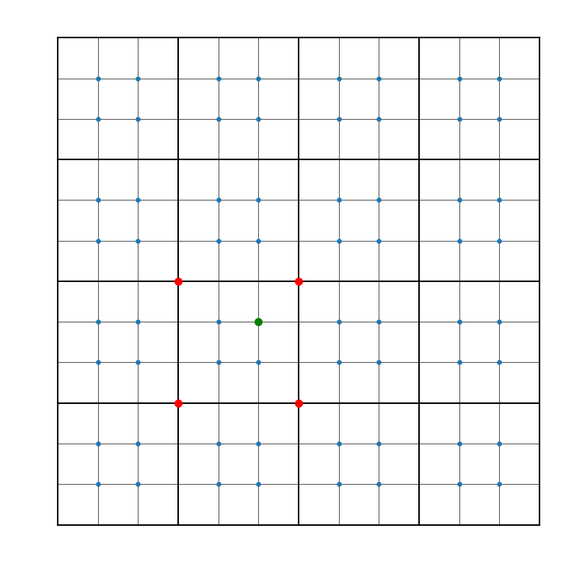
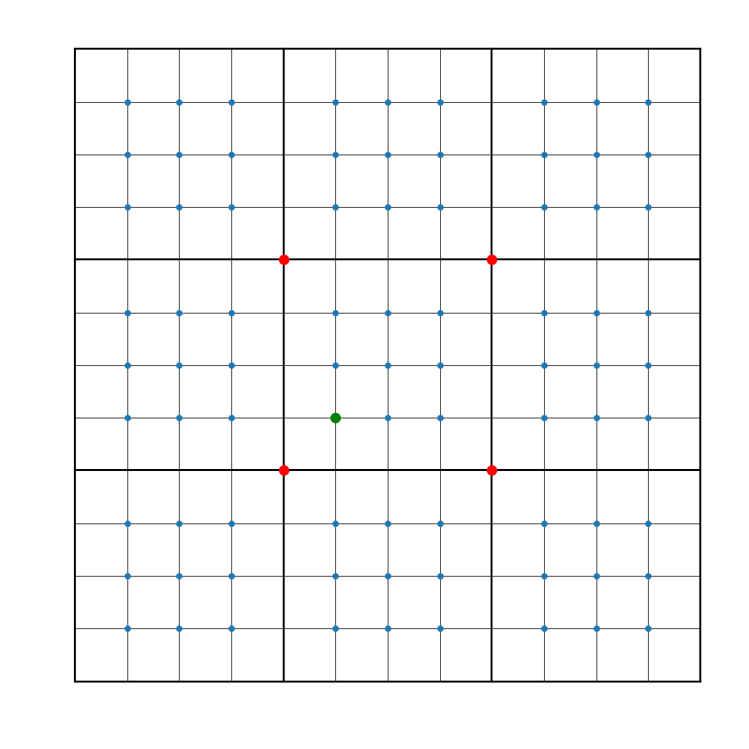
x
x
x
x
x
x
x
x

Slide 27
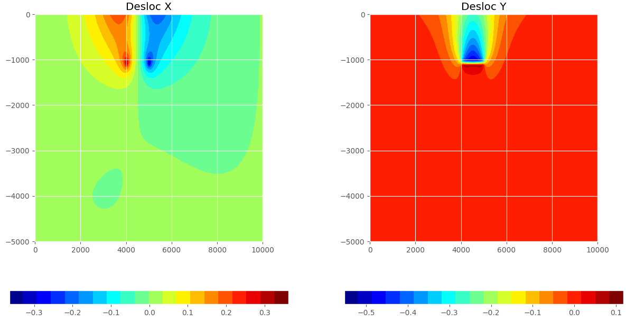
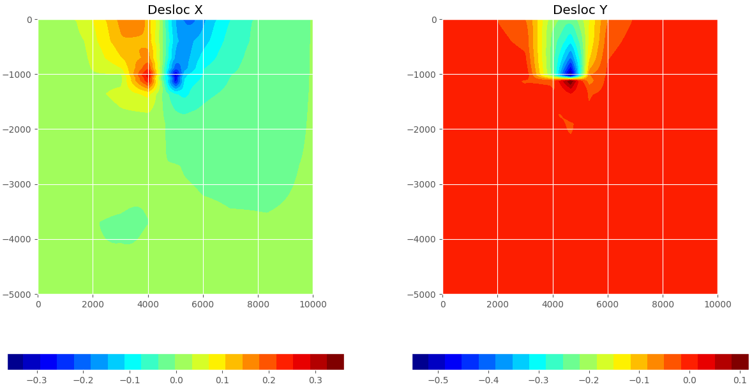

Slide 28
