Slide 1







































$$A^{1}$$
$$A^{1}$$
$$A^{1}$$
$$R_{1}^{2}$$
$$P_{2}^{1}$$
$$R_{1}^{2}$$
$$A^{2}$$
$$A^{2}$$
$$A^{2}$$
$$R_{2}^{3}$$
$$P_{3}^{2}$$
$$R_{2}^{3}$$
$$A^{3}$$
$$A^{3}$$
$$A^{3}$$
$$A^{3}$$
$$R_{3}^{4}$$
$$P_{4}^{3}$$
$$R_{3}^{4}$$
$$P_{4}^{3}$$
$$A^{4}$$
$$A^{4}$$
$$A^{1}$$
$$A^{1}$$
$$A^{1}$$
$$A^{1}$$
$$R_{1}^{2}$$
$$P_{2}^{1}$$
$$R_{1}^{2}$$
$$P_{2}^{1}$$
$$A^{2}$$
$$A^{2}$$
$$A^{2}$$
$$A^{2}$$
$$A^{2}$$
$$R_{2}^{3}$$
$$P_{3}^{2}$$
$$R_{2}^{3}$$
$$P_{3}^{2}$$
$$R_{2}^{3}$$
$$P_{3}^{2}$$
$$R_{2}^{3}$$
$$A^{3}$$
$$A^{3}$$
$$A^{3}$$
$$A^{3}$$
$$A^{3}$$
$$A^{3}$$
$$A^{3}$$
$$A^{3}$$
$$R_{3}^{4}$$
$$P_{4}^{3}$$
$$R_{3}^{4}$$
$$P_{4}^{3}$$
$$R_{3}^{4}$$
$$P_{4}^{3}$$
$$R_{3}^{4}$$
$$P_{4}^{3}$$
$$R_{3}^{4}$$
$$P_{4}^{3}$$
$$A^{4}$$
$$A^{4}$$
$$A^{4}$$
$$A^{4}$$
$$A^{4}$$

Slide 2
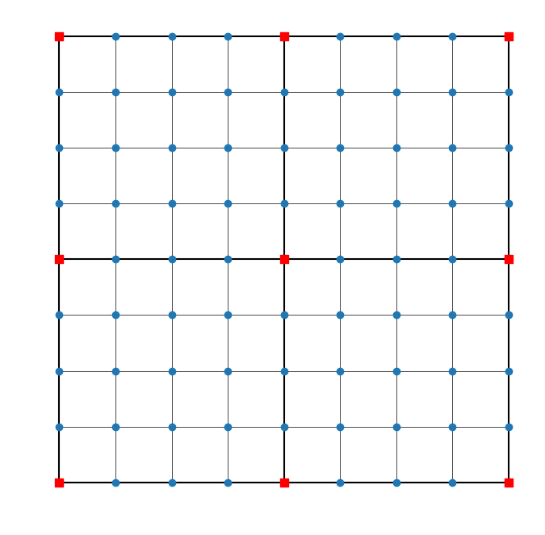
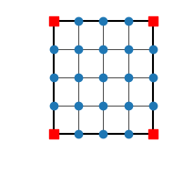
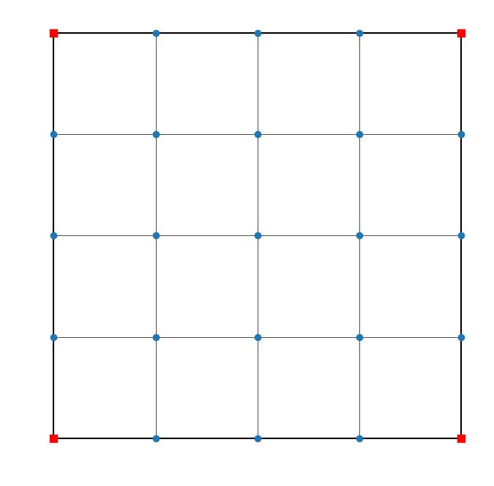





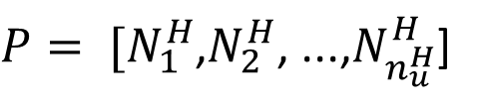
FemContext 3
FemContext 4
Construção
dos FemContext dos problemas locais
FemContext 1
FemContext 2
Solução dos Problemas locais
Assembly
Prolongamento
FemContext 1
FemContext 2
$[N_{e_{1}}^{H}$, $N_{e_{2}}^{H}$, ..., $N_{e_{8}}^{H}$]
$[N_{e_{1}}^{H}$, $N_{e_{2}}^{H}$, ..., $N_{e_{8}}^{H}$]
$P= [N_{1}^{H}$,$N_{2}^{H}$, ...,$N_{n_{u}^{H}}^{H}$]
FemContext 3
FemContext 4
$[N_{e_{1}}^{H}$, $N_{e_{2}}^{H}$, ..., $N_{e_{8}}^{H}$]
$[N_{e_{1}}^{H}$, $N_{e_{2}}^{H}$, ..., $N_{e_{8}}^{H}$]
Cálculo Operador Grosso
$$K^{H}=P^{T}K^{h}P$$

Slide 3
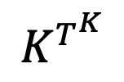

Nó 1
Nó 2
Nó 3
...
Nó 9
Nó 1
Nó 2
Nó 3
Nó 4
Nó 5
Nó 6
Nó 7
Nó 8
Nó 9
Nó 1
Nó 1
...
Nó 2
Nó 3
Nó 2
...
GetSubMatrix
Nó 4
...
...
...
Nó 5
Nó 6
Nó 9
...
Nó 7
Nó 8
Nó 9
$$K^{h}$$
$$K^{T^{K}}$$

