Slide 1
PFEP (PLAN FOR EVERY PART)
Larisa Hita Correa A01260185
Emilio Lamas García A01261609
Víctor Eduardo Nicolás Soledad A01261957

Slide 2
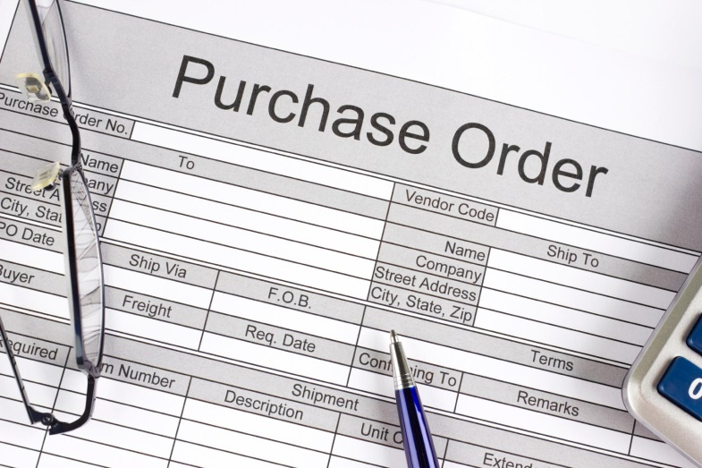


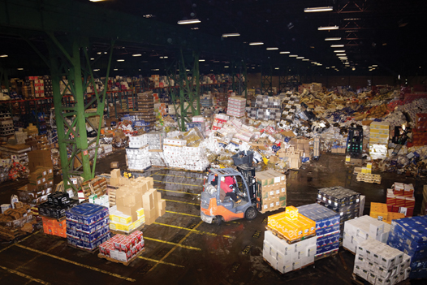


Slide 3
Part # | Number used to identify the material in the facility
Lot Number | Number used to identify the lot that the part arrived
Description | Material name (e.g., frame, bolt, nut, yoke)
Daily Usage | Maximum amount of material used in a day through the entire plant
Usage Location | Process/areas where the material is used (e.g., Cell 14)
Storage Location | Address (location) where the material is stored
Order Frequency | Frequency that the material is ordered from the supplier (e.g., daily, weekly, monthly, as required)
Supplier | Name of the material supplier
Supplier City | City where the supplier is located
Supplier State | (State, province, region, district) where the supplier is located
Supplier Country | Country where the supplier is located
Container Type | Packaging type of the container (e.g., cardboard box, reusable tote, wire basket)
Container Weight | Weight of an empty container
1 Part Weight | Weight of 1 unit of material
Total Package Weight | Weight of a full container of material
Container Length | Length or depth of the container
Container Width | Width of the container
Container Height | Height of the container
Usage Per Assembly | Number of parts required for 1 finished product
Hourly Usage | Maximum number of pieces used per hour
Standard Container Quantity | Piece count of material in one container
Containers Used Per Hour | Maximum number of containers required per hour
Shipment Size | Size of a standard shipment in days (1 week shipment = 5 days)
Carrier | Company providing parts-transportation services
Transit Time | Travel time required from the supplier to the facility (in days)
# of Cards In Loop | Number of pull signals that are in the system
Supplier Performance | Supplier performance rating that includes on-time delivery, quality, etc.
Reorder point | The level of inventory which triggers an action to replenish that particular inventory stock
Price | Price per unit

Slide 4
Savings
Time, because one of the proposals is to reduce time in all of the paperwork, and transition between departments.
Money, it could be expensive at the beginning because of the initial investment, but reducing errors the savings will payoff.
Communication between all of the departments will ensure a quick and updated information that will remove information bias.
Reduction of reworks.
Talent will be easier to emerge.

Slide 5
Improvements
Classify correctly every part in its own place, so it corresponds with the information captured in the database.
Select the best suppliers for every part.
Reduce the use of paper for paperwork.
Using a system. Bring just the needed information, about each part, for every department

Slide 6
Redesign Kanban cards, it could be read by barcode.
Standardize the amount of parts used in every process, so the transition could be easier and faster using the Kanban cards.
Automate orders, using the reorder point.
Consider subassemblies as part of the data base.

