Slide 1
Matthew Beale T1 Assessment 3
Terminal Application

Slide 2
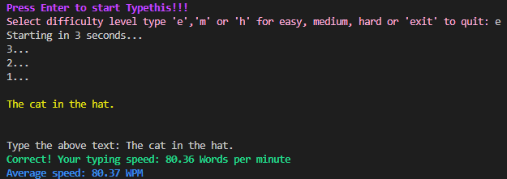
Typethis
Typethis is a terminal application I have created with reference to Youtube: “NeuralNine - Speed Typing Test in Python” to help with increasing a users type speed.
https://www.youtube.com/watch?v=quBb--IJPPc&t=384s

Slide 3
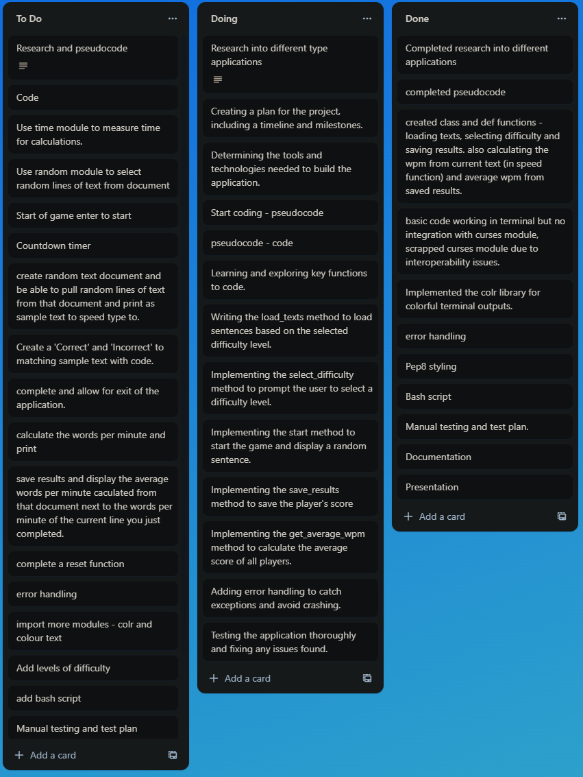
Planning

Slide 4
Features
Typethis key features include:
Difficulty selection
Countdown timer
Timer to measure and calculate words per minute
File handling to select and randomise lines of text as sample text to type to.
File handling to save results to results.txt
File handling to calculate the average words per minute from previous results.
Colourisation of text for aesthetics purposes using the colr module.

Slide 5
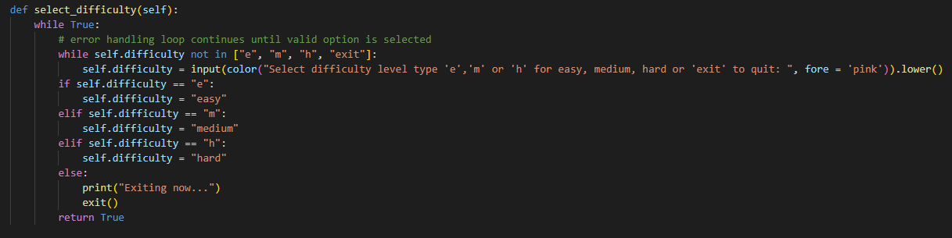
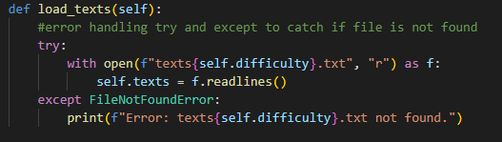
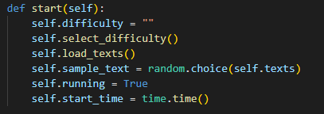
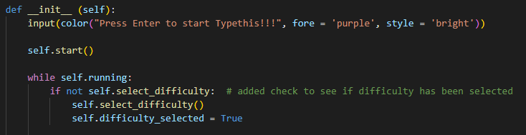
Difficulty Selection
I have defined select_difficulty to check if user input selects easy, medium or hard modes (by inputting e,m or h for ease instead of typing entire word) or decides to exit the application. It then sets self.difficulty to = the text of ‘easy’, ‘medium’ or ‘hard’ which is then inputted into the file handling of load_texts.
I have define load_texts to open the specific file of textseasy.txt, textsmedium.txt or textshard.txt as selected from the select_difficulty method. It then opens that file and defines self.texts to equal the individual lines of that document.
I have then defined a start method which calls the select_difficulty and load_texts methods and sets self.sample_text to equal a randomly selected line from whichever of the easy,medium or hard text documents were selected. It then activates the self.running method and sets self.start_time to current time ready for the calculation of words per minute.

Slide 6
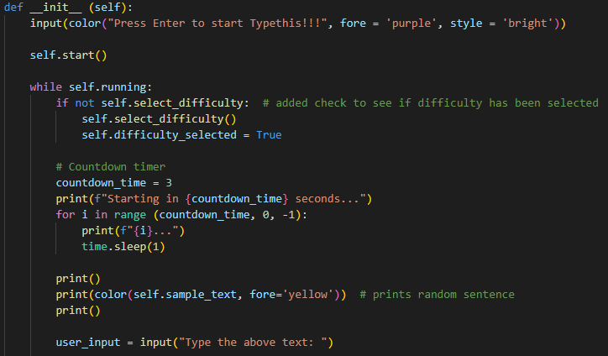
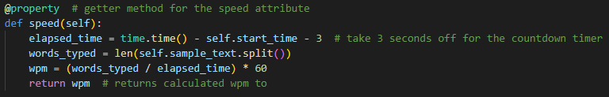
Countdown Timer
I have added a countdown timer before sample_text is displayed as selected from the difficulty section. This prints how many seconds are left before the user is presented with their text to speed type to.
I have then accounted for the 3 second countdown timer in the words per minute calculation.

Slide 7
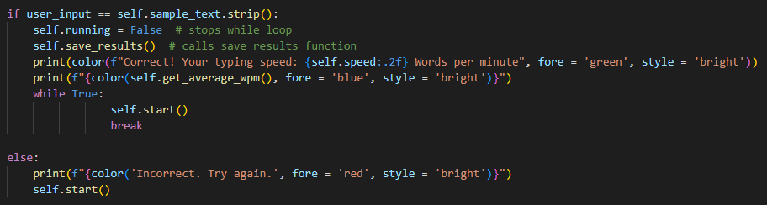
Calculate Words Per Minute
If users input equals the self.sample_text then self.running stops and the save_results function is called. (details on following slide)
The “Correct!” message is displayed with the calculated words per minute from the speed() function that calculates the words typed divided (using the len(self.sample_text.split())) by the elapsed_time x 60 seconds.
If Incorrect, the user gets to restart the speed typing test.

Slide 8
Save Results
The save_results function was called in the previous slide. This opens the file results.txt and appends a new line (as it’s opened as “a”) with the difficulty that was selected as well as the calculated words per minute.

Slide 9
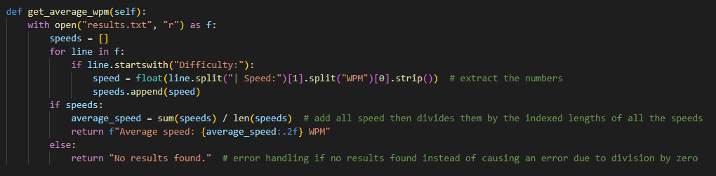
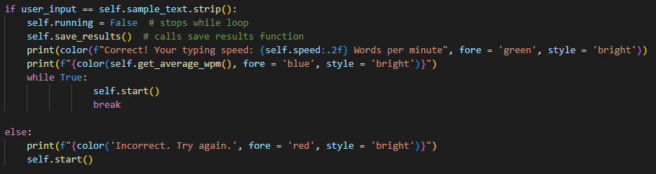
Average Words Per Minute
Average words per minute is calculated in the get_average_wpm method.
It gets the value by splitting off the unnecessary text read in the results.txt file and adds them all to a list ready for calculation.
The average_speed is calculated by adding all of the speeds in the list and dividing them by the total index of the list of speeds.
This value is displayed in the __init__ method to display the total average of previous results.

Slide 10
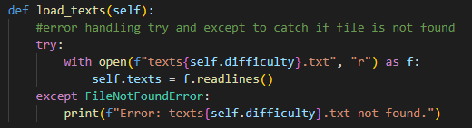
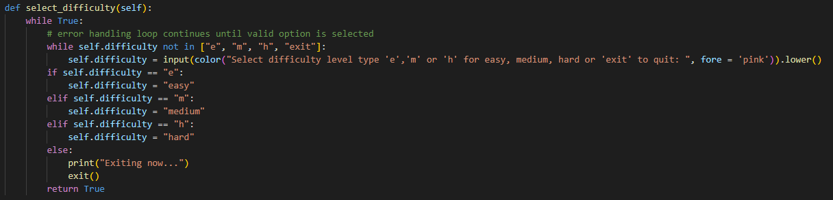

Error Handling
Here are some examples of how error handling is utilised through try and except, while loops and else statements.
Try-except is used to try and catch a FileNotFoundError when attempting to load the text files.
Additionally I use while loops with conditionals to handle user input errors when selecting difficulty levels, ensuring valid options are chosen.
I also use If and Else statements to handle cases where the user types the correct or incorrect lines.

Slide 11

Modules
For my application I have needed to use the time, random and colr modules.
Time module for calculation and measurement of time.
Random module for randomisation of lines of text from selected sample text document
Colr module for colourisation and pleasing aesthetics of the application when running in real time.

Slide 12
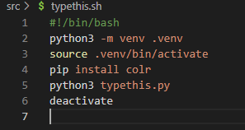
Bash Script
I have supplied a bash script to create and enable a virtual environment that then installs the modules required for the application to run.
The script then runs the program and after the program is terminated, the virtual environment is then deactivated.

Slide 13
Thankyou for watching!

