Slide 1
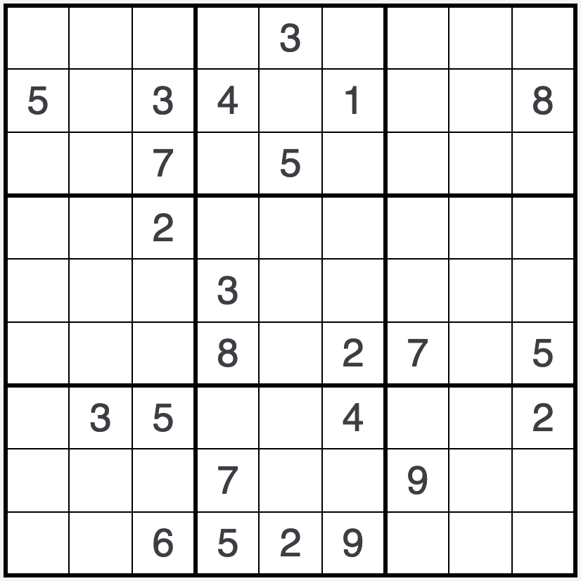
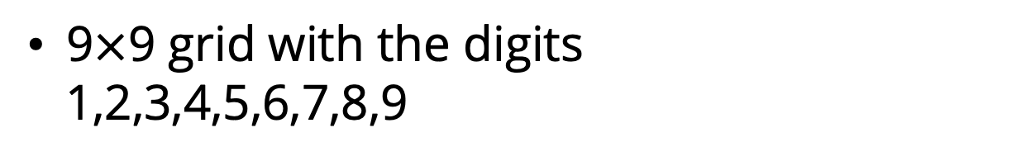
SUDOKU
Techniques
What is Sudoku ?
Logic-based number puzzle
9$×$9 grid with the digits
1,2,3,4,5,6,7,8,9
Puzzle have some digits appears
in some of the squares
Solve Sudoku Puzzles Without the Computer
The goal is to fill the
remaining squares
Matthew Setiadi - Zijian Zhang

Slide 2
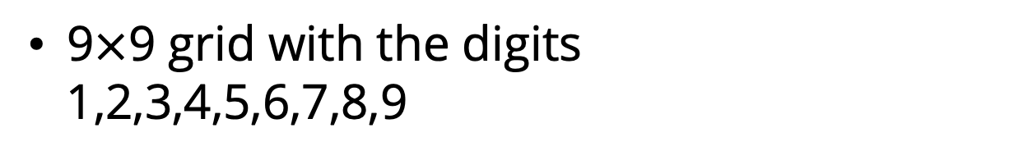
SUDOKU
Techniques
What is Sudoku ?
Logic-based number puzzle
9$×$9 grid with the digits
1,2,3,4,5,6,7,8,9
Puzzle have some digits appears
in some of the squares
The goal is to fill the
remaining squares
Solve Sudoku Puzzles Without the Computer
Matthew Setiadi - Zijian Zhang

Slide 3
SUDOKU
Techniques
What is Sudoku ?
Logic-based number puzzle
9$×$9 grid with the digits
1,2,3,4,5,6,7,8,9
Puzzle have some digits appears
in some of the squares
The goal is to fill the
remaining squares
Solve Sudoku Puzzles Without the Computer
Matthew Setiadi - Zijian Zhang

Slide 4
SUDOKU
Techniques
What is Sudoku ?
Rules of Sudoku !
1
9
8
2
6
5
4
7
Logic-based number puzzle
Each column must contain
digits 1-9 without repetition
6
7
2
9
9
3
9$×$9 grid with the digits
1,2,3,4,5,6,7,8,9
2
4
8
6
1
3
7
1
4
5
6
8
9
Each column must contain
digits 1-9 without repetition
8
5
9
6
7
1
2
4
Puzzle have some digits appears
in some of the squares
6
1
4
9
3
9
6
1
8
7
Each 3x3 box must contain
digits 1-9 without repetition
The goal is to fill the
remaining squares
4
2
1
8
3
5
6
7
8
4
1
3
Solve Sudoku Puzzles Without the Computer
Matthew Setiadi - Zijian Zhang

Slide 5
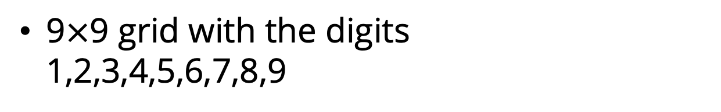
What is Sudoku ?
Rules of Sudoku !
1
9
8
2
6
5
4
7
Each column must contain
digits 1-9 without repetition
6
7
2
9
2
4
9
8
3
6
1
3
7
1
4
5
6
8
9
Each row must contain
digits 1-9 without repetition
8
5
9
6
7
1
2
4
6
1
4
9
3
9
6
1
8
7
Each 3x3 box must contain
digits 1-9 without repetition
4
2
1
8
3
5
6
7
8
4
1
3
Logic-based number puzzle
9$×$9 grid with the digits
1,2,3,4,5,6,7,8,9
Puzzle have some digits appears
in some of the squares
The goal is to fill the
remaining squares

Slide 6
SUDOKU
Techniques
What is Sudoku ?
Rules of Sudoku !
1
9
8
2
6
5
4
7
Each column must contain
digits 1-9 without repetition
6
7
2
9
2
4
9
8
3
6
1
3
7
1
4
5
6
8
9
Each row must contain
digits 1-9 without repetition
8
5
9
6
7
1
2
4
6
1
4
9
3
9
6
1
8
7
Each 3x3 box must contain
digits 1-9 without repetition
4
2
1
8
3
5
6
7
8
4
1
3
Solve Sudoku Puzzles Without the Computer
Matthew Setiadi - Zijian Zhang

Slide 7
SUDOKU
Techniques
What is Sudoku ?
Rules of Sudoku !
1
9
8
2
6
5
4
7
Each column must contain
digits 1-9 without repetition
6
7
2
9
2
4
9
8
3
6
1
3
7
1
4
5
6
8
9
Each row must contain
digits 1-9 without repetition
8
5
9
6
7
1
2
4
6
1
4
9
3
9
6
1
8
7
Each 3x3 box must contain
digits 1-9 without repetition
4
2
1
8
3
5
6
7
8
4
1
3
Solve Sudoku Puzzles Without the Computer
Matthew Setiadi - Zijian Zhang

Slide 8
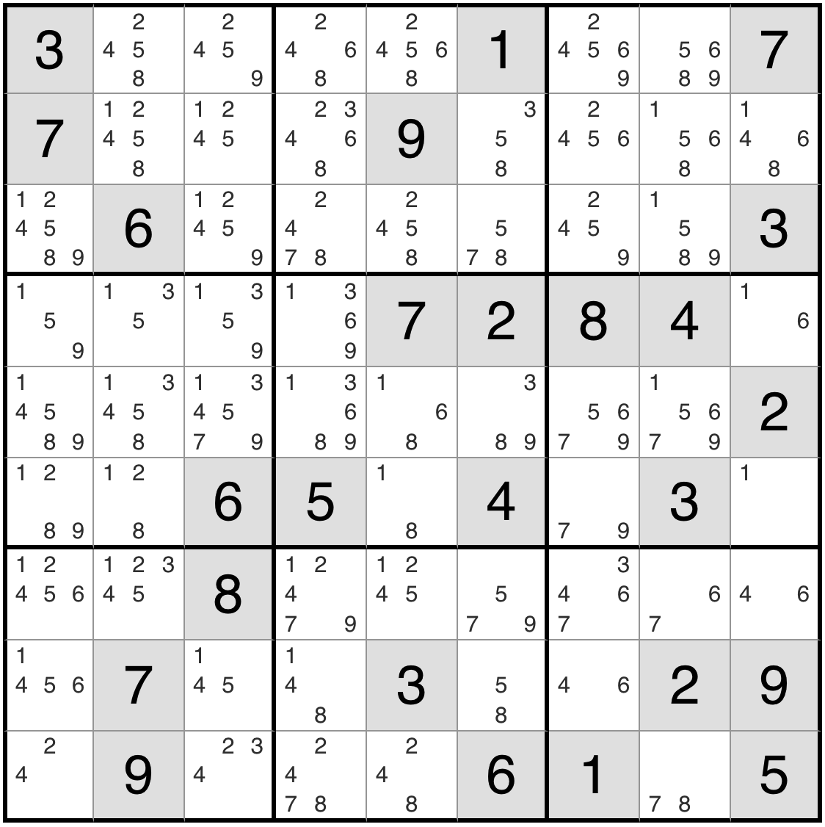
Basic Techniques
What is Sudoku ?
Rules of Sudoku !
NAKED SINGLES
1
9
8
2
6
5
4
7
Each column must contain
digits 1-9 without repetition
6
7
2
9
A naked single in Sudoku is a cell where there is only one possible number that can be placed
The circled number is the only possible number that can be placed in that square
2
4
9
8
3
6
1
3
7
1
4
5
6
8
9
Each row must contain
digits 1-9 without repetition
8
5
9
6
7
1
2
4
6
1
4
9
3
9
6
1
8
7
Each 3x3 box must contain
digits 1-9 without repetition
4
2
1
8
3
5
6
7
8
4
1
3
Matthew Setiadi - Zijian Zhang

Slide 9





Basic Techniques
What is Sudoku ?
Rules of Sudoku !
$$×$$
NAKED SINGLES
1
9
8
2
6
5
4
7
Each row must contain
digits 1-9 without repetition
6
7
2
9
$$×$$
2
9
3
6
1
By putting “1” in the square, some possibilties can be eliminated because they are in the square that is related to the square that just had the number “1”
4
8
$$×$$
3
7
1
4
5
6
8
9
Each column must contain
digits 1-9 without repetition
8
5
9
6
7
1
2
4
$$×$$
$$×$$
$$×$$
1
6
1
4
9
3
9
6
1
8
7
Each 3x3 box must contain
digits 1-9 without repetition
4
2
1
8
3
5
6
7
8
4
1
3
Matthew Setiadi - Zijian Zhang

Slide 10






Basic Techniques
What is Sudoku ?
Rules of Sudoku !
$$×$$
$$×$$
NAKED SINGLES
$$×$$
1
9
8
2
6
5
4
7
Each row must contain
digits 1-9 without repetition
6
7
2
9
$$×$$
These technique can be repeated after finding more naked singles, and eliminating more possibilities
Example:
Eliminating other possibilities of the number “8” in row 6 and in column 5
Eliminating other possibilities of the number “6” in row 4 and in column 9
$$×$$
6
2
9
3
6
1
$$×$$
4
8
$$×$$
3
7
1
4
5
6
8
9
Each column must contain
digits 1-9 without repetition
$$×$$
$$×$$
$$×$$
$$×$$
$$×$$
8
5
9
6
7
1
2
4
$$×$$
$$×$$
$$×$$
$$×$$
$$×$$
$$×$$
1
8
1
6
1
4
9
3
$$×$$
$$×$$
9
6
1
8
7
Each 3x3 box must contain
digits 1-9 without repetition
$$×$$
4
2
1
8
3
5
6
7
8
4
1
3
$$×$$
Matthew Setiadi - Zijian Zhang

Slide 11
Basic Techniques
What is Sudoku ?
Rules of Sudoku !
$$×$$
$$×$$
NAKED SINGLES
$$×$$
$$×$$
1
9
8
2
6
5
4
7
Each row must contain
digits 1-9 without repetition
6
7
2
9
$$×$$
$$×$$
6
2
9
3
6
1
$$×$$
4
8
These technique can be repeated after finding more naked singles, and eliminating more possibilities
$$×$$
3
7
1
4
5
6
8
9
Each column must contain
digits 1-9 without repetition
$$×$$
$$×$$
$$×$$
$$×$$
$$×$$
8
5
9
6
7
1
2
4
$$×$$
$$×$$
$$×$$
$$×$$
2
1
8
1
6
1
4
9
3
$$×$$
4
9
6
1
8
7
Each 3x3 box must contain
digits 1-9 without repetition
4
2
1
8
3
5
6
7
8
4
1
3
$$×$$
Matthew Setiadi - Zijian Zhang

Slide 12
Basic Techniques
What is Sudoku ?
Rules of Sudoku !
$$×$$
$$×$$
HIDDEN SINGLES
$$×$$
1
9
8
2
6
5
4
7
Each row must contain
digits 1-9 without repetition
6
7
2
9
A hidden single in Sudoku is a cell where only one possible digit can be placed, even though there are other candidate numbers in the cell
The circled numbers only appear once in the highlighted cells, so those are a hidden singles
$$×$$
$$×$$
6
2
9
3
6
1
$$×$$
4
8
$$×$$
3
7
1
4
5
6
8
9
Each column must contain
digits 1-9 without repetition
$$×$$
$$×$$
$$×$$
$$×$$
$$×$$
8
5
9
6
7
1
2
4
$$×$$
2
$$×$$
1
8
1
6
1
4
9
3
4
9
6
1
8
7
Each 3x3 box must contain
digits 1-9 without repetition
4
2
1
8
3
5
6
7
8
4
1
3
$$×$$
Matthew Setiadi - Zijian Zhang

Slide 13
Basic Techniques
What is Sudoku ?
Rules of Sudoku !
$$×$$
$$×$$
8
HIDDEN SINGLES
$$×$$
1
9
8
2
6
5
4
7
Each row must contain
digits 1-9 without repetition
6
7
2
9
A hidden single in Sudoku is a cell where only one possible digit can be placed, even though there are other candidate numbers in the cell
The circled numbers only appear once in the highlighted cells, so those are a hidden singles
$$×$$
$$×$$
6
2
9
3
6
1
$$×$$
4
8
$$×$$
3
7
1
4
5
6
8
9
Each column must contain
digits 1-9 without repetition
$$×$$
$$×$$
$$×$$
$$×$$
$$×$$
8
5
9
6
7
1
2
4
$$×$$
9
2
$$×$$
7
1
8
1
6
1
4
9
3
4
9
6
1
8
7
Each 3x3 box must contain
digits 1-9 without repetition
4
2
1
8
3
5
6
7
8
4
1
3
3
$$×$$
Matthew Setiadi - Zijian Zhang

Slide 14
Advanced Techniques
What is Sudoku ?
Rules of Sudoku !
$$×$$
$$×$$
8
Locked Candidates
$$×$$
1
9
8
2
6
5
4
7
Each row must contain
digits 1-9 without repetition
6
7
2
9
$$×$$
$$×$$
6
2
9
3
6
1
$$×$$
4
8
A locked candidate in Sudoku is a digit that can only be placed in a house (row, column, or box) at the intersection with another house. This allows the digit to be eliminated from the remaining cells of the other house.
$$×$$
3
7
1
4
5
6
8
9
Each column must contain
digits 1-9 without repetition
$$×$$
$$×$$
$$×$$
$$×$$
$$×$$
8
5
9
6
7
1
2
4
$$×$$
9
2
$$×$$
7
1
8
1
6
1
4
9
3
4
9
6
1
8
7
Each 3x3 box must contain
digits 1-9 without repetition
4
2
1
8
3
5
6
6
7
8
4
1
3
3
$$×$$
Matthew Setiadi - Zijian Zhang

Slide 15
Advanced Techniques
What is Sudoku ?
Rules of Sudoku !
$$×$$
$$×$$
8
Locked Candidates
$$×$$
1
9
8
2
6
5
4
7
Each row must contain
digits 1-9 without repetition
6
7
2
9
$$×$$
$$×$$
6
2
9
3
6
1
$$×$$
4
8
The circled number “2” in the highlighted column indicates that it is the only valid position for the number “2” within the bottom-left box. This is because no other square in the box allows for the placement of a “2”
$$×$$
3
7
1
4
5
6
8
9
Each column must contain
digits 1-9 without repetition
$$×$$
$$×$$
$$×$$
$$×$$
$$×$$
8
5
9
6
7
1
2
4
$$×$$
9
2
$$×$$
7
1
8
1
6
1
4
9
3
4
9
6
1
8
7
Each 3x3 box must contain
digits 1-9 without repetition
4
2
1
8
3
5
6
6
7
8
4
1
3
3
$$×$$
Matthew Setiadi - Zijian Zhang

Slide 16
Advanced Techniques
What is Sudoku ?
Rules of Sudoku !
$$×$$
$$×$$
8
Locked Candidates
$$×$$
1
9
8
2
6
5
4
7
$$×$$
Each row must contain
digits 1-9 without repetition
6
7
2
9
$$×$$
$$×$$
6
2
9
3
6
1
As a result, any other potential candidates in the highlighted column are invalid since the number “2” must occupy the circled positions. This conclusion ensures that the number “2” is uniquely placed in the leftmost column of the box, as no other possibilities exist.
$$×$$
4
8
$$×$$
3
7
1
4
5
6
8
9
Each column must contain
digits 1-9 without repetition
$$×$$
$$×$$
$$×$$
$$×$$
$$×$$
8
5
9
6
7
1
2
4
$$×$$
9
2
$$×$$
7
1
8
1
6
1
4
9
3
4
9
6
1
8
7
Each 3x3 box must contain
digits 1-9 without repetition
4
2
1
8
3
5
6
6
7
8
4
1
3
3
$$×$$
Matthew Setiadi - Zijian Zhang

Slide 17
Advanced Techniques
What is Sudoku ?
Rules of Sudoku !
$$×$$
$$×$$
8
Locked Candidates
$$×$$
1
9
8
2
6
5
4
7
$$×$$
Each row must contain
digits 1-9 without repetition
6
7
2
9
$$×$$
$$×$$
6
2
9
3
6
1
$$×$$
4
8
The circled number “5” in the highlighted row demonstrates that it is the only valid position for the number “5” within the box. This is because no other square in its box allows for the placement of a “5”
$$×$$
3
7
1
4
5
6
8
9
Each column must contain
digits 1-9 without repetition
$$×$$
$$×$$
$$×$$
$$×$$
$$×$$
8
5
9
6
7
1
2
4
$$×$$
9
2
$$×$$
7
1
8
1
6
1
4
9
3
4
9
6
1
8
7
Each 3x3 box must contain
digits 1-9 without repetition
4
2
1
8
3
5
6
6
7
8
4
1
3
3
$$×$$
Matthew Setiadi - Zijian Zhang

Slide 18

Advanced Techniques
What is Sudoku ?
Rules of Sudoku !
$$×$$
$$×$$
8
Locked Candidates
$$×$$
1
9
8
2
6
5
4
7
$$×$$
Each row must contain
digits 1-9 without repetition
6
7
2
9
$$×$$
$$×$$
6
2
9
3
6
1
Therefore, the number “5” must occupy one of the circled positions, eliminating all other possible candidates of “5” for these highlighted row.
This techniques also applies to the number “9”
$$×$$
4
8
$$×$$
3
7
1
4
5
6
8
9
Each column must contain
digits 1-9 without repetition
$$×$$
$$×$$
$$×$$
$$×$$
$$×$$
$$×$$
$$×$$
$$×$$
$$×$$
$$×$$
8
5
9
6
7
1
2
4
$$×$$
9
2
$$×$$
7
1
8
1
6
1
4
9
3
4
9
6
1
8
7
Each 3x3 box must contain
digits 1-9 without repetition
4
2
1
8
3
5
6
6
7
8
4
1
3
3
$$×$$
Matthew Setiadi - Zijian Zhang

Slide 19
Advanced Techniques
What is Sudoku ?
Rules of Sudoku !
$$×$$
$$×$$
8
Locked Candidates
$$×$$
1
9
8
2
6
5
4
7
$$×$$
Each row must contain
digits 1-9 without repetition
6
7
2
9
$$×$$
$$×$$
6
2
9
3
6
1
$$×$$
4
8
$$×$$
3
7
1
4
5
6
8
9
Each column must contain
digits 1-9 without repetition
$$×$$
$$×$$
$$×$$
$$×$$
$$×$$
The circled "9" is determined to be the only valid placement for the number “9” within the box after eliminating all the candidates.
$$×$$
$$×$$
$$×$$
$$×$$
$$×$$
8
5
9
6
7
1
2
4
$$×$$
9
2
$$×$$
7
1
8
1
6
1
4
9
3
4
9
6
1
8
7
Each 3x3 box must contain
digits 1-9 without repetition
4
2
1
8
3
5
6
6
7
8
4
1
3
3
$$×$$
Matthew Setiadi - Zijian Zhang

Slide 20
Advanced Techniques
What is Sudoku ?
Rules of Sudoku !
$$×$$
$$×$$
8
Locked Candidates
$$×$$
1
9
8
2
6
5
4
7
Each row must contain
digits 1-9 without repetition
6
7
2
9
$$×$$
$$×$$
9
6
2
9
3
6
1
This is another example, the circled "1s" show that the number “1” must occupy one of these highlighted cells in that row because no other highlighted cells in the row contain the number “1” as a possibility
$$×$$
4
8
$$×$$
3
7
1
4
5
6
8
9
Each column must contain
digits 1-9 without repetition
$$×$$
$$×$$
$$×$$
$$×$$
8
5
9
6
7
1
2
4
$$×$$
9
2
$$×$$
7
1
8
1
6
1
4
9
3
4
9
6
1
8
7
Each 3x3 box must contain
digits 1-9 without repetition
4
2
1
8
3
5
6
6
7
8
4
1
3
3
$$×$$
Matthew Setiadi - Zijian Zhang

Slide 21
Advanced Techniques
What is Sudoku ?
Rules of Sudoku !
$$×$$
$$×$$
8
Locked Candidates
$$×$$
1
9
8
2
6
5
4
7
Each row must contain
digits 1-9 without repetition
6
7
2
9
$$×$$
$$×$$
As a result, the number “1” is restricted to the circled cells, which leads to the elimination of “1” as a candidate from other cells within the same box. This restriction helps narrow down the possibilities for other cells and progresses the puzzle toward completion
9
6
2
9
3
6
1
$$×$$
4
8
$$×$$
$$×$$
$$×$$
$$×$$
3
7
1
4
5
6
8
9
Each column must contain
digits 1-9 without repetition
$$×$$
$$×$$
$$×$$
$$×$$
8
5
9
6
7
1
2
4
$$×$$
9
2
$$×$$
7
1
8
1
6
1
4
9
3
4
9
6
1
8
7
Each 3x3 box must contain
digits 1-9 without repetition
4
2
1
8
3
5
6
6
7
8
4
1
3
3
$$×$$
Matthew Setiadi - Zijian Zhang

Slide 22
Advanced Techniques
What is Sudoku ?
Rules of Sudoku !
$$×$$
$$×$$
8
Locked Candidates
$$×$$
1
9
8
2
6
5
4
7
$$×$$
Each row must contain
digits 1-9 without repetition
6
7
2
9
$$×$$
$$×$$
9
6
2
9
3
6
1
$$×$$
4
8
The circled “3s” show that the number “3” must occupy one of those specific cells because no other highlighted cells in the box can contain the number “3”
$$×$$
$$×$$
$$×$$
$$×$$
3
7
1
4
5
6
8
9
Each column must contain
digits 1-9 without repetition
$$×$$
$$×$$
$$×$$
$$×$$
$$×$$
$$×$$
8
5
9
6
7
1
2
4
$$×$$
9
2
$$×$$
7
1
8
1
6
1
4
9
3
4
9
6
1
8
7
Each 3x3 box must contain
digits 1-9 without repetition
4
2
1
8
3
5
6
6
7
8
4
1
3
3
$$×$$
Matthew Setiadi - Zijian Zhang

Slide 23

Advanced Techniques
What is Sudoku ?
Rules of Sudoku !
$$×$$
$$×$$
8
Locked Candidates
$$×$$
1
9
8
2
6
5
4
7
$$×$$
Each row must contain
digits 1-9 without repetition
6
7
2
9
$$×$$
$$×$$
9
6
2
9
3
6
1
$$×$$
4
8
This restriction ensures that the “3” is confined to the circled cells, eliminating “3” as a candidate from all other cells within the same row
$$×$$
$$×$$
$$×$$
$$×$$
$$×$$
$$×$$
3
7
1
4
5
6
8
9
Each column must contain
digits 1-9 without repetition
$$×$$
$$×$$
$$×$$
$$×$$
$$×$$
$$×$$
8
5
9
6
7
1
2
4
$$×$$
9
2
$$×$$
7
1
8
1
6
1
4
9
3
4
9
6
1
8
7
Each 3x3 box must contain
digits 1-9 without repetition
4
2
1
8
3
5
6
6
7
8
4
1
3
3
$$×$$
Matthew Setiadi - Zijian Zhang

Slide 24
Intermediate Techniques
What is Sudoku ?
Rules of Sudoku !
$$×$$
$$×$$
8
$$×$$
1
9
8
2
6
5
4
7
$$×$$
Each row must contain
digits 1-9 without repetition
X-Wing
6
7
2
9
$$×$$
$$×$$
6
2
9
3
6
1
$$×$$
4
8
$$×$$
$$×$$
$$×$$
$$×$$
3
7
1
4
5
6
8
9
Each column must contain
digits 1-9 without repetition
An X-wing is a Sudoku technique that involves finding a number that appears twice in a row or column, and then finding a corresponding row or column where that same number also appears twice
$$×$$
$$×$$
$$×$$
$$×$$
$$×$$
$$×$$
8
5
9
6
7
1
2
4
$$×$$
9
2
$$×$$
7
1
8
1
6
1
4
9
3
4
9
6
1
8
7
Each 3x3 box must contain
digits 1-9 without repetition
4
2
1
8
3
5
6
6
7
8
4
1
3
3
$$×$$
Matthew Setiadi - Zijian Zhang

Slide 25
Intermediate Techniques
What is Sudoku ?
Rules of Sudoku !
$$×$$
$$×$$
8
$$×$$
1
9
8
2
6
5
4
7
$$×$$
Each row must contain
digits 1-9 without repetition
X-Wing
6
7
2
9
$$×$$
$$×$$
6
2
9
3
6
1
$$×$$
4
8
$$×$$
$$×$$
$$×$$
$$×$$
3
7
1
4
5
6
8
9
The number 3 must occupy one of the two cells in each row (or column). However, the exact position of the 3 will be determined later.
$$×$$
$$×$$
Each column must contain
digits 1-9 without repetition
$$×$$
$$×$$
$$×$$
$$×$$
8
5
9
6
7
1
2
4
$$×$$
9
2
$$×$$
7
1
8
1
6
1
4
9
3
4
9
6
1
8
7
Each 3x3 box must contain
digits 1-9 without repetition
4
2
1
8
3
5
6
6
7
8
4
1
3
3
$$×$$
Matthew Setiadi - Zijian Zhang

Slide 26
Intermediate Techniques
What is Sudoku ?
Rules of Sudoku !
$$×$$
$$×$$
8
$$×$$
1
9
8
2
6
5
4
7
$$×$$
Each row must contain
digits 1-9 without repetition
X-Wing
6
7
2
9
$$×$$
$$×$$
$$×$$
6
2
9
3
6
1
$$×$$
4
8
Since the placement of 3 is constrained to the two rows (or columns) forming the X-Wing, 3 can no longer appear in any other cells in the same columns (or rows).
$$×$$
$$×$$
$$×$$
$$×$$
$$×$$
$$×$$
3
7
1
4
5
6
8
9
Each column must contain
digits 1-9 without repetition
$$×$$
$$×$$
$$×$$
$$×$$
$$×$$
$$×$$
8
5
9
6
7
1
2
4
$$×$$
9
2
$$×$$
7
1
8
1
6
1
4
9
3
4
9
6
1
8
7
Each 3x3 box must contain
digits 1-9 without repetition
4
2
1
8
3
5
6
6
7
8
4
1
3
3
$$×$$
Matthew Setiadi - Zijian Zhang

Slide 27
Intermediate Techniques
2
8
What is Sudoku ?
Rules of Sudoku !
$$×$$
5
$$×$$
8
$$×$$
1
9
8
2
6
5
4
7
$$×$$
9
7
Each row must contain
digits 1-9 without repetition
X-Wing
6
7
2
9
$$×$$
$$×$$
3
9
6
2
9
3
6
1
$$×$$
4
8
$$×$$
$$×$$
$$×$$
3
$$×$$
3
7
1
4
5
6
8
9
Each column must contain
digits 1-9 without repetition
$$×$$
$$×$$
The number 5 appears in exactly two cells in each of two different rows (or columns), and these cells form the corners of a rectangle (aligned diagonally)
$$×$$
$$×$$
$$×$$
$$×$$
8
5
9
6
7
1
2
4
$$×$$
9
2
$$×$$
7
8
1
1
6
1
4
9
3
6
1
2
5
9
3
7
4
9
6
1
8
7
Each 3x3 box must contain
digits 1-9 without repetition
4
2
1
8
3
5
6
6
7
8
4
1
3
2
3
7
4
8
$$×$$
Matthew Setiadi - Zijian Zhang

Slide 28
Intermediate Techniques
2
8
What is Sudoku ?
Rules of Sudoku !
$$×$$
5
$$×$$
8
$$×$$
1
9
8
2
6
5
4
7
$$×$$
9
7
Each row must contain
digits 1-9 without repetition
X-Wing
6
7
2
9
$$×$$
$$×$$
3
9
6
2
9
3
6
1
$$×$$
4
8
$$×$$
$$×$$
$$×$$
3
$$×$$
3
7
1
4
5
6
8
9
Each column must contain
digits 1-9 without repetition
$$×$$
$$×$$
The number 5 appears in exactly two cells in each of two different rows (or columns), and these cells form the corners of a rectangle (aligned diagonally)
$$×$$
$$×$$
$$×$$
$$×$$
8
5
9
6
7
1
2
4
$$×$$
9
2
$$×$$
7
8
1
1
6
1
4
9
3
6
1
2
5
9
3
7
4
9
6
1
8
7
Each 3x3 box must contain
digits 1-9 without repetition
4
2
1
8
3
5
6
6
7
8
4
1
3
2
3
7
4
8
$$×$$
Matthew Setiadi - Zijian Zhang

Slide 29

Intermediate Techniques
2
8
What is Sudoku ?
Rules of Sudoku !
$$×$$
5
$$×$$
8
$$×$$
$$×$$
1
9
8
2
6
5
4
7
$$×$$
9
7
Each row must contain
digits 1-9 without repetition
X-Wing
$$×$$
6
7
2
9
$$×$$
$$×$$
3
9
6
2
9
3
6
1
$$×$$
4
8
$$×$$
$$×$$
$$×$$
3
$$×$$
3
7
1
4
5
6
8
9
Each column must contain
digits 1-9 without repetition
$$×$$
$$×$$
$$×$$
$$×$$
$$×$$
Remove 5 as a possibility from any other cells in the same columns (or rows) as the rectangle.
$$×$$
$$×$$
$$×$$
$$×$$
8
5
9
6
7
1
2
4
$$×$$
9
2
$$×$$
7
8
1
1
6
1
4
9
3
6
1
2
5
9
3
7
4
9
6
1
8
7
Each 3x3 box must contain
digits 1-9 without repetition
4
2
1
8
3
5
6
6
$$×$$
7
8
4
1
3
2
3
7
4
8
$$×$$
Matthew Setiadi - Zijian Zhang

Slide 30
Other Techniques
2
8
What is Sudoku ?
Rules of Sudoku !
$$×$$
5
$$×$$
8
Cross-Hatching
$$×$$
1
9
8
2
6
5
4
7
$$×$$
8
9
7
Each row must contain
digits 1-9 without repetition
6
7
2
9
$$×$$
$$×$$
3
9
6
2
9
3
6
1
In the blue box, focus on one number 8, see where this number appears in rows and columns. Eliminate spots in the grid where the number cannot go. Narrow down possibilities.
$$×$$
4
8
$$×$$
$$×$$
$$×$$
3
$$×$$
3
7
1
4
5
6
8
9
Each column must contain
digits 1-9 without repetition
$$×$$
$$×$$
$$×$$
$$×$$
$$×$$
$$×$$
8
5
9
6
7
1
2
4
$$×$$
9
2
$$×$$
7
8
1
1
6
1
4
9
3
6
1
2
5
9
3
7
4
9
6
1
8
7
Each 3x3 box must contain
digits 1-9 without repetition
4
2
1
8
3
5
6
8
6
7
8
4
1
3
2
3
7
4
8
$$×$$
Matthew Setiadi - Zijian Zhang

Slide 31
Other Techniques
2
8
What is Sudoku ?
Rules of Sudoku !
$$×$$
5
$$×$$
8
Cross-Hatching
$$×$$
1
9
8
2
6
5
4
7
$$×$$
8
9
7
Each row must contain
digits 1-9 without repetition
6
7
2
9
$$×$$
$$×$$
3
9
6
2
9
3
6
1
$$×$$
4
8
Using this technique, we can find where the number 8 is placed in the blue highlighted box
$$×$$
$$×$$
8
$$×$$
3
$$×$$
3
7
1
4
5
6
8
9
Each column must contain
digits 1-9 without repetition
$$×$$
$$×$$
$$×$$
$$×$$
$$×$$
$$×$$
8
5
9
6
7
1
2
4
$$×$$
9
2
$$×$$
7
8
1
1
6
1
4
9
3
6
1
2
5
9
3
7
4
9
6
1
8
7
Each 3x3 box must contain
digits 1-9 without repetition
4
2
1
8
3
5
6
8
6
7
8
4
1
3
2
3
7
4
8
$$×$$
Matthew Setiadi - Zijian Zhang

Slide 32
Strategies to solve the puzzle
2
8
What is Sudoku ?
Rules of Sudoku !
$$×$$
5
$$×$$
8
$$×$$
1
9
8
2
6
5
4
7
$$×$$
8
9
7
Each row must contain
digits 1-9 without repetition
6
7
2
9
$$×$$
$$×$$
3
9
6
2
9
3
6
1
$$×$$
4
8
$$×$$
$$×$$
8
$$×$$
3
$$×$$
3
7
1
4
5
6
8
9
Each column must contain
digits 1-9 without repetition
$$×$$
$$×$$
Avoiding Guesswork: Do NOT try to guess numbers but try to use the logic to eliminate the puzzle.
$$×$$
$$×$$
$$×$$
$$×$$
8
5
9
6
7
1
2
4
$$×$$
9
2
$$×$$
7
8
1
1
6
1
4
9
3
6
1
2
5
9
3
7
4
9
6
1
8
7
Each 3x3 box must contain
digits 1-9 without repetition
4
2
1
8
3
5
6
1
8
6
7
8
4
1
3
2
3
7
4
8
$$×$$
Matthew Setiadi - Zijian Zhang

Slide 33
Strategies to solve the puzzle
2
8
What is Sudoku ?
Rules of Sudoku !
$$×$$
5
$$×$$
8
$$×$$
1
9
8
2
6
5
4
7
$$×$$
8
9
7
Each row must contain
digits 1-9 without repetition
6
7
2
9
$$×$$
$$×$$
3
9
6
2
9
3
6
1
$$×$$
4
8
$$×$$
$$×$$
$$×$$
$$×$$
3
7
1
4
5
6
8
9
4
8
3
$$×$$
Each column must contain
digits 1-9 without repetition
Practicing Regularly: First to solve some easy sudokus to practice the skills, then try to practice harder ones. Trying to play every day to make your thinking faster. Make sure to focus ONLY one technique at ONE time.
$$×$$
$$×$$
$$×$$
$$×$$
$$×$$
8
5
9
6
7
1
2
4
$$×$$
9
2
$$×$$
7
8
1
1
6
1
4
9
3
6
1
2
5
9
3
7
4
9
6
1
8
7
Each 3x3 box must contain
digits 1-9 without repetition
4
2
1
8
3
5
6
5
4
1
8
6
7
8
4
1
3
2
3
7
4
8
$$×$$
Matthew Setiadi - Zijian Zhang

Slide 34
Strategies to solve the puzzle
2
8
What is Sudoku ?
Rules of Sudoku !
$$×$$
5
$$×$$
8
$$×$$
1
9
8
2
6
5
4
7
$$×$$
8
9
2
7
Each row must contain
digits 1-9 without repetition
6
7
2
9
$$×$$
$$×$$
3
9
6
2
9
3
6
1
$$×$$
4
8
$$×$$
$$×$$
$$×$$
$$×$$
3
7
1
4
5
6
8
9
4
8
3
$$×$$
Each column must contain
digits 1-9 without repetition
Staying Organized: Keep track on filled cells. Trying to use different colors to mark your penciled-in numbers.
$$×$$
$$×$$
$$×$$
$$×$$
$$×$$
8
5
9
6
7
1
2
4
$$×$$
9
2
$$×$$
7
8
1
1
6
1
4
9
3
6
1
2
5
9
3
7
4
9
6
1
8
7
Each 3x3 box must contain
digits 1-9 without repetition
4
2
1
8
3
5
6
5
4
1
8
6
7
8
4
1
3
2
3
7
4
8
$$×$$
Matthew Setiadi - Zijian Zhang

Slide 35
Strategies to solve the puzzle
2
8
6
What is Sudoku ?
Rules of Sudoku !
$$×$$
4
1
5
$$×$$
8
$$×$$
1
9
8
2
6
5
4
7
$$×$$
8
9
4
2
7
Each row must contain
digits 1-9 without repetition
6
7
2
9
$$×$$
$$×$$
3
9
6
2
9
3
6
1
$$×$$
4
8
$$×$$
$$×$$
$$×$$
$$×$$
3
7
1
4
5
6
8
9
4
8
7
3
$$×$$
Each column must contain
digits 1-9 without repetition
Solving Without Stress: Take a deep breath and keep your patience.
$$×$$
$$×$$
$$×$$
$$×$$
$$×$$
8
5
9
6
7
1
2
4
$$×$$
9
2
$$×$$
7
8
1
1
6
1
4
9
3
6
1
2
5
9
3
7
4
9
6
1
8
7
Each 3x3 box must contain
digits 1-9 without repetition
4
2
1
8
3
5
6
5
4
1
8
6
7
8
4
1
3
2
3
7
4
8
$$×$$
Matthew Setiadi - Zijian Zhang

Slide 36
Strategies to solve the puzzle
2
8
6
What is Sudoku ?
Rules of Sudoku !
$$×$$
4
1
5
$$×$$
8
$$×$$
1
9
8
2
6
5
4
7
$$×$$
8
9
4
2
7
Each row must contain
digits 1-9 without repetition
6
7
2
9
$$×$$
$$×$$
3
9
6
2
9
3
6
1
$$×$$
4
8
$$×$$
$$×$$
$$×$$
$$×$$
3
7
1
4
5
6
8
9
4
8
7
3
$$×$$
Each column must contain
digits 1-9 without repetition
Learning From Others: Watch some tutorials and learn some ideas from members of the sudoku community.
$$×$$
$$×$$
$$×$$
$$×$$
$$×$$
8
5
9
6
7
1
2
4
$$×$$
9
2
$$×$$
7
8
1
1
6
1
4
9
3
6
1
2
5
9
3
7
4
9
6
1
8
7
Each 3x3 box must contain
digits 1-9 without repetition
4
2
1
8
3
5
6
5
4
1
8
6
7
8
4
1
3
2
3
7
4
8
$$×$$
Matthew Setiadi - Zijian Zhang

Slide 37
SUDOKU
Techniques
What is Sudoku ?
Rules of Sudoku !
5
2
8
6
9
$$×$$
4
1
3
5
2
6
$$×$$
8
$$×$$
1
9
8
2
6
5
4
7
$$×$$
8
9
4
2
7
Each row must contain
digits 1-9 without repetition
6
7
2
9
$$×$$
$$×$$
3
9
6
2
9
3
6
1
$$×$$
4
8
Thank You
$$×$$
$$×$$
$$×$$
1
$$×$$
3
7
1
4
5
6
8
9
4
8
7
3
$$×$$
Each column must contain
digits 1-9 without repetition
$$×$$
$$×$$
$$×$$
$$×$$
$$×$$
8
5
9
6
7
1
2
4
$$×$$
9
2
$$×$$
7
8
1
1
6
1
4
9
3
6
1
2
5
9
3
7
4
9
6
1
8
7
Each 3x3 box must contain
digits 1-9 without repetition
4
2
1
8
3
5
6
5
4
1
8
6
7
8
4
1
3
2
3
7
4
8
$$×$$
Matthew Setiadi - Zijian Zhang
CIS 1166 Final Project
Matthew Setiadi - Zijian Zhang

Slide 38
SUDOKU
Techniques
Thank You
What is Sudoku ?
Rules of Sudoku !
5
2
8
6
4
9
$$×$$
4
1
3
5
2
6
$$×$$
8
$$×$$
1
9
8
2
6
5
4
7
$$×$$
5
1
8
9
4
2
7
Each row must contain
digits 1-9 without repetition
6
7
2
9
$$×$$
1
$$×$$
3
5
9
6
2
9
3
6
1
$$×$$
4
8
$$×$$
$$×$$
$$×$$
1
$$×$$
3
7
1
4
5
6
8
9
4
8
7
6
3
9
$$×$$
5
Each column must contain
digits 1-9 without repetition
$$×$$
$$×$$
$$×$$
$$×$$
$$×$$
8
5
9
6
7
1
2
4
$$×$$
CIS 1166 Final Project
Matthew Setiadi - Zijian Zhang
9
2
$$×$$
7
8
1
1
6
1
4
9
3
6
1
2
5
9
3
7
4
9
6
1
8
7
Each 3x3 box must contain
digits 1-9 without repetition
4
2
1
8
3
5
6
5
4
1
8
6
7
8
4
1
3
2
3
7
4
8
$$×$$

