Slide 1


Pcto 5°inc
Group_2 Google Maps API
Matteo Panicciari - Antonenko Giuliano

Slide 2
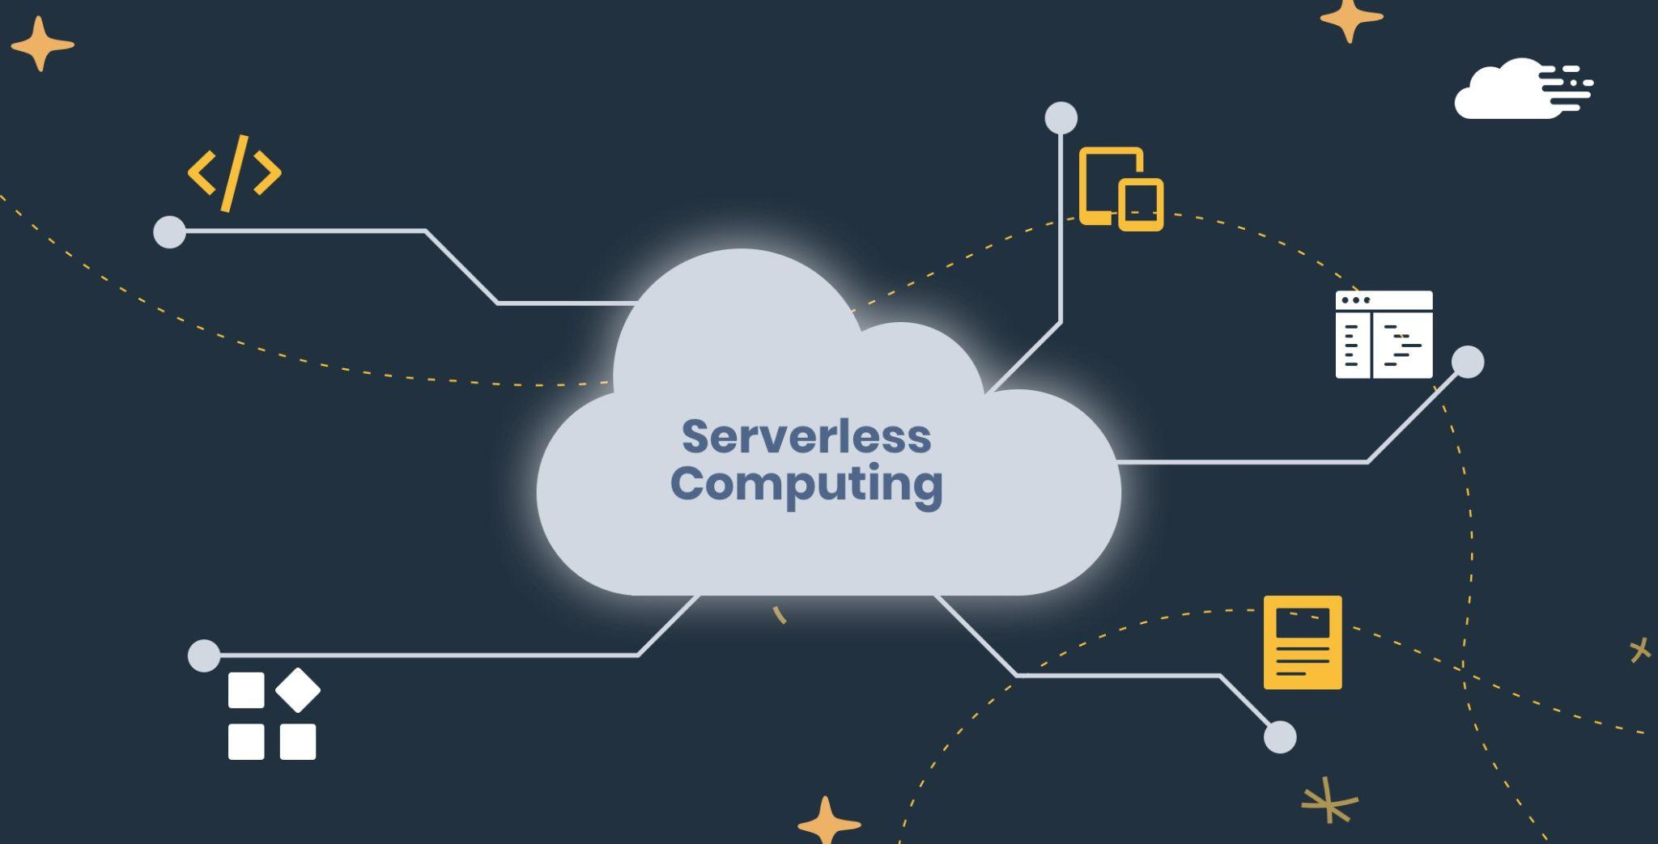
Serverless computing
Serverless computing consists in the use of an external infrastructure to develop and run applications. The management and operation of these servers is delegated to a third party.
Physical server disadvantages:
Keeping the server up even when we are not serving out any requests.
Maintenance of the server and all its resources.
Applying security updates to the server.

Slide 3



Amazon Web Services (AWS)
Lambda
API Gateway
Amazon developer

Slide 4

Tasks division
Reading the requests several times
Brainstorming to collect all ideas
Development of the lambda
Intents and the slot types.
Developing of the alexa code.
Testing

Slide 5
Purpose of the project
Design, develop and test an alexa application that is able to:
Provide the overall length and duration in minutes of a trip knowing the source and the destination.
Compare different journey duration in different hours of the days.
Find a place in a city with only the type of the place and the source addresses.
Technology used :
AMAZON WEB SERVICES (AWS)
Lambda
Cloud Watch
Api Gateway
Alexa developer console
Postman
datetime, json, requests

Slide 6
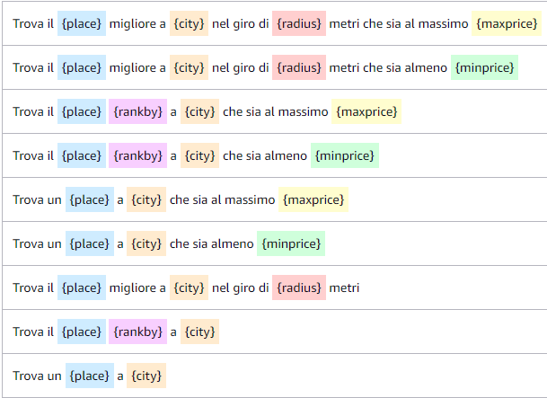
Extra Stuff
Attributes
Sample Utterances
Slot types
Variable Controls

Slide 7

Problems
Debugging alexa developer code

Slide 8

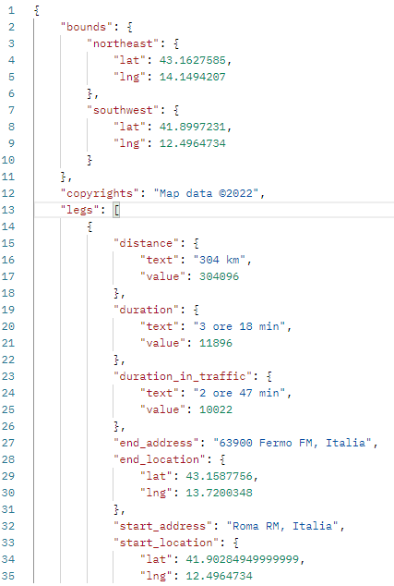

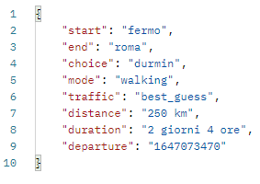

Results

Slide 9
Thanks for listening and attention

