Slide 1
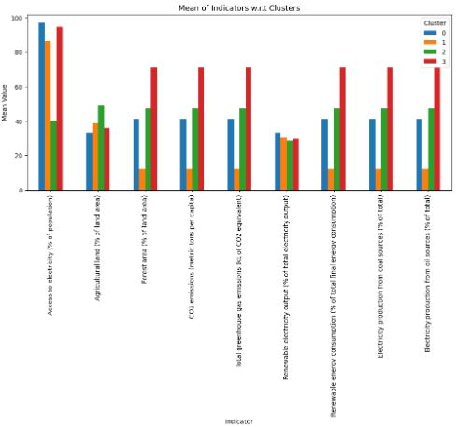
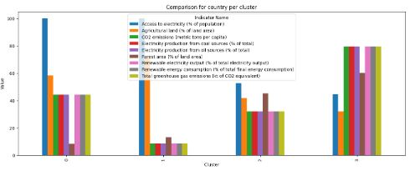
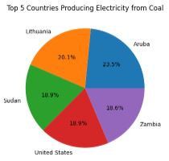
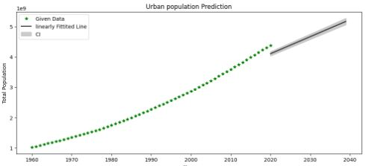
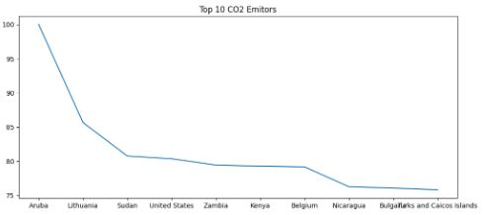
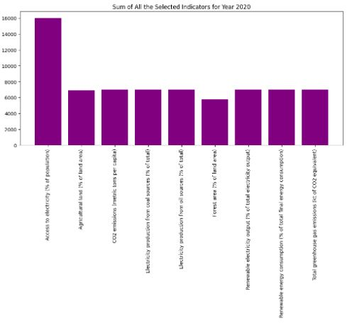
Climate Change Analysis Muhammad Tufail [22014806]
Background
We used these climate change indicators from the World Bank: Access to electricity, Agricultural land, Forest area, CO2 emissions, Total greenhouse gas emissions, Renewable electricity output, Renewable energy consumption, Electricity production from coal sources, Electricity production from oil sources.
Cluster 0
Cluster 1
Cluster 3
98% Access to electricity
10% CO2 emissions
80% CO2 emissions
30% Agricultural land
Cluster 2
50% Access to electricity
100% Access to electricity
10% Forest Area
30% CO2 emissions
In the clustering analysis, it was observed that cluster 0, 1 and 2 shows the highest level of Access to electricity and cluster 3 shows the highest level of CO2 emissions. In cluster 0 lowest level is Forest Area and in Cluster 1 and 2 lowest level is CO2 emissions and in Cluster 3 lowest level is Agricultural land.
In this Line graph we are predicting from year 2020 to year 2040 and in this we can see population is increasing as years increases. We can see a major change in population from year 1960 to 2020.
Form this Pie chart we can see Aruba is the country which is at top in producing the Electricity from Coal whose percentage is 23.5%.
From this Pie chart we can also conclude that Zambia comes at the last in producing Electricity from coal and its percentage is 18.6.
We can see again Aruba is at top in CO2 Emitors and Caicos islands is at last in CO2 Emitors list.
Conclusion
The World Bank indicators related to the environment reveal significant concerns regarding environmental degradation, including deforestation, declining biodiversity, and increasing pollution levels. Urgent action is needed to address these issues and prioritize sustainable development and environmental conservation. International cooperation and policy measures are crucial to tackle global environmental challenges and promote sustainable practices across sectors.
From this bar chart We can see Access to Electricity have the maximum sum which is 16000 and Forest Area has the minimum sum which is near 5500
Github Link: https://github.com/mtufli/Applied-Data-Science-1-Assignment-3-Clustering-and-fitting

