Slide 1



dashboarding
View in Power BI
Last data refresh:
15.05.2023 13:06:16 UTC
Downloaded at:
15.05.2023 13:19:20 UTC

Slide 2
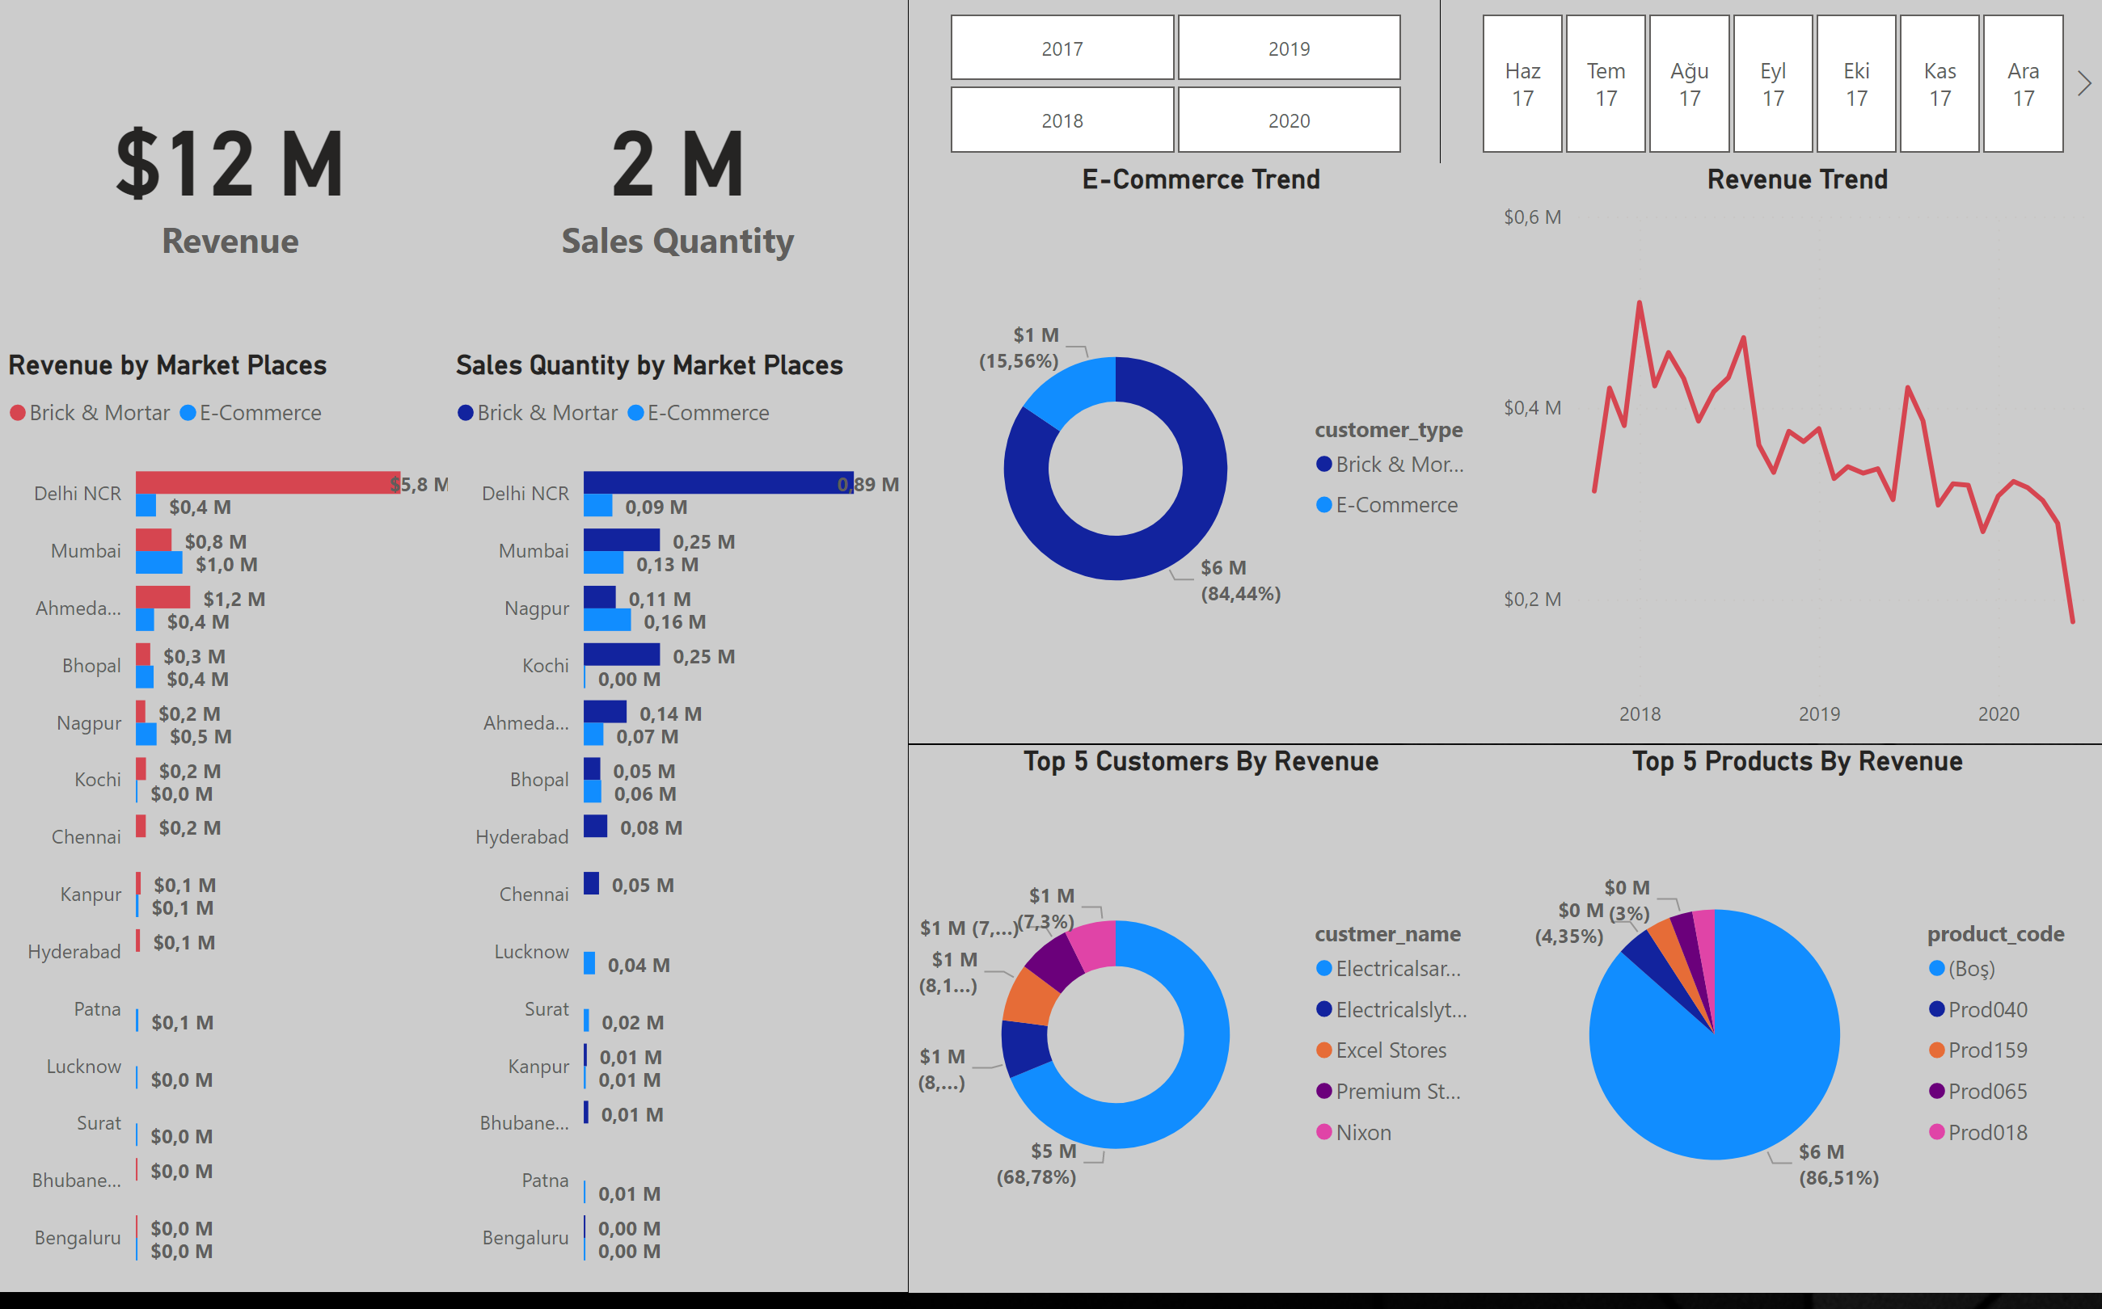
Key Insights
Notes:
card
No alt text provided
card
No alt text provided
Revenue by Market Places
No alt text provided
Sales Quantity by Market Places
No alt text provided
slicer
No alt text provided
slicer
No alt text provided
Top 5 Customers By Revenue
No alt text provided
Top 5 Products By Revenue
No alt text provided
Revenue Trend
No alt text provided
E-Commerce Trend
No alt text provided

Slide 3
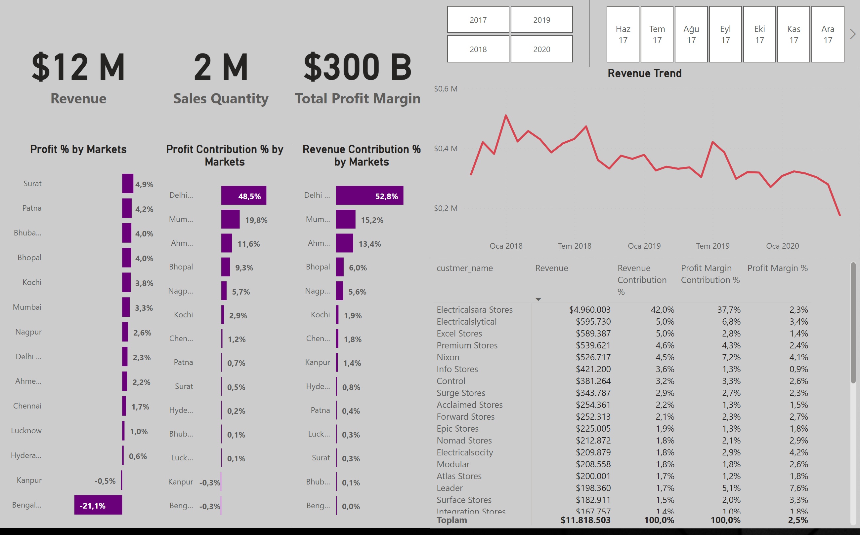
Profit Analysis
Notes:
card
No alt text provided
Profit Contribution % by Markets
No alt text provided
slicer
No alt text provided
slicer
No alt text provided
Top 5 Customers By Revenue
No alt text provided
Revenue Trend
No alt text provided
card
No alt text provided
Profit % by Markets
No alt text provided
Revenue Contribution % by Markets
No alt text provided
card
No alt text provided

Slide 4
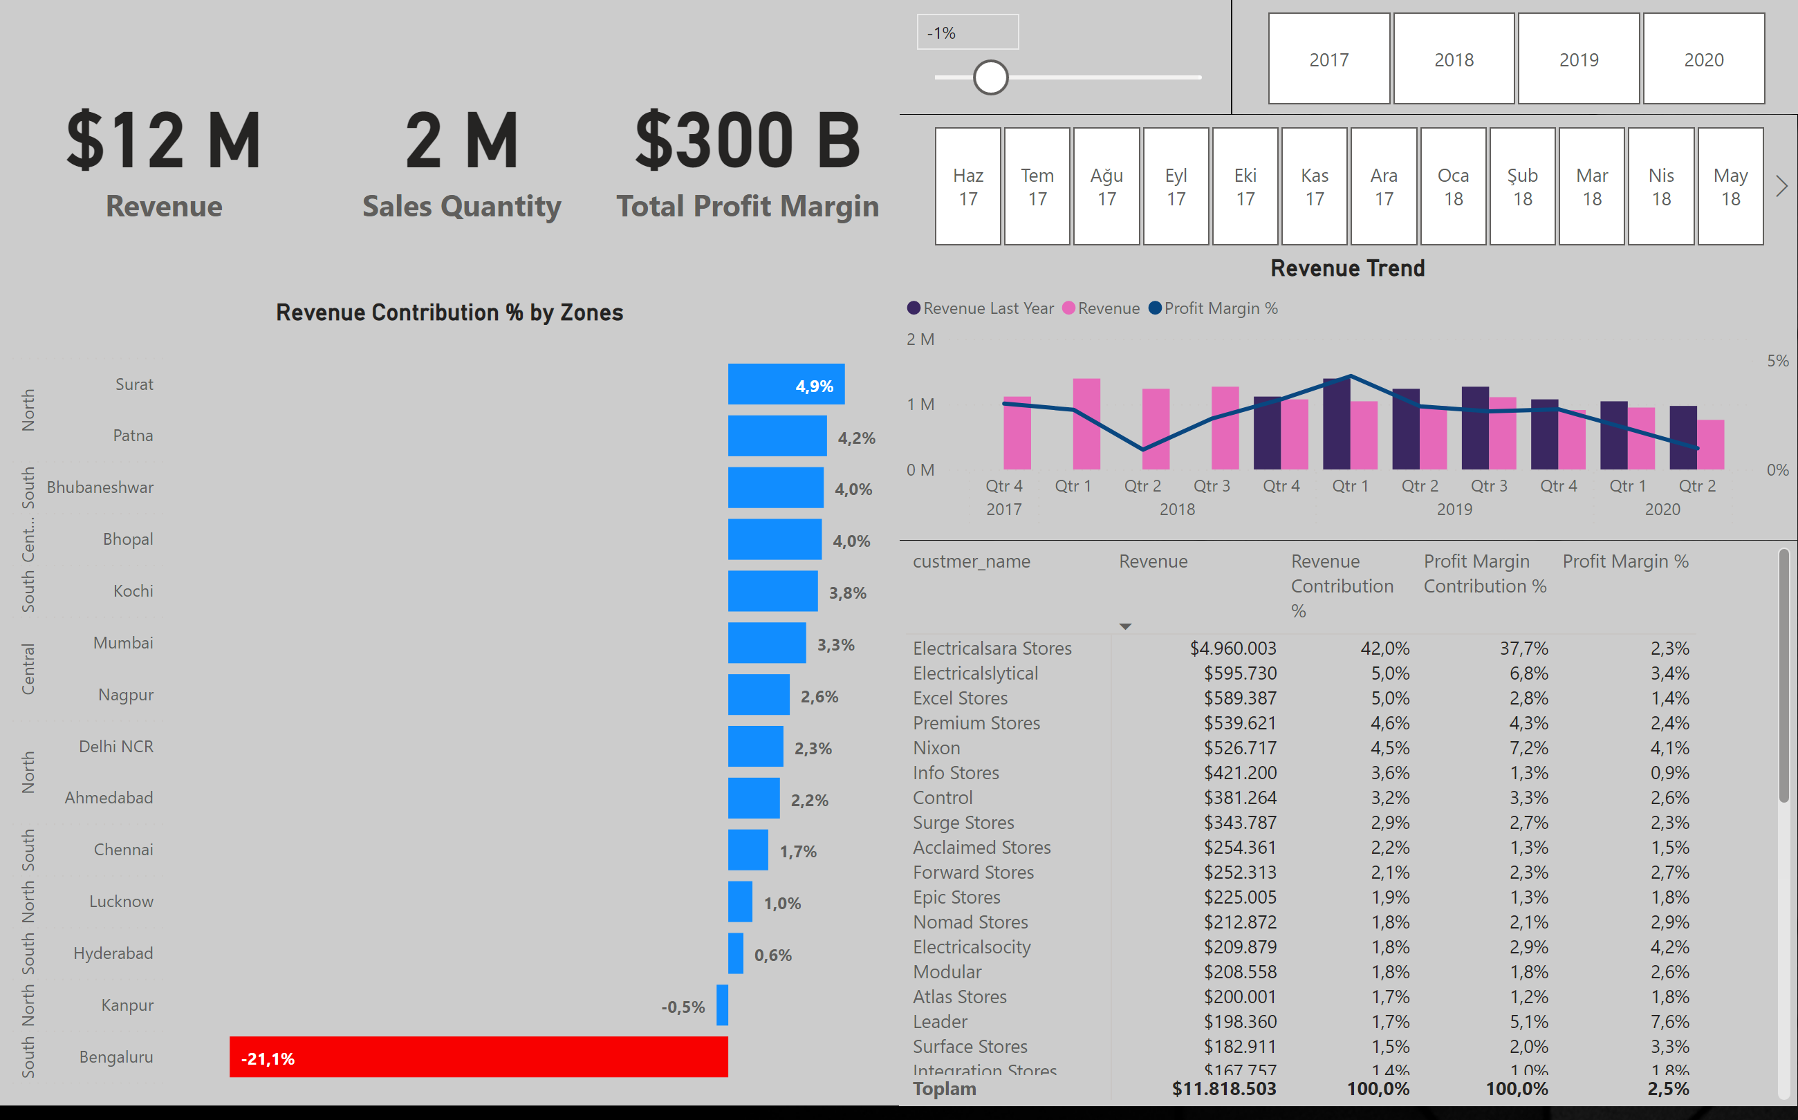
Perfomance Insigths
Notes:
card
No alt text provided
slicer
No alt text provided
slicer
No alt text provided
Top 5 Customers By Revenue
No alt text provided
Revenue Trend
No alt text provided
card
No alt text provided
Revenue Contribution % by Zones
No alt text provided
card
No alt text provided
slicer
No alt text provided

