Slide 1
Normalized Cross Correlation GPU Implementation for Ultrasound Elasticity Imaging
Rashid Al Mukaddim, Michael Turney, Robert Pohlman
Advised by Dr. Tomy Varghese
Medical Physics Department
DATE

Slide 2
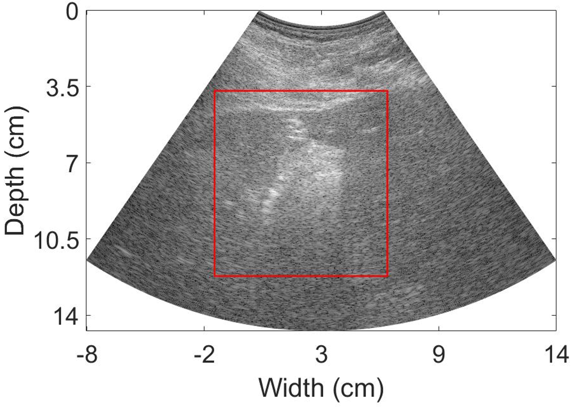
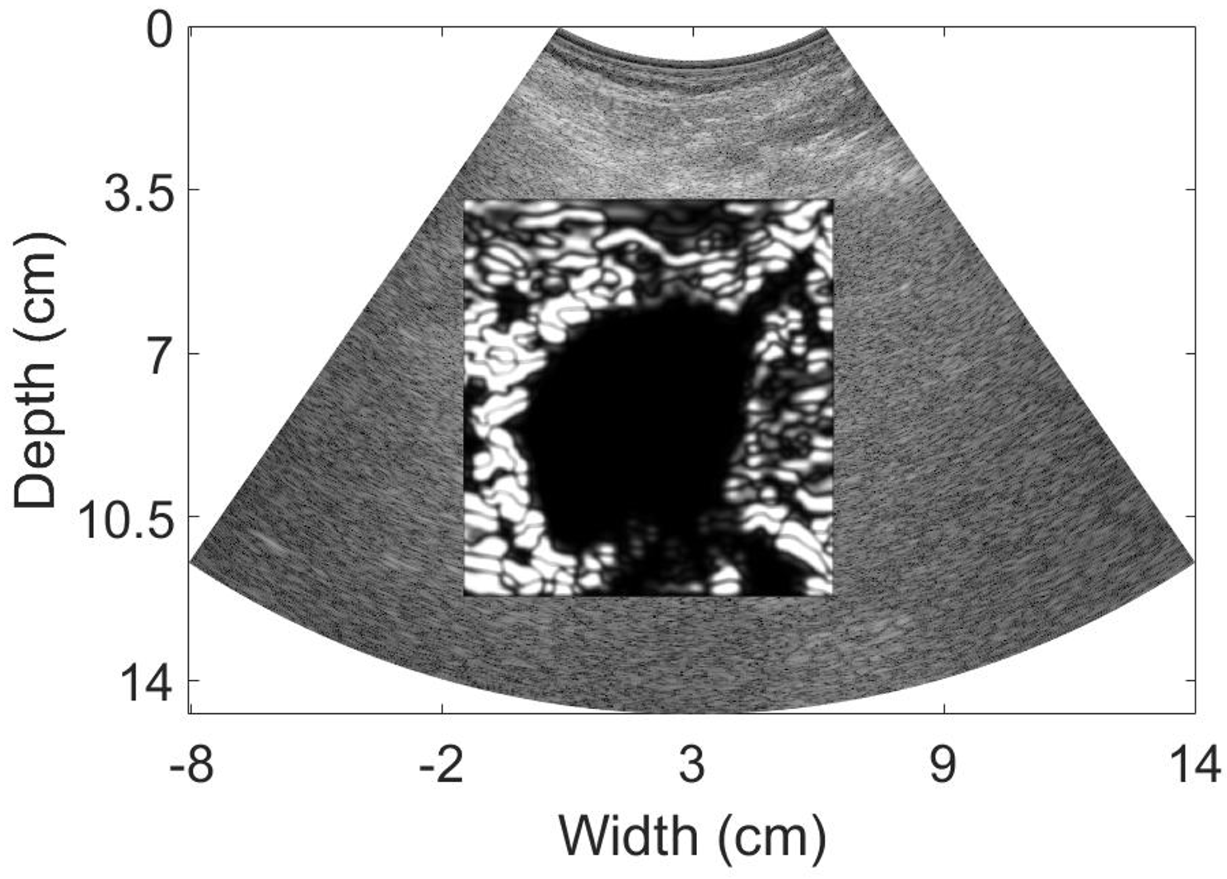
Problem Statement
B-mode
Elastography is a process of using Ultrasound to measure the elasticity of a material from an applied force.
The elasticity can be used for imaging purposes and is an important aspect for clinicians to deduce the tissue properties for assessing current treatments or ailments.
Current methods for calculating displacements are very computationally expensive and time consuming due to Normalized Cross Correlation.
Strain
We aim to create a GPU implementation for one grid level of the Multilevel using 2D Normalized Cross Correlation to speed up displacement estimation computational time.

Slide 3
Flowchart of Implementation

Slide 4
Results

Slide 5
Conclusion
Successes
Future Work

Slide 6
Thank you for your attention.

