Slide 1

Profiling Version 2 – “Basic Implementation”
Without optimization, 15 seconds. With -o3 optimization, 5 seconds.

Slide 2
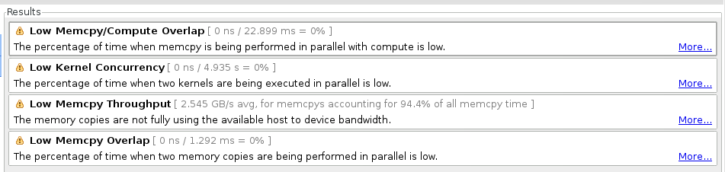
Profiling Version 2 – Profiler Analysis

Slide 3
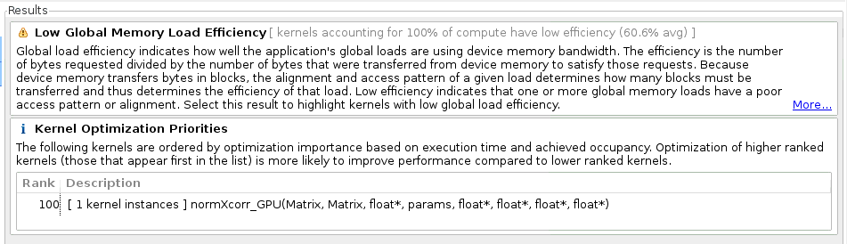
Profiling Version 2 – Profiler Analysis

Slide 4
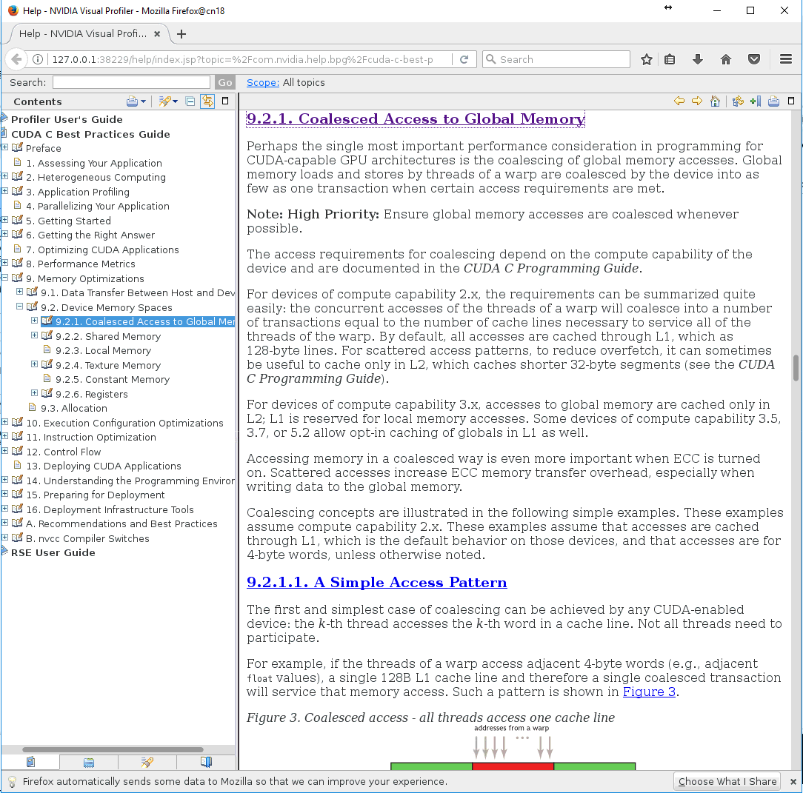
Profiling Version 2 – Profiler Analysis

Slide 5
Profiling Version 2 – Profiler Analysis

Slide 7
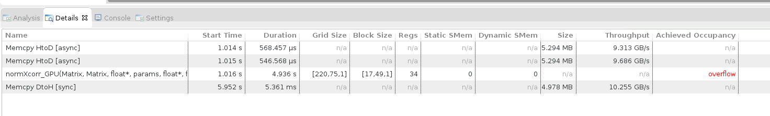

Profiling Version 4 – “Modified Implementation”

Slide 8
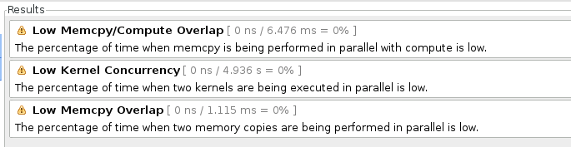
Profiling Version 4 – Profiler Analysis

Slide 9
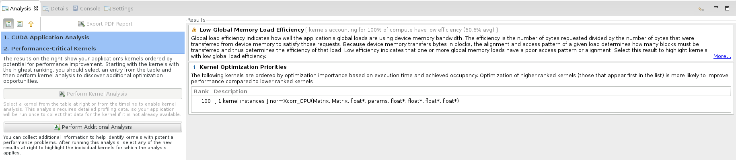
Profiling Version 4 – Profiler Analysis

Slide 10
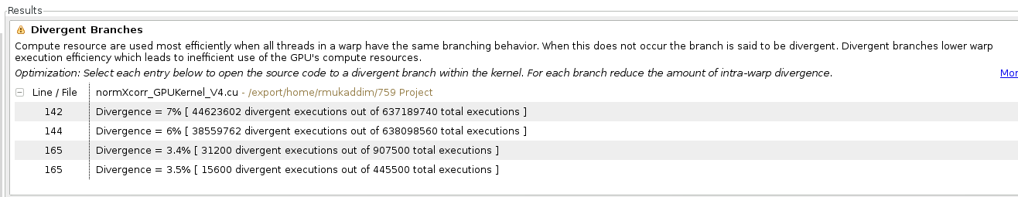
Profiling Version 4 – Profiler Analysis

Slide 12

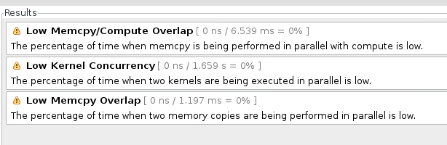
Profiling Version 5

Slide 13
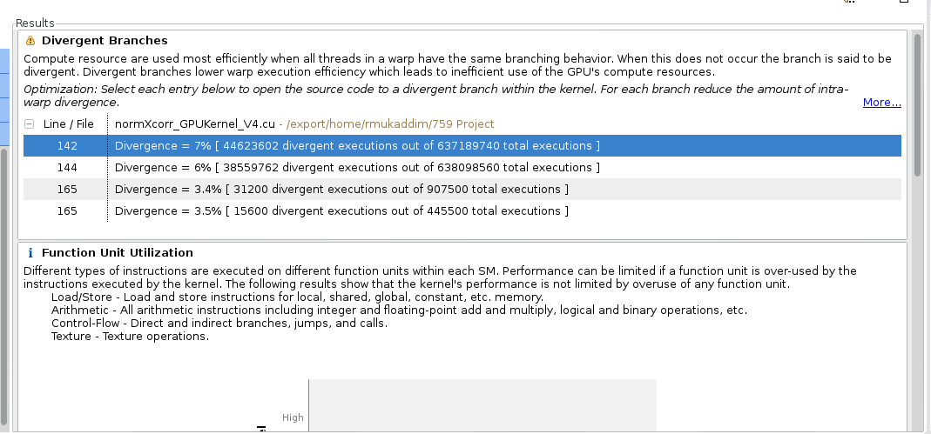
Profiling Version 4

Slide 14
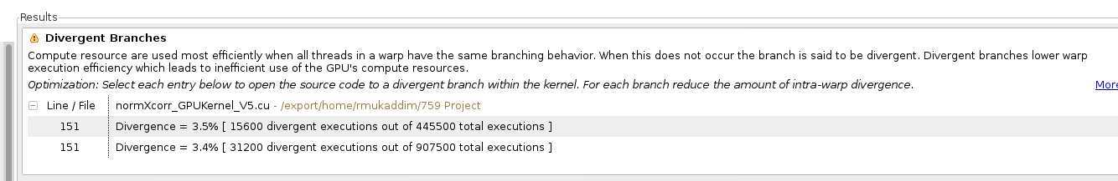
Profiling Version 4

Slide 15
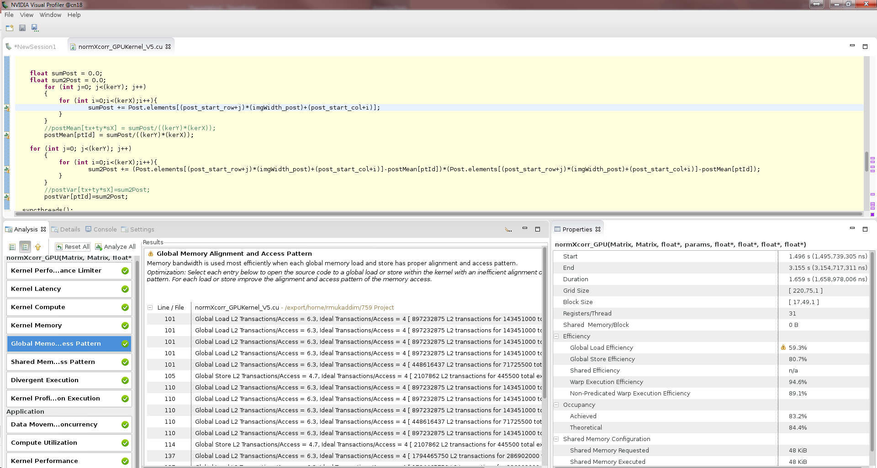

Slide 16
