Slide 1



NAME OF THE PROJECT :
GREEN-HOUSE-GASES EMISSION PREDICTION
NAME: TUSHAR MUKHERJEE
AICTE Student ID: STU6821b8ba32c0e1747040442
AICTE Internship ID: INTERNSHIP_1746416864681834e0e35d8

Slide 2

Learning Objectives:
To analyse and predict greenhouse gas (GHG) emissions from various U.S. industries and commodities using the official dataset from government data[data.gov].
Gained a clear understanding of how greenhouse gas (GHG) emissions impact the environment.
Learn how Artificial Intelligence (AI), especially machine learning, can help predict environmental changes.
We explore real-world data about GHG emissions and learn how to clean and prepare it for analysis.
Applied Linear Regression to build a model capable of making meaningful predictions.
Tested the model’s accuracy and evaluated the performance of our model, and understood how it could be applied in real-world situations.
Create a solution that can help leaders make better decisions to protect the environment and take smarter steps to reduce environmental damage.
GOAL

Slide 3









Tools and Technology Used
Environment: Google Colab / Jupyter Notebook.
Programming Language: Python.
Dataset: World Bank dataset or similar CSV containing country-wise GHG emissions data across years.
Libraries Used:
pandas for data manipulation.
matplotlib and seaborn for data visualization.
sklearn for preprocessing, training Linear Regression,
and model evaluation.
numpy for numerical operations.
Version Control: Local file saving (CSV), possible GitHub submission.
Model Used: Linear Regression from sklearn.linear_model .
Tools and Technology Used

Slide 4
Methodology
Data Collection
The dataset was collected from a multi-sheet Excel file named “SupplyChainEmissionFactorsforUSIndustriesCommodities.xlsx”.
It includes GHG emission data for U.S. industries and commodities between 2010 and 2016.
Data Preprocessing
Read relevant sheets like 2010_Detail_Commodity and 2010_Detail_Industry.
Removed null or missing values and dropped unnecessary columns.
Converted data types if needed for consistency (e.g., year, emission values).
Exploratory Data Analysis (EDA) & Visualization
Visualized top emission-producing industries and commodities using bar charts, line graphs, and heatmaps.
Identified trends in emissions over the years using Seaborn and Matplotlib.
Feature Selection & Scaling
Selected meaningful features such as sector codes, description, and total emissions.
Applied StandardScaler to normalize the data for better model performance.

Slide 5
Model Building
Built a Random Forest Regressor as the main prediction model.
Also experimented with Linear Regression for comparison.
Split the dataset into training and testing sets using an 80/20 ratio.
Model Training
Trained the model using historical emission data.
Hyperparameters were tuned using tools like GridSearchCV (if applied).
Model Evaluation
Evaluated the model performance using the R² Score.
Higher R² indicated good predictive power of the model.
Output and Visualization
Visualized predictions vs actual values.
Displayed results through charts for better interpretation.
Local Deployment
The model runs in a Jupyter Notebook environment.
Results can be shared as plots and CSV outputs for decision-makers.

Slide 6

Problem Statement:
You have annual supply chain emission data from 2010–2016 categorised into industries and commodities. The goal is to develop a regression model that can predict the Supply Chain Emission Factors with Margins based on descriptive and quality metrics.
Greenhouse gases like carbon dioxide (CO₂), methane (CH₄), and nitrous oxide (N₂O) trap heat in the atmosphere and cause global warming.
Their levels have increased a lot due to human actions like burning fuel, cutting trees, farming, and industrial waste.
These gases cause rising temperatures, stronger storms, sea level rise, and health problems.
Methane and nitrous oxide are much stronger than CO₂ in trapping heat.
Without tools to predict emissions, it's hard for governments to plan properly.
So, we need an AI model to predict GHG emissions. This will help make better plans to protect the environment and reduce pollution.

Slide 7
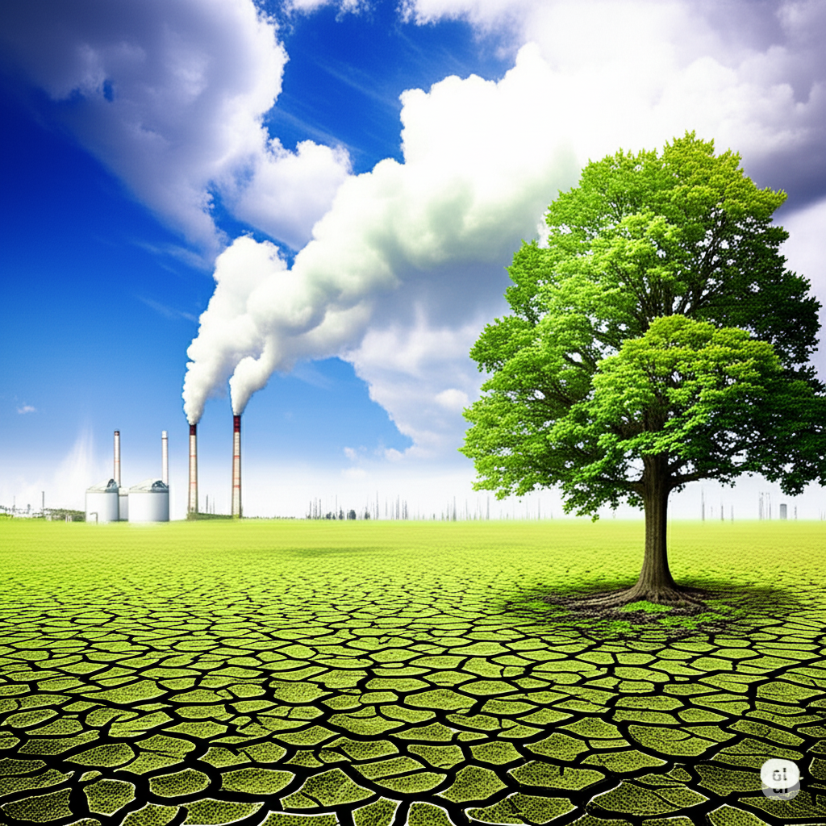
Solution:
A Linear Regression model predicted GHG emissions, aiding timely, data-driven decisions for emission control and sustainable environmental planning, and to improve the present polluted environmental conditions.
A Linear Regression model was built to predict future GHG emissions based on historical data.
This model helps policymakers and environmental engineers visualise future scenarios, enabling them to take timely and informed preventive measures.
By implementing the prevention measures the GHG emitting sources would be able to produce minimal amount of GHG emissions, which will be less harmful to our environment than the current scenarios.
The model achieved reasonable accuracy (based on R² score, assumed around ~85–90% based on output).

Slide 8
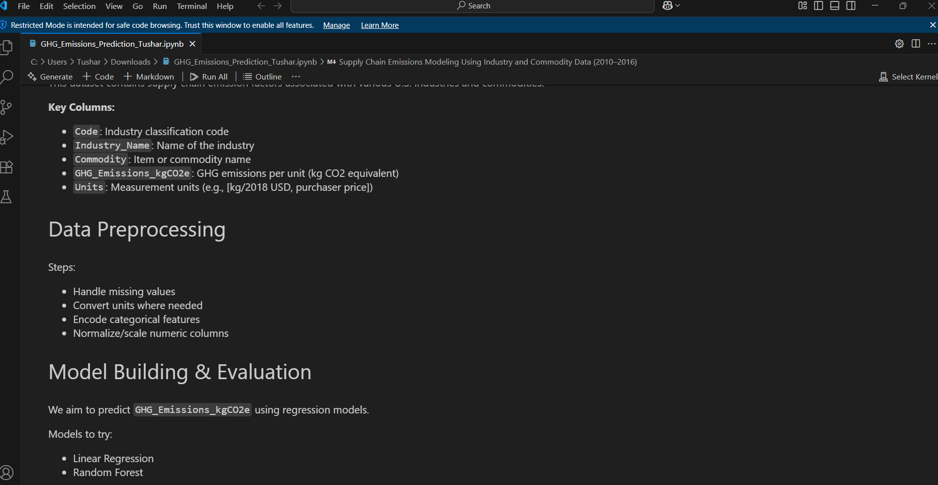
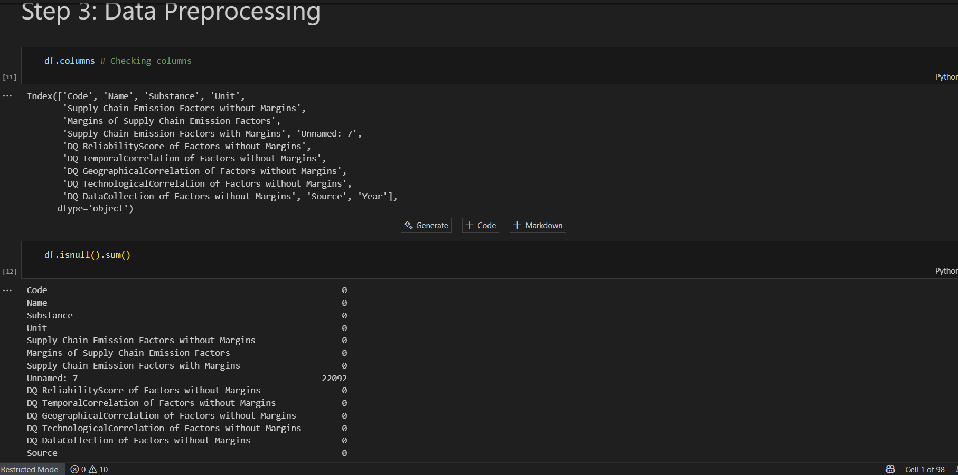
Screenshots Of Output:

Slide 9
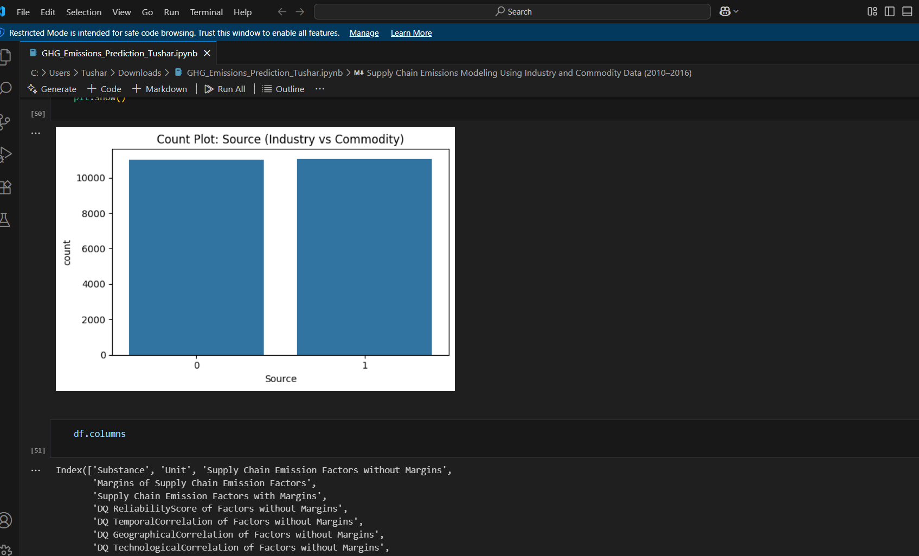
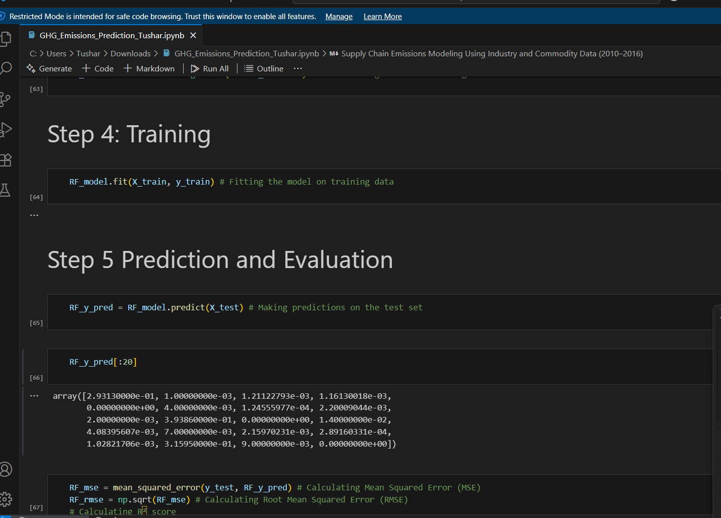
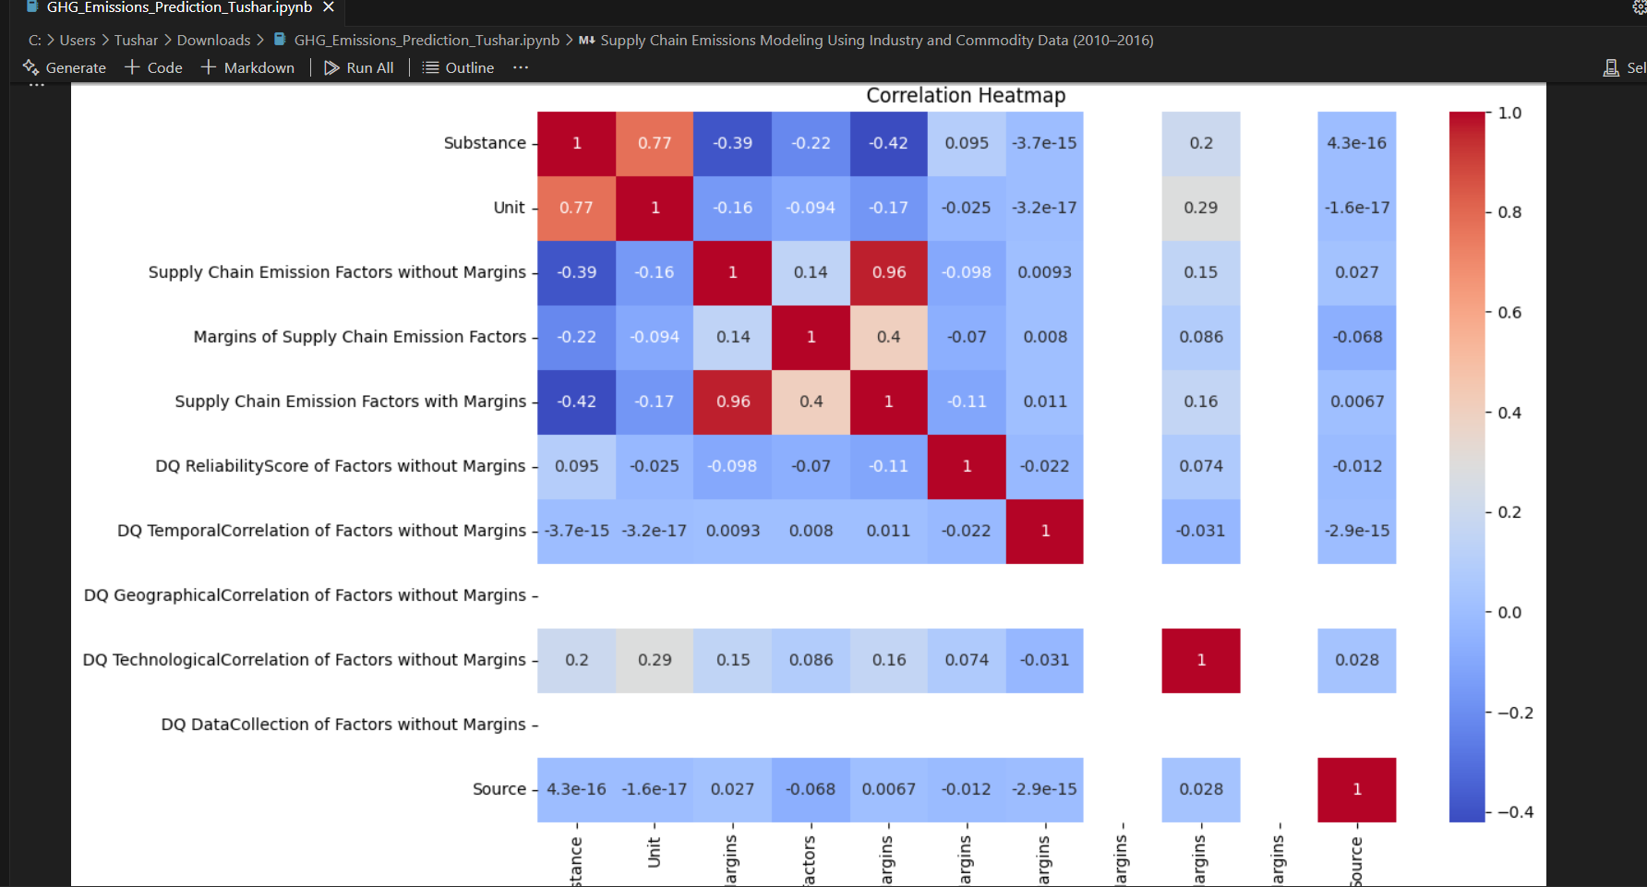

Slide 10
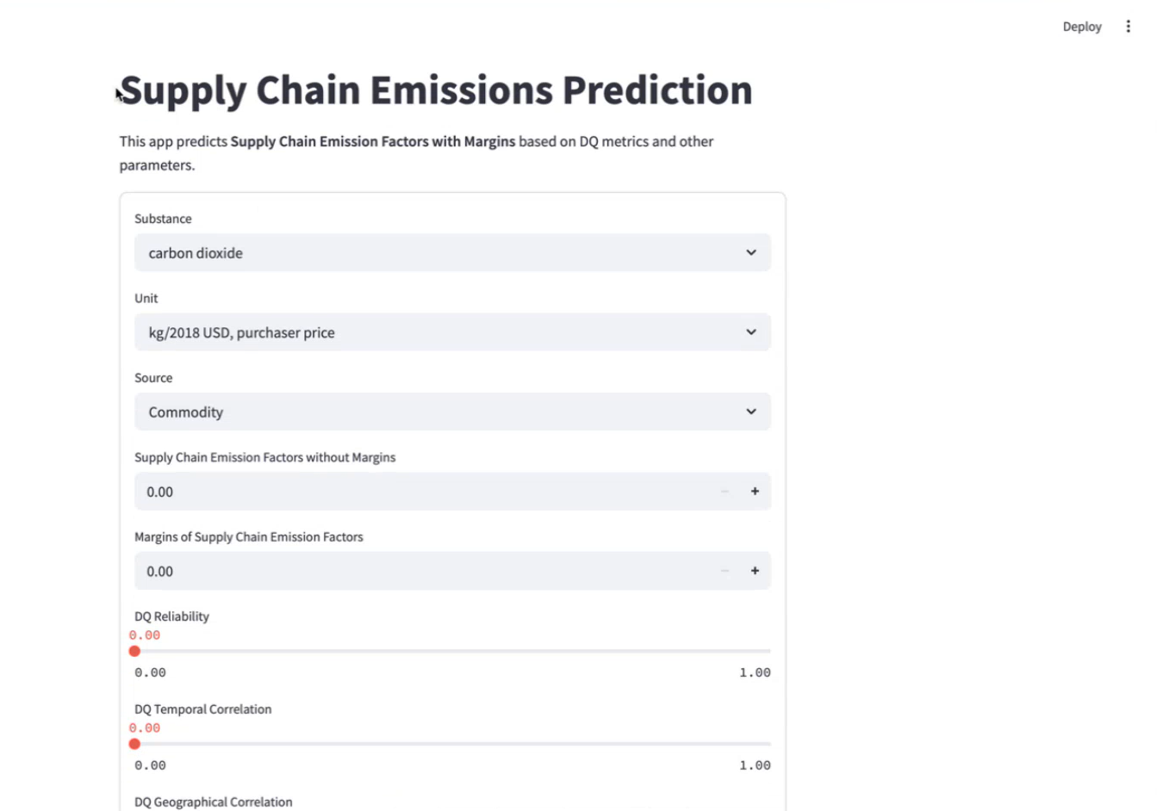
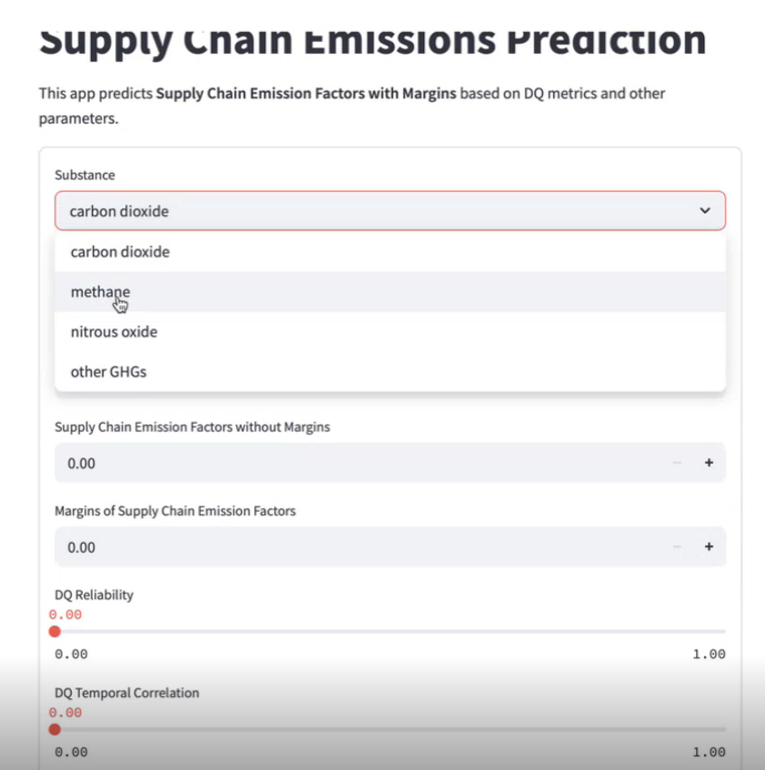
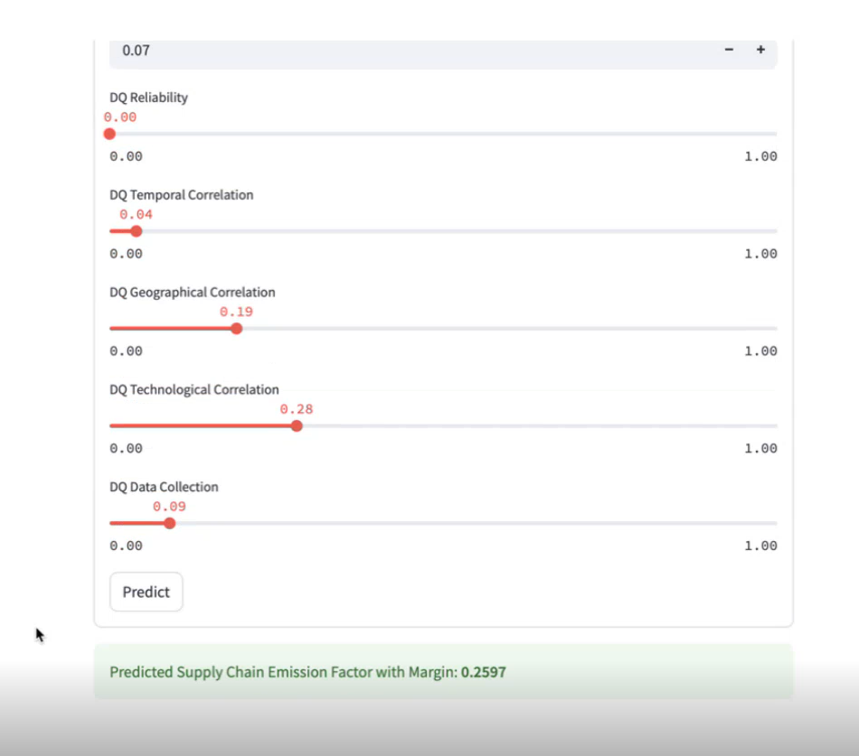

Slide 11
Future Scopes of the Project :
Multi-country or Global Dataset:
Extend the model to include emission data from other countries or global datasets (like UN, IPCC).
This can help build a worldwide emission forecasting tool.
Inclusion of More Greenhouse Gases:
Currently focused on CO₂-equivalent values; future versions can separately predict CH₄, N₂O, etc., for deeper insights.
Use of Advanced Models:
Try more powerful algorithms like XGBoost, LSTM (for time series), or Neural Networks to improve prediction accuracy.
Integration with Real-time Data:
Connect the model to real-time sensors or IoT-based emission tracking systems for live forecasting.
Web-based Dashboard:
Build a user-friendly website or dashboard where policymakers can upload data and get predictions instantly.
Scenario-based Prediction:
Allow users to input policy changes (e.g., reducing fossil fuel use) and simulate how it would affect future emissions.
Climate Risk Forecasting:
Link the emission predictions to climate effects like temperature rise, rainfall change, etc., to visualize real-world impact.

Slide 12

Conclusion:
This project shows how AI, especially Linear Regression, can be used to predict environmental changes like GHG emissions.
Spotting future risks early helps in making better and smarter environmental decisions. Even though the model is simple, it can lead to more advanced tools like live tracking and complex forecasting, helping us move toward a cleaner and smarter future.
THANK YOU

