Slide 1
CLINIX
Diagnostic Medicare Center Management
PREPARED BY –
799181 - VAISHNAVI KULKARNI
799234 - ANKIT CHHAJED
799261 - ABHISHEK SAWANT
799272 - AMIT WANI
799182 - SANHITA PALUSKAR
799309 - MITALI MARKANDE

Slide 2
OBJECTIVES:
SIMPLICITY IN BOOKING DOCTOR’S APPOINTMENT FOR PATIENT.
DIGITIZATION OF MEDICARE SERVICES.
QUICK ACCESS FOR YOUR MEDICAL TESTS.
HAVE PREMIUM SERVICES IN YOUR EMERGENCY.

Slide 3
ENTITIES:
ADMIN
AGENT
DOCTOR
PATIENT

Slide 4
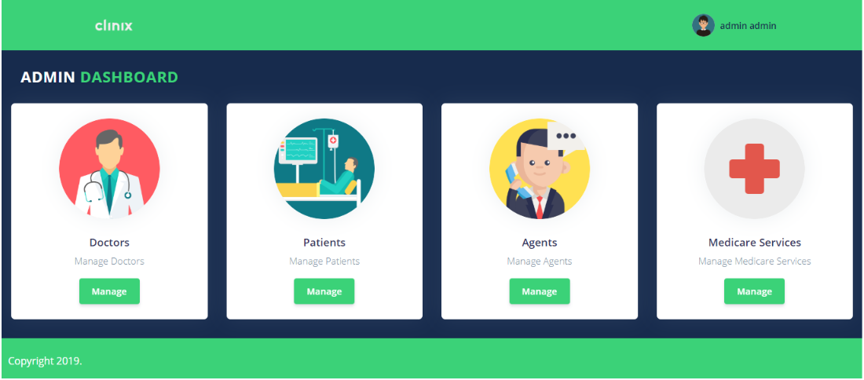
ADMIN FUNCTIONALITIES:

Slide 5
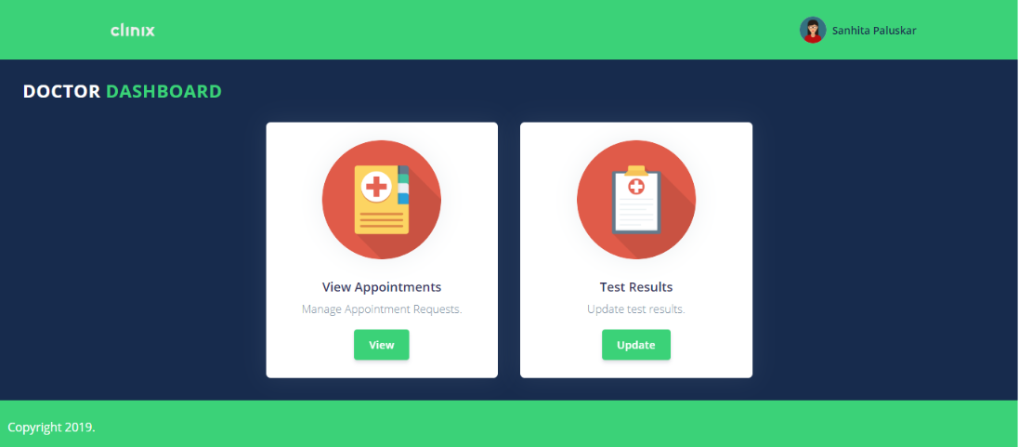
DOCTOR FUNCTIONALITIES :

Slide 6
PATIENT FUNCTIONALITIES :

Slide 7
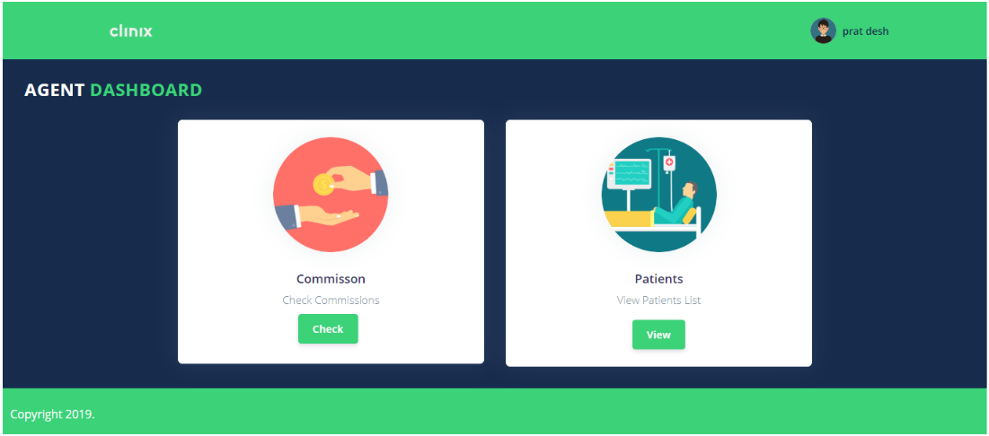
AGENT FUNCTIONALITIES :

Slide 8
THANK YOU!

