Slide 1
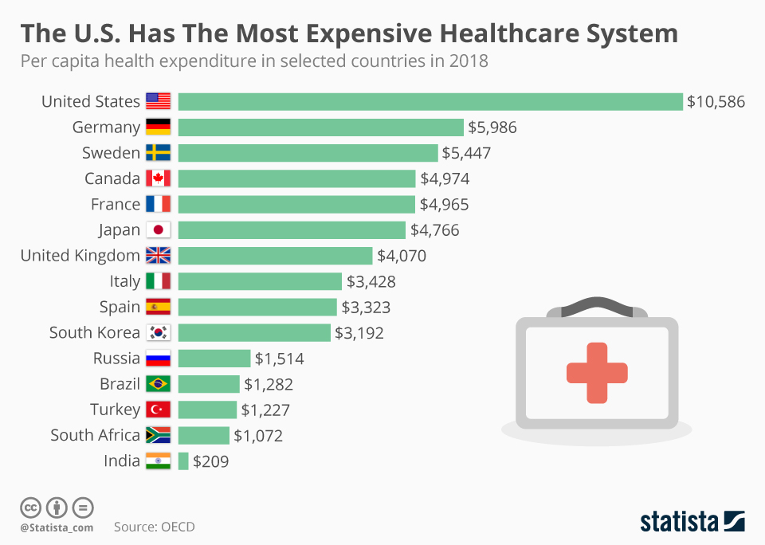

Slide 2
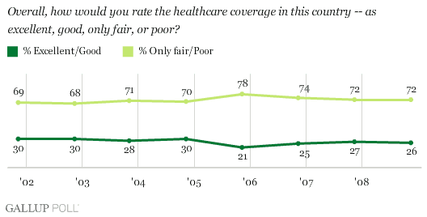

Slide 3
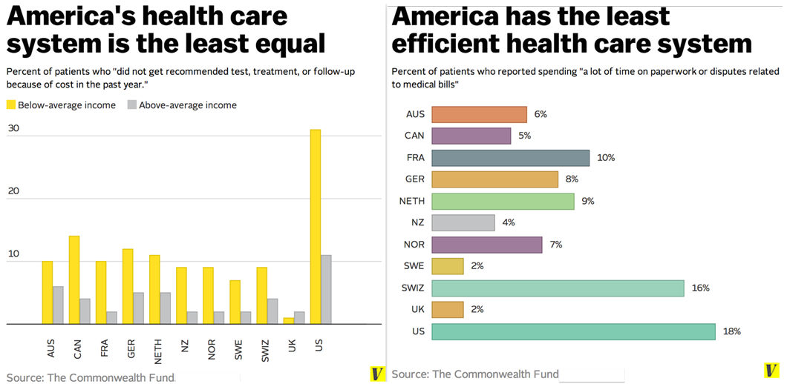

Slide 4
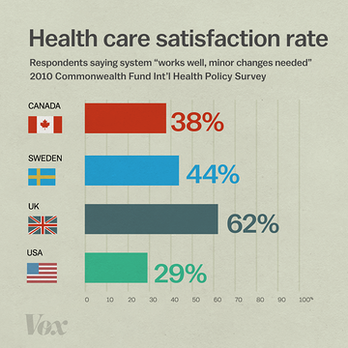

Slide 5
Make Health Care Work Better For America. (n.d.). https://uspirg.org/issues/usp/make-health-care-work-better-america.
Single-Payer Health Care: A Tale of 3 States – Third Way. (n.d.). https://www.thirdway.org/report/single-payer-health-care-a-tale-of-3-states.
McCarthy, N., & Richter, F. (2019, August 8). Infographic: The U.S. Has the Most Expensive Healthcare System in the World. https://www.statista.com/chart/8658/health-spending-per-capita/.
Burke, L. A., & Ryan, A. M. (2014, February 1). The Complex Relationship between Cost and Quality in US Health Care. https://journalofethics.ama-assn.org/article/complex-relationship-between-cost-and-quality-us-health-care/2014-02.
YoniBlum. (2018, September 3). Here's the real reason health care costs so much more in the US. https://www.cnbc.com/2018/03/22/the-real-reason-medical-care-costs-so-much-more-in-the-us.html.
Why We Need Single-Payer. (n.d.).https://healthcareforall.org/single-payer/why/.

