Slide 1



APPLICATION FOR THE LOGISTICS INDUSTRY

Slide 2



What is ?
1. Necessity of the Porcelain Floor Industry.

Slide 3

2. Improvement of Logistics Operation

Slide 4
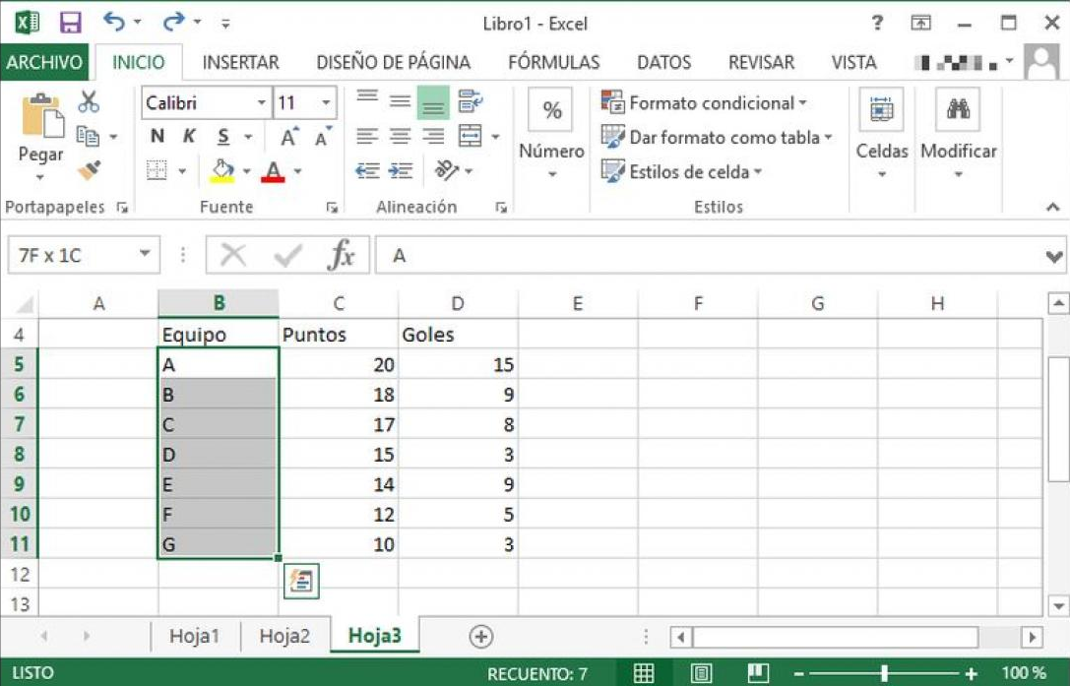
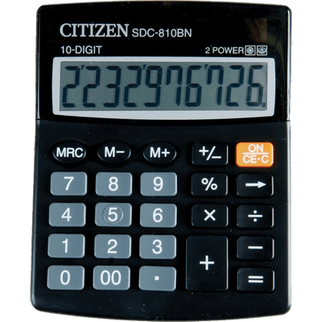
3. Improvement of Logistics Technology

Slide 5
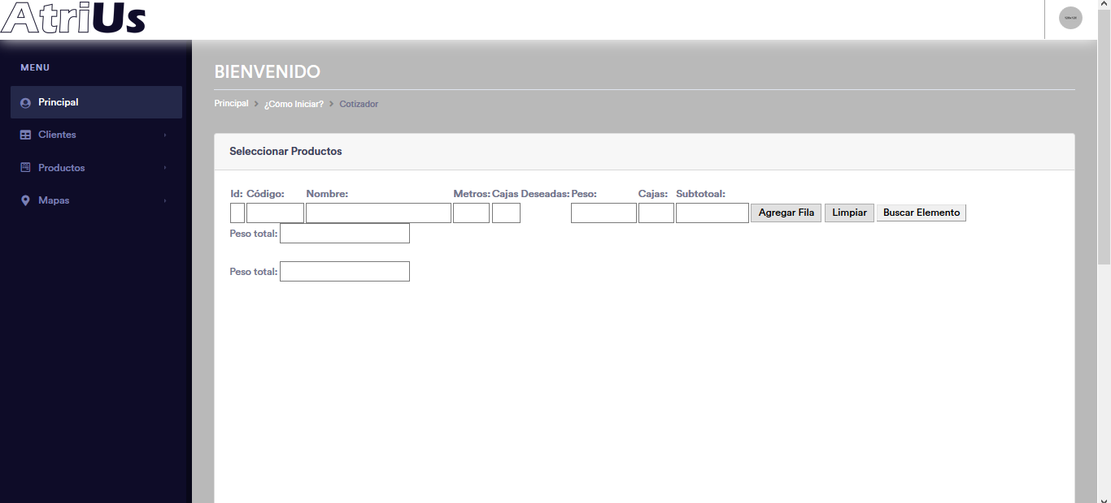
Web Calculator Example
Click Here!

Slide 6
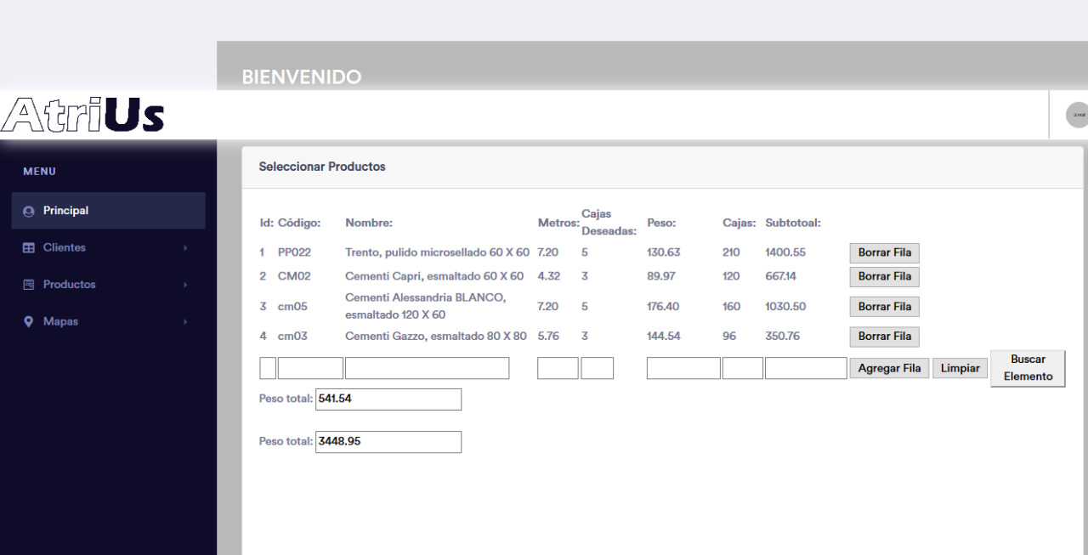
Filled Calculator

Slide 7

Live Presentation

Slide 8


1. Costs savings

Slide 9

2. Upgrade Customer Experience

Slide 10
Contact
<Ing. Samuel Vázquez email= samuelvazcal@hotmail.com phone=“33 1781 5529”>
<Ing. Juan Martínez email=ing.mtzjuanjose@gmail.com phone=“33 1170 7462”>
<Ing. Javier Valenzuela email=javamm91@gmail.com phone=“33 1607 4611”>
<Ing. Carlos Gutiérrez email=c.gutierrez@padretierra.com phone=“33 1908 2811”>
<Act. Ernesto Caballero email=ernesto.cab.del@gmail.com phone=“33 2170 1201”>

