Slide 1

Prediction of Anticancer Peptides
Using Machine Learning
Department of Biophysics
Faculty of Bioinformatics
By:
Mohammadtabar Zeynab
Supervisor:
Dr. Abdolmaleki Parviz
January 2022

Slide 2
Outline
01
Introduction
02
Materials and Methods
03
Results
04
Suggestions
1

Slide 3
Introduction
2

Slide 4
ACPs Prediction Importance
Cancer remains the major cause of death, killing millions of people every year, and it is caused by the growth and spreading of abnormal cells without control.
In 2018, it was anticipated that about 18 million new cancer cases and over 9 million deaths could occur due to cancer, and these deaths could reach well over 13 million by 2030 [1].
For cancer treatment, conventional chemotherapy is currently a common way.
It usually has an adverse effect on normal cells, resulting in that the treatment effect is not that good.
The traditional chemotherapy approach is very expensive.
New treatment options are therefore highly demanded for relieving symptoms and ultimately eradicating the disease.
During the last few decades, the role of peptides as anti-cancer therapeutic agents has been promising, which is apparent from various strategies available to address the advancement of tumor growth and spreading of the disease.
These anti-cancer peptides (ACPs) have shown the potential to inactivate various types of cancer cells [2].
Bray, F., et al., Global cancer statistics 2018: GLOBOCAN estimates of incidence and mortality worldwide for 36 cancers in 185 countries. CA: a cancer journal for clinicians, 2018. 68(6): p. 394-424.
Wijdeven, R.H., et al., Old drugs, novel ways out: Drug resistance toward cytotoxic chemotherapeutics. Drug Resistance Updates, 2016. 28: p. 65-81
3

Slide 5
Why ACPs?
ACPs are naturally occurring biologics and hence are safer
Because ACPs can interact with the anionic cell membrane components of cancer cells, cancer cells can be killed selectively by the ACPs without impairing the normal cells (2,3)
Traditional treatment methods focus on killing cancer cells, but at the same time normal cells are also killed and there are high costs involved(2,3)
Accurate prediction of ACPs is of great importance for the exploration of their mechanism of action
and for the development of therapeutic ACPs.
It is quite expensive and time-consuming to identify anticancer peptides using experimental methods.(1)
Thundimadathil, J. Cancer treatment using peptides: Current therapies and future prospects. J. Amino Acids 2012, 2012, 967347.
Mader, J.S.; Hoskin, D.W. Cationic antimicrobial peptides as novel cytotoxic agents for cancer treatment. Expert Opin. Investig. Drugs 2006, 15, 933–946.
Hoskin, D.W.; Ramamoorthy, A. Studies on anticancer activities of antimicrobial peptides. BBA Biomembr. 2008, 1778, 357–375.
4

Slide 6
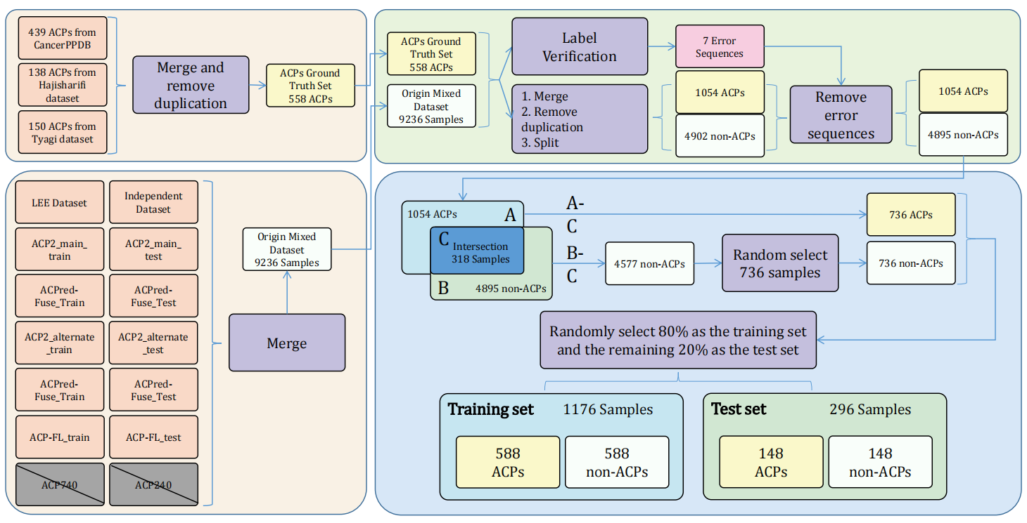
Data Collection
6
Learning embedding features based on multisense-scaled attention architecture to improve the predictive performance of anticancer peptides- Bioinformatics-2021

Slide 7
My Data Used for My Research
http://120.24.47.30:8080/ACPred_LAF/Download.html:
CD-Hit Range | #ACP | #non-ACP
Before cd-hit | 736 | 4577
100% | 736 | 4577
90% | 479 | 4346
80% | 350 | 4184
70% | 242 | 3608
60% | 181 | 3416
50% | 102 | 2674
40% | 40 | 1579

Slide 8
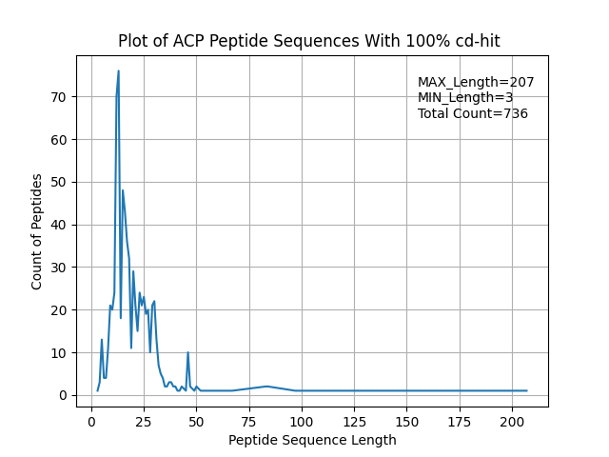
Data Views
Original data – positive data

Slide 9
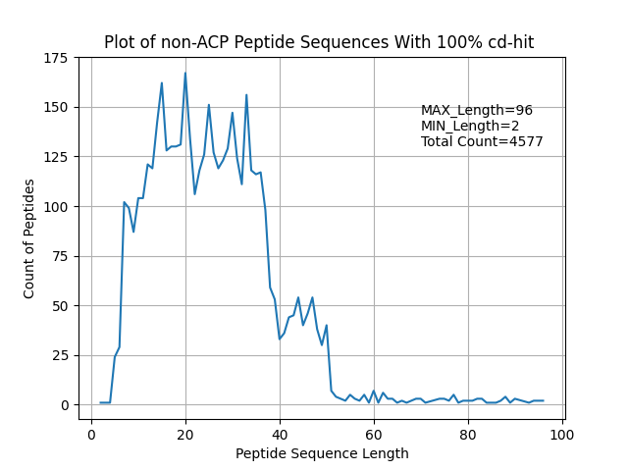
Data Views
Original data – negative data

Slide 10
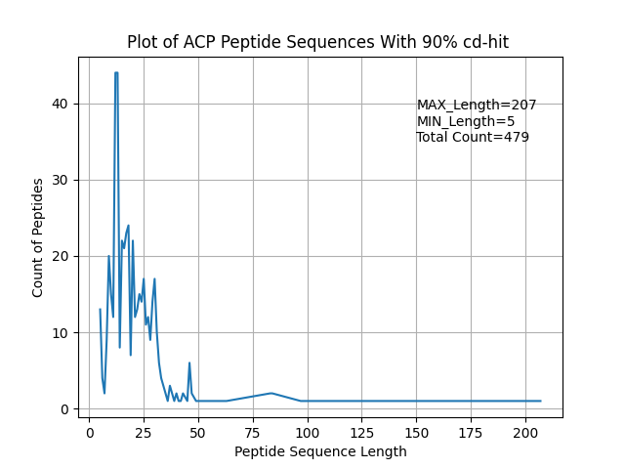
Data Views
Cdhit 90 – positive data

Slide 11
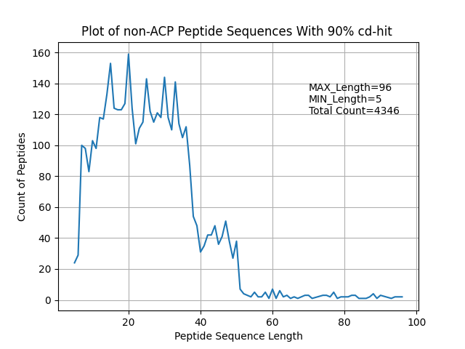
Data Views
Cdhit 90 – negative data

Slide 12
Filter Sequence Length

Slide 13
Filter Sequence Data by seq length
sequences with 50 < length < 5 deleted
CD-Hit Range | Before filter #ACP | After filter seqLength #ACP | Before filter #non-ACP | After seqLength #non-ACP
Original data | 736 |  | 4577
90% | 479 | 470 | 4346 | 4244

Slide 14
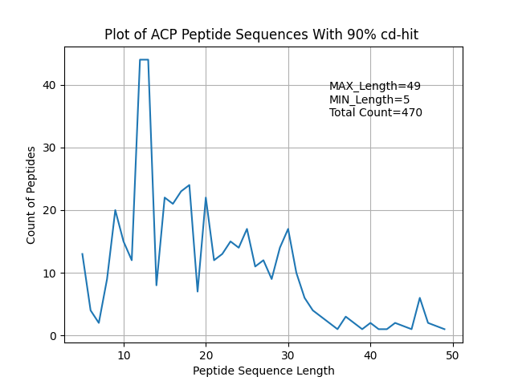
Data Views after seq length filter
Cdhit 90 – positive data

Slide 15
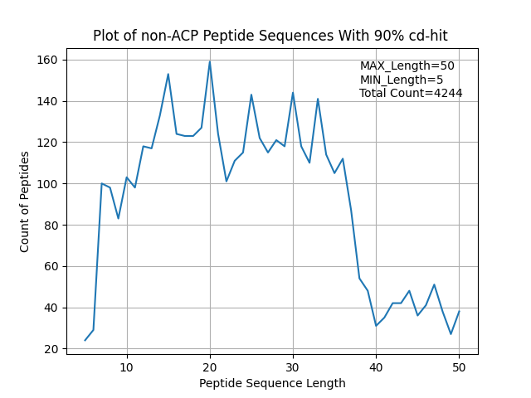
Data Views after seq length filter
Cdhit 90 – negative data

Slide 16
Select random negative data

Slide 17
Select random negative data as much as positive data
CD-Hit Range | After filter seqLength #ACP | After seqLength #non-ACP | After Select random #non-ACP
90% | 470 | 4244 | 470
Final result:
#ACPs = #non-ACPs

Slide 18
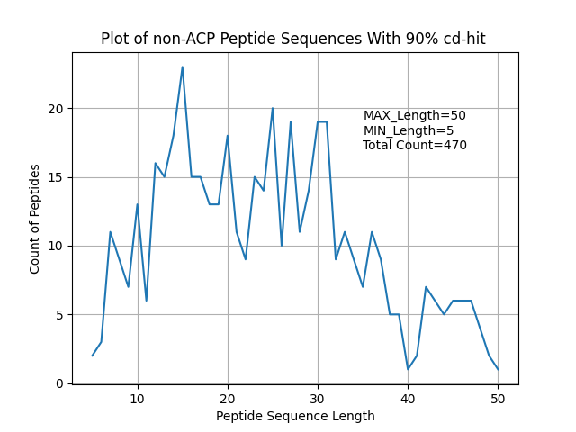
Data View of selected random negative data
Cdhit 90 – negative data

Slide 19
Train-Test data split

Slide 20
Train-Test data split
Split by 80 , 20
80% for train == == > 752
20% for test == == > 188
All random as #positive = #negative
CD-Hit Range | #ACP | #non-ACP
90% | Total: 470 Train: 376 Test: 94 | Total: 470 Train: 376 Test: 94

Slide 21
Feature Extraction

Slide 22
Sequence based features:
amino acid composition (AAC) | amino acid index (AAIF) | auto covariance of the average chemical shift(acACS) | local alignment kernel (LAK)
dipeptide composition (DPC) | binary profile (NC5) | amphiphilic pseudo amino acid composition(Am-PseAAC) | Physicochemical properties(PCP)
composition-transition-distribution (CTD) | conjoint triad (CTF) | composite protein sequence representation(CPDR) | Pseudo amino acid composition (PseACC)
quasi-sequence-order (QSO) | atomic composition(ATC) | G-Gap dipeptide composition (g-gap DPC) | Pseudo G-Gap dipeptide composition(Pse-g-gap DPC)
protein relatedness measure(PRM) | reduce amino acid composition(RACC) | split amino acid composition(SAAC) | Geary autocorrelation descriptor
Composition on terminal region | N5C5 | k-space | position-specifc scoring matrix (PSSM)
k-spaced amino acid group pairs (CKSAAGP)
7

Slide 23
Sequence based features:
amino acid composition (AAC) | amino acid index (AAIF) | auto covariance of the average chemical shift(acACS) | local alignment kernel (LAK)
dipeptide composition (DPC) | binary profile (NC5) | amphiphilic pseudo amino acid composition(Am-PseAAC) | Physicochemical properties(PCP)
composition-transition-distribution (CTD) | conjoint triad (CTF) | composite protein sequence representation(CPDR) | Pseudo amino acid composition (PseACC)
quasi-sequence-order (QSO) | atomic composition(ATC) | G-Gap dipeptide composition (g-gap DPC) | Pseudo G-Gap dipeptide composition(Pse-g-gap DPC)
protein relatedness measure(PRM) | reduce amino acid composition(RACC) | split amino acid composition(SAAC) | Geary autocorrelation descriptor
Composition on terminal region | N5C5 | k-space | position-specifc scoring matrix (PSSM)
k-spaced amino acid group pairs (CKSAAGP)
7

Slide 24
Sequence based features:
All the features extracted by iFeature toolkit.
Decided to extract 10 following features.
amphiphilic pseudo amino acid composition(Am-PseAAC) | Pseudo amino acid composition (PseACC) | G-Gap dipeptide composition (g-gap DPC) | composition-transition-distribution (CTD)
k-spaced Conjoint Triad (KSCTriad) | quasi-sequence-order (QSOrder) | Geary_autocorrelation | Moran_autocorrelation
NMBroto_autocorrelation | Dipeptide Deviation from Expected Mean (DDE)
iFeature: a Python package and web server for features extraction and selection from protein and peptide sequences – Bioinformatics - 2018

Slide 25
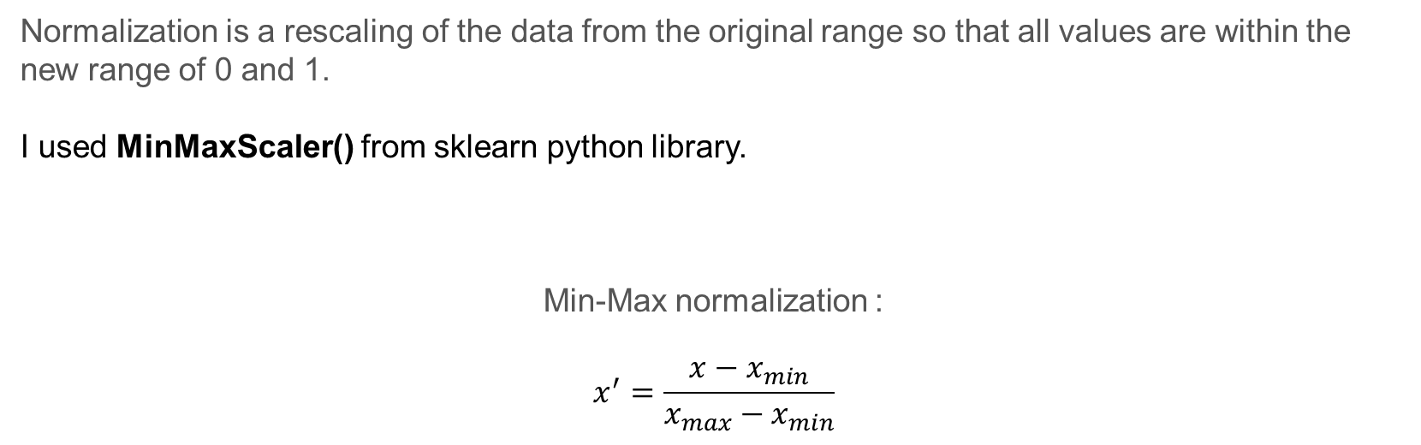
Data Normalization
Normalization is a rescaling of the data from the original range so that all values are within the new range of 0 and 1.
I used MinMaxScaler() from sklearn python library.
Min-Max normalization :
$$x^{′}=\frac{x−x_{min}}{x_{max}−x_{min}}$$

Slide 26
Drop Data Duplication
Applied 3 methods for Drop Data duplication:
1- Dropped duplicate columns
2- Dropped Columns with same value
3- Dropped Duplicate Rows

Slide 27
Dimension Reduction
PCA (Pearson, 1901) is used to decompose a multivariate dataset in a set of successive orthogonal components that explain a maximum amount of the variance.
Used PCA with 10 components on 10 extracted features.
Extracted pca components using iFeature Feature selection analysis

Slide 28
Random Forest classification

Slide 29
Hyper parameters:
# Number of trees in random forest n_estimators = [int(x) for x in np.linspace(start=100, stop=1000, num=10)] # Number of features to consider at every split max_features = ['auto', 'sqrt'] # Maximum number of levels in tree max_depth = [int(x) for x in np.linspace(10, 110, num=11)] max_depth.append(None) # Minimum number of samples required to split a node min_samples_split = [2, 5, 10] # Minimum number of samples required at each leaf node min_samples_leaf = [1, 2, 4] # Method of selecting samples for training each tree bootstrap = [True, False]
# On each iteration, the algorithm will choose a difference combination of the features. Altogether, # there are 2 * 12 * 2 * 3 * 3 * 10 = 4320 settings!

Slide 30
Train pipeline:
generate
100 Random
Random-Forest
Based on 4320 settings
Choose best estimator
PCA
Features
Train 100
Random RF
Based on
10 fold cv
(1000 train run)
Train RF
With the
best params
On whole 80% train data
Evaluate the best estimator
(20% independent test set)

Slide 31
Random Forest Overview Results
PCA Features:
Features | Best Mean Acc (cv=10) | Best Mean roc_auc (cv=10) | ACC (Independent test) | Precision (Independent test) | Recall (Independent test) | F1-score (Independent test)
APseudoAAC | 0.79 | 0.87 | 0.79 | 0.79 | 0.79 | 0.79
CKSAAP | 0.80 | 0.89 | 0.79 | 0.78 | 0.78 | 0.78
CTD | 0.76 | 0.84 | 0.74 | 0.74 | 0.74 | 0.74
DDE | 0.77 | 0.85 | 0.74 | 0.74 | 0.74 | 0.74
Geary_correlation | 0.71 | 0.77 | 0.71 | 0.71 | 0.72 | 0.71
KSCTriad | 0.71 | 0.84 | 0.77 | 0.76 | 0.76 | 0.76
Moran_correlation | 0.70 | 0.75 | 0.66 | 0.67 | 0.67 | 0.66
NMBroto_correlation | 0.71 | 0.78 | 0.66 | 0.66 | 0.66 | 0.66
PseudoAAC | 0.79 | 0.87 | 0.79 | 0.78 | 0.78 | 0.78
QSOrder | 0.79 | 0.86 | 0.81 | 0.81 | 0.81 | 0.81

Slide 32
Random Forest Overview Results
PCA Features:
Features | Best Mean Acc (cv=10) | Best Mean roc_auc (cv=10) | ACC (Independent test) | Precision (Independent test) | Recall (Independent test) | F1-score (Independent test)
APseudoAAC | 0.79 | 0.87 | 0.79 | 0.79 | 0.79 | 0.79
CKSAAP | 0.80 | 0.89 | 0.79 | 0.78 | 0.78 | 0.78
CTD | 0.76 | 0.84 | 0.74 | 0.74 | 0.74 | 0.74
DDE | 0.77 | 0.85 | 0.74 | 0.74 | 0.74 | 0.74
Geary_correlation | 0.71 | 0.77 | 0.71 | 0.71 | 0.72 | 0.71
KSCTriad | 0.71 | 0.84 | 0.77 | 0.76 | 0.76 | 0.76
Moran_correlation | 0.70 | 0.75 | 0.66 | 0.67 | 0.67 | 0.66
NMBroto_correlation | 0.71 | 0.78 | 0.66 | 0.66 | 0.66 | 0.66
PseudoAAC | 0.79 | 0.87 | 0.79 | 0.78 | 0.78 | 0.78
QSOrder | 0.79 | 0.86 | 0.81 | 0.81 | 0.81 | 0.81

Slide 33
Combined Top Features
Combined 7 top Features with acc > 0.74
APseudoAAC
CKSAAP
CTD
DDE
KSCTriad
PseudoAAC
QSOrder
Results Feature Vector: (940, 3063)

Slide 34
Drop Data Duplication
Applied 3 methods for Drop Data duplication:
1- Dropped duplicate columns
2- Dropped Columns with same value
3- Dropped Duplicate Rows
Results Feature Vector:
(940, 3063) reduced to => (940, 3014)

Slide 35
Feature Selection
Sequential Feature Selection (sfs)
Used Logistic Regression for classification
Runed 3 times to select different feature counts: ( 50, 100 and 200)
lr_model = LogisticRegression() # -------------------------------------------------- sfs = SFS(lr_model, k_features=(1, 200), forward=True, floating=False, scoring='accuracy', verbose=2, n_jobs=-1, cv=10) sfs = sfs.fit(x90_train, y90_train)

Slide 36
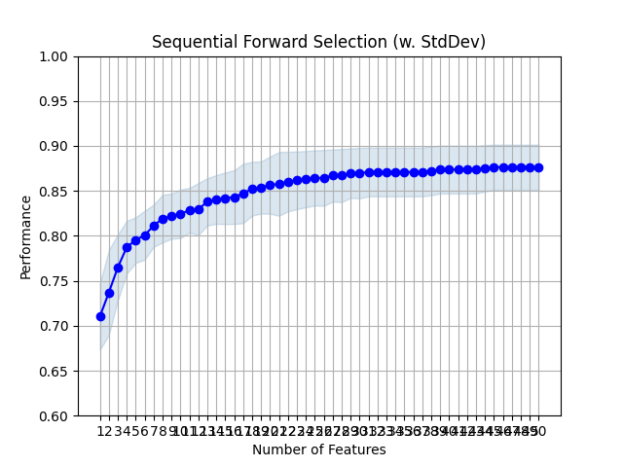
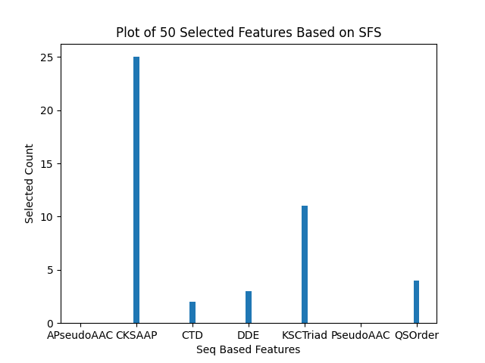
Results of 50 Selected Features By SFS

Slide 37
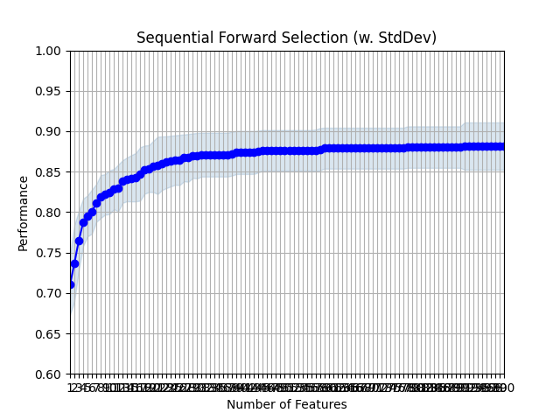
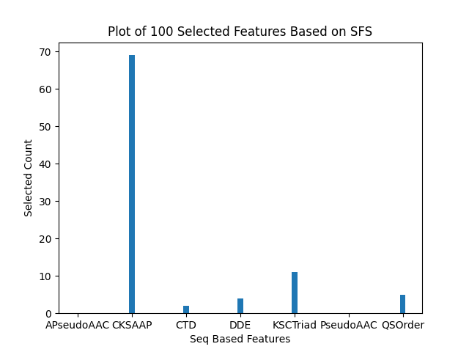
Results of 100 Selected Features By SFS

Slide 38
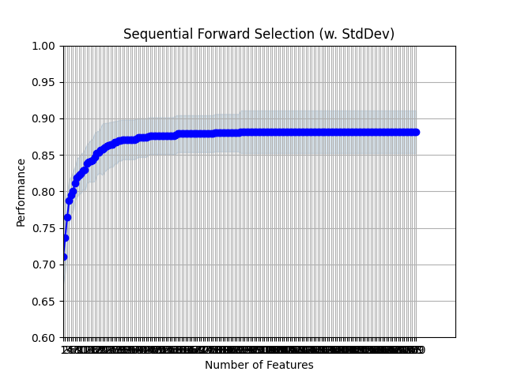

Results of 200 Selected Features By SFS

Slide 39
Random Forest Overview Results
Sequential Forward Selected Features:
Combined 7 features:
APseudoAAC
CKSAAP
CTD
DDE
KSCTriad
PseudoAAC
QSOrder
Features | Best Mean Acc (cv=10) | Best Mean roc_auc (cv=10) | ACC (Independent test) | Precision (Independent test) | Recall (Independent test) | F1-score (Independent test)
Selected 50 features | 0.82 | 0.89 | 0.73 | 0.73 | 0.73 | 0.73
Selected 100 features | 0.82 | 0.89 | 0.74 | 0.74 | 0.74 | 0.74
Selected 200 features | 0.82 | 0.89 | 0.74 | 0.74 | 0.74 | 0.74

Slide 40
Combine Features

Slide 41
Combined Top Features
Combined 7 top Features with acc > 0.73
APseudoAAC
CKSAAP
CTD
DDE
KSCTriad
PseudoAAC
QSOrder
Results Feature Vector: (940, 3063)

Slide 42
Combined Features Overview
Features | Features Length | Features Length (After Drop duplication Process) | Features | Features Length | Features Length (After Drop duplication Process)
QSOrder+CKSAAP | (940, 1649) | (940, 1649 ) | CKSAAP+DDE | (940, 2001) | (940, 2001)
QSOrder+CTD | (940, 322) | (940, 306) | CKSAAP+KSCTriad | (940, 2287) | (940, 2282)
QSOrder+DDE | (940, 449) | (940, 449) | CTD+APseudoAAC | (940, 302) | (940, 286)
QSOrder+KSCTriad | (940, 735) | (940, 730) | CTD+DDE | (940, 674) | (940, 658)
QSOrder+PseudoAAC | (940, 77) | (940, 77) | CTD+KSCTriad | (940, 960) | (940, 939)
QSOrder+APseudoAAC | (940, 77) | (940, 77) | DDE+APseudoAAC | (940, 429) | (940, 429)
PseudoAAC+APseudoAAC | (940, 57) | (940, 29) | DDE+KSCTriad | (940, 1087) | (940, 1082)
PseudoAAC+CKSAAP | (940, 1629) | (940, 1629) | APseudoAAC+KSCTriad | (940, 715) | (940, 710)
PseudoAAC+CTD | (940, 302) | (940, 286) | NMBroto+APseudoAAC | (940, 61) | (940, 61)
PseudoAAC+DDE | (940, 429) | (940, 429) | NMBroto+CKSAAP | (940, 1633) | (940, 1633)
PseudoAAC+KSCTriad | (940, 715) | (940, 710) | NMBroto+CTD | (940, 306) | (940, 290)
CKSAAP+APseudoAAC | (940, 1629) | (940, 1629) | NMBroto+DDE | (940, 433) | (940, 433)
CKSAAP+CTD | (940, 1874) | (940, 1858) | NMBroto+KSCTriad | (940, 719) | (940, 714)

Slide 43
Combined Features Overview
Features | Features Length | Features Length (After Drop duplication Process) | Features | Features Length | Features Length (After Drop duplication Process)
NMBroto+PseudoAAC | (940, 61) | (940, 61 )
NMBroto+QSOrder | (940, 81) | (940, 81)

Slide 44
Random Forest Overview Results - among 100 Random Random Forest
PCA Features(10 component):
Features | Best Acc (cv=10) | Best roc_auc (cv=10) | ACC (Independent test) | Precision (Independent test) | Recall (Independent test) | F1-score (Independent test)
QSOrder+CKSAAP | 0.82 | 0.89 | 0.80 | 0.80 | 0.80 | 0.80
QSOrder+CTD | 0.76 | 0.84 | 0.76 | 0.76 | 0.75 | 0.75
QSOrder+DDE | 0.83 | 0.89 | 0.80 | 0.79 | 0.80 | 0.79
QSOrder+KSCTriad | 0.79 | 0.86 | 0.77 | 0.77 | 0.76 | 0.76
QSOrder+PseudoAAC | 0.81 | 0.88 | 0.81 | 0.81 | 0.81 | 0.81
QSOrder+APseudoAAC | 0.81 | 0.88 | 0.81 | 0.81 | 0.81 | 0.81
PseudoAAC+APseudoAAC | 0.79 | 0.87 | 0.79 | 0.79 | 0.79 | 0.79
PseudoAAC+CKSAAP | 0.82 | 0.90 | 0.78 | 0.77 | 0.78 | 0.77
PseudoAAC+CTD | 0.75 | 0.84 | 0.76 | 0.75 | 0.75 | 0.75
PseudoAAC+DDE | 0.81 | 0.89 | 0.80 | 0.80 | 0.80 | 0.80

Slide 45
Random Forest Overview Results - among 100 Random Random Forest
PCA Features(10 component):
Features | Best Acc (cv=10) | Best roc_auc (cv=10) | ACC (Independent test) | Precision (Independent test) | Recall (Independent test) | F1-score (Independent test)
PseudoAAC+KSCTriad | 0.78 | 0.86 | 0.76 | 0.75 | 0.75 | 0.75
CKSAAP+APseudoAAC | 0.81 | 0.90 | 0.78 | 0.78 | 0.78 | 0.78
CKSAAP+CTD | 0.78 | 0.86 | 0.77 | 0.77 | 0.76 | 0.77
CKSAAP+DDE | 0.80 | 0.89 | 0.75 | 0.75 | 0.74 | 0.74
CKSAAP+KSCTriad | 0.80 | 0.88 | 0.78 | 0.77 | 0.77 | 0.77
CTD+APseudoAAC | 0.75 | 0.84 | 0.77 | 0.77 | 0.77 | 0.77
CTD+DDE | 0.76 | 0.85 | 0.78 | 0.78 | 0.78 | 0.78
CTD+KSCTriad | 0.78 | 0.86 | 0.80 | 0.80 | 0.79 | 0.80
DDE+APseudoAAC | 0.81 | 0.89 | 0.80 | 0.80 | 0.80 | 0.80
DDE+KSCTriad | 0.77 | 0.86 | 0.75 | 0.75 | 0.74 | 0.74
APseudoAAC+KSCTriad | 0.79 | 0.86 | 0.77 | 0.76 | 0.76 | 0.76

Slide 46
Random Forest Overview Results - among 100 Random Random Forest
PCA Features(10 component):
Features | Best Acc (cv=10) | Best roc_auc (cv=10) | ACC (Independent test) | Precision (Independent test) | Recall (Independent test) | F1-score (Independent test)
Combine all 7 features | 0.80 | 0.89 | 0.82 | 0.82 | 0.82 | 0.82

Slide 47
SVM classification

Slide 48
SVM Overview Results
PCA Features:
Features | Best Mean Acc (cv=10) | Best Mean roc_auc (cv=10) | ACC (Independent test) | Precision (Independent test) | Recall (Independent test) | F1-score (Independent test)
APseudoAAC | 0.79 |  | 0.77 | 0.77 | 0.76 | 0.76
CKSAAP | 0.79 |  | 0.78 | 0.77 | 0.77 | 0.77
CTD | 0.77 |  | 0.78 | 0.77 | 0.77 | 0.77
DDE | 0.77 |  | 0.73 | 0.73 | 0.73 | 0.73
Geary_correlation | 0.69 |  | 0.65 | 0.65 | 0.65 | 0.65
KSCTriad | 0.77 |  | 0.73 | 0.72 | 0.73 | 0.72
Moran_correlation | 0.69 |  | 0.64 | 0.63 | 0.63 | 0.63
NMBroto_correlation | 0.72 |  | 0.75 | 0.75 | 0.75 | 0.75
PseudoAAC | 0.80 |  | 0.77 | 0.76 | 0.76 | 0.76
QSOrder | 0.79 |  | 0.80 | 0.80 | 0.80 | 0.80

Slide 49
SVM Overview Results
PCA Features:
Features | Best Mean Acc (cv=10) | Best Mean roc_auc (cv=10) | ACC (Independent test) | Precision (Independent test) | Recall (Independent test) | F1-score (Independent test)
APseudoAAC | 0.79 |  | 0.77 | 0.77 | 0.76 | 0.76
CKSAAP | 0.79 |  | 0.78 | 0.77 | 0.77 | 0.77
CTD | 0.77 |  | 0.78 | 0.77 | 0.77 | 0.77
DDE | 0.77 |  | 0.73 | 0.73 | 0.73 | 0.73
Geary_correlation | 0.69 |  | 0.65 | 0.65 | 0.65 | 0.65
KSCTriad | 0.77 |  | 0.73 | 0.72 | 0.73 | 0.72
Moran_correlation | 0.69 |  | 0.64 | 0.63 | 0.63 | 0.63
NMBroto_correlation | 0.72 |  | 0.75 | 0.75 | 0.75 | 0.75
PseudoAAC | 0.80 |  | 0.77 | 0.76 | 0.76 | 0.76
QSOrder | 0.79 |  | 0.80 | 0.80 | 0.80 | 0.80

Slide 50
SVM Overview Results
PCA Features(10 component):
Features | Best Acc (cv=10) | Best roc_auc (cv=10) | ACC (Independent test) | Precision (Independent test) | Recall (Independent test) | F1-score (Independent test)
QSOrder+CKSAAP | 0.82 |  | 0.78 | 0.78 | 0.78 | 0.78
QSOrder+CTD | 0.77 |  | 0.77 | 0.77 | 0.76 | 0.77
QSOrder+DDE | 0.81 |  | 0.79 | 0.79 | 0.79 | 0.79
QSOrder+KSCTriad | 0.78 |  | 0.71 | 0.70 | 0.71 | 0.70
QSOrder+PseudoAAC | 0.81 |  | 0.79 | 0.79 | 0.79 | 0.79
QSOrder+APseudoAAC | 0.81 |  | 0.81 | 0.81 | 0.81 | 0.81
PseudoAAC+APseudoAAC | 0.79 |  | 0.77 | 0.77 | 0.76 | 0.76
PseudoAAC+CKSAAP | 0.81 |  | 0.80 | 0.80 | 0.80 | 0.80
PseudoAAC+CTD | 0.76 |  | 0.76 | 0.75 | 0.75 | 0.75
PseudoAAC+DDE | 0.80 |  | 0.73 | 0.73 | 0.74 | 0.73

Slide 51
SVM Overview Results
PCA Features(10 component):
Features | Best Acc (cv=10) | Best roc_auc (cv=10) | ACC (Independent test) | Precision (Independent test) | Recall (Independent test) | F1-score (Independent test)
PseudoAAC+KSCTriad | 0.78 |  | 0.71 | 0.71 | 0.71 | 0.71
CKSAAP+APseudoAAC | 0.81 |  | 0.80 | 0.79 | 0.79 | 0.79
CKSAAP+CTD | 0.78 |  | 0.75 | 0.75 | 0.74 | 0.74
CKSAAP+DDE | 0.80 |  | 0.78 | 0.78 | 0.76 | 0.77
CKSAAP+KSCTriad | 0.79 |  | 0.75 | 0.75 | 0.75 | 0.75
CTD+APseudoAAC | 0.77 |  | 0.76 | 0.75 | 0.75 | 0.75
CTD+DDE | 0.76 |  | 0.78 | 0.77 | 0.77 | 0.77
CTD+KSCTriad | 0.77 |  | 0.72 | 0.72 | 0.72 | 0.72
DDE+APseudoAAC | 0.81 |  | 0.75 | 0.75 | 0.74 | 0.74
DDE+KSCTriad | 0.78 |  | 0.74 | 0.73 | 0.74 | 0.74
APseudoAAC+KSCTriad | 0.78 |  | 0.74 | 0.73 | 0.74 | 0.73

Slide 52
SVM Overview Results – among 520 fits
PCA Features(10 component):
Features | Best Acc (cv=10) | Best roc_auc (cv=10) | ACC (Independent test) | Precision (Independent test) | Recall (Independent test) | F1-score (Independent test)
NMBroto+APseudoAAC | 0.82 |  | 0.78 | 0.77 | 0.77 | 0.77
NMBroto+CKSAAP | 0.80 |  | 0.79 | 0.79 | 0.78 | 0.78
NMBroto+CTD | 0.76 |  | 0.75 | 0.75 | 0.74 | 0.74
NMBroto+DDE | 0.80 |  | 0.77 | 0.76 | 0.75 | 0.76
NMBroto+KSCTriad | 0.78 |  | 0.73 | 0.73 | 0.73 | 0.73
NMBroto+PseudoAAC | 0.82 |  | 0.79 | 0.78 | 0.78 | 0.78
NMBroto+QSOrder | 0.80 |  | 0.79 | 0.79 | 0.79 | 0.79
Combine all 8 features | 0.79 |  | 0.76 | 0.76 | 0.76 | 0.76

Slide 53
Thank You
Zeynab MohammadTabar
Fall 2021

