Slide 1
AntiCancer Peptides Prediction via Machine Learning Approches
Supervisor: Dr. Abdolmaleki
Student: Zeynab Mohammadtabar
Fall 2021
15-December-2021
Bioinformatics | TMU

Slide 2
Outline:
01
Data Collection
02
Feature Extracted
03
Preprocessing
04
Dimension Reduction
05
Train-Test Split
1

Slide 3
Data Collection

Slide 4
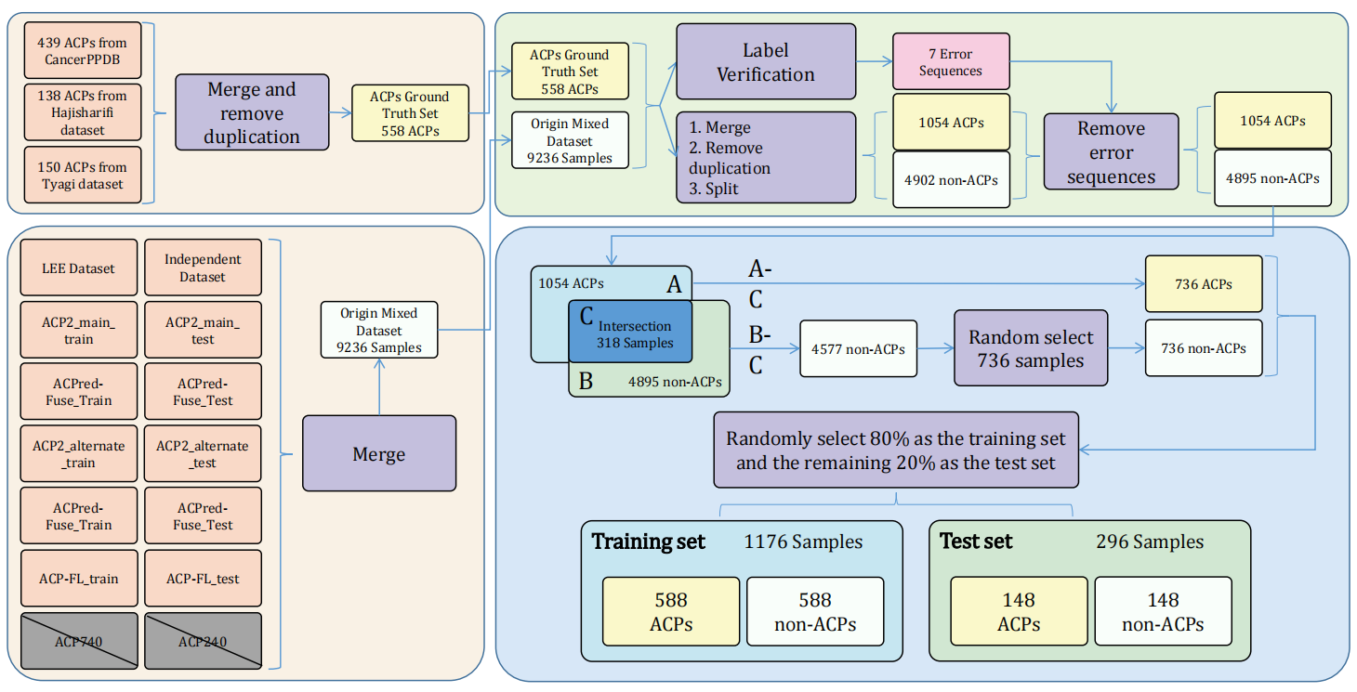
Data Collection
6
Learning embedding features based on multisense-scaled attention architecture to improve the predictive performance of anticancer peptides- Bioinformatics-2021

Slide 5
My Data Used for My Research
http://120.24.47.30:8080/ACPred_LAF/Download.html:
CD-Hit Range | #ACP | #non-ACP
Before cd-hit | 736 | 4577
100% | 736 | 4577
90% | 416 | 3909
80% | 303 | 3766
70% | 242 | 3608
60% | 181 | 3416
50% | 102 | 2674
40% | 40 | 1579

Slide 6
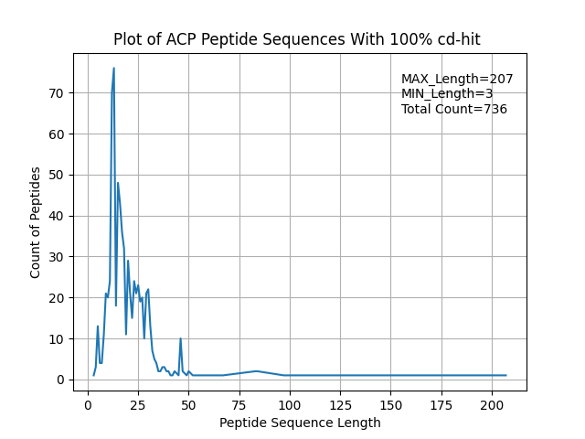
Data Views
Original data – positive data

Slide 7
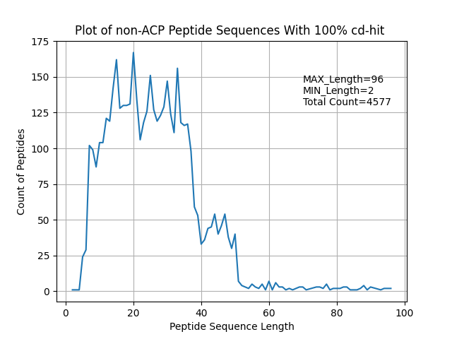
Data Views
Original data – negative data

Slide 8
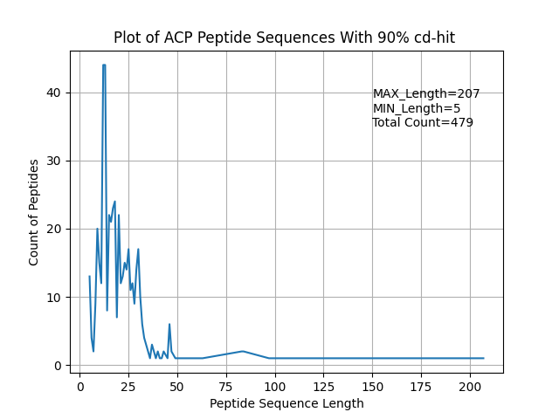
Data Views
Cdhit 90 – positive data

Slide 9
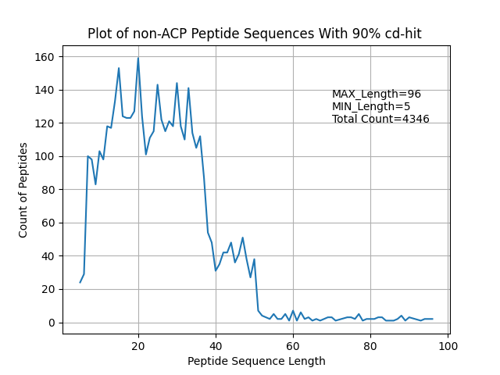
Data Views
Cdhit 90 – negative data

Slide 10
Filter Sequence Length

Slide 11
Filter Sequence Data by seq length
sequences with 50 < length < 5 deleted
CD-Hit Range | Before filter #ACP | After filter seqLength #ACP | Before filter #non-ACP | After seqLength #non-ACP
Original data | 736 |  | 4577
90% | 479 | 470 | 4346 | 4244

Slide 12
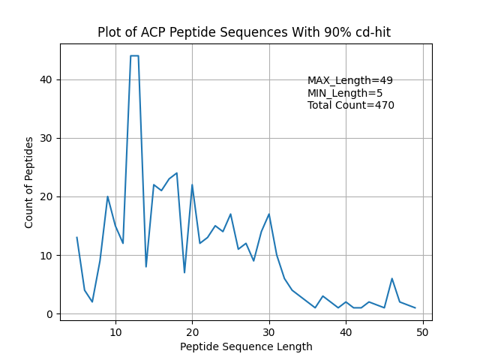
Data Views after seq length filter
Cdhit 90 – positive data

Slide 13
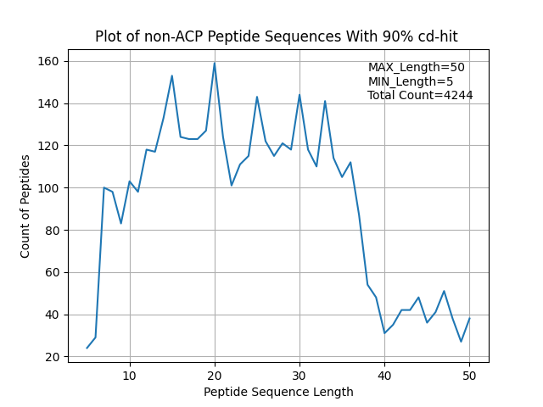
Data Views after seq length filter
Cdhit 90 – negative data

Slide 14
Select random negative data

Slide 15
Select random negative data as much as positive data
CD-Hit Range | After filter seqLength #ACP | After seqLength #non-ACP | After Select random #non-ACP
90% | 470 | 4244 | 470
Final result:
#ACPs = #non-ACPs

Slide 16
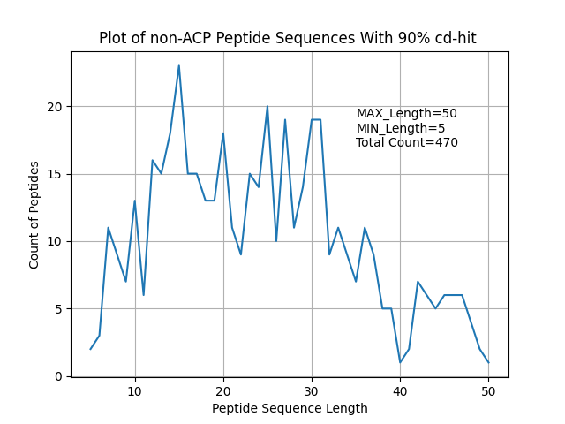
Data View of selected random negative data
Cdhit 90 – negative data

Slide 17
Train-Test data split

Slide 18
Train-Test data split
Split by 80 , 20
80% for train == == > 752
20% for test == == > 188
All random as #positive = #negative
CD-Hit Range | #ACP | #non-ACP
90% | Total: 470 Train: 376 Test: 94 | Total: 470 Train: 376 Test: 94

Slide 19
Feature Extraction

Slide 20
Sequence based features:
amino acid composition (AAC) | amino acid index (AAIF) | auto covariance of the average chemical shift(acACS) | local alignment kernel (LAK)
dipeptide composition (DPC) | binary profile (NC5) | amphiphilic pseudo amino acid composition(Am-PseAAC) | Physicochemical properties(PCP)
composition-transition-distribution (CTD) | conjoint triad (CTF) | composite protein sequence representation(CPDR) | Pseudo amino acid composition (PseACC)
quasi-sequence-order (QSO) | atomic composition(ATC) | G-Gap dipeptide composition (g-gap DPC) | Pseudo G-Gap dipeptide composition(Pse-g-gap DPC)
protein relatedness measure(PRM) | reduce amino acid composition(RACC) | split amino acid composition(SAAC) | Geary autocorrelation descriptor
Composition on terminal region | N5C5 | k-space | position-specifc scoring matrix (PSSM)
k-spaced amino acid group pairs (CKSAAGP)
7

Slide 21
Sequence based features:
amino acid composition (AAC) | amino acid index (AAIF) | auto covariance of the average chemical shift(acACS) | local alignment kernel (LAK)
dipeptide composition (DPC) | binary profile (NC5) | amphiphilic pseudo amino acid composition(Am-PseAAC) | Physicochemical properties(PCP)
composition-transition-distribution (CTD) | conjoint triad (CTF) | composite protein sequence representation(CPDR) | Pseudo amino acid composition (PseACC)
quasi-sequence-order (QSO) | atomic composition(ATC) | G-Gap dipeptide composition (g-gap DPC) | Pseudo G-Gap dipeptide composition(Pse-g-gap DPC)
protein relatedness measure(PRM) | reduce amino acid composition(RACC) | split amino acid composition(SAAC) | Geary autocorrelation descriptor
Composition on terminal region | N5C5 | k-space | position-specifc scoring matrix (PSSM)
k-spaced amino acid group pairs (CKSAAGP)
7

Slide 22
Sequence based features:
All the features extracted by iFeature toolkit.
Decided to extract 10 following features.
amphiphilic pseudo amino acid composition(Am-PseAAC) | Pseudo amino acid composition (PseACC) | G-Gap dipeptide composition (g-gap DPC) | composition-transition-distribution (CTD)
k-spaced Conjoint Triad (KSCTriad) | quasi-sequence-order (QSOrder) | Geary_autocorrelation | Moran_autocorrelation
NMBroto_autocorrelation | Dipeptide Deviation from Expected Mean (DDE)
iFeature: a Python package and web server for features extraction and selection from protein and peptide sequences – Bioinformatics - 2018

Slide 23
Data Normalization
Normalization is a rescaling of the data from the original range so that all values are within the new range of 0 and 1.
I used MinMaxScaler() from sklearn python library.
Min-Max normalization :
y = (x – min) / (max – min)

Slide 24
Drop Data Duplication
Applied 3 methods for Drop Data duplication:
1- Dropped duplicate columns
2- Dropped Columns with same value
3- Dropped Duplicate Rows

Slide 25
Dimension Reduction
PCA (Pearson, 1901) is used to decompose a multivariate dataset in a set of successive orthogonal components that explain a maximum amount of the variance.
Used PCA with 10 components on 10 extracted features.
Extracted pca components using iFeature Feature selection analysis

Slide 26
Random Forest classification

Slide 27
Hyper parameters:
# Number of trees in random forest n_estimators = [int(x) for x in np.linspace(start=100, stop=1000, num=10)] # Number of features to consider at every split max_features = ['auto', 'sqrt'] # Maximum number of levels in tree max_depth = [int(x) for x in np.linspace(10, 110, num=11)] max_depth.append(None) # Minimum number of samples required to split a node min_samples_split = [2, 5, 10] # Minimum number of samples required at each leaf node min_samples_leaf = [1, 2, 4] # Method of selecting samples for training each tree bootstrap = [True, False]
# On each iteration, the algorithm will choose a difference combination of the features. Altogether, # there are 2 * 12 * 2 * 3 * 3 * 10 = 4320 settings!

Slide 28
Train pipeline:
generate
100 Random
Random-Forest
Based on 4320 settings
Choose best estimator
PCA
Features
Train 100
Random RF
Based on
10 fold cv
(1000 train run)
Train RF
With the
best params
On whole 80% train data
Evaluate the best estimator
(20% independent test set)

Slide 29
Random Forest Overview Results
PCA Features:
Features | Best Mean Acc (cv=10) | Best Mean roc_auc (cv=10) | ACC (Independent test) | Precision (Independent test) | Recall (Independent test) | F1-score (Independent test)
APseudoAAC | 0.79 | 0.87 | 0.79 | 0.79 | 0.79 | 0.79
CKSAAP | 0.80 | 0.89 | 0.79 | 0.78 | 0.78 | 0.78
CTD | 0.76 | 0.84 | 0.74 | 0.74 | 0.74 | 0.74
DDE | 0.77 | 0.85 | 0.74 | 0.74 | 0.74 | 0.74
Geary_correlation | 0.71 | 0.77 | 0.71 | 0.71 | 0.72 | 0.71
KSCTriad | 0.71 | 0.84 | 0.77 | 0.76 | 0.76 | 0.76
Moran_correlation | 0.70 | 0.75 | 0.66 | 0.67 | 0.67 | 0.66
NMBroto_correlation | 0.71 | 0.78 | 0.66 | 0.66 | 0.66 | 0.66
PseudoAAC | 0.79 | 0.87 | 0.79 | 0.78 | 0.78 | 0.78
QSOrder | 0.79 | 0.86 | 0.81 | 0.81 | 0.81 | 0.81

Slide 30
Random Forest Overview Results
PCA Features:
Features | Best Mean Acc (cv=10) | Best Mean roc_auc (cv=10) | ACC (Independent test) | Precision (Independent test) | Recall (Independent test) | F1-score (Independent test)
APseudoAAC | 0.79 | 0.87 | 0.79 | 0.79 | 0.79 | 0.79
CKSAAP | 0.80 | 0.89 | 0.79 | 0.78 | 0.78 | 0.78
CTD | 0.76 | 0.84 | 0.74 | 0.74 | 0.74 | 0.74
DDE | 0.77 | 0.85 | 0.74 | 0.74 | 0.74 | 0.74
Geary_correlation | 0.71 | 0.77 | 0.71 | 0.71 | 0.72 | 0.71
KSCTriad | 0.71 | 0.84 | 0.77 | 0.76 | 0.76 | 0.76
Moran_correlation | 0.70 | 0.75 | 0.66 | 0.67 | 0.67 | 0.66
NMBroto_correlation | 0.71 | 0.78 | 0.66 | 0.66 | 0.66 | 0.66
PseudoAAC | 0.79 | 0.87 | 0.79 | 0.78 | 0.78 | 0.78
QSOrder | 0.79 | 0.86 | 0.81 | 0.81 | 0.81 | 0.81

Slide 31
Combined Top Features
Combined 7 top Features with acc > 0.74
APseudoAAC
CKSAAP
CTD
DDE
KSCTriad
PseudoAAC
QSOrder
Results Feature Vector: (940, 3063)

Slide 32
Drop Data Duplication
Applied 3 methods for Drop Data duplication:
1- Dropped duplicate columns
2- Dropped Columns with same value
3- Dropped Duplicate Rows
Results Feature Vector:
(940, 3063) reduced to => (940, 3014)

Slide 33
Feature Selection
Sequential Feature Selection (sfs)
Used Logistic Regression for classification
Runed 3 times to select different feature counts: ( 50, 100 and 200)
lr_model = LogisticRegression() # -------------------------------------------------- sfs = SFS(lr_model, k_features=(1, 200), forward=True, floating=False, scoring='accuracy', verbose=2, n_jobs=-1, cv=10) sfs = sfs.fit(x90_train, y90_train)

Slide 34
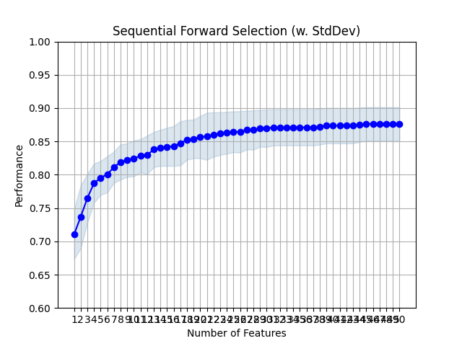
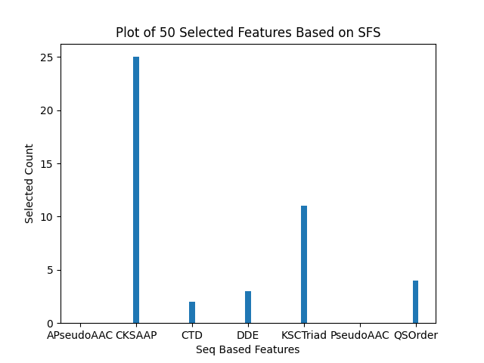
Results of 50 Selected Features By SFS

Slide 35
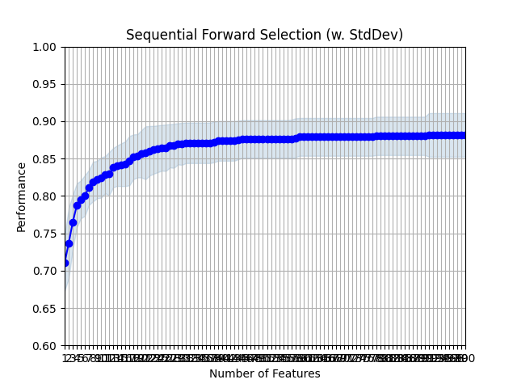
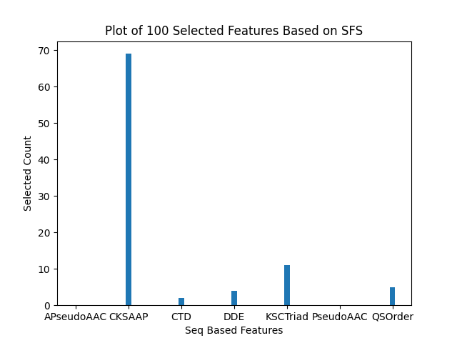
Results of 100 Selected Features By SFS

Slide 36
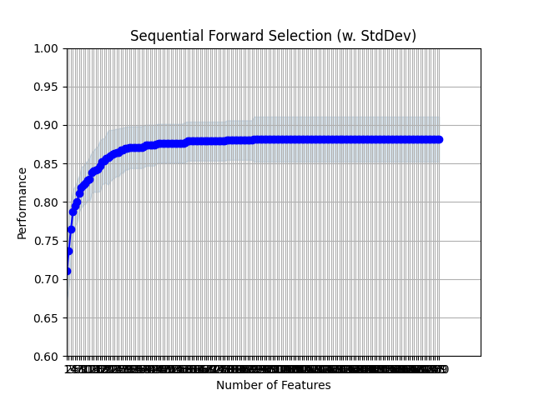

Results of 200 Selected Features By SFS

Slide 37
Random Forest Overview Results
Sequential Forward Selected Features:
Combined 7 features:
APseudoAAC
CKSAAP
CTD
DDE
KSCTriad
PseudoAAC
QSOrder
Features | Best Mean Acc (cv=10) | Best Mean roc_auc (cv=10) | ACC (Independent test) | Precision (Independent test) | Recall (Independent test) | F1-score (Independent test)
Selected 50 features | 0.82 | 0.89 | 0.73 | 0.73 | 0.73 | 0.73
Selected 100 features | 0.82 | 0.89 | 0.74 | 0.74 | 0.74 | 0.74
Selected 200 features | 0.82 | 0.89 | 0.74 | 0.74 | 0.74 | 0.74

Slide 38
Combine Features

Slide 39
Combined Top Features
Combined 7 top Features with acc > 0.74
APseudoAAC
CKSAAP
CTD
DDE
KSCTriad
PseudoAAC
QSOrder
Results Feature Vector: (940, 3063)

Slide 40
Combined Features Overview
Features | Features Length | Features Length (After Drop duplication Process) | Features | Features Length | Features Length (After Drop duplication Process)
QSOrder+CKSAAP | (940, 1649) | (940, 1649 ) | CKSAAP+DDE | (940, 2001) | (940, 2001)
QSOrder+CTD | (940, 322) | (940, 306) | CKSAAP+KSCTriad | (940, 2287) | (940, 2282)
QSOrder+DDE | (940, 449) | (940, 449) | CTD+APseudoAAC | (940, 302) | (940, 286)
QSOrder+KSCTriad | (940, 735) | (940, 730) | CTD+DDE | (940, 674) | (940, 658)
QSOrder+PseudoAAC | (940, 77) | (940, 77) | CTD+KSCTriad | (940, 960) | (940, 939)
QSOrder+APseudoAAC | (940, 77) | (940, 77) | DDE+APseudoAAC | (940, 429) | (940, 429)
PseudoAAC+APseudoAAC | (940, 57) | (940, 29) | DDE+KSCTriad | (940, 1087) | (940, 1082)
PseudoAAC+CKSAAP | (940, 1629) | (940, 1629) | APseudoAAC+KSCTriad | (940, 715) | (940, 710)
PseudoAAC+CTD | (940, 302) | (940, 286) | NMBroto+APseudoAAC | (940, 61) | (940, 61)
PseudoAAC+DDE | (940, 429) | (940, 429) | NMBroto+CKSAAP | (940, 1633) | (940, 1633)
PseudoAAC+KSCTriad | (940, 715) | (940, 710) | NMBroto+CTD | (940, 306) | (940, 290)
CKSAAP+APseudoAAC | (940, 1629) | (940, 1629) | NMBroto+DDE | (940, 433) | (940, 433)
CKSAAP+CTD | (940, 1874) | (940, 1858) | NMBroto+KSCTriad | (940, 719) | (940, 714)

Slide 41
Combined Features Overview
Features | Features Length | Features Length (After Drop duplication Process) | Features | Features Length | Features Length (After Drop duplication Process)
NMBroto+PseudoAAC | (940, 61) | (940, 61 )
NMBroto+QSOrder | (940, 81) | (940, 81)

Slide 42
Random Forest Overview Results - among 100 Random Random Forest
PCA Features(10 component):
Features | Best Acc (cv=10) | Best roc_auc (cv=10) | ACC (Independent test) | Precision (Independent test) | Recall (Independent test) | F1-score (Independent test)
QSOrder+CKSAAP | 0.82 | 0.89 | 0.80 | 0.80 | 0.80 | 0.80
QSOrder+CTD | 0.76 | 0.84 | 0.76 | 0.76 | 0.75 | 0.75
QSOrder+DDE | 0.83 | 0.89 | 0.80 | 0.79 | 0.80 | 0.79
QSOrder+KSCTriad | 0.79 | 0.86 | 0.77 | 0.77 | 0.76 | 0.77
QSOrder+PseudoAAC | 0.81 | 0.88 | 0.81 | 0.81 | 0.81 | 0.81
QSOrder+APseudoAAC | 0.81 | 0.88 | 0.81 | 0.81 | 0.81 | 0.81
PseudoAAC+APseudoAAC | 0.79 | 0.87 | 0.79 | 0.79 | 0.79 | 0.79
PseudoAAC+CKSAAP | 0.82 | 0.90 | 0.78 | 0.77 | 0.78 | 0.77
PseudoAAC+CTD | 0.75 | 0.84 | 0.76 | 0.75 | 0.75 | 0.75
PseudoAAC+DDE | 0.81 | 0.89 | 0.80 | 0.80 | 0.80 | 0.80

Slide 43
Random Forest Overview Results - among 100 Random Random Forest
PCA Features(10 component):
Features | Best Acc (cv=10) | Best roc_auc (cv=10) | ACC (Independent test) | Precision (Independent test) | Recall (Independent test) | F1-score (Independent test)
PseudoAAC+KSCTriad | 0.78 | 0.86 | 0.76 | 0.75 | 0.75 | 0.75
CKSAAP+APseudoAAC | 0.81 | 0.90 | 0.78 | 0.78 | 0.78 | 0.78
CKSAAP+CTD | 0.78 | 0.86 | 0.77 | 0.77 | 0.76 | 0.77
CKSAAP+DDE | 0.80 | 0.89 | 0.75 | 0.75 | 0.74 | 0.74
CKSAAP+KSCTriad | 0.80 | 0.88 | 0.78 | 0.77 | 0.77 | 0.77
CTD+APseudoAAC | 0.75 | 0.84 | 0.77 | 0.77 | 0.77 | 0.77
CTD+DDE | 0.76 | 0.85 | 0.78 | 0.78 | 0.78 | 0.78
CTD+KSCTriad | 0.78 | 0.86 | 0.80 | 0.80 | 0.79 | 0.80
DDE+APseudoAAC | 0.81 | 0.89 | 0.80 | 0.80 | 0.80 | 0.80
DDE+KSCTriad | 0.77 | 0.86 | 0.75 | 0.75 | 0.74 | 0.74
APseudoAAC+KSCTriad | 0.79 | 0.86 | 0.77 | 0.76 | 0.76 | 0.76

Slide 44
SVM classification

Slide 45
SVM Overview Results
PCA Features:
Features | Best Mean Acc (cv=10) | Best Mean roc_auc (cv=10) | ACC (Independent test) | Precision (Independent test) | Recall (Independent test) | F1-score (Independent test)
APseudoAAC | 0.79 |  | 0.77 | 0.77 | 0.76 | 0.76
CKSAAP | 0.79 |  | 0.78 | 0.77 | 0.77 | 0.77
CTD | 0.77 |  | 0.78 | 0.77 | 0.77 | 0.77
DDE | 0.77 |  | 0.73 | 0.73 | 0.73 | 0.73
Geary_correlation | 0.69 |  | 0.65 | 0.65 | 0.65 | 0.65
KSCTriad | 0.77 |  | 0.73 | 0.72 | 0.73 | 0.72
Moran_correlation | 0.69 |  | 0.64 | 0.63 | 0.63 | 0.63
NMBroto_correlation | 0.72 |  | 0.75 | 0.75 | 0.75 | 0.75
PseudoAAC | 0.80 |  | 0.77 | 0.76 | 0.76 | 0.76
QSOrder | 0.79 |  | 0.80 | 0.80 | 0.80 | 0.80

Slide 46
SVM Overview Results
PCA Features:
Features | Best Mean Acc (cv=10) | Best Mean roc_auc (cv=10) | ACC (Independent test) | Precision (Independent test) | Recall (Independent test) | F1-score (Independent test)
APseudoAAC | 0.79 |  | 0.77 | 0.77 | 0.76 | 0.76
CKSAAP | 0.79 |  | 0.78 | 0.77 | 0.77 | 0.77
CTD | 0.77 |  | 0.78 | 0.77 | 0.77 | 0.77
DDE | 0.77 |  | 0.73 | 0.73 | 0.73 | 0.73
Geary_correlation | 0.69 |  | 0.65 | 0.65 | 0.65 | 0.65
KSCTriad | 0.77 |  | 0.73 | 0.72 | 0.73 | 0.72
Moran_correlation | 0.69 |  | 0.64 | 0.63 | 0.63 | 0.63
NMBroto_correlation | 0.72 |  | 0.75 | 0.75 | 0.75 | 0.75
PseudoAAC | 0.80 |  | 0.77 | 0.76 | 0.76 | 0.76
QSOrder | 0.79 |  | 0.80 | 0.80 | 0.80 | 0.80

Slide 47
SVM Overview Results
PCA Features(10 component):
Features | Best Acc (cv=10) | Best roc_auc (cv=10) | ACC (Independent test) | Precision (Independent test) | Recall (Independent test) | F1-score (Independent test)
QSOrder+CKSAAP | 0.82 |  | 0.78 | 0.78 | 0.78 | 0.78
QSOrder+CTD | 0.77 |  | 0.77 | 0.77 | 0.76 | 0.77
QSOrder+DDE | 0.81 |  | 0.79 | 0.79 | 0.79 | 0.79
QSOrder+KSCTriad | 0.78 |  | 0.71 | 0.70 | 0.71 | 0.70
QSOrder+PseudoAAC | 0.81 |  | 0.79 | 0.79 | 0.79 | 0.79
QSOrder+APseudoAAC | 0.81 |  | 0.81 | 0.81 | 0.81 | 0.81
PseudoAAC+APseudoAAC | 0.79 |  | 0.77 | 0.77 | 0.76 | 0.76
PseudoAAC+CKSAAP | 0.81 |  | 0.80 | 0.80 | 0.80 | 0.80
PseudoAAC+CTD | 0.76 |  | 0.76 | 0.75 | 0.75 | 0.75
PseudoAAC+DDE | 0.80 |  | 0.73 | 0.73 | 0.74 | 0.73

Slide 48
SVM Overview Results
PCA Features(10 component):
Features | Best Acc (cv=10) | Best roc_auc (cv=10) | ACC (Independent test) | Precision (Independent test) | Recall (Independent test) | F1-score (Independent test)
PseudoAAC+KSCTriad | 0.78 |  | 0.71 | 0.71 | 0.71 | 0.71
CKSAAP+APseudoAAC | 0.81 |  | 0.80 | 0.79 | 0.79 | 0.79
CKSAAP+CTD | 0.78 |  | 0.75 | 0.75 | 0.74 | 0.74
CKSAAP+DDE | 0.80 |  | 0.78 | 0.78 | 0.76 | 0.77
CKSAAP+KSCTriad | 0.79 |  | 0.75 | 0.75 | 0.75 | 0.75
CTD+APseudoAAC | 0.77 |  | 0.76 | 0.75 | 0.75 | 0.75
CTD+DDE | 0.76 |  | 0.78 | 0.77 | 0.77 | 0.77
CTD+KSCTriad | 0.77 |  | 0.72 | 0.72 | 0.72 | 0.72
DDE+APseudoAAC | 0.81 |  | 0.75 | 0.75 | 0.74 | 0.74
DDE+KSCTriad | 0.78 |  | 0.74 | 0.73 | 0.74 | 0.74
APseudoAAC+KSCTriad | 0.78 |  | 0.74 | 0.73 | 0.74 | 0.73

Slide 49
SVM Overview Results – among 520 fits
PCA Features(10 component):
Features | Best Acc (cv=10) | Best roc_auc (cv=10) | ACC (Independent test) | Precision (Independent test) | Recall (Independent test) | F1-score (Independent test)
NMBroto+APseudoAAC | 0.82 |  | 0.78 | 0.77 | 0.77 | 0.77
NMBroto+CKSAAP | 0.80 |  | 0.79 | 0.79 | 0.78 | 0.78
NMBroto+CTD | 0.76 |  | 0.75 | 0.75 | 0.74 | 0.74
NMBroto+DDE | 0.80 |  | 0.77 | 0.76 | 0.75 | 0.76
NMBroto+KSCTriad | 0.78 |  | 0.73 | 0.73 | 0.73 | 0.73
NMBroto+PseudoAAC | 0.82 |  | 0.79 | 0.78 | 0.78 | 0.78
NMBroto+QSOrder | 0.80 |  | 0.79 | 0.79 | 0.79 | 0.79

Slide 50
Thank You
Zeynab MohammadTabar
Fall 2021

