Slide 1

Prediction of Anticancer Peptides
Using Machine Learning
Department of Biophysics
Faculty of Bioinformatics
By:
Mohammadtabar Zeynab
Supervisor:
Dr. Abdolmaleki Parviz
January 2022

Slide 2
Outline
01
Introduction
02
Materials and Methods
03
Results
04
Suggestions
1

Slide 3
Introduction
2

Slide 4
ACPs Prediction Importance
Cancer remains the major cause of death, killing millions of people every year, and it is caused by the growth and spreading of abnormal cells without control.
In 2018, it was anticipated that about 18 million new cancer cases and over 9 million deaths could occur due to cancer, and these deaths could reach well over 13 million by 2030 [1].
For cancer treatment, conventional chemotherapy is currently a common way.
It usually has an adverse effect on normal cells, resulting in that the treatment effect is not that good.
The traditional chemotherapy approach is very expensive.
New treatment options are therefore highly demanded for relieving symptoms and ultimately eradicating the disease.
During the last few decades, the role of peptides as anti-cancer therapeutic agents has been promising, which is apparent from various strategies available to address the advancement of tumor growth and spreading of the disease.
These anti-cancer peptides (ACPs) have shown the potential to inactivate various types of cancer cells [2].
Bray, F., et al., Global cancer statistics 2018: GLOBOCAN estimates of incidence and mortality worldwide for 36 cancers in 185 countries. CA: a cancer journal for clinicians, 2018. 68(6): p. 394-424.
Wijdeven, R.H., et al., Old drugs, novel ways out: Drug resistance toward cytotoxic chemotherapeutics. Drug Resistance Updates, 2016. 28: p. 65-81
3

Slide 5
Why ACPs?
ACPs are naturally occurring biologics and hence are safer than
synthetic drugs [4]
Because ACPs can interact with the anionic cell membrane components of cancer cells, cancer cells can be killed selectively by the ACPs without impairing the normal cells [2,3]
Traditional treatment methods focus on killing cancer cells, but at the same time normal cells are also killed and there are high costs involved [2,3]
Accurate prediction of ACPs is of great importance for the exploration of their mechanism of action
and for the development of therapeutic ACPs [5].
It is quite expensive and time-consuming to identify anticancer peptides using experimental methods [1].
Thundimadathil, J., Cancer treatment using peptides: current therapies and future prospects. Journal of amino acids, 2012. 2012.
Mader, J.S. and D.W. Hoskin, Cationic antimicrobial peptides as novel cytotoxic agents for cancer treatment. Expert opinion on investigational drugs, 2006. 15(8): p. 933-946.
Hoskin, D.W. and A. Ramamoorthy, Studies on anticancer activities of antimicrobial peptides. Biochimica et Biophysica Acta (BBA)-Biomembranes, 2008. 1778(2): p. 357-375.
Chen, W., et al., iACP: a sequence-based tool for identifying anticancer peptides. Oncotarget, 2016. 7(13): p. 16895.
Schaduangrat, N., et al., ACPred: a computational tool for the prediction and analysis of anticancer peptides. Molecules, 2019. 24(10): p. 1973.
4

Slide 6
Biological Properties of Anticancer Peptides
Cationic, Amphipathic antimicrobial peptides
High tissue penetration
Natural Organisms that are Sources of Anticancer Peptides
Low occurrence of drug resistance
Up to 50 amino acids long
A net positive charge
ACPs can be divided into four categories:
α-helical, β-pleated sheets, random coil and cyclic
1. Xie, M., D. Liu, and Y. Yang, Anti-cancer peptides: classification, mechanism of action, reconstruction and modification. Open Biology, 2020. 10(7): p.200004.
5

Slide 7
Identifying Anticancer Peptides in Lab Experiments
Finding anticancer peptides by experiments could be both time-consuming and labor-intensive [1].
To deal with this problem, computational identification before wet-lab experiments is necessary. Machine-learning-based methods could be of great help to classify and predict these special peptides!
1. Wan, Y., Z. Wang, and T.-Y. Lee, Incorporating support vector machine with sequential minimal optimization to identify anticancer peptides. BMC bioinformatics, 2021. 22(1): p. 1-16.
5

Slide 8
Earlier Computational Researches in Identification of ACPs
Many computational efforts have been done. Notably, most of them aim to extract features from protein primary sequences only.
in silico
Genome Based Methods
Domain Based
Based on Seq Structure of Peptides
First, Second Structures
همسایگی ژن
Gene-related information
Drug Discovery
QSAR
5

Slide 9
GOAL of the Study
Finding a modern drug/treatment to cancer with low toxicity on normal cells and low drug resistance
Reduce financial and time costs of we-lab experiments to identify anticancer peptides
All by using computational methods, Machine Learning
5

Slide 10
Materials and Methods
2

Slide 11
Study Process
Data Collection
(Finding Experimental ACP and
non-ACP Data)
Filter Peptide Seq Length to
5-50 Amino Acid
Select non-ACP data equal to ACP data
Train-Test data split
(80-20)
Feature Extraction
(10 Features Based on First Peptide Structures Extracted)
Normalized Data
(Min-Max Scaler)
Preprocess Data
Dimension Reduction and Forward Feature Selection
Use CD-HIT 90 %
On Data
Hyper Parameter Tuning For RF and SVM
Choose The Best Params
(Based on 10Fold-CV)
Train the Best Model on Whole Train data
Evaluate Model on
Test Data
Results
6

Slide 12
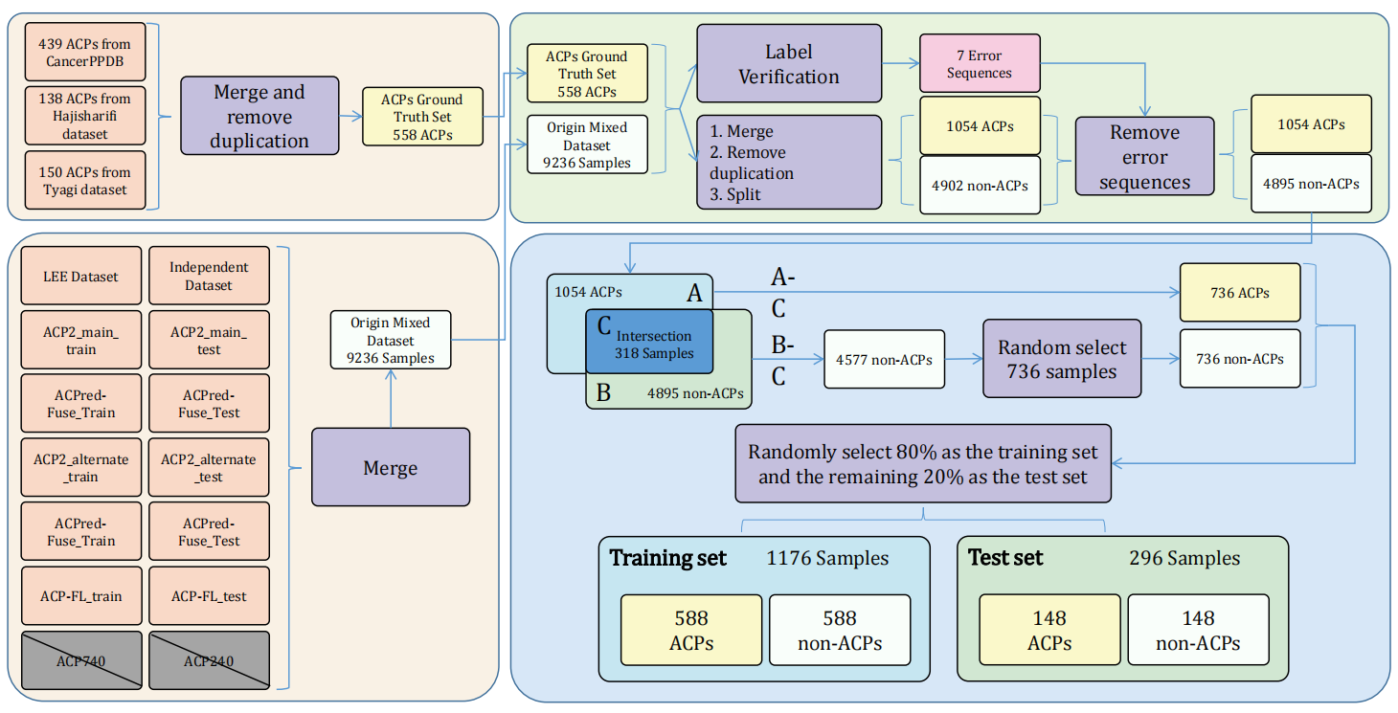
Data Collection
6
He, W., et al., Learning embedding features based on multisense-scaled attention architecture to improve the predictive performance of anticancer peptides. Bioinformatics, 2021. 37(24): p. 4684-4693.

Slide 13
Data Used For My Research
Because the sequence similarity in the dataset has a certain impact on the performance evaluation of the classifier, we used CD-HIT [1].
https://github.com/TearsWaiting/ACPred-LAF : [2]
CD-Hit Range | #ACP | #non-ACP
Before cd-hit | 736 | 4577
90% | 479 | 4346
80% | 350 | 4184
70% | 242 | 3608
60% | 181 | 3416
50% | 102 | 2674
40% | 40 | 1579
1.Huang, Y., et al., CD-HIT Suite: a web server for clustering and comparing biological sequences. Bioinformatics, 2010. 26(5): p. 680-682.
2.He, W., et al., Learning embedding features based on multisense-scaled attention architecture to improve the predictive performance of anticancer peptides. Bioinformatics, 2021. 37(24): p. 4684-4693.

Slide 14
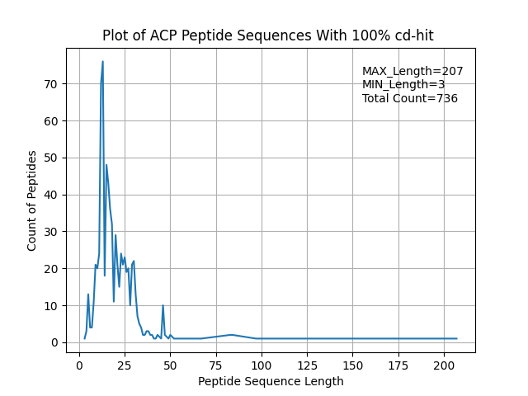
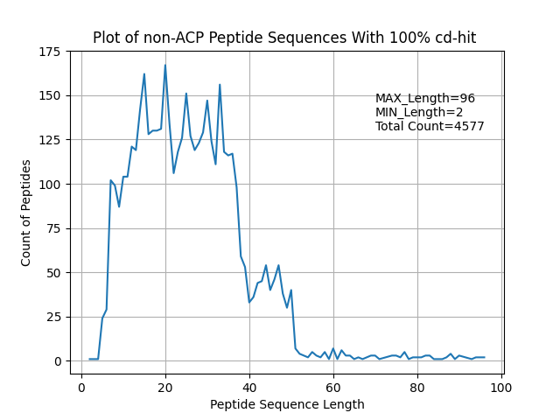
Data Views
Original data – positive data
Original data – negative data

Slide 15
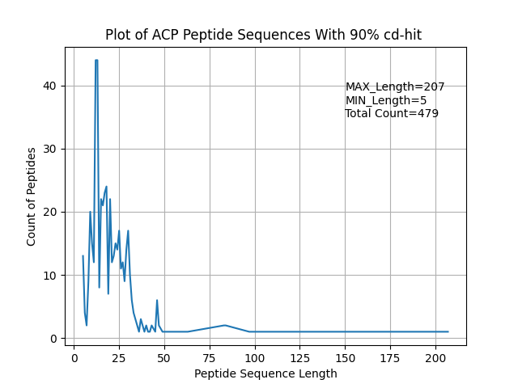
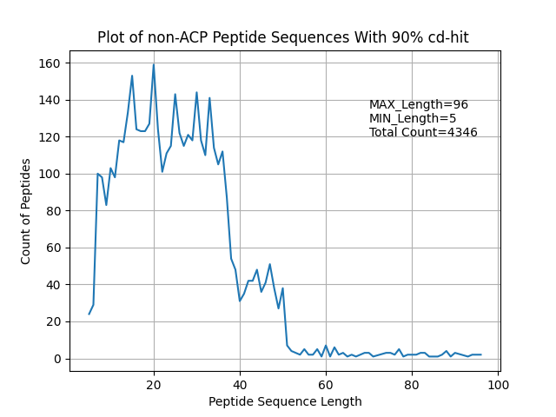
Data Views
CD-HIT90 – positive data
CD-HIT90 – negative data

Slide 16
Filter Sequence Data by Seq Length
Sequences with 50 < length < 5 deleted
CD-Hit Range | Before filter #ACP | After Filter Seq Length #ACP | Before Filter #non-ACP | After Seq Length #non-ACP
Original data | 736 |  | 4577
90% | 479 | 470 | 4346 | 4244

Slide 17
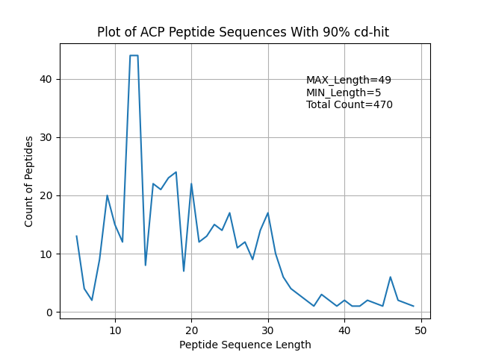
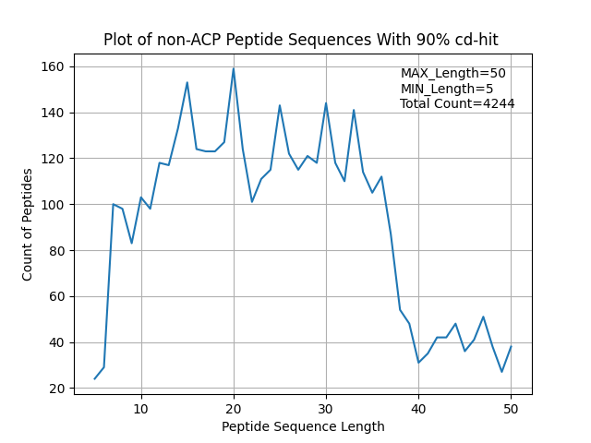
Data Views After Seq Length Filter
CD-Hit90 – positive data
CD-Hit90 – negative data

Slide 18
Select Negative Data
Select negative data randomly as much as positive data
CD-Hit Range | After filter Seq Length #ACP | After Seq Length #non-ACP | After Select random #non-ACP
90% | 470 | 4244 | 470
Final result:
#ACPs = #non-ACPs

Slide 19
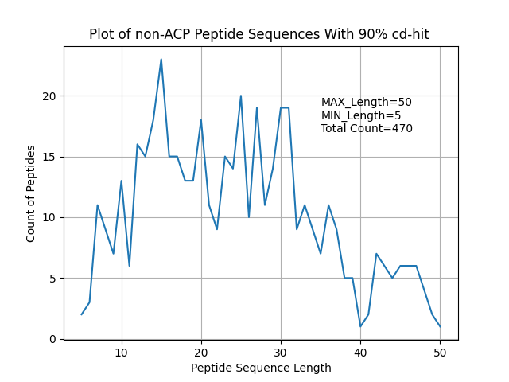
Data View Of Selected Random Negative Data
CD-Hit90 – negative data

Slide 20
Train-Test Split Data
Split by 80 , 20
80% for train == == > 752
20% for test == == > 188
All random as #positive = #negative
CD-Hit Range | #ACP | #non-ACP
90% | Total: 470 Train: 376 Test: 94 | Total: 470 Train: 376 Test: 94

Slide 21
Feature Extraction
Sequence based features:
All the features extracted by iFeature toolkit.
Amphiphilic Pseudo Amino Acid Composition(Am-PseAAC) | Pseudo Amino Acid Composition (PseACC)
g-gap Dipeptide Composition (g-gap DPC) | Composition-Transition-Distribution (CTD)
k-spaced Conjoint Triad (KSCTriad) | Quasi-Sequence-Order (QSOrder)
Geary_autocorrelation | Moran_autocorrelation
NMBroto_autocorrelation | Dipeptide Deviation from Expected Mean (DDE)
1. Chen, Z., et al., iFeature: a python package and web server for features extraction and selection from protein and peptide sequences. Bioinformatics, 2018. 34(14): p. 2499-2502.

Slide 22
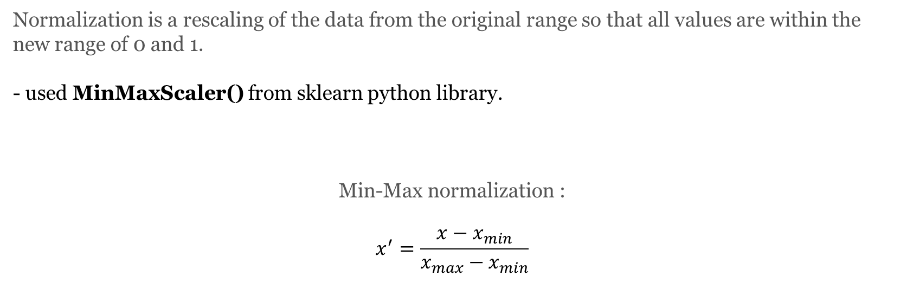
Data Normalization
Normalization is a rescaling of the data from the original range so that all values are within the new range of 0 and 1.
- used MinMaxScaler() from sklearn python library.
Min-Max normalization :
$$x^{′}=\frac{x−x_{min}}{x_{max}−x_{min}}$$

Slide 23
Drop Data Duplication
Applied 3 methods for Drop Data duplication:
1- Dropped duplicate columns
2- Dropped columns with same value
3- Dropped duplicate rows

Slide 24
Dimension Reduction
PCA is used to decompose a multivariate dataset in a set of successive orthogonal components that explain a maximum amount of the variance.
Used PCA with 10 components on 10 extracted features.
Extracted pca components using iFeature -- -- >Feature selection analysis part

Slide 25
Random Forest classification

Slide 26
Hyper parameters:
# Number of trees in random forest n_estimators = [int(x) for x in np.linspace(start=100, stop=1000, num=10)] # Number of features to consider at every split max_features = ['auto', 'sqrt'] # Maximum number of levels in tree max_depth = [int(x) for x in np.linspace(10, 110, num=11)] max_depth.append(None) # Minimum number of samples required to split a node min_samples_split = [2, 5, 10] # Minimum number of samples required at each leaf node min_samples_leaf = [1, 2, 4] # Method of selecting samples for training each tree bootstrap = [True, False]
# On each iteration, the algorithm will choose a difference combination of the features. Altogether, # there are 2 * 12 * 2 * 3 * 3 * 10 = 4320 settings!

Slide 27
Train pipeline:
generate
100 Random
Random-Forest
Based on 4320 settings
Choose best estimator
PCA
Features
Train 100
Random RF
Based on
10 fold cv
(1000 train run)
Train RF
With the
best params
On whole 80% train data
Evaluate the best estimator
(20% independent test set)

Slide 28
Random Forest Overview Results
PCA Features:
Features | Best Mean Acc (cv=10) | Best Mean roc_auc (cv=10) | ACC (Independent test) | Precision (Independent test) | Recall (Independent test) | F1-score (Independent test)
APseudoAAC | 0.79 | 0.87 | 0.79 | 0.79 | 0.79 | 0.79
CKSAAP | 0.80 | 0.89 | 0.79 | 0.78 | 0.78 | 0.78
CTD | 0.76 | 0.84 | 0.74 | 0.74 | 0.74 | 0.74
DDE | 0.77 | 0.85 | 0.74 | 0.74 | 0.74 | 0.74
Geary_correlation | 0.71 | 0.77 | 0.71 | 0.71 | 0.72 | 0.71
KSCTriad | 0.71 | 0.84 | 0.77 | 0.76 | 0.76 | 0.76
Moran_correlation | 0.70 | 0.75 | 0.66 | 0.67 | 0.67 | 0.66
NMBroto_correlation | 0.71 | 0.78 | 0.66 | 0.66 | 0.66 | 0.66
PseudoAAC | 0.79 | 0.87 | 0.79 | 0.78 | 0.78 | 0.78
QSOrder | 0.79 | 0.86 | 0.81 | 0.81 | 0.81 | 0.81

Slide 29
Random Forest Overview Results
PCA Features:
Features | Best Mean Acc (cv=10) | Best Mean roc_auc (cv=10) | ACC (Independent test) | Precision (Independent test) | Recall (Independent test) | F1-score (Independent test)
APseudoAAC | 0.79 | 0.87 | 0.79 | 0.79 | 0.79 | 0.79
CKSAAP | 0.80 | 0.89 | 0.79 | 0.78 | 0.78 | 0.78
CTD | 0.76 | 0.84 | 0.74 | 0.74 | 0.74 | 0.74
DDE | 0.77 | 0.85 | 0.74 | 0.74 | 0.74 | 0.74
Geary_correlation | 0.71 | 0.77 | 0.71 | 0.71 | 0.72 | 0.71
KSCTriad | 0.71 | 0.84 | 0.77 | 0.76 | 0.76 | 0.76
Moran_correlation | 0.70 | 0.75 | 0.66 | 0.67 | 0.67 | 0.66
NMBroto_correlation | 0.71 | 0.78 | 0.66 | 0.66 | 0.66 | 0.66
PseudoAAC | 0.79 | 0.87 | 0.79 | 0.78 | 0.78 | 0.78
QSOrder | 0.79 | 0.86 | 0.81 | 0.81 | 0.81 | 0.81

Slide 30
Combined Top Features
Combined 7 top Features with acc > 0.74
APseudoAAC
CKSAAP
CTD
DDE
KSCTriad
PseudoAAC
QSOrder
Results Feature Vector: (940, 3063)

Slide 31
Drop Data Duplication
Applied 3 methods for Drop Data duplication:
1- Dropped duplicate columns
2- Dropped Columns with same value
3- Dropped Duplicate Rows
Results Feature Vector:
(940, 3063) reduced to => (940, 3014)

Slide 32
Feature Selection
Sequential Feature Selection (sfs)
Used Logistic Regression for classification
Runed 3 times to select different feature counts: ( 50, 100 and 200)
lr_model = LogisticRegression() # -------------------------------------------------- sfs = SFS(lr_model, k_features=(1, 200), forward=True, floating=False, scoring='accuracy', verbose=2, n_jobs=-1, cv=10) sfs = sfs.fit(x90_train, y90_train)

Slide 33
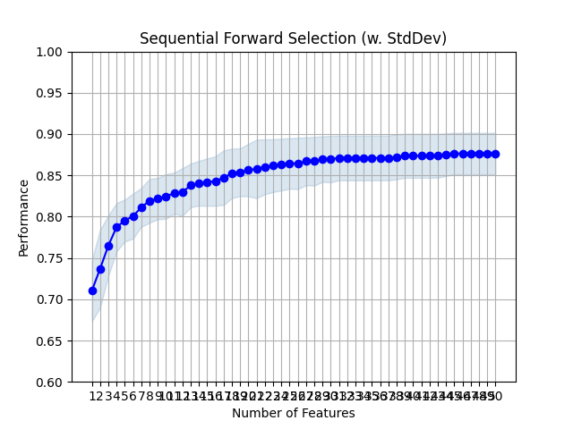
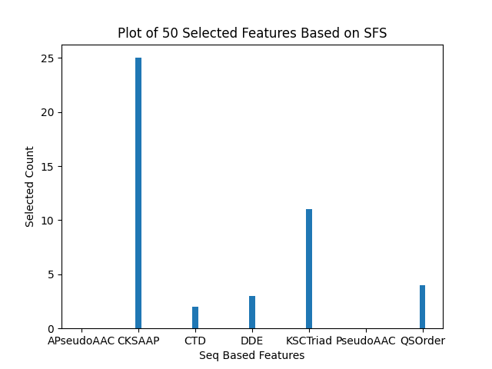
Results of 50 Selected Features By SFS

Slide 34
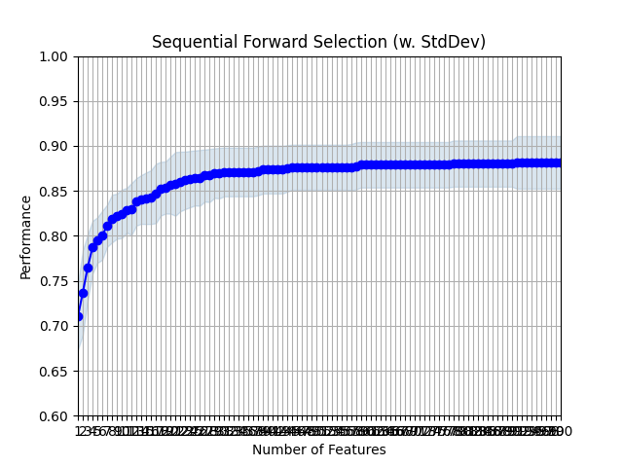
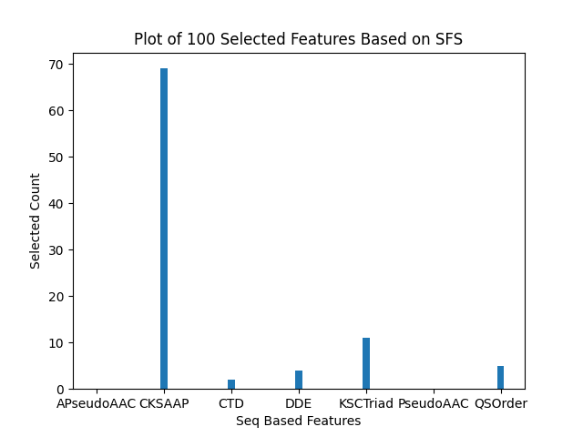
Results of 100 Selected Features By SFS

Slide 35
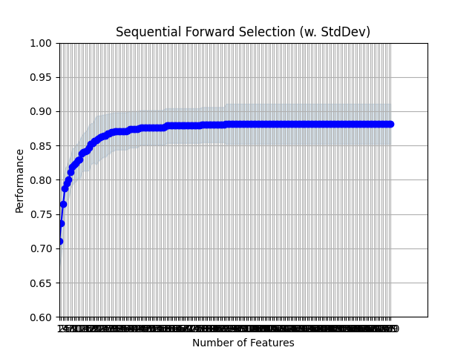

Results of 200 Selected Features By SFS

Slide 36
Random Forest Overview Results
Sequential Forward Selected Features:
Combined 7 features:
APseudoAAC
CKSAAP
CTD
DDE
KSCTriad
PseudoAAC
QSOrder
Features | Best Mean Acc (cv=10) | Best Mean roc_auc (cv=10) | ACC (Independent test) | Precision (Independent test) | Recall (Independent test) | F1-score (Independent test)
Selected 50 features | 0.82 | 0.89 | 0.73 | 0.73 | 0.73 | 0.73
Selected 100 features | 0.82 | 0.89 | 0.74 | 0.74 | 0.74 | 0.74
Selected 200 features | 0.82 | 0.89 | 0.74 | 0.74 | 0.74 | 0.74

Slide 37
Combine Features

Slide 38
Combined Top Features
Combined 7 top Features with acc > 0.73
APseudoAAC
CKSAAP
CTD
DDE
KSCTriad
PseudoAAC
QSOrder
Results Feature Vector: (940, 3063)

Slide 39
Combined Features Overview
Features | Features Length | Features Length (After Drop duplication Process) | Features | Features Length | Features Length (After Drop duplication Process)
QSOrder+CKSAAP | (940, 1649) | (940, 1649 ) | CKSAAP+DDE | (940, 2001) | (940, 2001)
QSOrder+CTD | (940, 322) | (940, 306) | CKSAAP+KSCTriad | (940, 2287) | (940, 2282)
QSOrder+DDE | (940, 449) | (940, 449) | CTD+APseudoAAC | (940, 302) | (940, 286)
QSOrder+KSCTriad | (940, 735) | (940, 730) | CTD+DDE | (940, 674) | (940, 658)
QSOrder+PseudoAAC | (940, 77) | (940, 77) | CTD+KSCTriad | (940, 960) | (940, 939)
QSOrder+APseudoAAC | (940, 77) | (940, 77) | DDE+APseudoAAC | (940, 429) | (940, 429)
PseudoAAC+APseudoAAC | (940, 57) | (940, 29) | DDE+KSCTriad | (940, 1087) | (940, 1082)
PseudoAAC+CKSAAP | (940, 1629) | (940, 1629) | APseudoAAC+KSCTriad | (940, 715) | (940, 710)
PseudoAAC+CTD | (940, 302) | (940, 286) | NMBroto+APseudoAAC | (940, 61) | (940, 61)
PseudoAAC+DDE | (940, 429) | (940, 429) | NMBroto+CKSAAP | (940, 1633) | (940, 1633)
PseudoAAC+KSCTriad | (940, 715) | (940, 710) | NMBroto+CTD | (940, 306) | (940, 290)
CKSAAP+APseudoAAC | (940, 1629) | (940, 1629) | NMBroto+DDE | (940, 433) | (940, 433)
CKSAAP+CTD | (940, 1874) | (940, 1858) | NMBroto+KSCTriad | (940, 719) | (940, 714)

Slide 40
Combined Features Overview
Features | Features Length | Features Length (After Drop duplication Process) | Features | Features Length | Features Length (After Drop duplication Process)
NMBroto+PseudoAAC | (940, 61) | (940, 61 )
NMBroto+QSOrder | (940, 81) | (940, 81)

Slide 41
Random Forest Overview Results - among 100 Random Random Forest
PCA Features(10 component):
Features | Best Acc (cv=10) | Best roc_auc (cv=10) | ACC (Independent test) | Precision (Independent test) | Recall (Independent test) | F1-score (Independent test)
QSOrder+CKSAAP | 0.82 | 0.89 | 0.80 | 0.80 | 0.80 | 0.80
QSOrder+CTD | 0.76 | 0.84 | 0.76 | 0.76 | 0.75 | 0.75
QSOrder+DDE | 0.83 | 0.89 | 0.80 | 0.79 | 0.80 | 0.79
QSOrder+KSCTriad | 0.79 | 0.86 | 0.77 | 0.77 | 0.76 | 0.76
QSOrder+PseudoAAC | 0.81 | 0.88 | 0.81 | 0.81 | 0.81 | 0.81
QSOrder+APseudoAAC | 0.81 | 0.88 | 0.81 | 0.81 | 0.81 | 0.81
PseudoAAC+APseudoAAC | 0.79 | 0.87 | 0.79 | 0.79 | 0.79 | 0.79
PseudoAAC+CKSAAP | 0.82 | 0.90 | 0.78 | 0.77 | 0.78 | 0.77
PseudoAAC+CTD | 0.75 | 0.84 | 0.76 | 0.75 | 0.75 | 0.75
PseudoAAC+DDE | 0.81 | 0.89 | 0.80 | 0.80 | 0.80 | 0.80

Slide 42
Random Forest Overview Results - among 100 Random Random Forest
PCA Features(10 component):
Features | Best Acc (cv=10) | Best roc_auc (cv=10) | ACC (Independent test) | Precision (Independent test) | Recall (Independent test) | F1-score (Independent test)
PseudoAAC+KSCTriad | 0.78 | 0.86 | 0.76 | 0.75 | 0.75 | 0.75
CKSAAP+APseudoAAC | 0.81 | 0.90 | 0.78 | 0.78 | 0.78 | 0.78
CKSAAP+CTD | 0.78 | 0.86 | 0.77 | 0.77 | 0.76 | 0.77
CKSAAP+DDE | 0.80 | 0.89 | 0.75 | 0.75 | 0.74 | 0.74
CKSAAP+KSCTriad | 0.80 | 0.88 | 0.78 | 0.77 | 0.77 | 0.77
CTD+APseudoAAC | 0.75 | 0.84 | 0.77 | 0.77 | 0.77 | 0.77
CTD+DDE | 0.76 | 0.85 | 0.78 | 0.78 | 0.78 | 0.78
CTD+KSCTriad | 0.78 | 0.86 | 0.80 | 0.80 | 0.79 | 0.80
DDE+APseudoAAC | 0.81 | 0.89 | 0.80 | 0.80 | 0.80 | 0.80
DDE+KSCTriad | 0.77 | 0.86 | 0.75 | 0.75 | 0.74 | 0.74
APseudoAAC+KSCTriad | 0.79 | 0.86 | 0.77 | 0.76 | 0.76 | 0.76

Slide 43
Random Forest Overview Results - among 100 Random Random Forest
PCA Features(10 component):
Features | Best Acc (cv=10) | Best roc_auc (cv=10) | ACC (Independent test) | Precision (Independent test) | Recall (Independent test) | F1-score (Independent test)
Combine all 7 features | 0.80 | 0.89 | 0.82 | 0.82 | 0.82 | 0.82

Slide 44
SVM classification

Slide 45
SVM Overview Results
PCA Features:
Features | Best Mean Acc (cv=10) | Best Mean roc_auc (cv=10) | ACC (Independent test) | Precision (Independent test) | Recall (Independent test) | F1-score (Independent test)
APseudoAAC | 0.79 |  | 0.77 | 0.77 | 0.76 | 0.76
CKSAAP | 0.79 |  | 0.78 | 0.77 | 0.77 | 0.77
CTD | 0.77 |  | 0.78 | 0.77 | 0.77 | 0.77
DDE | 0.77 |  | 0.73 | 0.73 | 0.73 | 0.73
Geary_correlation | 0.69 |  | 0.65 | 0.65 | 0.65 | 0.65
KSCTriad | 0.77 |  | 0.73 | 0.72 | 0.73 | 0.72
Moran_correlation | 0.69 |  | 0.64 | 0.63 | 0.63 | 0.63
NMBroto_correlation | 0.72 |  | 0.75 | 0.75 | 0.75 | 0.75
PseudoAAC | 0.80 |  | 0.77 | 0.76 | 0.76 | 0.76
QSOrder | 0.79 |  | 0.80 | 0.80 | 0.80 | 0.80

Slide 46
SVM Overview Results
PCA Features:
Features | Best Mean Acc (cv=10) | Best Mean roc_auc (cv=10) | ACC (Independent test) | Precision (Independent test) | Recall (Independent test) | F1-score (Independent test)
APseudoAAC | 0.79 |  | 0.77 | 0.77 | 0.76 | 0.76
CKSAAP | 0.79 |  | 0.78 | 0.77 | 0.77 | 0.77
CTD | 0.77 |  | 0.78 | 0.77 | 0.77 | 0.77
DDE | 0.77 |  | 0.73 | 0.73 | 0.73 | 0.73
Geary_correlation | 0.69 |  | 0.65 | 0.65 | 0.65 | 0.65
KSCTriad | 0.77 |  | 0.73 | 0.72 | 0.73 | 0.72
Moran_correlation | 0.69 |  | 0.64 | 0.63 | 0.63 | 0.63
NMBroto_correlation | 0.72 |  | 0.75 | 0.75 | 0.75 | 0.75
PseudoAAC | 0.80 |  | 0.77 | 0.76 | 0.76 | 0.76
QSOrder | 0.79 |  | 0.80 | 0.80 | 0.80 | 0.80

Slide 47
SVM Overview Results
PCA Features(10 component):
Features | Best Acc (cv=10) | Best roc_auc (cv=10) | ACC (Independent test) | Precision (Independent test) | Recall (Independent test) | F1-score (Independent test)
QSOrder+CKSAAP | 0.82 |  | 0.78 | 0.78 | 0.78 | 0.78
QSOrder+CTD | 0.77 |  | 0.77 | 0.77 | 0.76 | 0.77
QSOrder+DDE | 0.81 |  | 0.79 | 0.79 | 0.79 | 0.79
QSOrder+KSCTriad | 0.78 |  | 0.71 | 0.70 | 0.71 | 0.70
QSOrder+PseudoAAC | 0.81 |  | 0.79 | 0.79 | 0.79 | 0.79
QSOrder+APseudoAAC | 0.81 |  | 0.81 | 0.81 | 0.81 | 0.81
PseudoAAC+APseudoAAC | 0.79 |  | 0.77 | 0.77 | 0.76 | 0.76
PseudoAAC+CKSAAP | 0.81 |  | 0.80 | 0.80 | 0.80 | 0.80
PseudoAAC+CTD | 0.76 |  | 0.76 | 0.75 | 0.75 | 0.75
PseudoAAC+DDE | 0.80 |  | 0.73 | 0.73 | 0.74 | 0.73

Slide 48
SVM Overview Results
PCA Features(10 component):
Features | Best Acc (cv=10) | Best roc_auc (cv=10) | ACC (Independent test) | Precision (Independent test) | Recall (Independent test) | F1-score (Independent test)
PseudoAAC+KSCTriad | 0.78 |  | 0.71 | 0.71 | 0.71 | 0.71
CKSAAP+APseudoAAC | 0.81 |  | 0.80 | 0.79 | 0.79 | 0.79
CKSAAP+CTD | 0.78 |  | 0.75 | 0.75 | 0.74 | 0.74
CKSAAP+DDE | 0.80 |  | 0.78 | 0.78 | 0.76 | 0.77
CKSAAP+KSCTriad | 0.79 |  | 0.75 | 0.75 | 0.75 | 0.75
CTD+APseudoAAC | 0.77 |  | 0.76 | 0.75 | 0.75 | 0.75
CTD+DDE | 0.76 |  | 0.78 | 0.77 | 0.77 | 0.77
CTD+KSCTriad | 0.77 |  | 0.72 | 0.72 | 0.72 | 0.72
DDE+APseudoAAC | 0.81 |  | 0.75 | 0.75 | 0.74 | 0.74
DDE+KSCTriad | 0.78 |  | 0.74 | 0.73 | 0.74 | 0.74
APseudoAAC+KSCTriad | 0.78 |  | 0.74 | 0.73 | 0.74 | 0.73

Slide 49
SVM Overview Results – among 520 fits
PCA Features(10 component):
Features | Best Acc (cv=10) | Best roc_auc (cv=10) | ACC (Independent test) | Precision (Independent test) | Recall (Independent test) | F1-score (Independent test)
NMBroto+APseudoAAC | 0.82 |  | 0.78 | 0.77 | 0.77 | 0.77
NMBroto+CKSAAP | 0.80 |  | 0.79 | 0.79 | 0.78 | 0.78
NMBroto+CTD | 0.76 |  | 0.75 | 0.75 | 0.74 | 0.74
NMBroto+DDE | 0.80 |  | 0.77 | 0.76 | 0.75 | 0.76
NMBroto+KSCTriad | 0.78 |  | 0.73 | 0.73 | 0.73 | 0.73
NMBroto+PseudoAAC | 0.82 |  | 0.79 | 0.78 | 0.78 | 0.78
NMBroto+QSOrder | 0.80 |  | 0.79 | 0.79 | 0.79 | 0.79
Combine all 8 features | 0.79 |  | 0.76 | 0.76 | 0.76 | 0.76

Slide 50
Thank You
Zeynab MohammadTabar
Fall 2021

