Slide 1
AntiCancer Peptides Prediction via Machine Learning Approches
Supervisor: Dr. Abdolmaleki
Student: Zeynab Mohammadtabar
Summer 2021
Bioinformatics | TMU

Slide 2
Outline:
01
ACPs prediction importance
02
What are ACPs
03
Earlier researches
04
List of ACP DBs
05
Possible Achievements
1

Slide 3
ACPs prediction importance
Cancer remains the major cause of death, killing millions of people every year, and it is caused by the growth and spreading of abnormal cells without control.
In 2018, it was anticipated that about 18 million new cancer cases and over 9 million deaths could occur due to cancer [6], and these deaths could reach well over 13 million by 2030 [1].
For cancer treatment, conventional chemotherapy is currently a common way.
It usually has an adverse effect on normal cells, resulting in that the treatment effect is not that good.
The traditional chemotherapy approach is very expensive.
New treatment options are therefore highly demanded for relieving symptoms and ultimately eradicating the disease.
During the last few decades, the role of peptides as anti-cancer therapeutic agents has been promising, which is apparent from various strategies available to address the advancement of tumor growth and spreading of the disease.[2]
These anti-cancer peptides (ACPs) have shown the potential to inactivate various types of cancer cells
[1] Liao Z, Li D, Wang X, et al. Cancer diagnosis from isomiR expression with machine learning method. Curr Bioinform 2018;13:57–63
[2] Thundimadathil, J. Cancer treatment using peptides: Current therapies and future prospects. J. Amino Acids 2012, 2012, 967347.
3

Slide 4
ACPs Advantages
ACPs are naturally occurring biologics and hence are safer
Because ACPs can interact with the anionic cell membrane components of cancer cells, cancer cells can be killed selectively by the ACPs without impairing the normal cells (2,3)
Traditional treatment methods focus on killing cancer cells, but at the same time normal cells are also killed and there are high costs involved(2,3)
Accurate prediction of ACPs is of great importance for the exploration of their mechanism of action
and for the development of therapeutic ACPs.
It is quite expensive and time-consuming to identify anticancer peptides using experimental methods.(1)
Thundimadathil, J. Cancer treatment using peptides: Current therapies and future prospects. J. Amino Acids 2012, 2012, 967347.
Mader, J.S.; Hoskin, D.W. Cationic antimicrobial peptides as novel cytotoxic agents for cancer treatment. Expert Opin. Investig. Drugs 2006, 15, 933–946.
Hoskin, D.W.; Ramamoorthy, A. Studies on anticancer activities of antimicrobial peptides. BBA Biomembr. 2008, 1778, 357–375.
`
4

Slide 5
From antimicrobial to anticancer peptides
Cationic, Amphipathic antimicrobial peptides, important for regulating the innate immune system of plants, insects, and animals and enveloped viruses, such as HIV and herpes virus.
Antibacterial, antifungal, antiviral, antitumour, anticancer and antiparasitic peptides.
up to 50 amino acids long
A net positive charge of at least +2 (Arg, Lys)
Gaspar,D., Veiga,A.S. and Castanho,M.A. (2013) From antimicrobial to anticancer peptides. A review. Front Microbiol., 4, 294.
5

Slide 6
Earlier researches

Slide 7
Earlier Researches in identification of ACPs
Many computational efforts have been done. Notably, most of them aim to extract features from protein primary sequences only
Various sequence-based features have been proposed:
6

Slide 8
Sequence based features:
amino acid composition (AAC) | amino acid index (AAIF) | auto covariance of the average chemical shift(acACS) | local alignment kernel (LAK)
dipeptide composition (DPC) | binary profile (NC5) | amphiphilic pseudo amino acid composition(Am-PseAAC) | Physicochemical properties(PCP)
composition-transition-distribution (CTD) | conjoint triad (CTF) | composite protein sequence representation(CPDR) | Pseudo amino acid composition (PseACC)
quasi-sequence-order (QSO) | atomic composition(ATC) | G-Gap dipeptide composition (g-gap DPC) | Pseudo G-Gap dipeptide composition(Pse-g-gap DPC)
protein relatedness measure(PRM) | reduce amino acid composition(RACC) | split amino acid composition(SAAC) | Geary autocorrelation descriptor
Composition on terminal region | N5C5 | k-space | position-specifc scoring matrix (PSSM)
k-spaced amino acid group pairs (CKSAAGP)
7

Slide 9
Sequence based features:
amino acid composition (AAC) | amino acid index (AAIF) | auto covariance of the average chemical shift(acACS) | local alignment kernel (LAK)
dipeptide composition (DPC) | binary profile (NC5) | amphiphilic pseudo amino acid composition(Am-PseAAC) | Physicochemical properties(PCP)
composition-transition-distribution (CTD) | conjoint triad (CTF) | composite protein sequence representation(CPDR) | Pseudo amino acid composition (PseACC)
quasi-sequence-order (QSO) | atomic composition(ATC) | G-Gap dipeptide composition (g-gap DPC) | Pseudo G-Gap dipeptide composition(Pse-g-gap DPC)
protein relatedness measure(PRM) | reduce amino acid composition(RACC) | split amino acid composition(SAAC) | Geary autocorrelation descriptor
Composition on terminal region | N5C5 | k-space | position-specifc scoring matrix (PSSM)
k-spaced amino acid group pairs (CKSAAGP)
7

Slide 10
Using 3d structure of ACP peptides
The first research of the ACP prediction based on 3D Structure of Peptides:
Published on May 2021
Prediction of Anticancer Peptides with High Efficacy and Low Toxicity by Hybrid Model Based on 3D Structure of Peptides –
International Journal of Molecular Sciences

Slide 11
Data sets from articles
https://github.com/haichengyi/ACP-DL [1]
https://github.com/Shoombuatong/ACPred [2]
CancerPPD: https://webs.iiitd.edu.in/raghava/cancerppd/index.php [3]
APD3: (Antimicrobial peptide database)
https://aps.unmc.edu/ [4]
[1] ACP-DL: A Deep Learning Long Short-Term Memory Model to Predict Anticancer Peptides Using High-Efficiency Feature Representation – 2019 – Nucleic Acids
[2] ACPred: A Computational Tool for the Prediction and Analysis of Anticancer Peptides -2019 – moleculs
[3] CancerPPD: a database of anticancer peptides and proteins – 2014 - Nucleic Acids Research
[4] APD3: the antimicrobial peptide database as a tool for research and education – 2015 - Nucleic Acids Research

Slide 12
http://120.24.47.30:8080/ACPred_LAF/Download.html [1]
[1] Learning embedding features based on multisense-scaled attention architecture to improve the predictive performance of anticancer peptides -2021 , bioinformatics

Slide 13
My Data Used for My Research
http://120.24.47.30:8080/ACPred_LAF/Download.html:
CD-Hit Range | #ACP | #non-ACP
Before cd-hit | 736 | 4577
100% | 736 | 4577
90% | 416 | 3909
80% | 303 | 3766
70% | 242 | 3608
60% | 181 | 3416
50% | 102 | 2674
40% | 40 | 1579

Slide 15
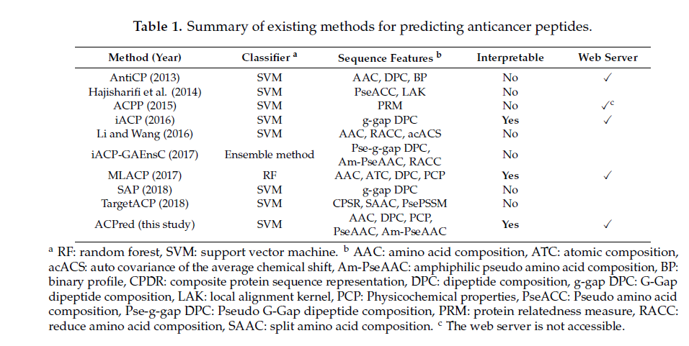
Summary of existing methods for ACPs prediction
You can simply impress your audience and add a unique zing and appeal to your Presentations. Easy to change colors, photos and Text. Get a modern PowerPoint Presentation that is beautifully designed. You can simply impress your audience and add a unique zing and appeal to your Presentations. Easy to change colors, photos and Text. Get a modern PowerPoint Presentation that is beautifully designed.
Modern Portfolio Presentation
1Schaduangrat, N., et al. (2019). "ACPred: A Computational Tool for the Prediction and Analysis of Anticancer Peptides." Molecules 24(10):1973.
5

Slide 16
Works we can do:
Using primary sequence features:
Most of the classifiers used in articles are classical machine learning approaches, like : SVM, RF, NB, KNN
We can use some other classifiers like: logistic regression, Multi layer perceptrons (MLP)
We can use different primary sequence features with different machine learning algorithms and compare them.
Using 3D Structure of peptides
Using deep Neural Networks.

Slide 17
AMP and ACP data bases
Database of Antimicrobial Activity and Structure of Peptides
DBAASP
DADP
Database of Anuran Defense Peptides.
a database of anticancer peptides and proteins
Cancer PPD
The Antimicrobial Peptide Database (APD) contains 3136 antimicrobial peptides from six kingdoms (344 bacteriocins/peptide antibiotics from bacteria, 5 from archaea, 8 from protists, 20 from fungi, 352 from plants, and 2327 from animals, including some synthetic peptides)
APD
CAMP_{R3}
Collection of Anti-Microbial Peptides
4

Slide 18
Possible Achievements
Data base
Collect ACPs and non-ACPs
Feature Selection
Research questions
Data set train
Structure-based
Sequence -based
Accessible surface area
The second structure
AAC
Binary profiling
DPC
…
Choose of machine learning algorithms for prediction of ACPs
SVM
RF
NN
…
Evaluation
6

Slide 19
Thank You
Zeynab Mt
Summer 2021

