Slide 1
AntiCancer Peptides Prediction via Machine Learning Approches
Supervisor: Dr. Abdolmaleki
Student: Zeynab Mohammadtabar
Fall 2021
11-October-2021
Bioinformatics | TMU

Slide 2
Outline:
01
Data Collection
02
Feature Extracted
03
Preprocessing
04
Dimension Reduction
05
Train-Test Split
1

Slide 3
Data Collection

Slide 4
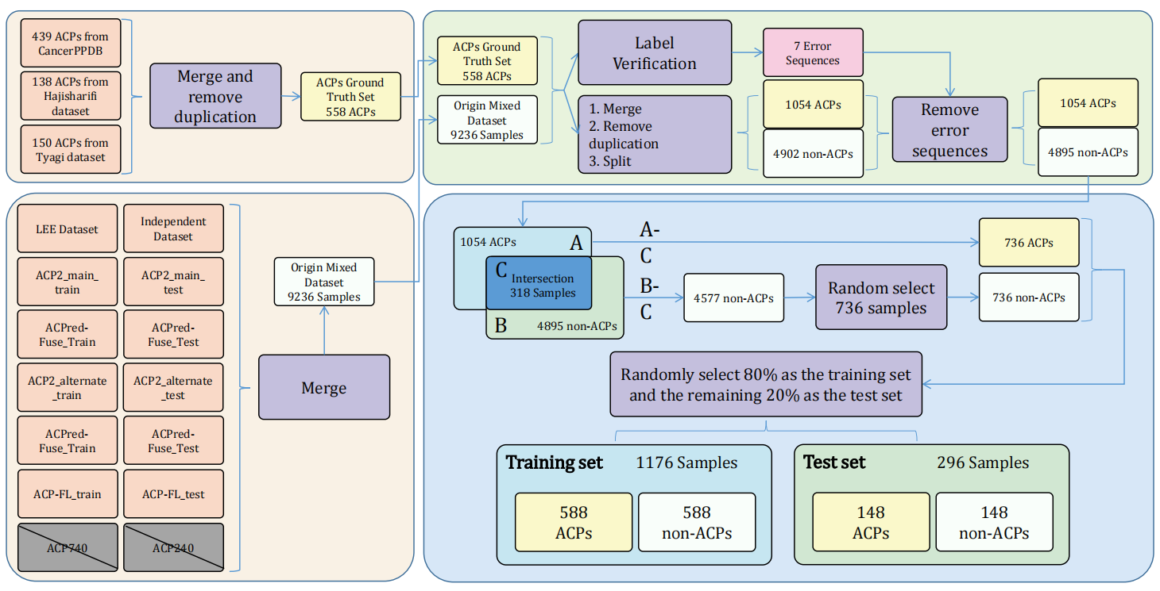
Data Collection
6
Learning embedding features based on multisense-scaled attention architecture to improve the predictive performance of anticancer peptides- Bioinformatics-2021

Slide 5
My Data Used for My Research
http://120.24.47.30:8080/ACPred_LAF/Download.html:
CD-Hit Range | #ACP | #non-ACP
Before cd-hit | 736 | 4577
100% | 736 | 4577
90% | 416 | 3909
80% | 303 | 3766
70% | 242 | 3608
60% | 181 | 3416
50% | 102 | 2674
40% | 40 | 1579

Slide 6
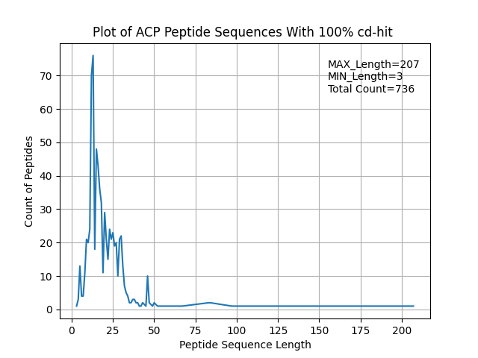
Data Views
Cdhit 100 – positive data

Slide 7
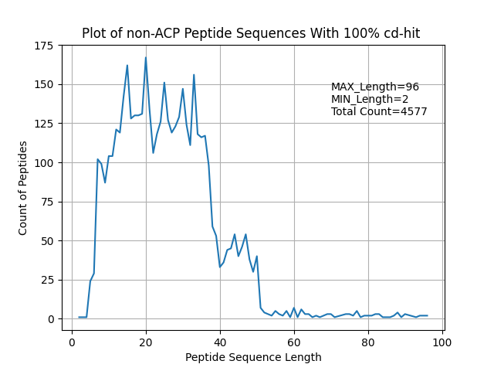
Data Views
Cdhit 100 – negetive data

Slide 8
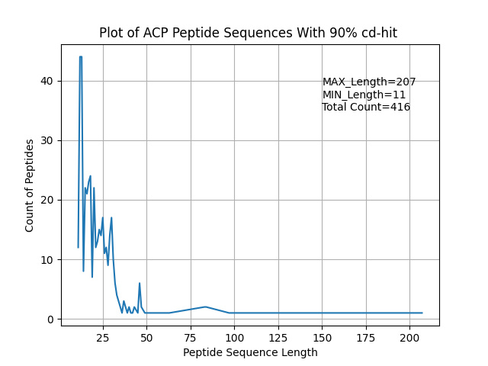
Data Views
Cdhit 90 –positive data

Slide 9
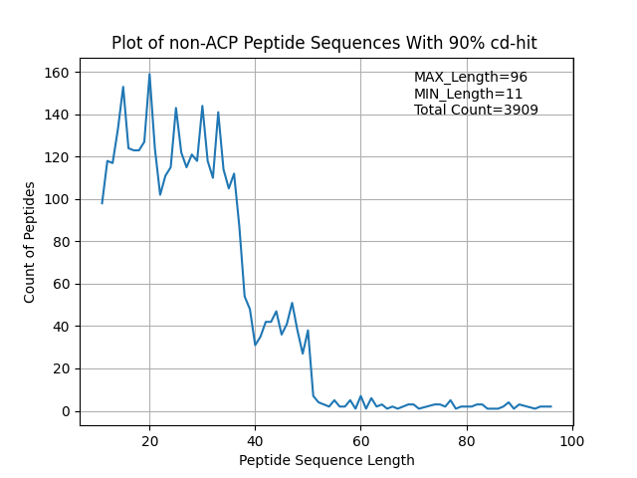
Data Views
Cdhit 90 – negative data

Slide 10
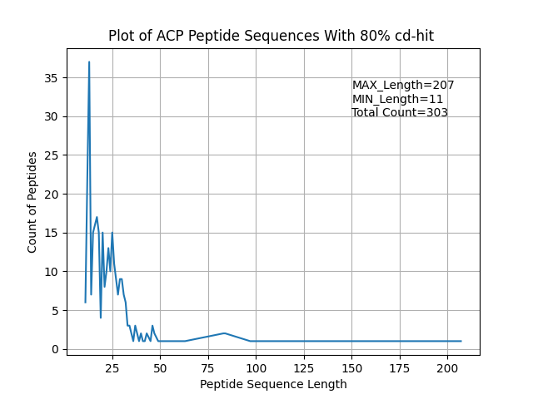
Data Views
Cdhit 80 –positive data

Slide 11
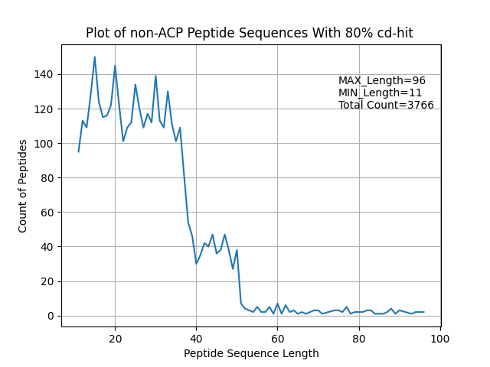
Data Views
Cdhit 80 –negative data

Slide 12
Filter Sequence Length

Slide 13
Filter Sequence Data by seq length
sequences with 100 < length <10 deleted
CD-Hit Range | Before filter #ACP | After filter seqLength #ACP | Before filter #non-ACP | After seqLength #non-ACP
100% | 736 | 655 | 4577 | 4130
90% | 416 | 413 | 3909 | 3909
80% | 303 | 300 | 3766 | 3766

Slide 14
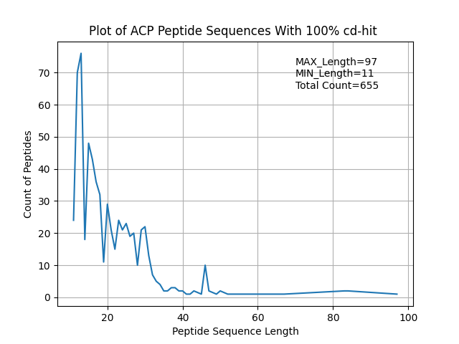
Data Views after seq length filter
Cdhit 100 – positive data

Slide 15
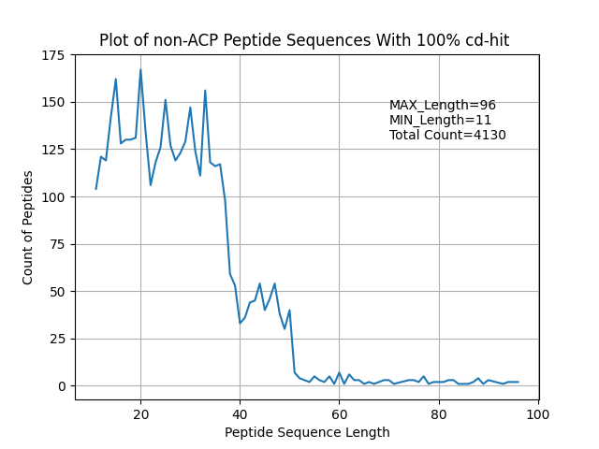
Data Views after seq length filter
Cdhit 100 – negative data

Slide 16
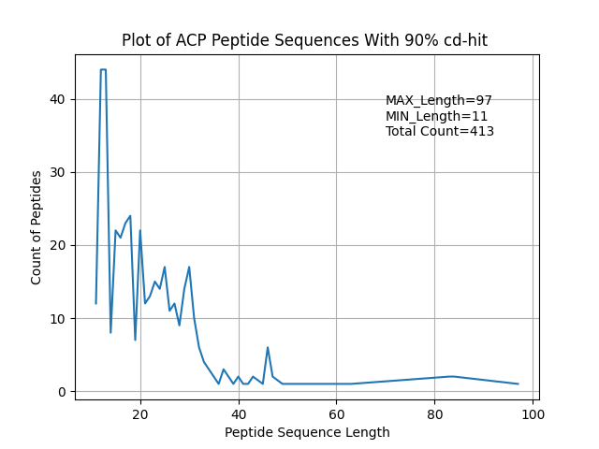
Data Views after seq length filter
Cdhit 90 – positive data

Slide 17

Data Views after seq length filter
Cdhit 90 – negative data

Slide 18
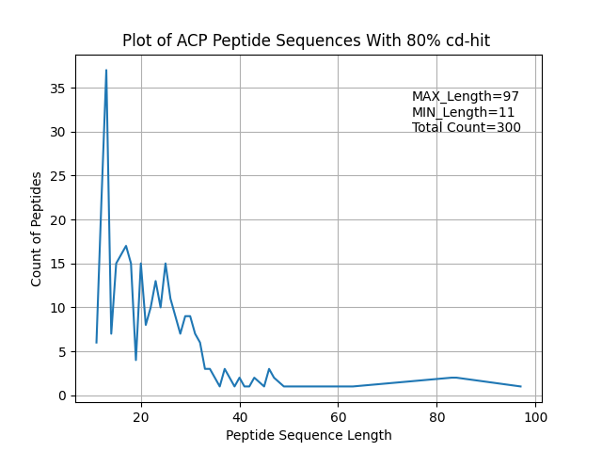
Data Views after seq length filter
Cdhit 80 – positive data

Slide 19

Data Views after seq length filter
Cdhit 80 – negative data

Slide 20
Select random negative data

Slide 21
Select random negative data as much as positive data
CD-Hit Range | After filter seqLength #ACP | After seqLength #non-ACP | After Select random #non-ACP
100% | 655 | 4130 | 655
90% | 413 | 3909 | 413
80% | 300 | 3766 | 300
Final result:
#ACPs = #non-ACPs

Slide 22
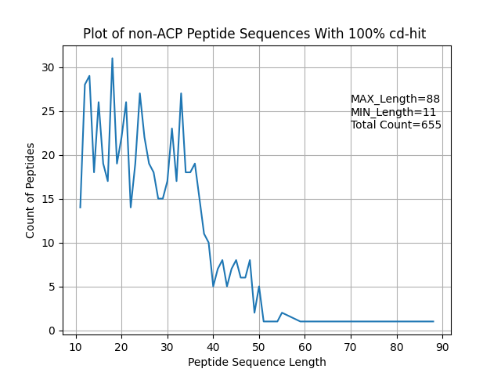
Data View of selected random negative data
Cdhit 100 – negative data

Slide 23
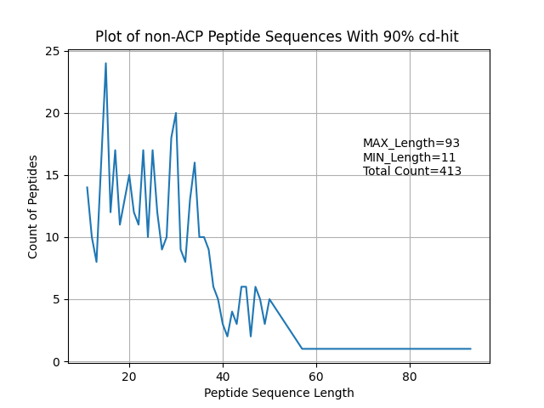
Data View of selected random negative data
Cdhit 90 – negative data

Slide 24
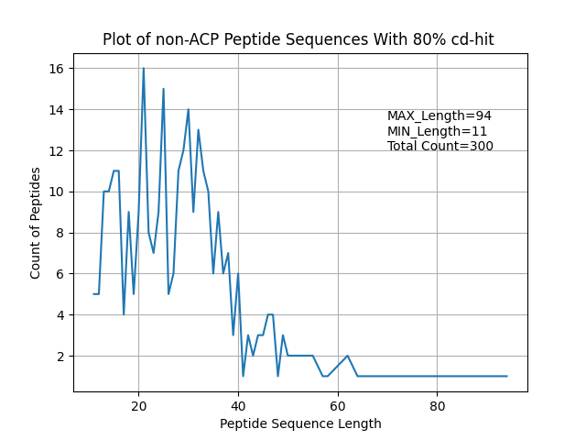
Data View of selected random negative data
Cdhit 80 – negative data

Slide 25
Train-Test data split

Slide 26
Train-Test data split
Split by 80 , 20
80% for train
20% for test
All random as #positive = #negative
CD-Hit Range | #ACP | #non-ACP
100% | Total: 655 Train:524 Test: 131 | Total: 655 Train: 524 Test: 131
90% | Total: 413 Train: 330 Test: 83 | Total: 413 Train: 330 Test: 83
80% | Total: 300 Train: 240 Test: 60 | Total: 300 Train: 240 Test: 60

Slide 27
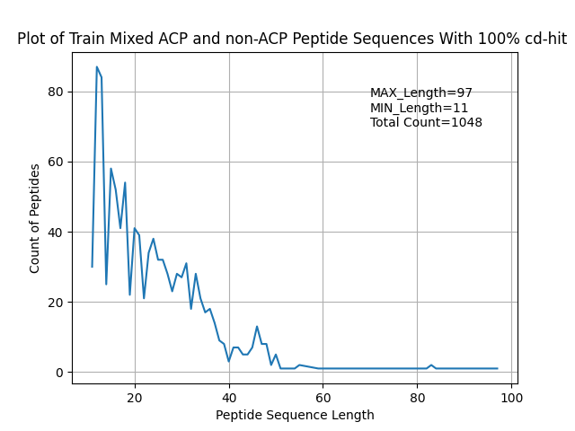
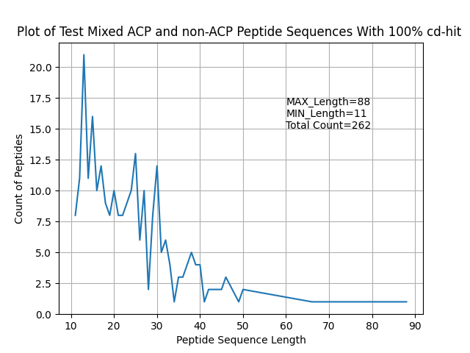
Data View of Train and Test data
Cdhit 100 – mixed positive and negative data

Slide 28
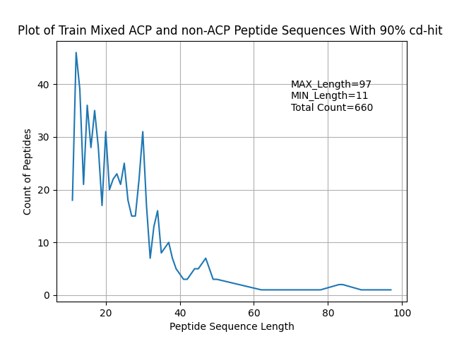
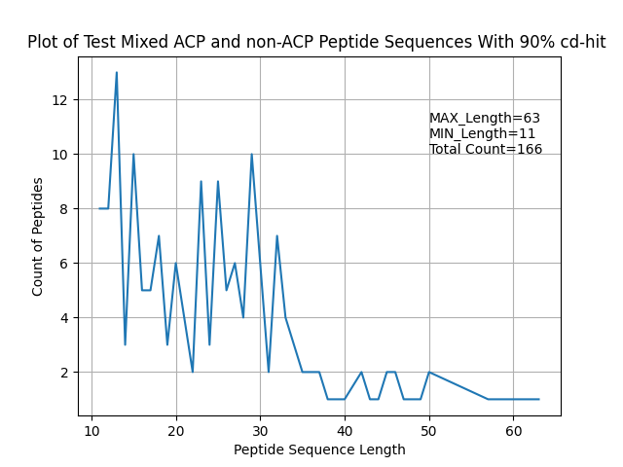
Data View of Train and Test data
Cdhit 90 – mixed positive and negative data

Slide 29
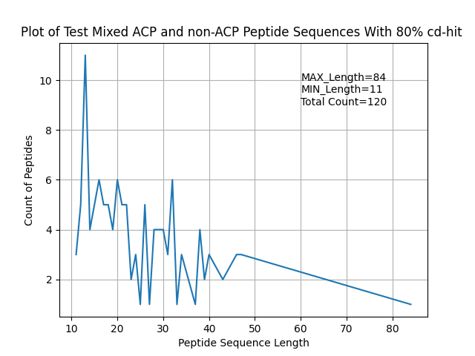
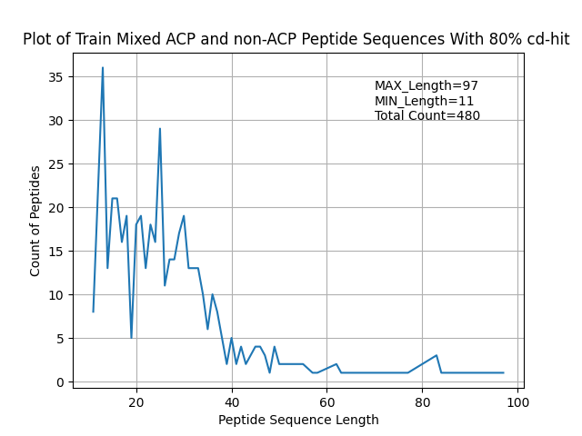
Data View of Train and Test data
Cdhit 80 – mixed positive and negative data

Slide 30
Feature Extraction

Slide 31
Sequence based features:
amino acid composition (AAC) | amino acid index (AAIF) | auto covariance of the average chemical shift(acACS) | local alignment kernel (LAK)
dipeptide composition (DPC) | binary profile (NC5) | amphiphilic pseudo amino acid composition(Am-PseAAC) | Physicochemical properties(PCP)
composition-transition-distribution (CTD) | conjoint triad (CTF) | composite protein sequence representation(CPDR) | Pseudo amino acid composition (PseACC)
quasi-sequence-order (QSO) | atomic composition(ATC) | G-Gap dipeptide composition (g-gap DPC) | Pseudo G-Gap dipeptide composition(Pse-g-gap DPC)
protein relatedness measure(PRM) | reduce amino acid composition(RACC) | split amino acid composition(SAAC) | Geary autocorrelation descriptor
Composition on terminal region | N5C5 | k-space | position-specifc scoring matrix (PSSM)
k-spaced amino acid group pairs (CKSAAGP)
7

Slide 32
Sequence based features:
amino acid composition (AAC) | amino acid index (AAIF) | auto covariance of the average chemical shift(acACS) | local alignment kernel (LAK)
dipeptide composition (DPC) | binary profile (NC5) | amphiphilic pseudo amino acid composition(Am-PseAAC) | Physicochemical properties(PCP)
composition-transition-distribution (CTD) | conjoint triad (CTF) | composite protein sequence representation(CPDR) | Pseudo amino acid composition (PseACC)
quasi-sequence-order (QSO) | atomic composition(ATC) | G-Gap dipeptide composition (g-gap DPC) | Pseudo G-Gap dipeptide composition(Pse-g-gap DPC)
protein relatedness measure(PRM) | reduce amino acid composition(RACC) | split amino acid composition(SAAC) | Geary autocorrelation descriptor
Composition on terminal region | N5C5 | k-space | position-specifc scoring matrix (PSSM)
k-spaced amino acid group pairs (CKSAAGP)
7

Slide 33
Sequence based features:
All the features extracted by iFeature toolkit.
Decided to extract 10 following features.
amphiphilic pseudo amino acid composition(Am-PseAAC) | Pseudo amino acid composition (PseACC) | G-Gap dipeptide composition (g-gap DPC) | composition-transition-distribution (CTD)
k-spaced Conjoint Triad (KSCTriad) | quasi-sequence-order (QSOrder) | Geary_autocorrelation | Moran_autocorrelation
NMBroto_autocorrelation | Dipeptide Deviation from Expected Mean (DDE)
iFeature: a Python package and web server for features extraction and selection from protein and peptide sequences – Bioinformatics - 2018

Slide 34
Data Normalization
Normalization is a rescaling of the data from the original range so that all values are within the new range of 0 and 1.
I used MinMaxScaler() from sklearn python library.
Min-Max normalization :
y = (x – min) / (max – min)

Slide 35
Drop Data Duplication
Applied 3 methods for Drop Data duplication:
1- Dropped duplicate columns
2- Dropped Columns with same value
3- Dropped Duplicate Rows

Slide 36
Demension Redection
PCA (Pearson, 1901) is used to decompose a multivariate dataset in a set of successive orthogonal components that explain a maximum amount of the variance.
Used PCA with 10 components on 10 extracted features.
Extracted pca components using iFeature Feature selection analysis

Slide 37
Thank You
Zeynab Mt
Summer 2021

