Slide 1
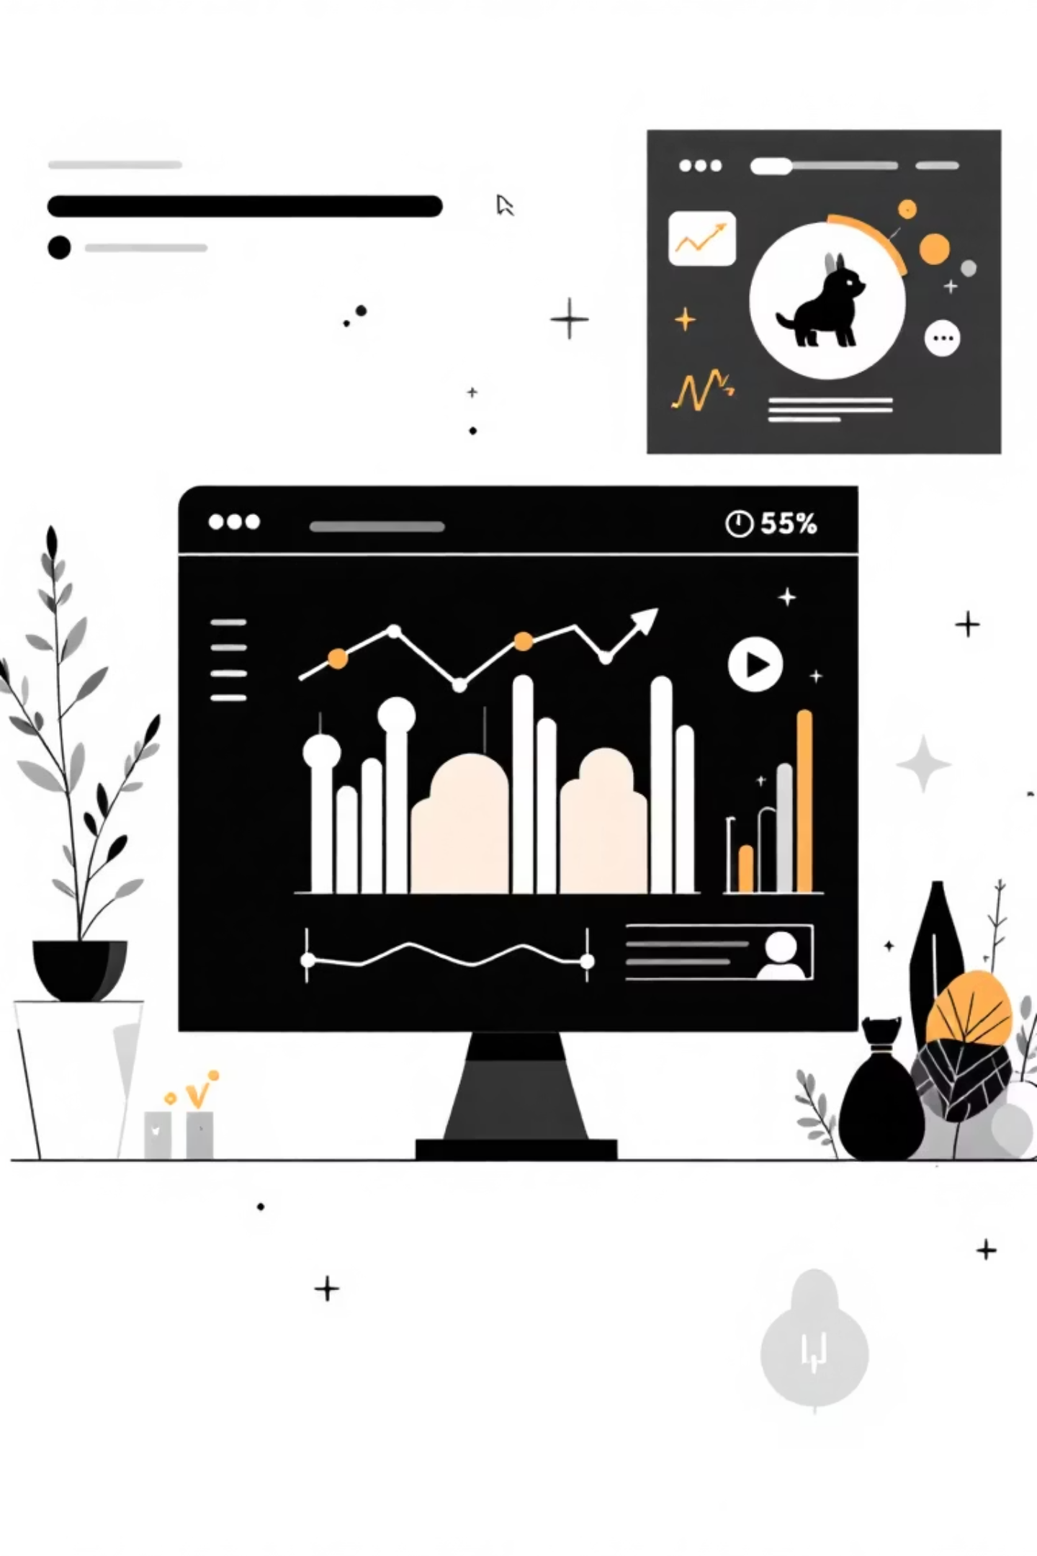
Customer Shopping Behaviour Analysis
Uncovering insights from 3,900 purchases to guide strategic business decisions

Slide 2
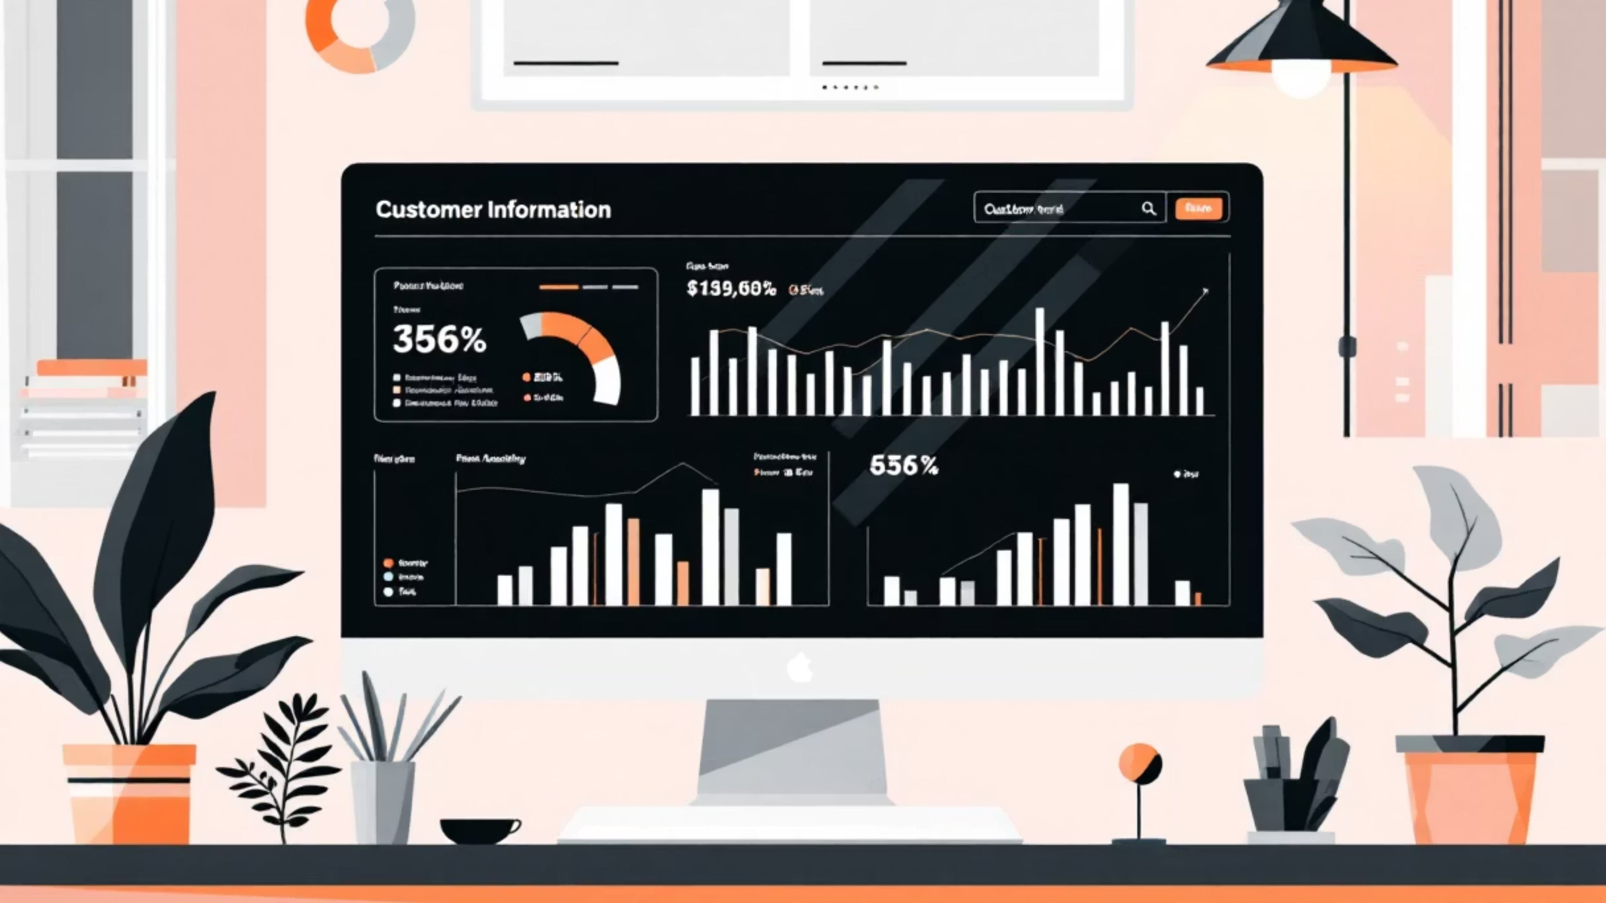
DATASET OVERVIEW
The Data Behind the Insights
Total Purchases
Data Points
Missing Values
3,900 Transactions analyzed
18 Features per customer
37 In Review Rating column
Dataset includes demographics, purchase details, shopping behavior, and customer preferences

Slide 3
PYTHON ANALYSIS
Data Preparation & Cleaning
01
02
03
Data Loading
Initial Exploration
Missing Data Handling
Imported dataset using pandas
Structure check and summary statistics
Imputed Review Ratings using median by category
04
05
Feature Engineering
Database Integration
Created age groups and purchase frequency metrics
Connected to MySQL for SQL analysis

Slide 4


SQL INSIGHTS
Revenue Analysis
Gender Breakdown
Subscription Impact
Male customers drive majority of revenue
Non-subscribers generate more total revenue
Male: $157,890
No: $170,436 (2,847 customers)
Female: $75,191
Yes: $62,645 (1,053 customers)

Slide 5
Top-Rated Products
77%
76%
76%
Gloves
Sandals
Boots
3.86 average rating
3.84 average rating
3.82 average rating
76%
75%
Hat
Skirt
3.80 average rating
3.78 average rating

Slide 6



CUSTOMER SEGMENTS
Understanding Customer Loyalty
Returning
701 customers
Moderate engagement
Loyal
3,116 customers
Highest purchase frequency
New
83 customers
First-time buyers
Repeat buyers (>5 purchases): 958 subscribed, 2,518 non-subscribed

Slide 7
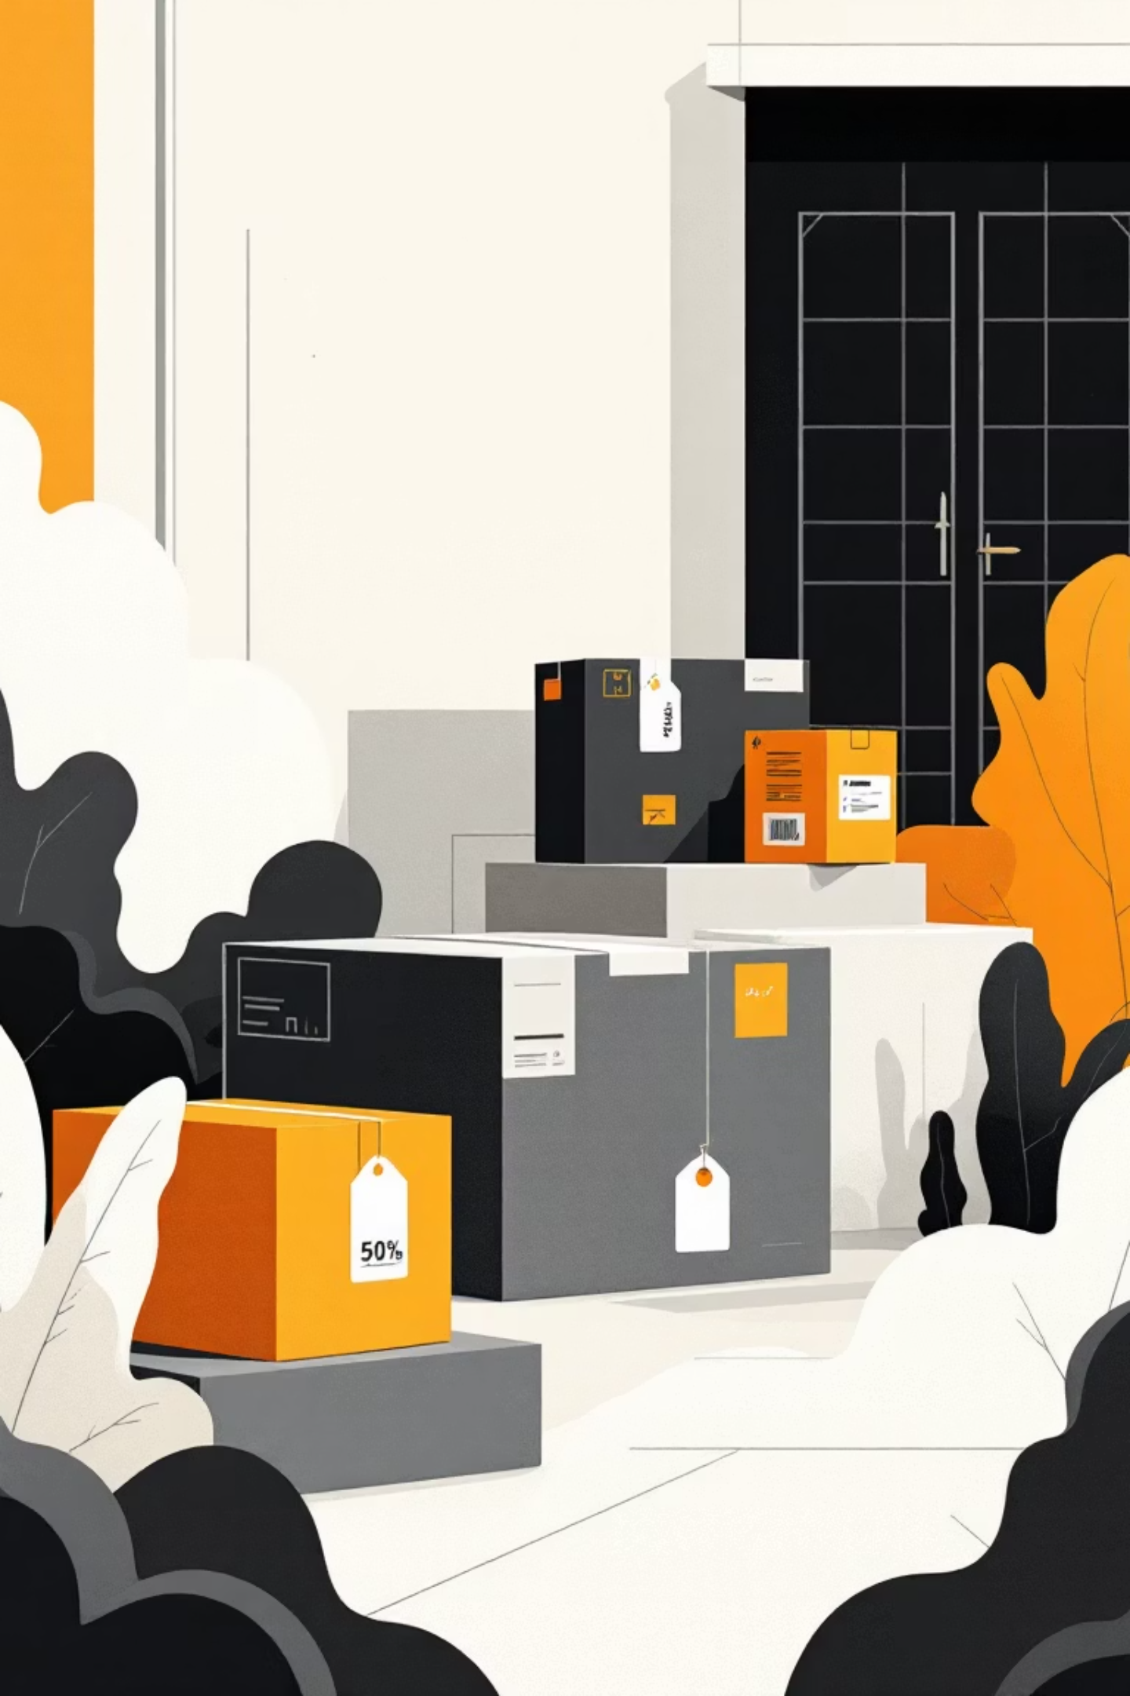
Shipping & Discount Insights
Shipping Type Performance
Discount-Dependent Products
Express: $60.48 avg purchase
Hat: 50% discount rate
Sneakers: 49.66%
Standard: $58.46 avg purchase
Coat: 49.07%
Sweater: 48.17%
Express shipping correlates with higher spending
Pants: 47.37%

Slide 8


POWER BI DASHBOARD
Key Performance Metrics
3.90K
$233K
Total Customers
Sales Revenue
$59.76
3.75
Average Purchase
Average Rating
73%
27%
Non-Subscribers
Subscribers

Slide 9
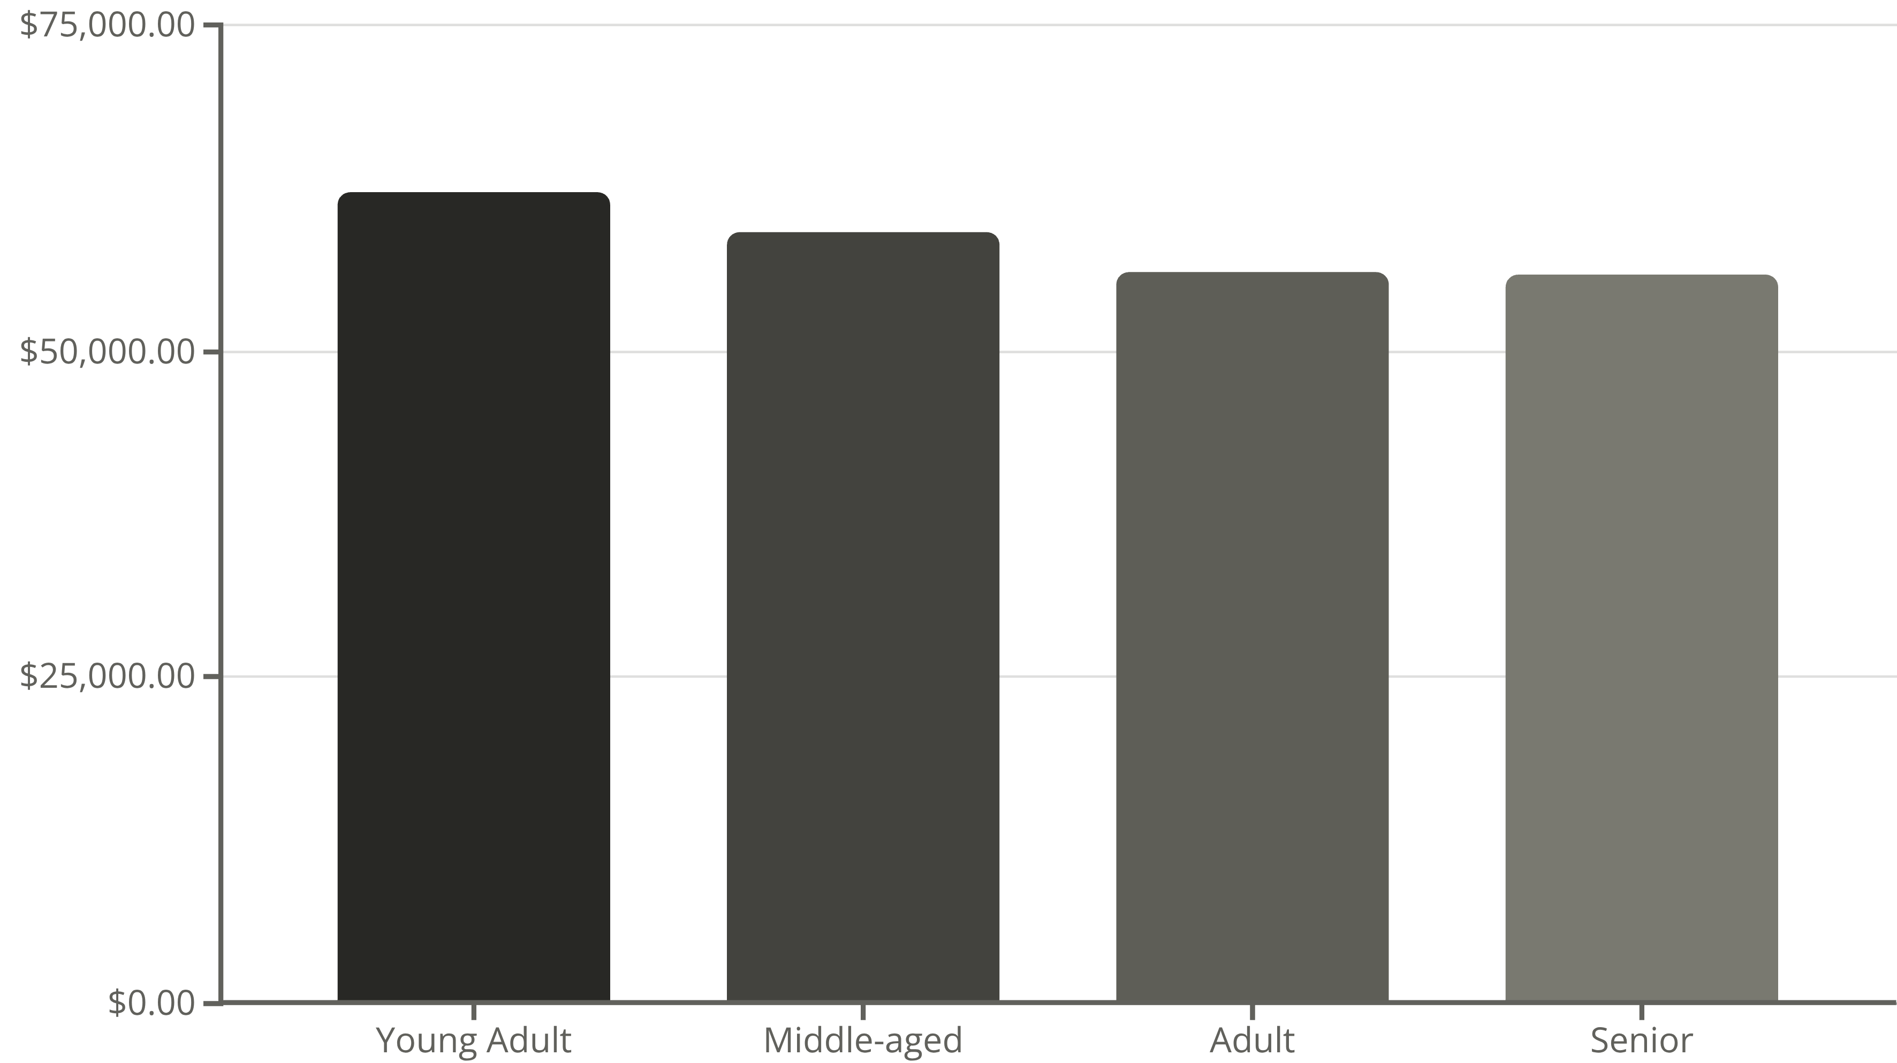
Revenue Distribution
Young adults lead revenue generation, followed closely by middle-aged customers

Slide 10
STRATEGIC RECOMMENDATIONS
Action Plan for Growth
1
2
3
Boost Subscriptions
Loyalty Programs
Review Discount Policy
Promote exclusive benefits to convert 73% non-subscribers
Reward repeat buyers to grow loyal segment
Balance sales growth with margin control
4
5
Product Positioning
Targeted Marketing
Highlight top-rated items in marketing campaigns
Focus on high-revenue age groups and express shipping users

