Slide 1

Inject Neural Network into Kalman Filter
Manjiang
April 27,2024

Slide 2

Catalogue
Introduction
Existing work
Simulation

Slide 3
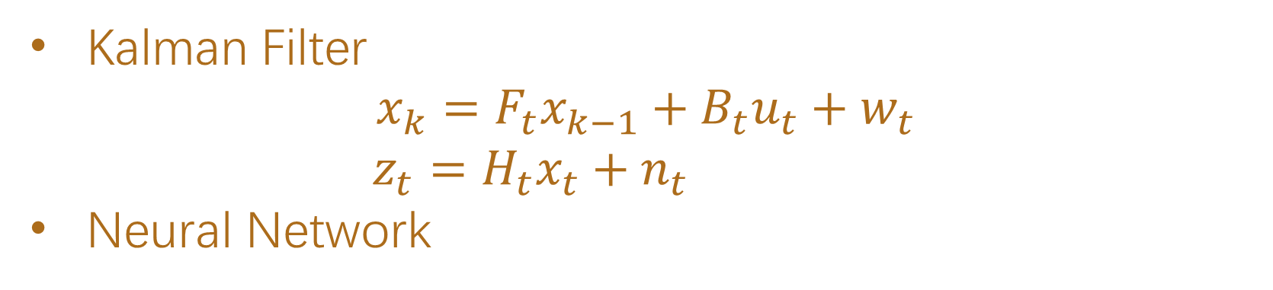
Introduction
Kalman Filter
$$x_{k}=F_{t}x_{k−1}+B_{t}u_{t}+w_{t}$$
$z_{t}=H_{t}x_{t}+n_{t}$
Neural Network

Slide 4
Existing work
Tuning parameters of KF
Compensating errors in KF
Estimating pseudo-measurements of KF

Slide 5
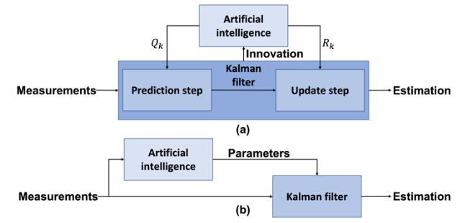
Tuning parameters of KF
Tuning the noise matrix
Tuning the parameters in the equations

Slide 6
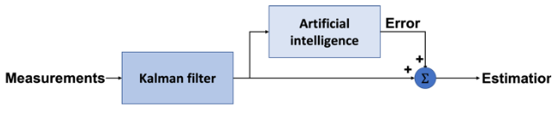
Compensating errors in KF
EKF estimate the modelled error
NN predict the unmodelled error

Slide 7

Estimating pseudo-measurements of KF
Reconstruction measurements to simplify the KF
Reject error measurement

Slide 8
Simulation
u(t)
G(t)
G(u(t))
z(t)
Input control function
Output function
Observation
Training a model for G(t)
Let input function go through the model and get predicted output function
Shift the predicted output function and training a transition model
Calculate the jacobian of the transition model and implement an EKF

Slide 9
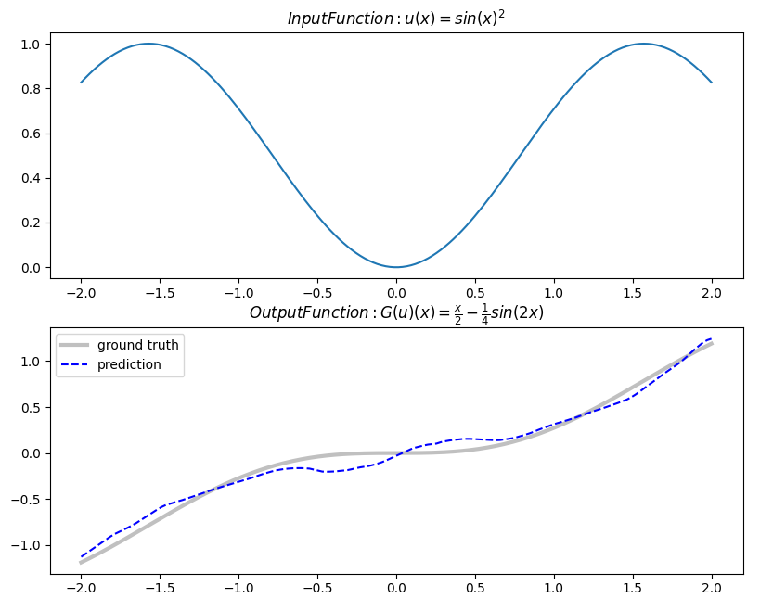
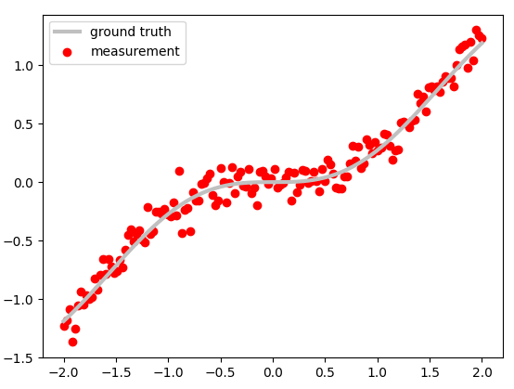
Simulation

Slide 10
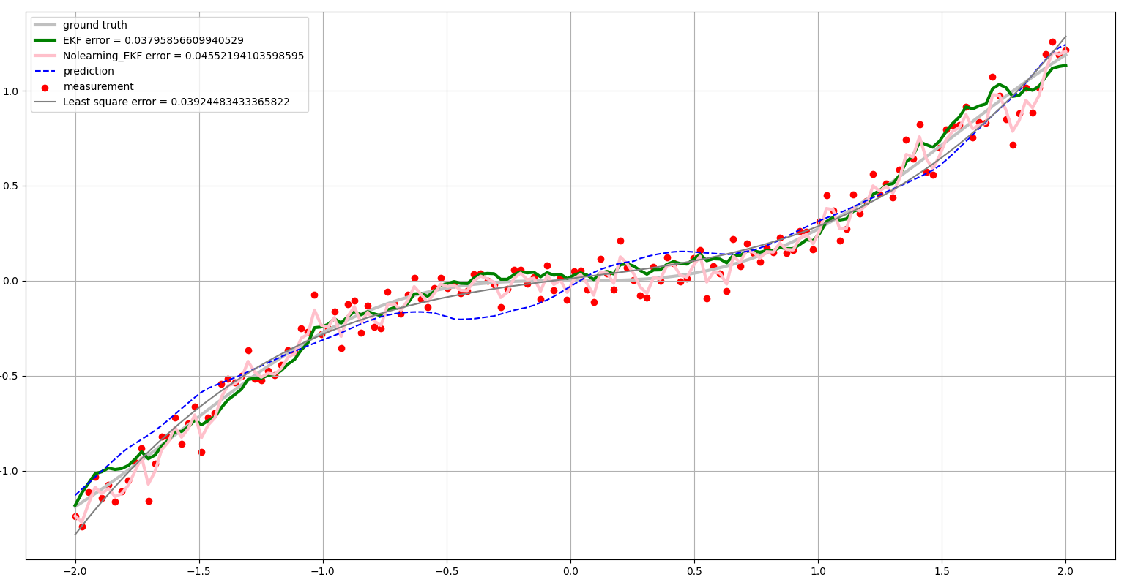
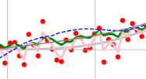
Simulation

Slide 11
Inject Neural Network into Kalman Filter
Thanks for listening

