Slide 1
Supervised learning capstone project
Murali Mandayam
April 15th, 2019

Slide 2
Hypothesis
Classify an automobile driver as “Safe” or “Not-Safe” when they buy insurance
Why do we need this classification?
Will the driver initiate a claim within a year of buying insurance?
Actuary need it to keeps premiums low

Slide 3
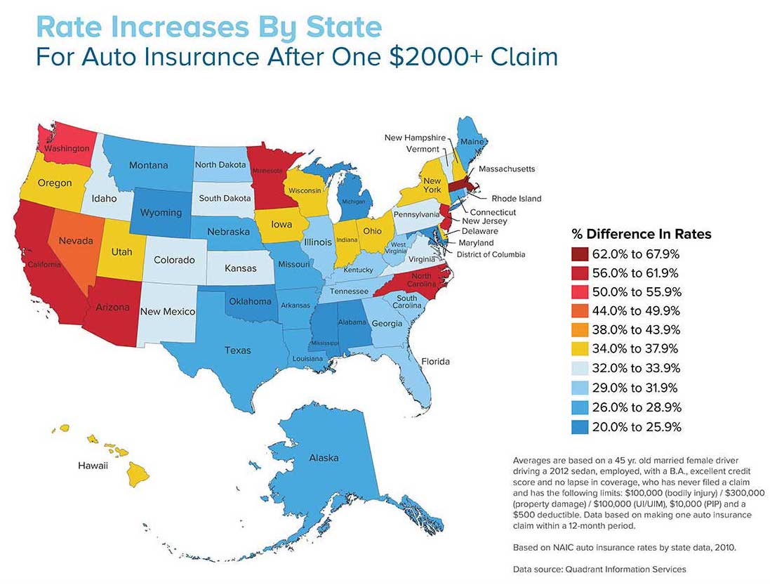

Slide 4
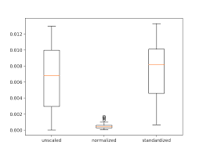
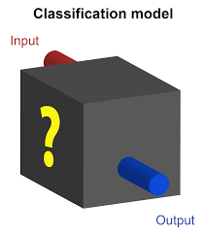
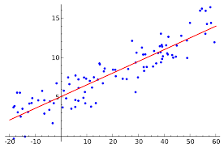
What are we attempting to find?
Driver data/features
Safe Driver
Run thru various models
Not-Safe Driver

Slide 5
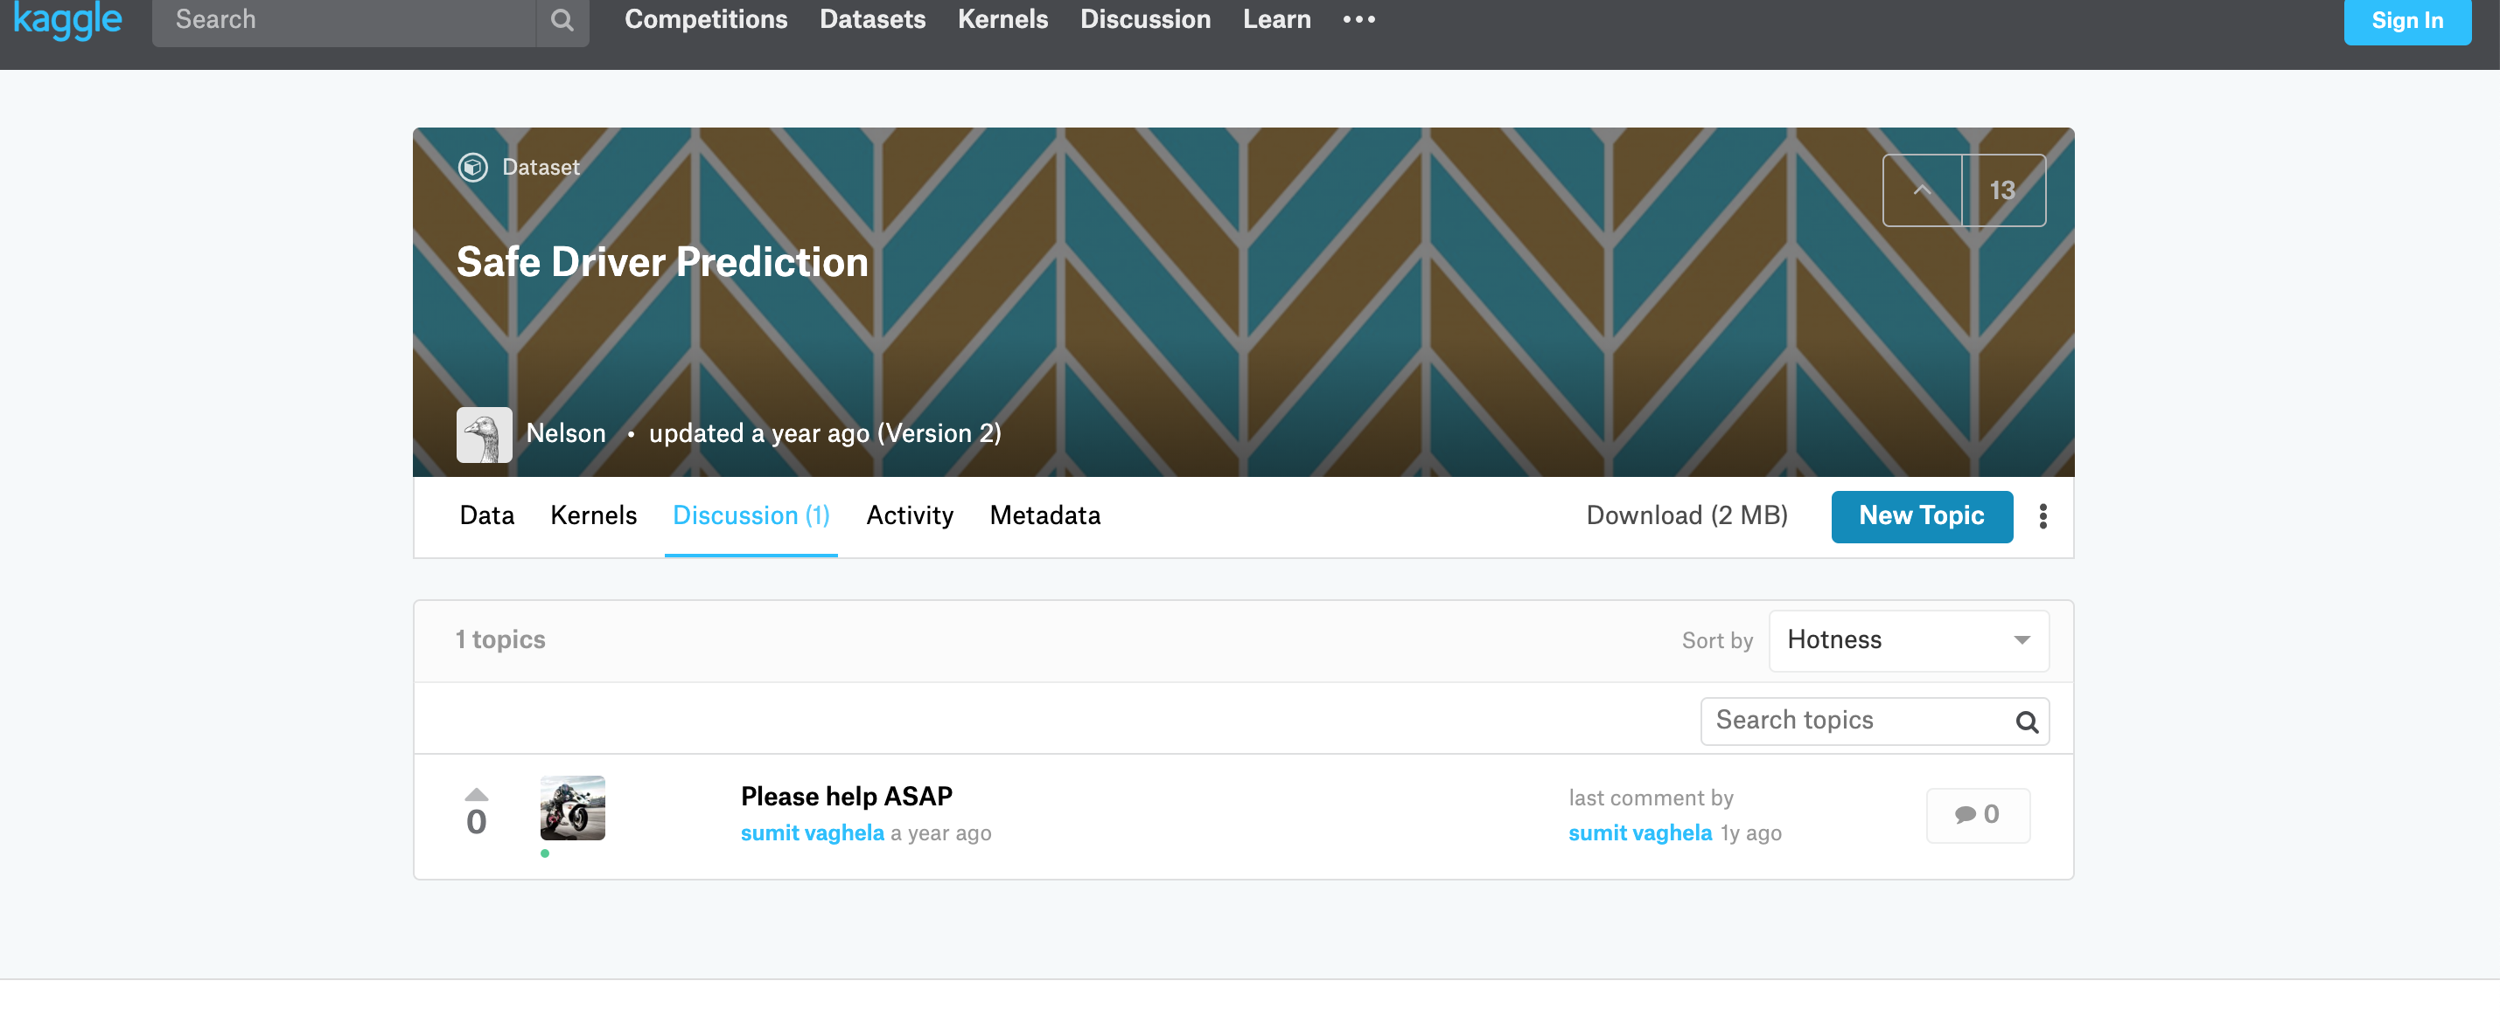
https://www.kaggle.com/mu202199/safe-driver-prediction/discussion

Slide 6
ID 30240 non-null int64
target 30240 non-null int64
Gender 30240 non-null object
EngineHP 30240 non-null int64
credit_history 30240 non-null int64
Years_Experience 30240 non-null int64
annual_claims 30240 non-null int64
Marital_Status 30240 non-null object
Vehicle_Type 30240 non-null object
Miles_driven_annually 30232 non-null float64
size_of_family 30240 non-null int64
Age_bucket 30240 non-null object
EngineHP_bucket 30240 non-null object
Years_Experience_bucket 30240 non-null object
Miles_driven_annually_bucket 30232 non-null object
credit_history_bucket 30240 non-null object
State 30240 non-null object
Data Cleaning
and
Pre-processing

Slide 7
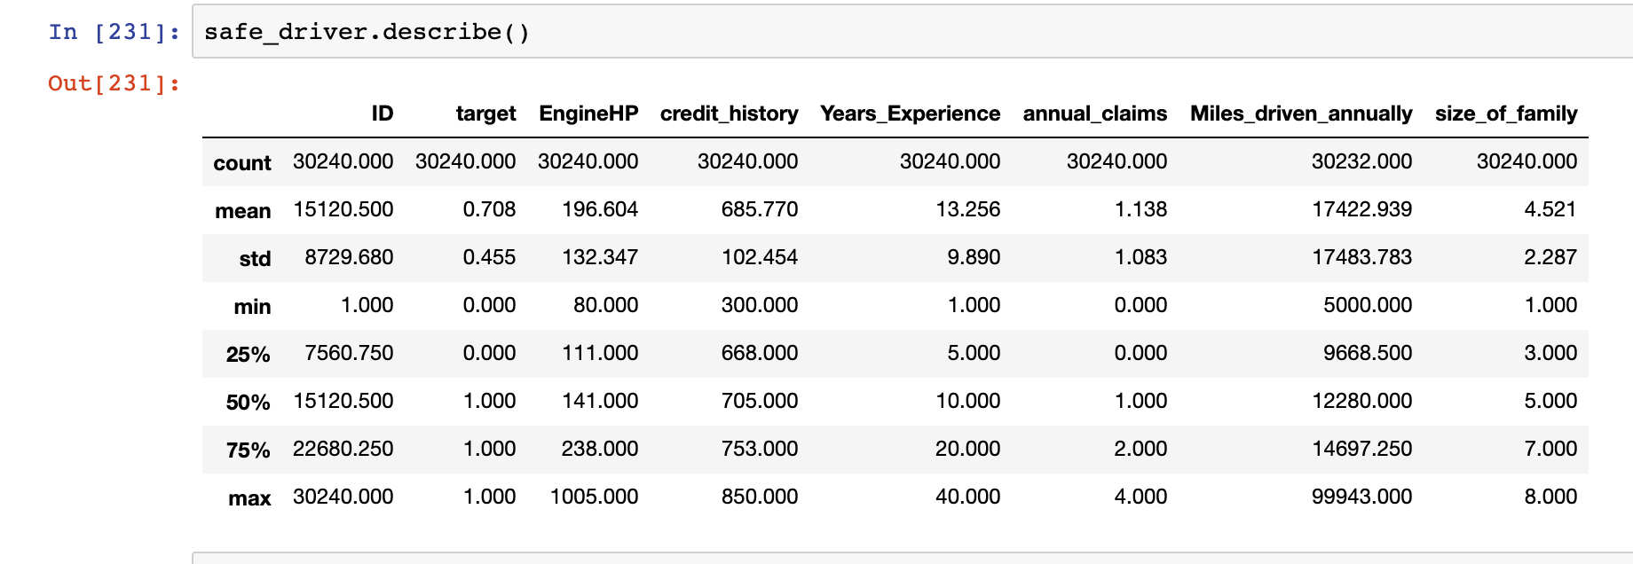

Slide 8
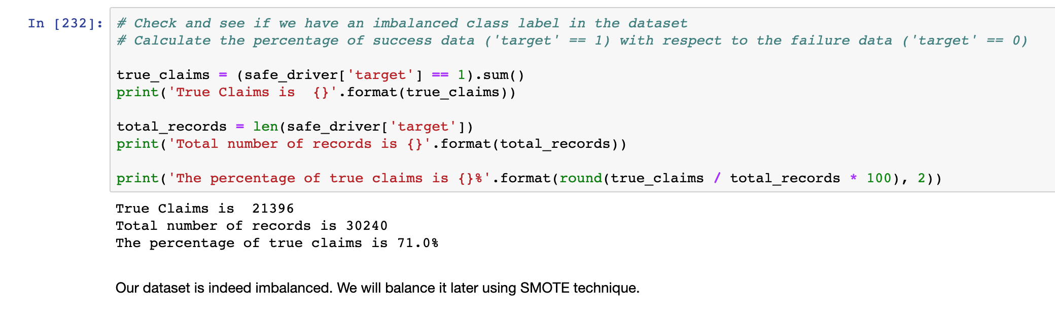
Check to see if the dataset is balanced or not

Slide 9
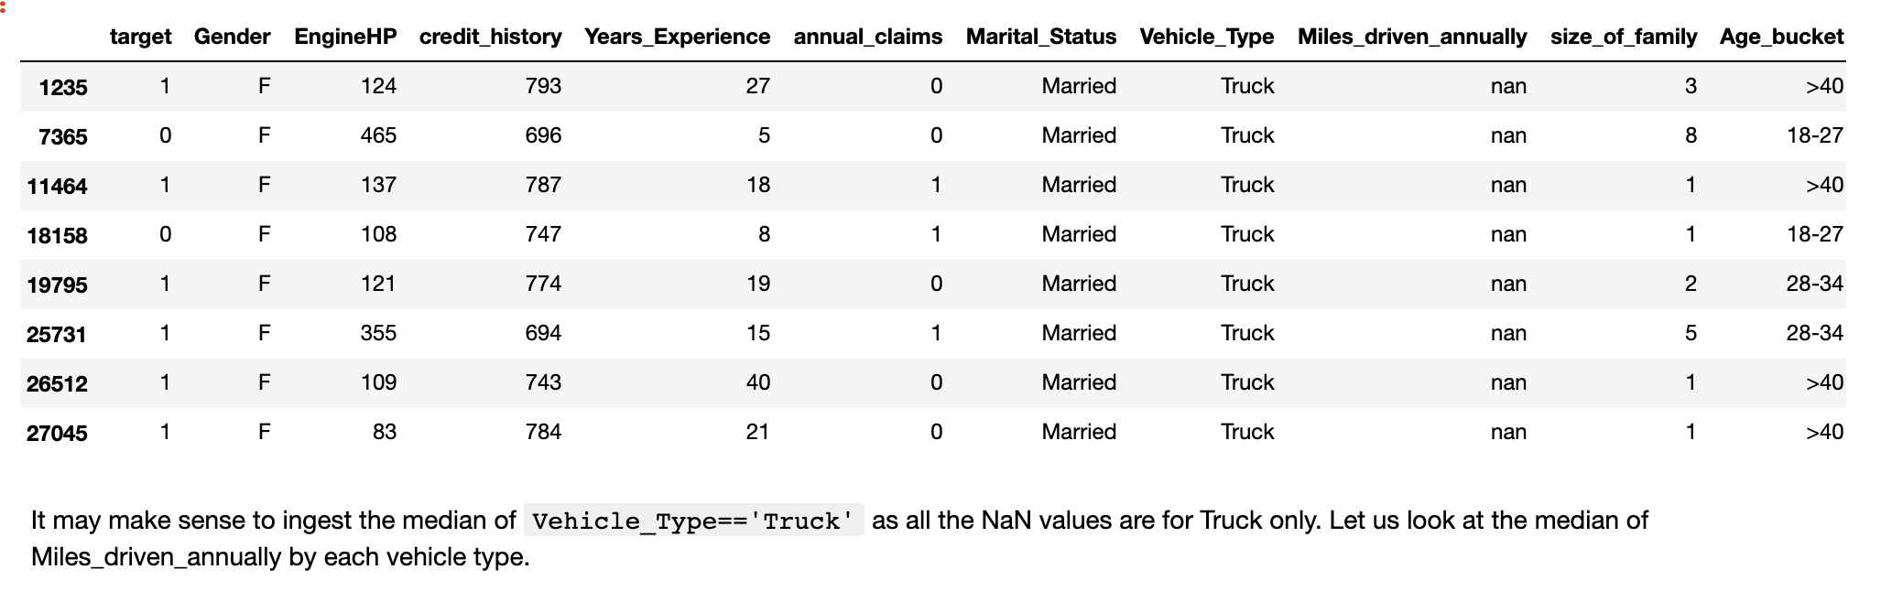
Overall, there are 8 NaN values in a total of 30K+ rows. This is less than 0.03% of the data. Dropping these rows also would work

Slide 10
target 30240 non-null int64
Gender 30240 non-null object
EngineHP 30240 non-null int64
credit_history 30240 non-null int64
Miles_driven_annually 30232 non-null float64
size_of_family 30240 non-null int64
Years_Experience 30240 non-null int64
annual_claims 30240 non-null int64
Marital_Status 30240 non-null object
Vehicle_Type 30240 non-null object
Age_bucket 30240 non-null object
State 30240 non-null object
Scaling of features
EngineHP
credit_history
Miles_driven_annually
size_of_family
Years_Experience
annual_claims
safe_driver_scaled = pd.DataFrame( preprocessing.scale(safe_driver_num_features), columns=safe_driver_num_features.columns)

Slide 11
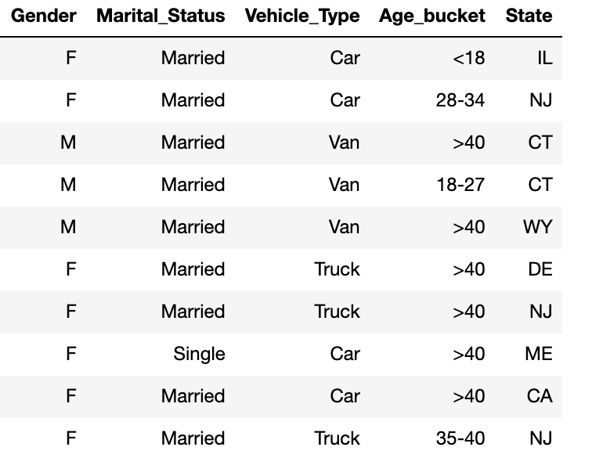
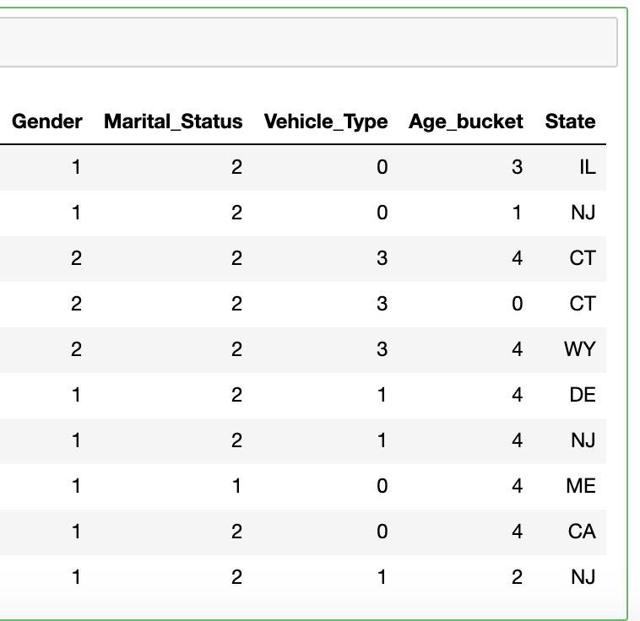
Label Encoding of Categorical values

Slide 12
Results from modeling

Slide 13
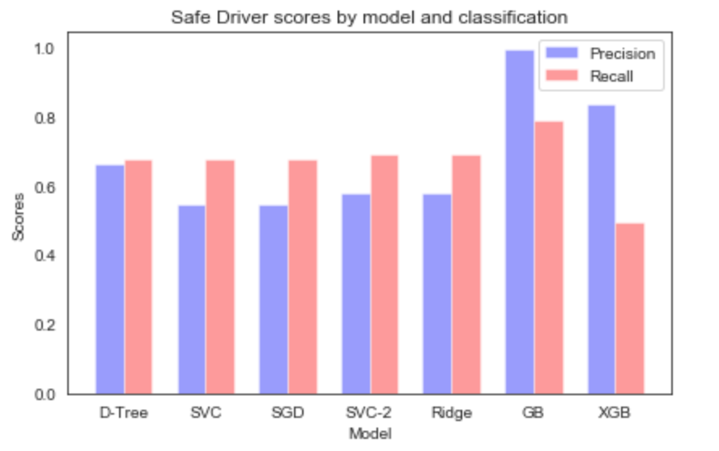

Slide 14
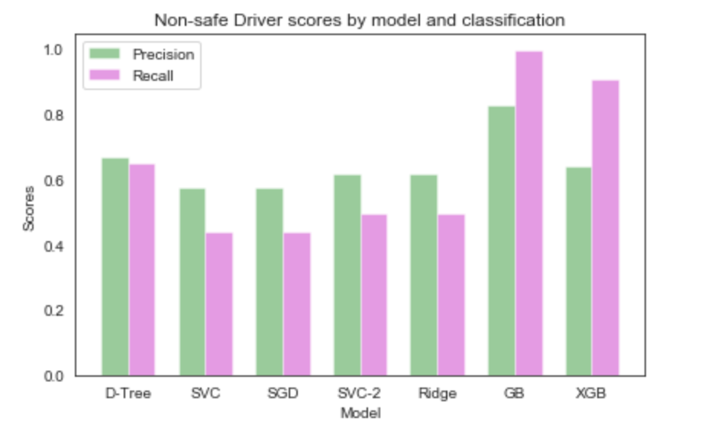

Slide 15
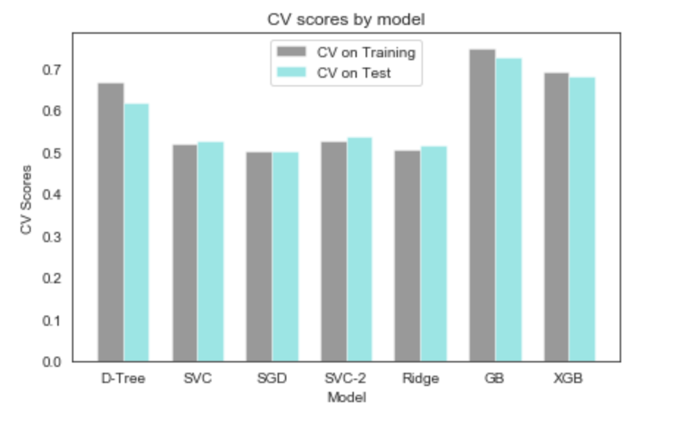

Slide 16
Model | Pros | Cons
Decision Tree | Easy to represent and build model Figures out feature importance Does not suffer multicollinearity (because of feature importance) | Prone to overfitting Needs balanced data
Support Vector Classifier (SVC) | Can model complex, nonlinear relationships Robust to noise (because they maximize margins) | Requires significant memory and processing power Model parameters are difficult to interpret
Stochastic Gradient Descent (SGD) | Minimizes loss function faster | Common learning rate for all parameters Could be noisier (i.e. may oscillate around minimum)
Ridge Classifier | Better fitting models Works well when features are highly correlated | Not good for high number for features
Gradient Boosting | Number of trees, depth of trees, and learning rate make it predict better Uses output of one model as input to the next | Longer time to build models as each model is evaluated independently Harder to tune parameters
Xtreme Gradient Boosting | Parallel processing and thus faster

Slide 17
conclusions
Great experience in transitioning from ‘black box’ knowledge to appreciating how the models work
Good insight into how actuaries use data to calculate premiums
This is not the end. Next step is to find lot more training data and do more tuning to arrive at better results
References:
https://www.kaggle.com/mu202199/safe-driver-prediction - for dataset
https://github.com/ngbolin/PortoSeguroXGB - Kaggle project using Brazilian Insurance company data
https://www.datacamp.com/community/tutorials/categorical-data - For ideas on converting categorical data to numeric
https://towardsdatascience.com/one-hot-encoding-is-making-your-tree-based-ensembles-worse-heres-why-d64b282b5769 -For ideas on converting categorical data to numeric

Slide 18
Thank you!

Slide 19
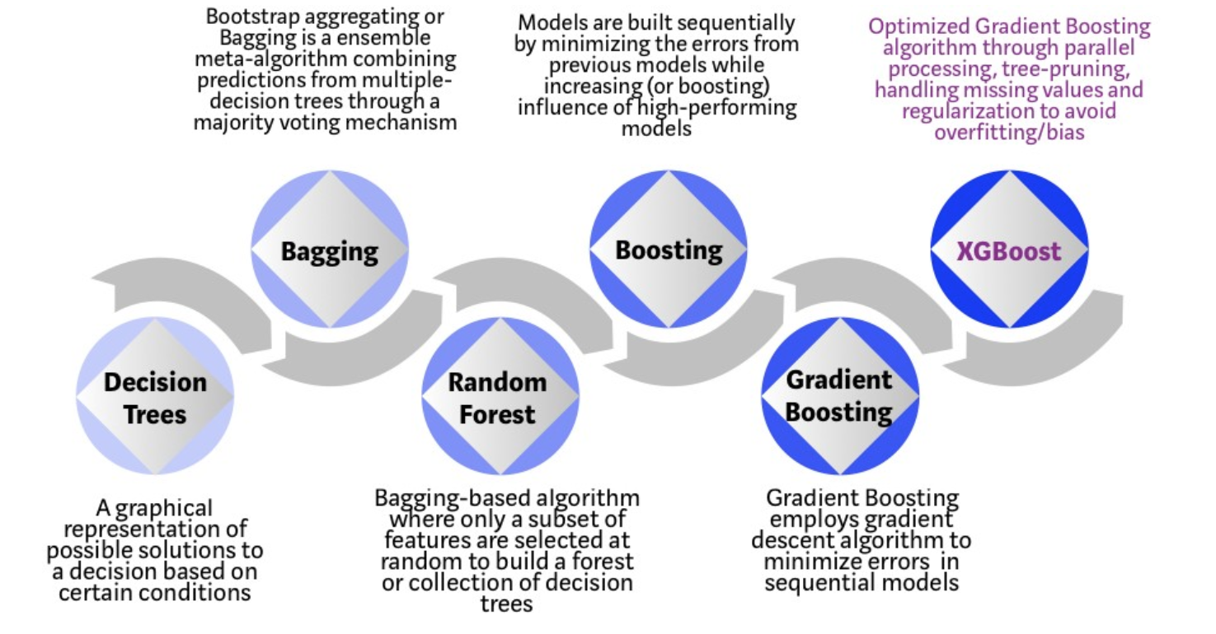

Slide 20
