Slide 1
DESCRIPTION
It is a platform where people can consult to get ideas for situations that they have not yet encountered but may encounter. In addition, users can exchange ideas by sharing their own experiences. They can ask a question about a topic and get answers from different perspectives.

Slide 2
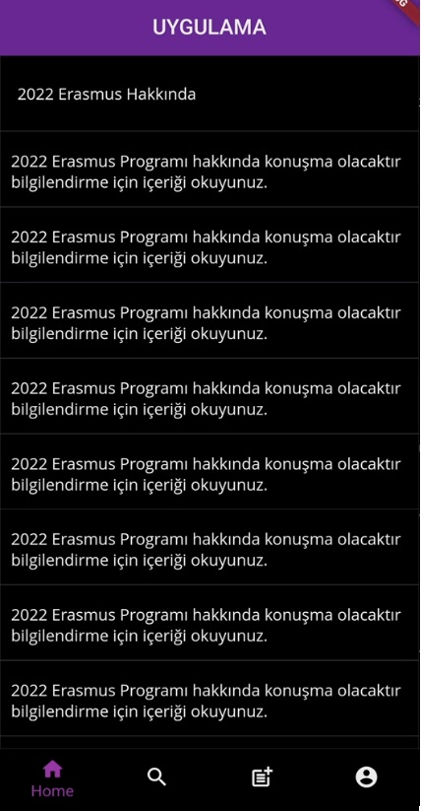
SE373 MOBILE PROGRAMMING SYSTEM ARCHITECTURE 190704037 Haluk AYDIN
HOME PAGE
Each heading is the title of the post it contains. When you click on the title, it will direct you to the mail it is defined for.
This is BottomNavigationBar. This bar is designed to switch between pages.
This button will take you to the home page.
This button will redirect you to the createpost page.
This button will take you to the search page.
This button will redirect you to the login page.

Slide 3
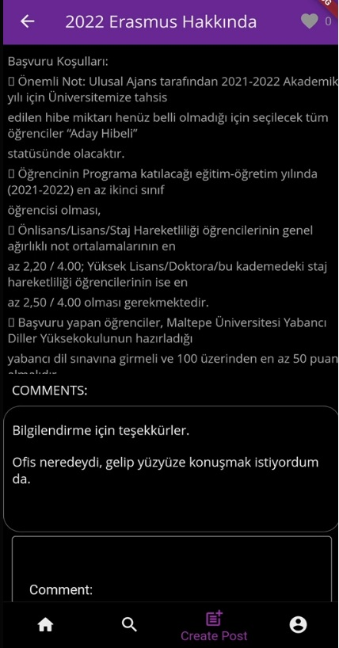
You can see the title and content of the post created on this page, read the comments about it and make your own comment, as well as see how many likes it has received.
POST PAGE
In this section, you can see the number of likes the post has received.
This is the title of the post.
This part is the content of the post.
In this section, you can see the comments about the post.
You can comment on the post in this section.

Slide 4
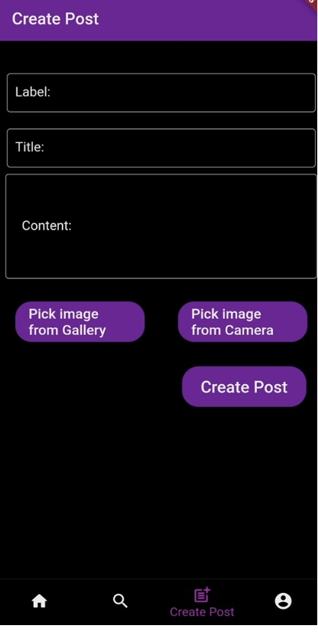
This page is designed for post creation. You must specify the label title and content for the post you will create on this page. No field can be left blank. You must also be logged in to create a post.
CreatePost PAGE.
In this section, you must specify the label of your post.
In this section, you must specify the title of your post.
In this section, you must specify the content of your post.
You can choose the picture you want from the gallery or your camera, but no pictures are added to the posts yet.
When you click this button, it will redirect you to the post you created.

Slide 5
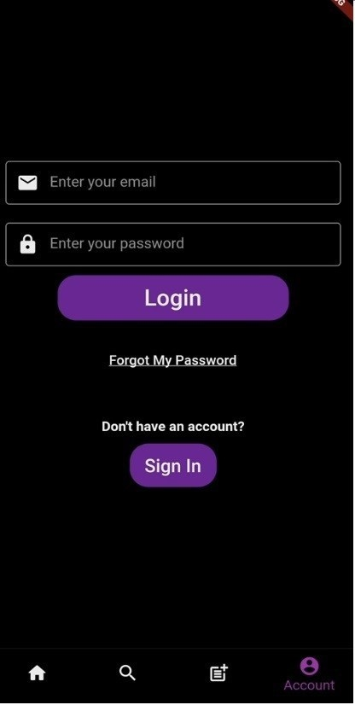
You must have an account to log in. If you do not have an account, you can create an account from the Sign In button.
LOGIN PAGE
You need to enter your e-mail in this section.
You must enter your password in this section.
This button will direct you to the loggedpage.
If you do not remember your password, click this button. The button will redirect you to the resetPassword page.
If you do not have an account, click this button. This button will redirect you to the signIn page.

Slide 6
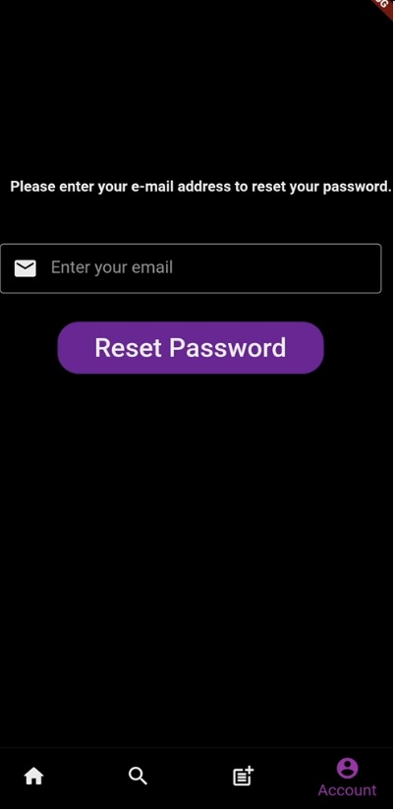
ResetPassword PAGE
On this page, you can send a password reset request to your e-mail by entering the e-mail to which your account is linked.
Enter the e-mail to which your account is linked here.
This button will send a password reset request to the email you entered.

Slide 7
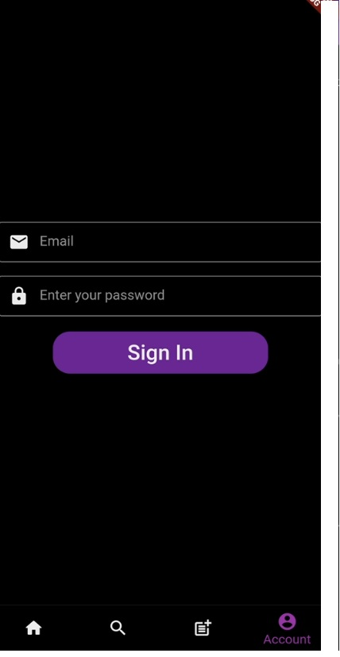
To create an account on this page, enter a valid e-mail and create a password containing at least one letter.
SignIn PAGE
Enter your e-mail in this field.
Enter a password containing at least one letter in this section.
This button will create an account with the information you entered above and direct you to loginPage.

Slide 8
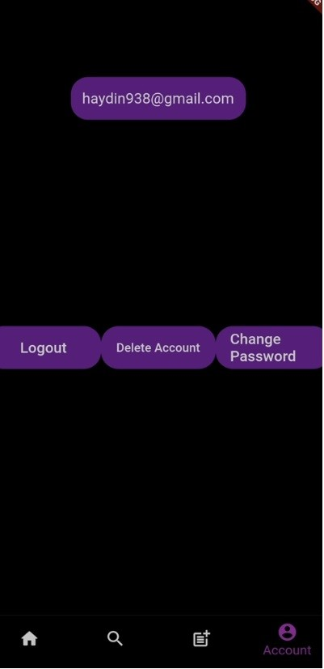
LOGGED PAGE
On this page, you can log out of your account, delete your account or change your password.
Here you can see the e-mail you have linked to your account.
You can logout with this button.
You can delete your account with this button.
You can change your password with this button.

Slide 9
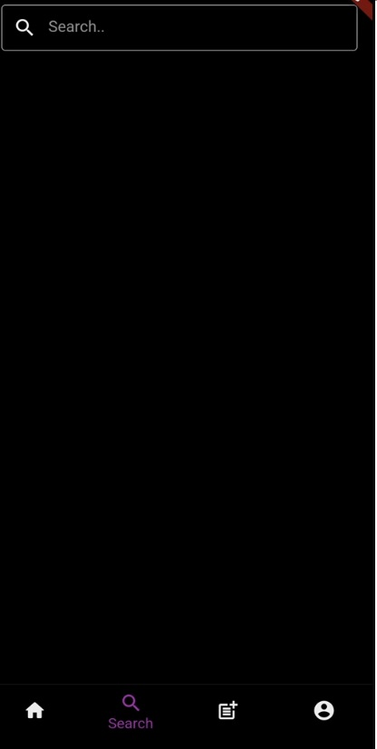
Search Page
You can search between posts on this page, but this search doesn't work with the database yet.
You can enter the post title you are looking for in this section.

Slide 10
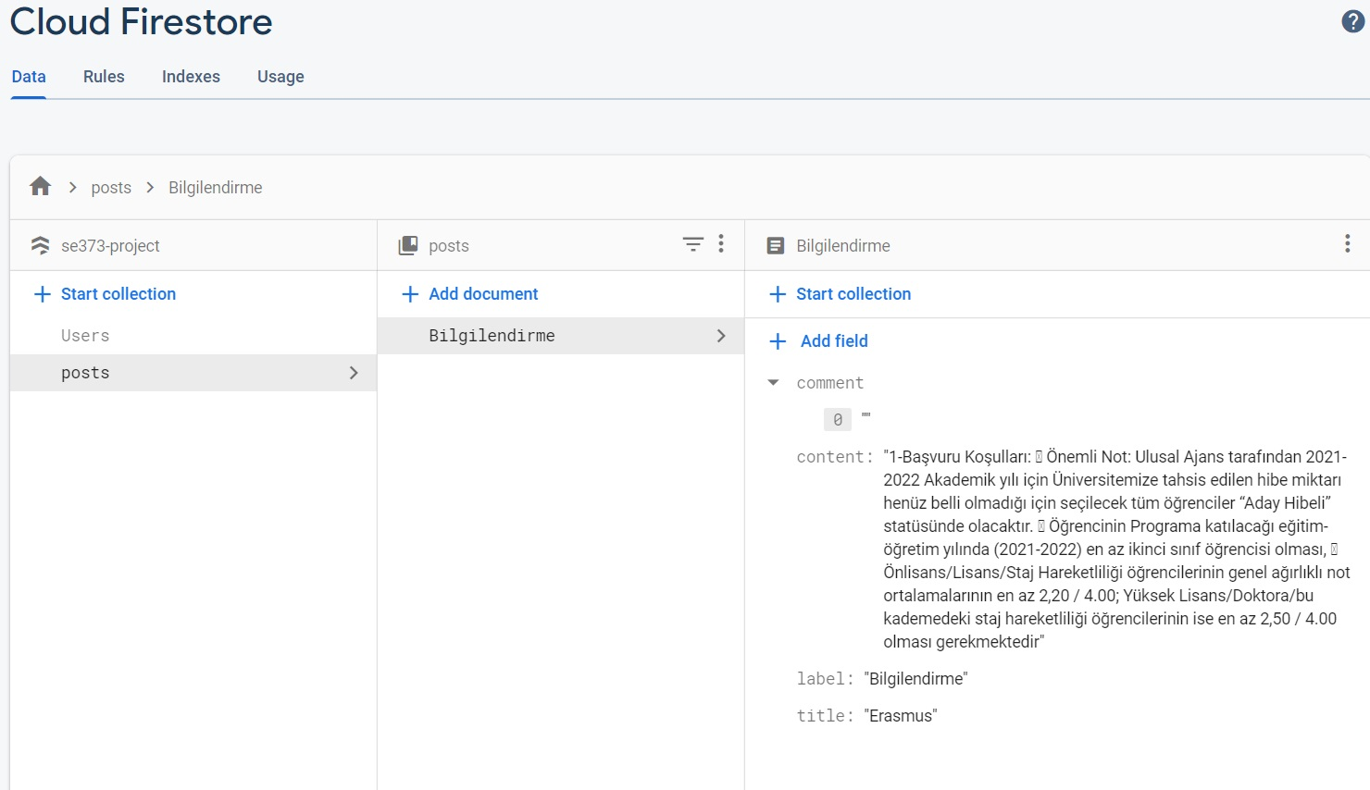
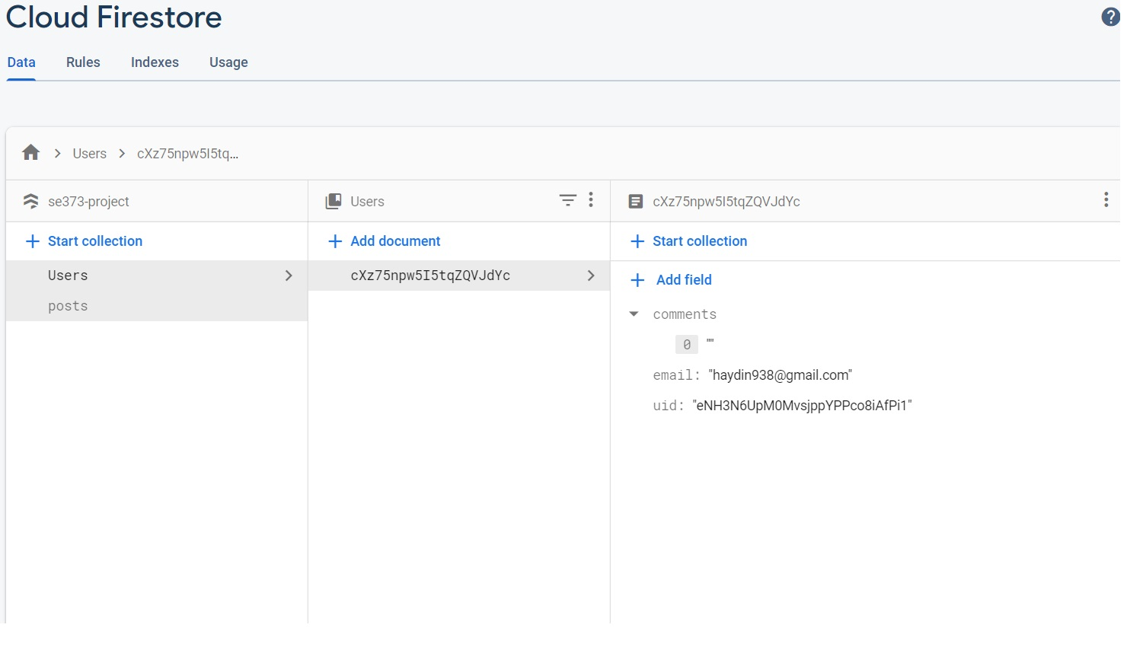
This Firestore Database is where posts are stored. For storage, a collection is first created and data is stored in that collection under the name of documentation.
Here you can see the email users used to create a membership, their comments and their uids.

Slide 11
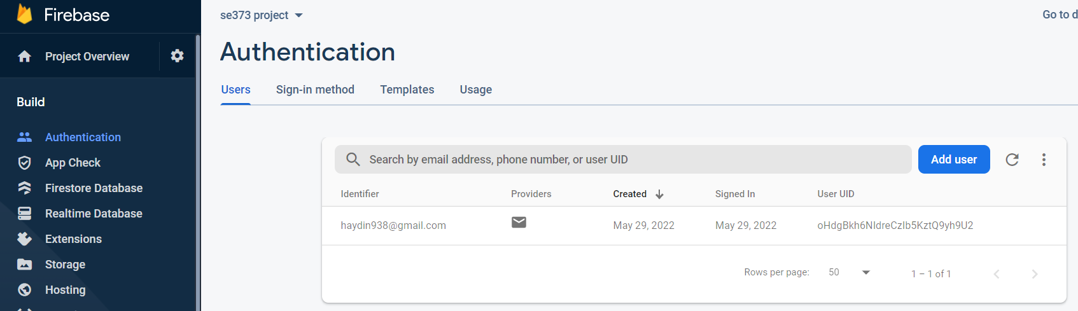
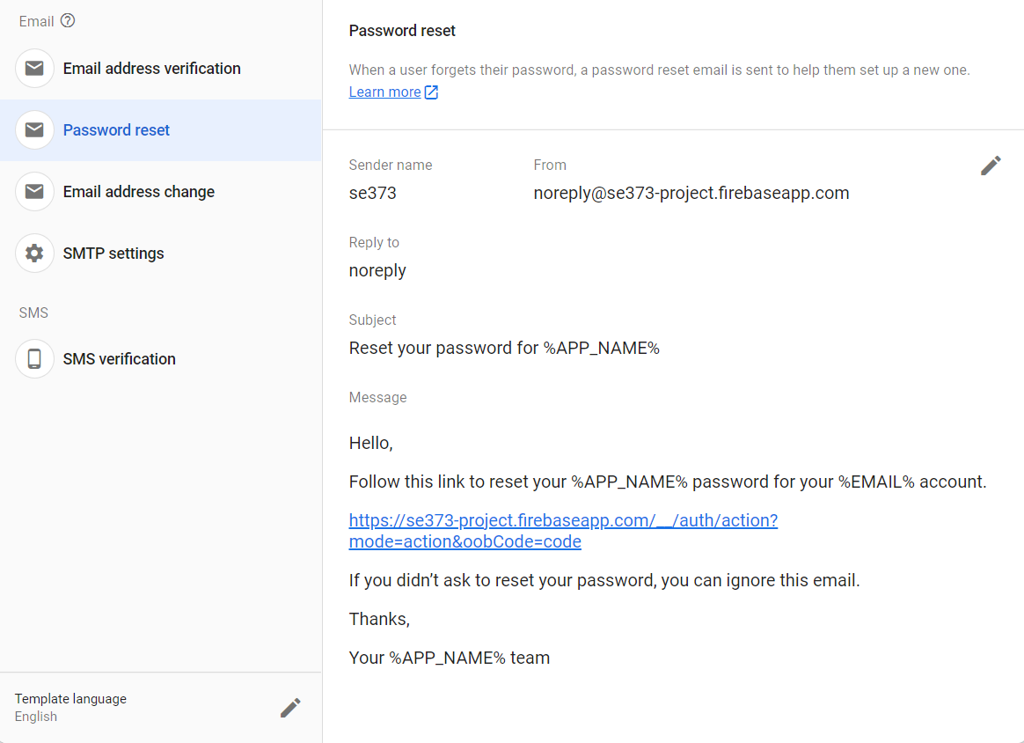
This is firebase authentication. Where created memberships are stored. At the same time, the password reset process is done from the side section.

