Slide 1
System Architecture of My App
Furkan Yaman -190706015

Slide 2
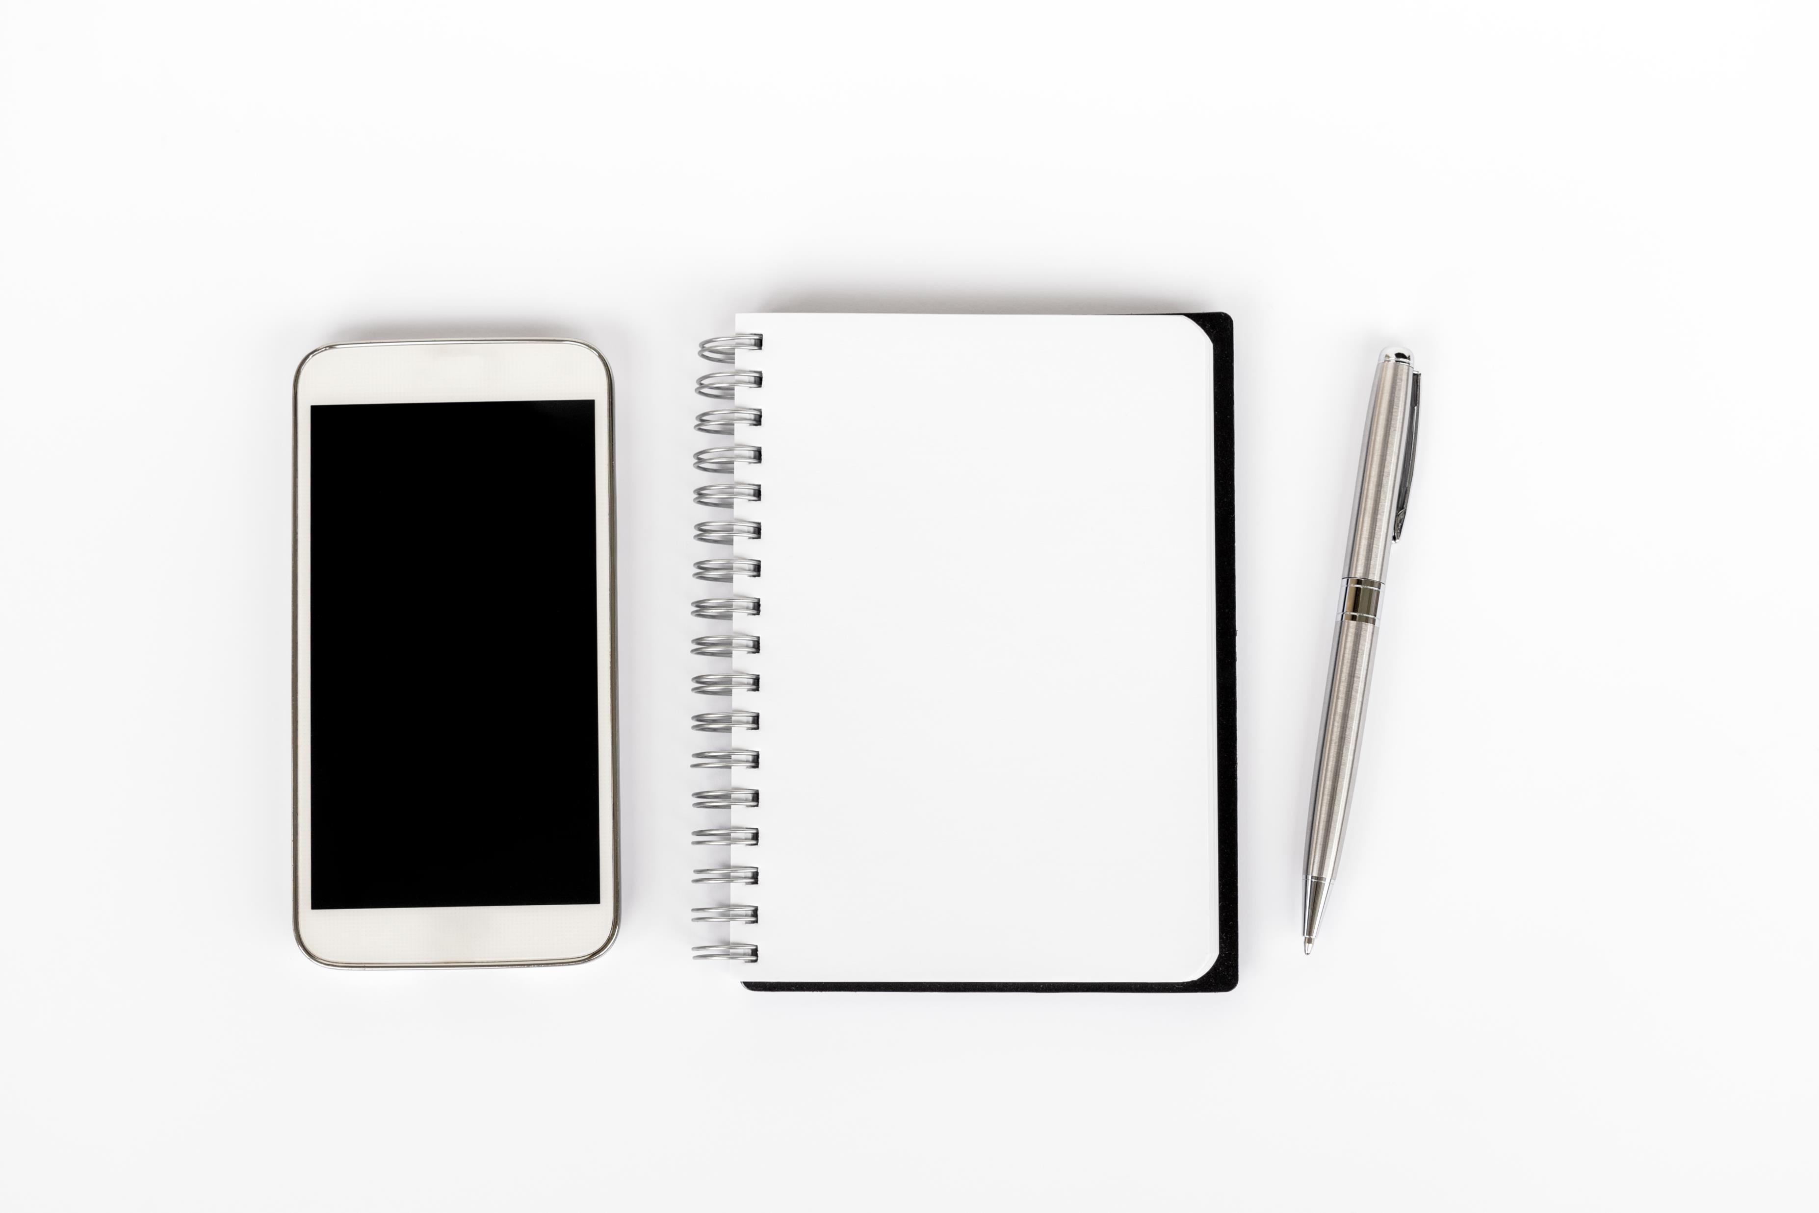
My app Detail’s

Slide 3
Client
Make an emergency call
Saving a to do List
makes a alarm for Medicine Remember System
manages a doctor or givecarries call

Slide 4
Server
request for the emergency Call
Request for Dr.and Givecarries
Be able to login and register
Can do easily take a medicine plan
Can do easily make a call (emergency)

Slide 5
Emergency Contact
If you are not with your parents dont worry! When an emergency situations your parents push just one button and Healthy Crew will help to them.

Slide 6

Medicine Remember System
You dont have to remember When your parents take a medicine
You can use this for your parents medicine timing ,
Also You dont have to remember Which Medicine You take which time?
App is using that for us .You can save medicine and time.It will send a notification

Slide 7
To do List
With this Properties You can check which Activites do your parents,
01
You can see and manage ,your parents healthy situtations you can follow easily.
02
You can change some activites (Which One is better?)
03

Slide 8
Call Dr.and GiveCarries
Your parents can make a call just one push.Dont worry If you are not with your parents ☺
These System for emergency situtations or weekly control etc.

Slide 9
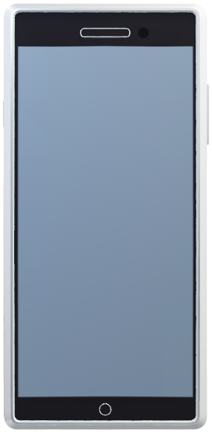
App-Visualization
Main Page
Time UTC+3
To do List
Medicine Remember System
Make a call Dr.and givecarries
Emergency Call

Slide 10
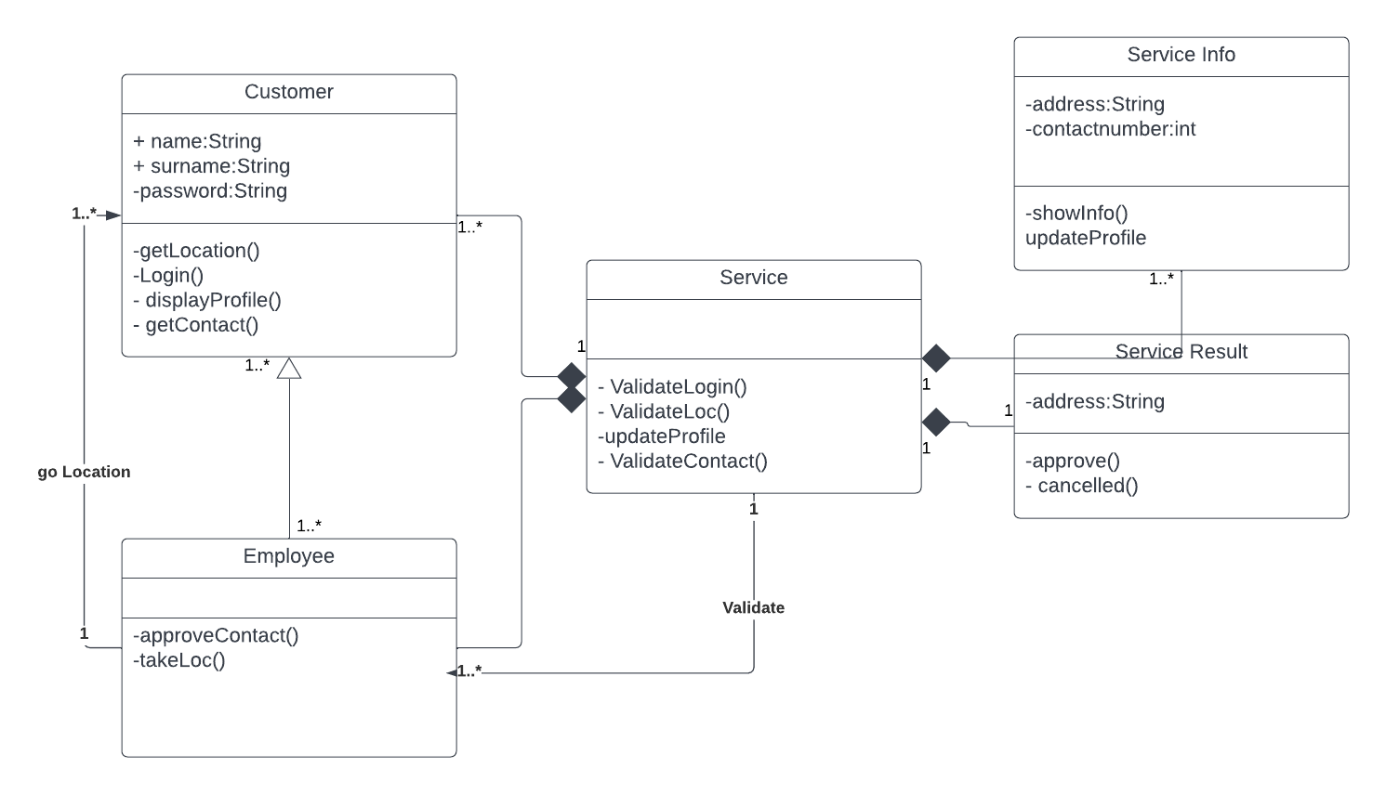
Class Diagram of My Program

Slide 11
Data Tables
In My class Diagram You can see my functions and my datas

Slide 12
Interactions
That’s Our Interaction Between Server and Client
Client
Communication table
Server
Text Files
Call

