Slide 1
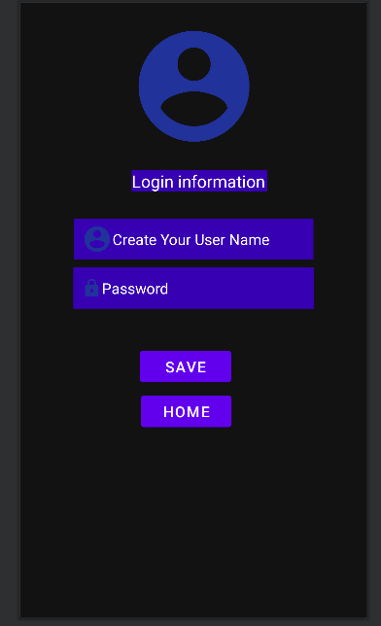
The Icon
This is the page where the app take your information
The name of your choice. You will be able to write your name or nickname
The password of your choice.
The button take your information and save
The button take you to home page

Slide 2
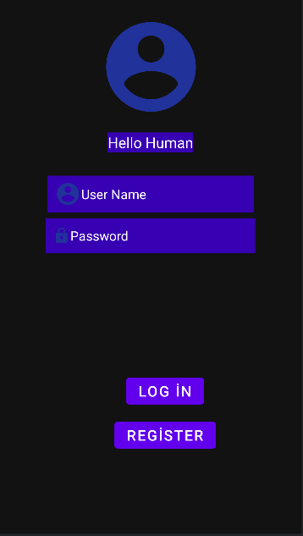
The Icon
Sayin hi to every human being
You need to write you user name to log in
You need to write you password to log in
This is the page you can log in or register
The button take your information and log in
The button take you to Register page so you will be able to register.

Slide 3

The Icon
This is the page you can only see when you succesfully log in
A friendly welcome
The button takes you to Homer(homeowner) page
The button takes you to page where you can share advert
The button takes you to petter(customer) page

Slide 4

You can write your advertisment
The button take you back
The button will be share your ad.

Slide 5
Catty Problem Definition: Long journeys can be harmful for your pet and your trip can be hell. For their health and for your mental health it is okay to be give them for a few days but sometimes your family or friends can’t handle with this. There is a way to help you. Catty will help you with finding good homeowner so you can travel without worrying. Requirments: *Petter -Can create post advert - Can reply the comments *Homer -Can comment to the advert -Can see posts Activities: Main: Log in and Register. You can Log in or you can go to register page Register: Create your account so you can log in Welcome: Choose what are you and what do you need. Become Petter or Homer Petter: Page for pet owner Homer: Page for home owner Page: Write and share an Advert

