Slide 1
Natural Language Processing DTS305TC
Huakang Li
Huakang.li@xjtlu.edu.cn
School of AI and Advanced Computing
Notes:
English Title: Uppercase, Calibri size 60, XJTLU Navy
English Subtitle: Uppercase, Calibri size 36, XJTLU Navy

Slide 2
Group Coursework
Q&A

Slide 3
important information
Due: 5:00 pm China time (UTC+8 Beijing) on Sat. 19th. Oct. 2024
Weight: 40%
Maximum score: 100 marks (80 % group marks + 20 % individual marks by peer assessment)
Groupings: Each group consists of 4-5 students. The detailed grouping table is published in the group assessment section.

Slide 4
Assessed learning outcomes
A.Understand the basic concepts and techniques of Natural Language Processing.
B.Apply statistical and machine learning techniques to process and analyse large-scale textual data.

Slide 5
Overview
Document clustering is an unsupervised learning task in NLP that aims to group a collection of documents into clusters based on their content similarity, without prior knowledge of the groupings.
Unlike document classification, which assigns predefined categories to documents, clustering discovers the inherent groupings within the data.
This task is essential for exploratory data analysis, organizing large document sets, and identifying patterns or themes that may not be immediately apparent.
The key aspects of document clustering include: Text Representation, Feature Extraction, Clustering Algorithms, and Similarity Metrics.

Slide 6
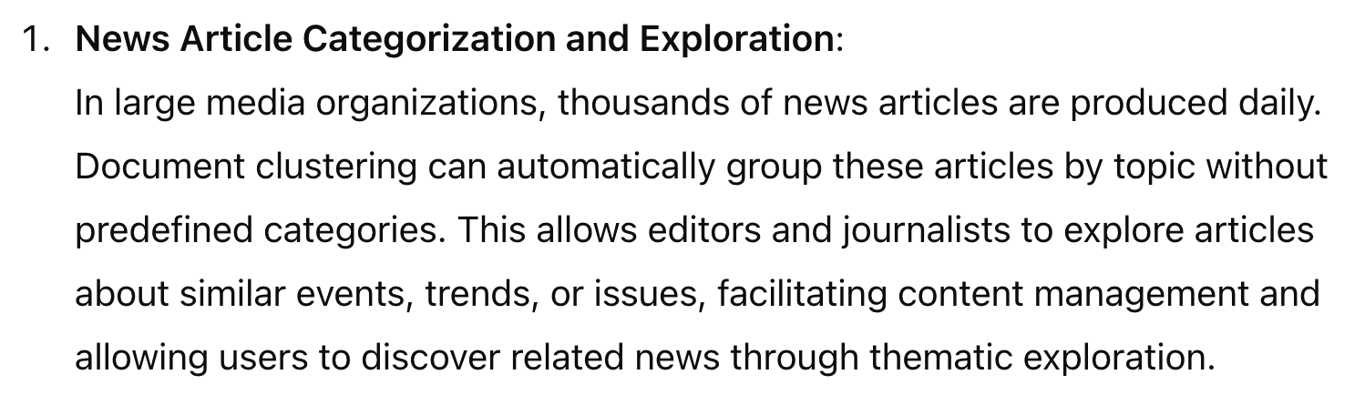
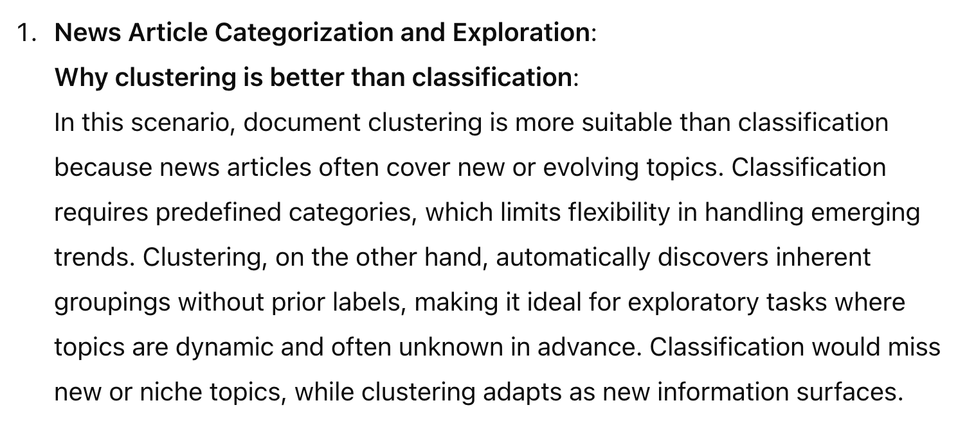
Tasks-1.Background Knowledge (10 Marks)
(1)Please provide 3 real-life application scenarios that require document clustering methods. (6 Marks)
(2)Please analyze why document clustering methods, rather than other natural language processing methods, are the most suitable for these 3 application scenarios? (4 Marks)

Slide 7
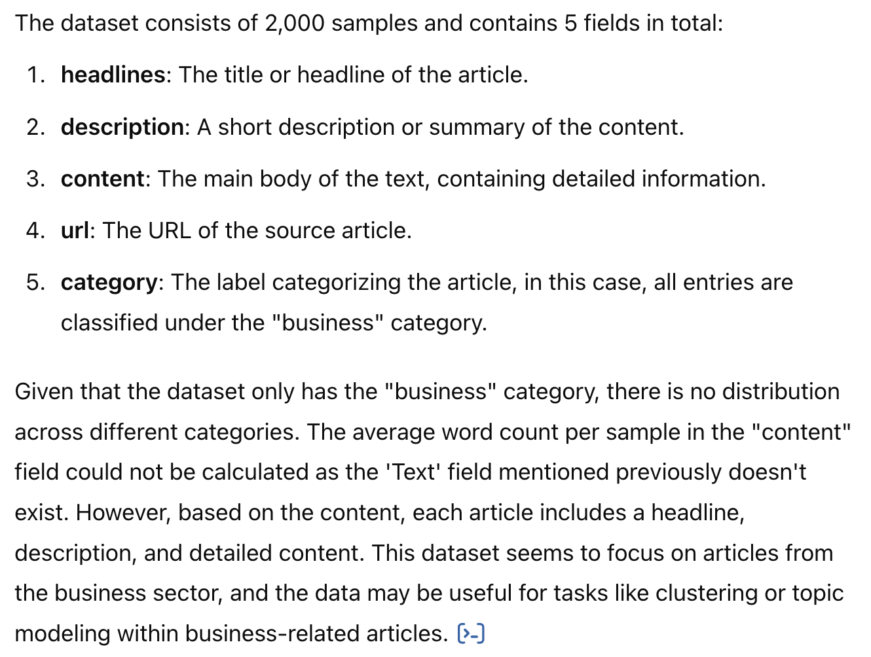
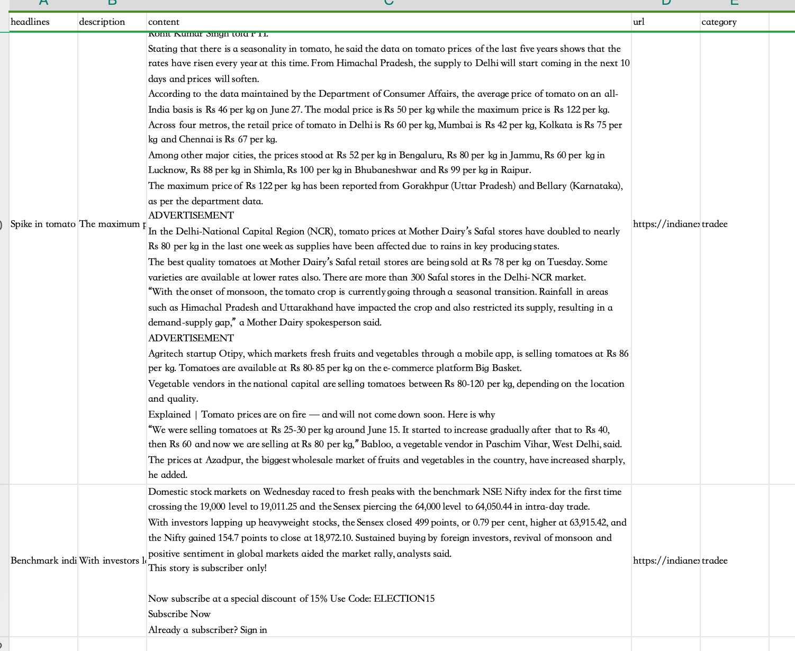
2.Data Collection (15 Marks)
Please collect three text datasets for each of the document clustering scenarios given in Task 1, with a requirement of no less than 2000 samples per dataset for clustering. And provide a 100 word explanation for each dataset, including but not limited to statistical analysis of data samples, feature analysis, and other related content. (5 Marks/dataset x 3=15 Marks)

Slide 8
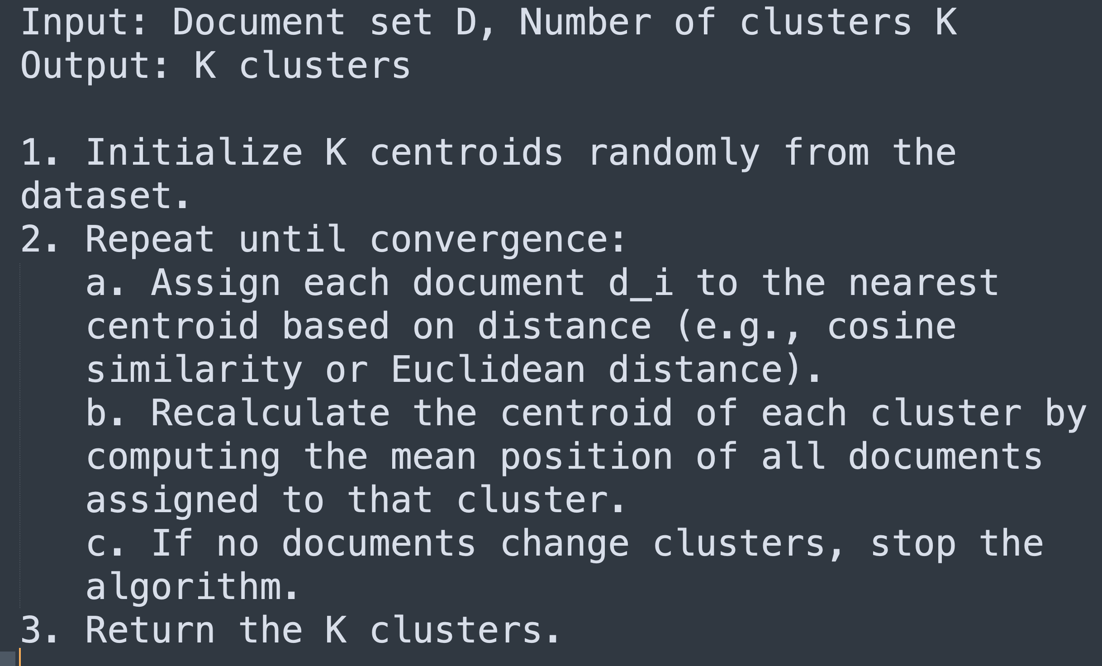
3.Algorithm Design (20 Marks)
(1)Please select three different document clustering algorithms for the datasets in Task 2, and provide pseudo-code for each clustering algorithm. (5 Marks/algorithm x 3=15 Marks)
(2)Please compare the three algorithms in 3.(1) and analyze their advantages and disadvantages. (5 Marks)
Pseudo-code for K-Means Clustering:
Algorithm 1: K-Means Clustering
K-Means is a partition-based clustering algorithm that divides the dataset into a predefined number of clusters by minimizing the distance between documents and their respective cluster centroids.

Slide 9
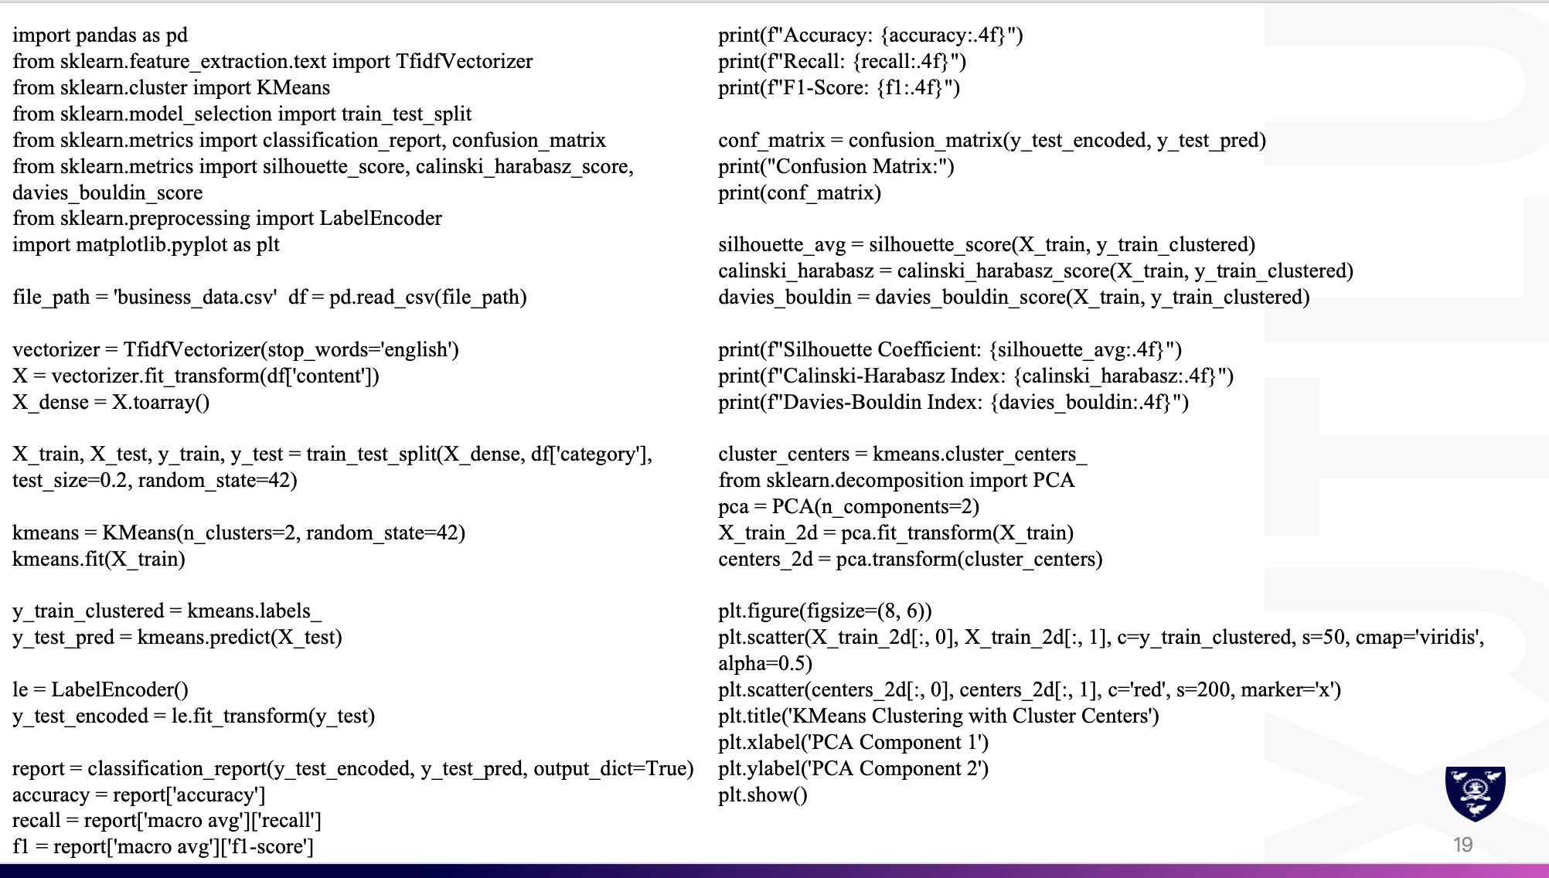
4.Algorithm Implementation (30 Marks)
Please use Python to implement the system development for each clustering algorithm designed in Task 3. System development includes but is not limited to data reading (2 marks), feature processing (3 marks), clustering algorithms (3 marks), results printing (2 marks), and other parts. Please submit the Python implementation of each algorithm as a separate *.py file. Please paste the Python code of the clustering algorithm function in the report. (10 Marks/algorithm x 3 = 30 Marks)
Lab7 Slide10

Slide 10
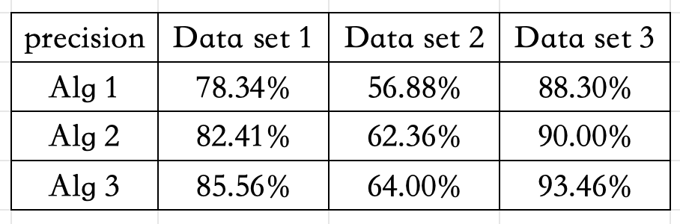
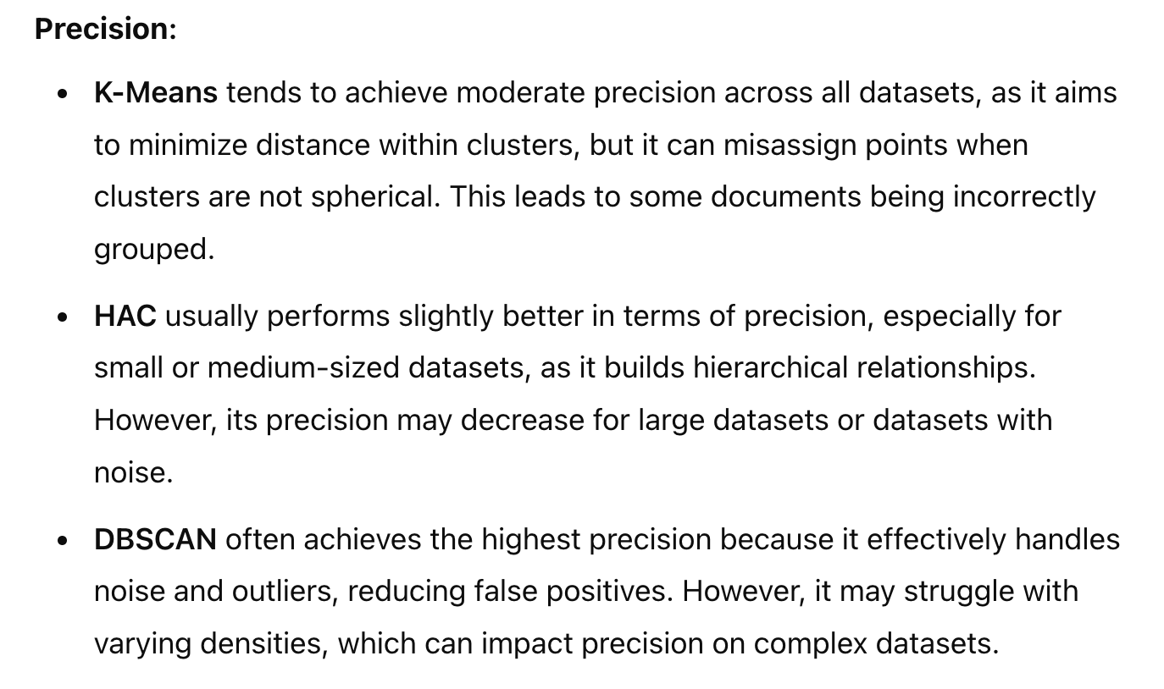
5.Results Analysis (20 Marks)
(1)Please provide the clustering results of each algorithm for three different sample datasets, including precision (3 Marks), recall (3 Marks), and F1 score (4 Marks).
(2)Please discuss the different performances of different clustering algorithms in precision (3 Marks), recall (3 Marks), and F1 score (4 Marks).

Slide 11
6.Report Quality (5 Marks)
This coursework not only assesses everyone's algorithm comprehension and implementation abilities, but also exercises your professional knowledge in terms of terminology, algorithm design expression, experimental result presentation, and the readability of function variables and function logic. Please be cautious about the quality of the report. (5 Marks)
Report structure consistent with the requirements
Primary title or secondary title
Font of the main text consistent
Images and tables have captions
Word count meet the requirements

Slide 12
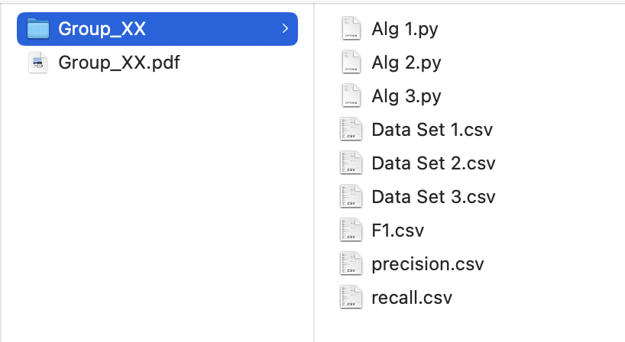
Submission
A Group_ID.pdf file contains a cover letter with your group member information, and all the task report content.
A Group_ID.zip file contains your program implementation and output files, such as dataset1.csv, dataset2.csv, dataset3.csv, algorithm1.py, algorithm2.py, algorithm3.py, precision.csv, recall.csv, F1.csv.

Slide 13
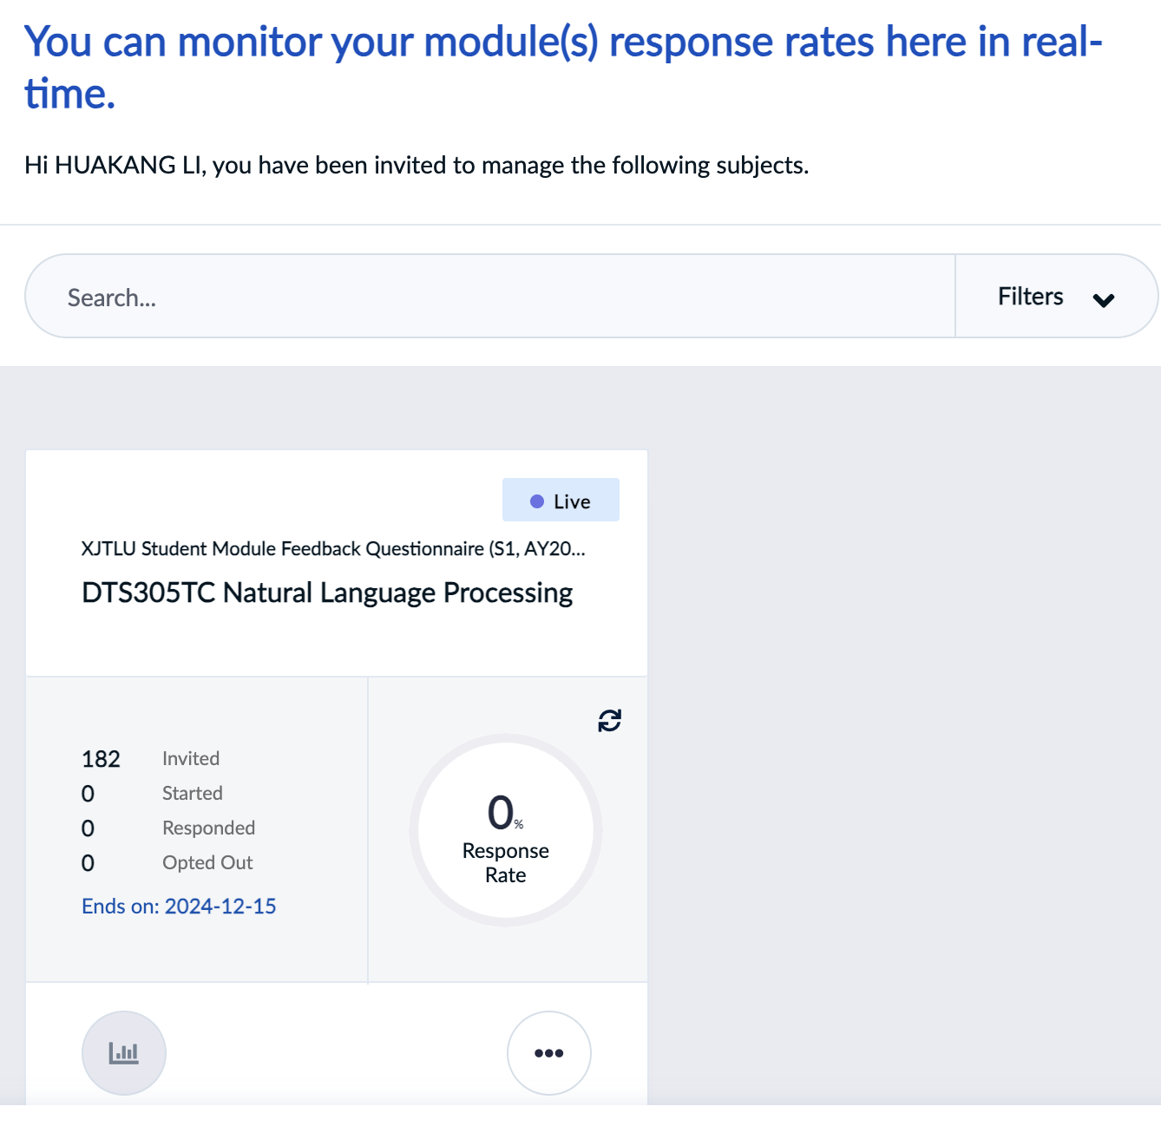
MQ
https://mq.xjtlu.edu.cn/
Ends on 2024/10/21

Slide 14



THANK YOU
Visit us
FOLLOW us
www.xjtlu.edu.cn
Notes:
Title: Uppercase, Calibri size 60, XJTLU Navy

