Slide 1
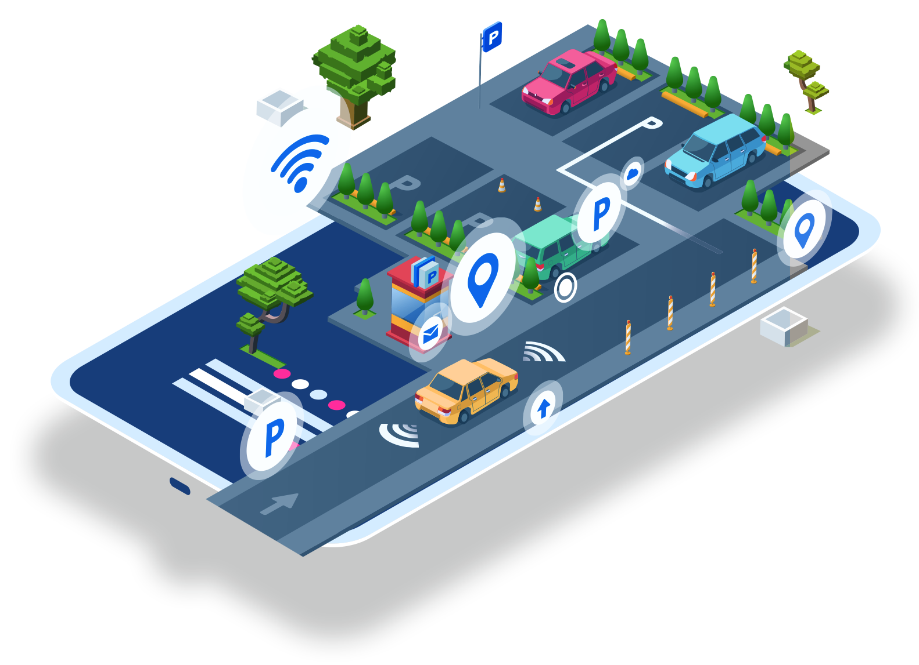
Pclick
Monitor & Pay by 1 Click
Jan 2022
NTI IoT Graduation Project

Slide 2
Who we Are ?
Mo'men Hesham Hassan
Asmaa abdelnaser hussien
Mayar Mansour Ezzat
Mokhtar Mohammed Mokhtar
Zeinab Muhammad AlGhoryb
Mohammed Hamada Mohammed

Slide 3
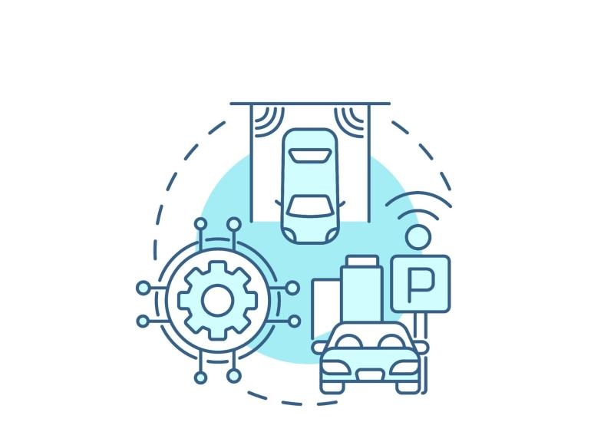
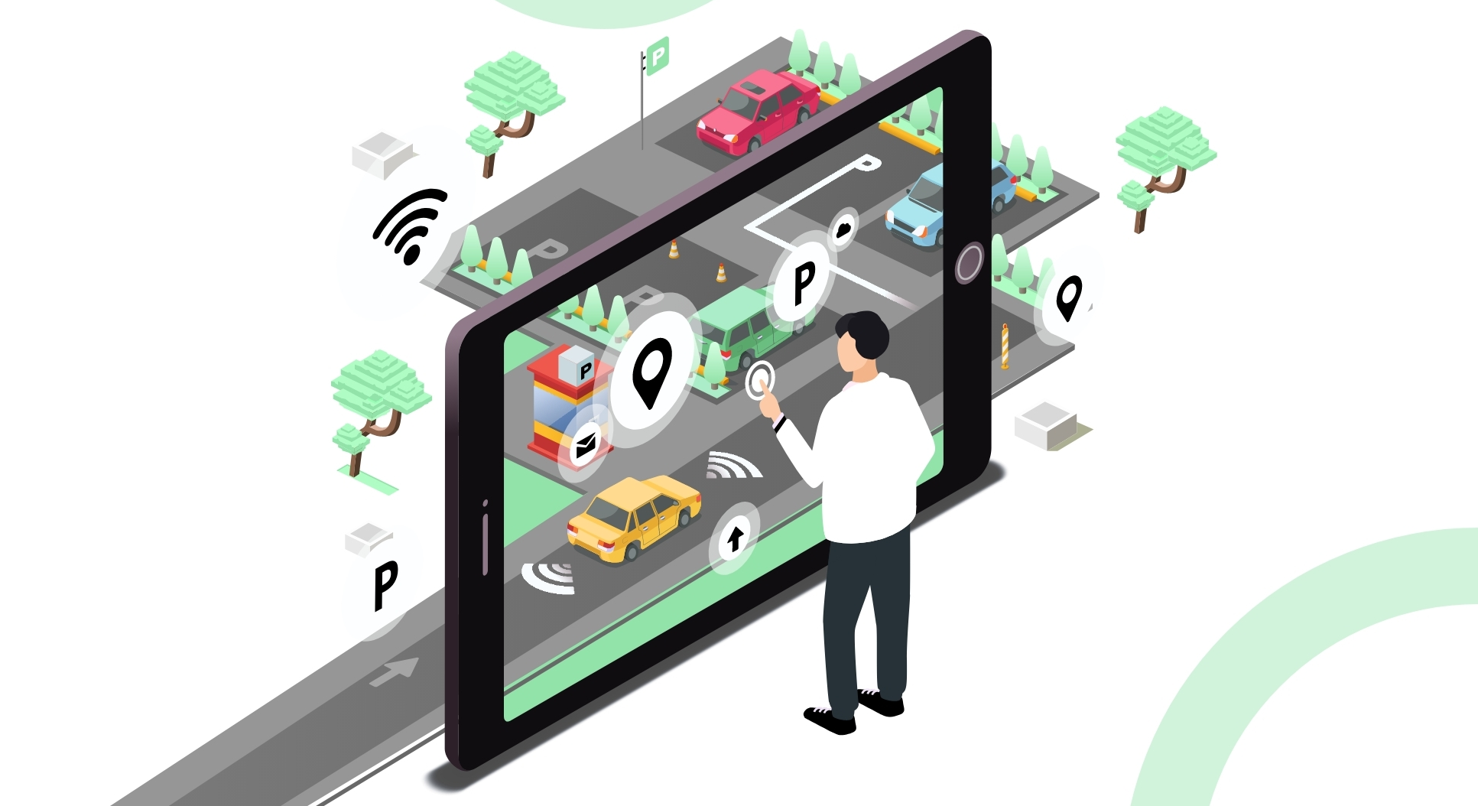

Why smart Parking ?
Data Driven Decision , Are the best decision
Save Your Fuel & Time
Monitor Your facility
More profit

Slide 4

Take Your Retail to the Next Chapter !

Slide 5

No More Assumptions !
collect much more data about Your
customers and their shopping habits
improve brand experiences accordingly.

Slide 6
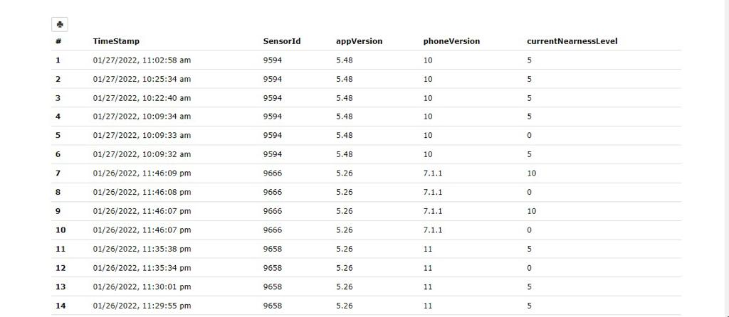

Slide 7
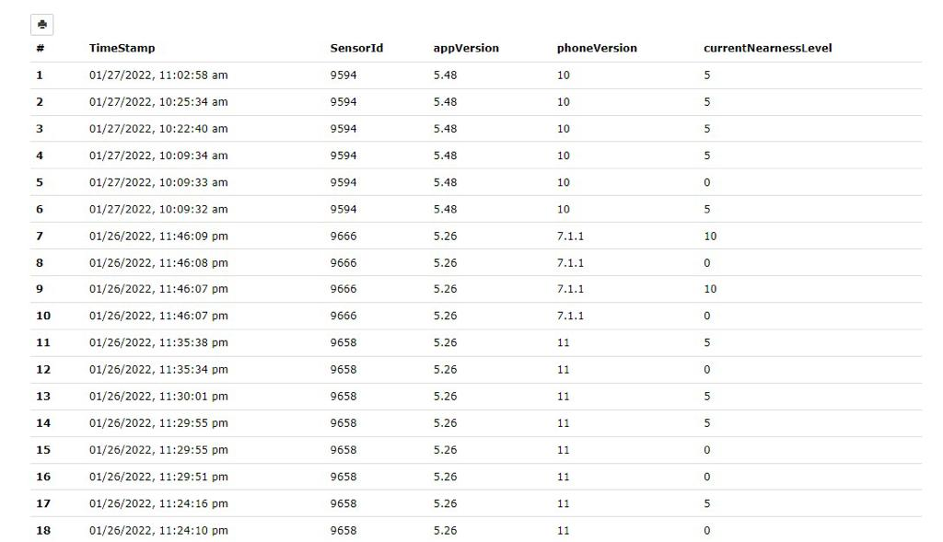

Slide 8
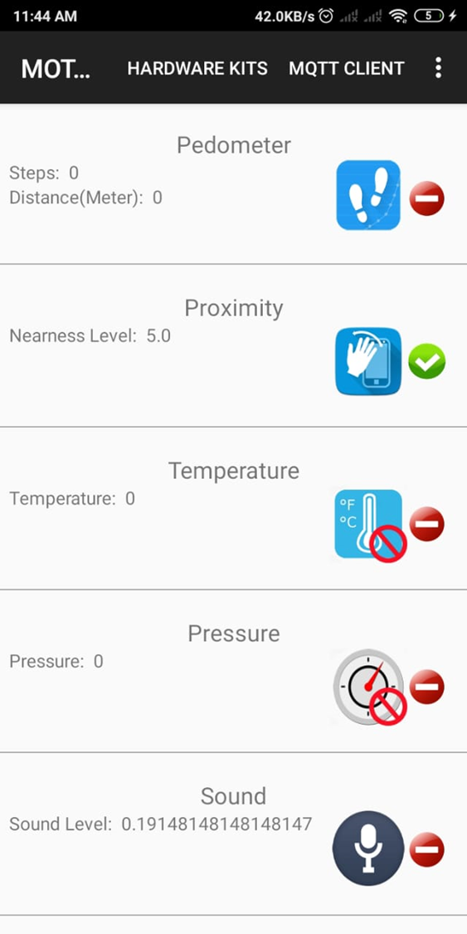
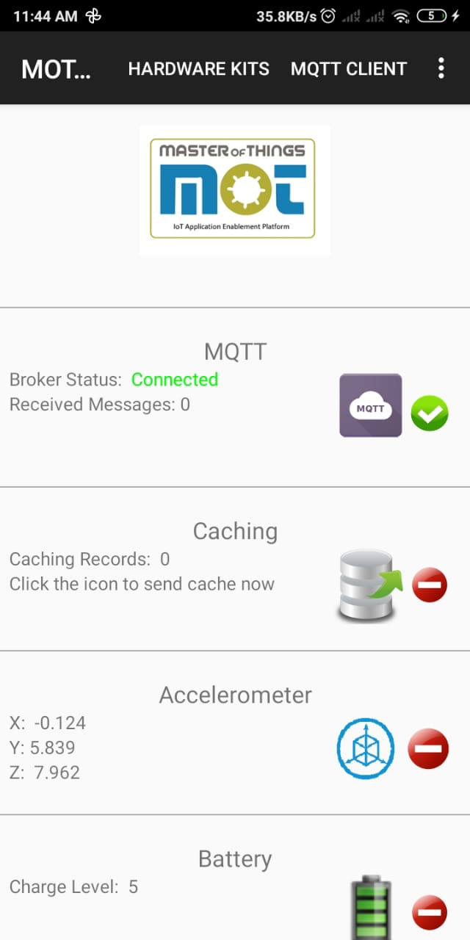
What Is Our Solution ?
Real Time Slot Monitoring
Sensor Type :
Proximity Sensor
Support :
MQTT Protocol
Data Rate :
Every Change

Slide 9
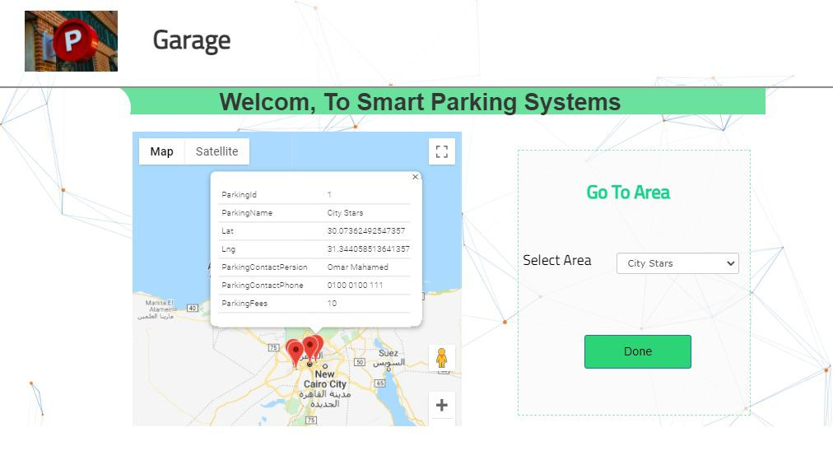
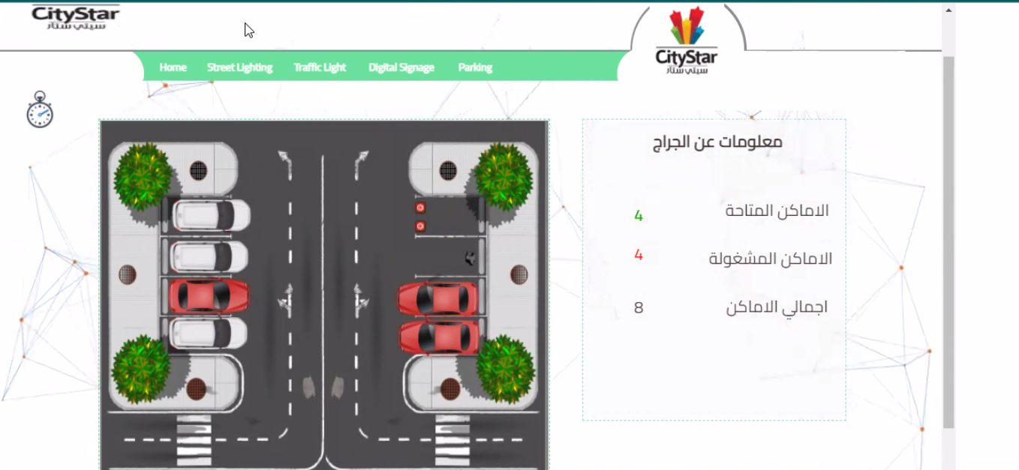
Pclick UI:

Slide 10
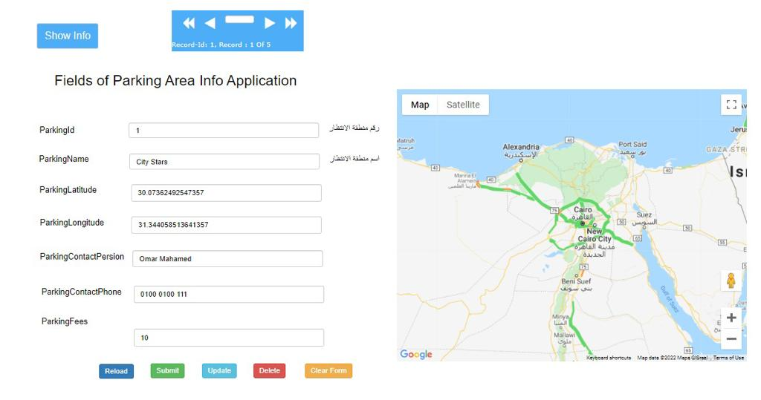
Pclick Admin Interface

Slide 11
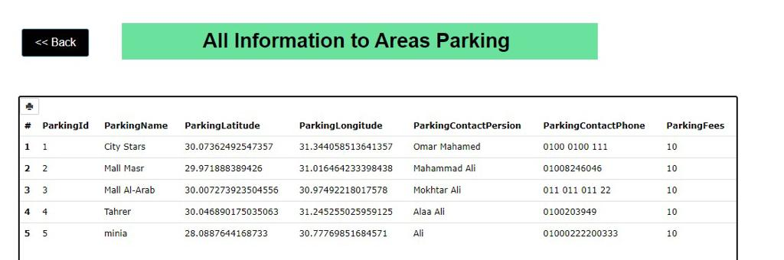

Slide 12
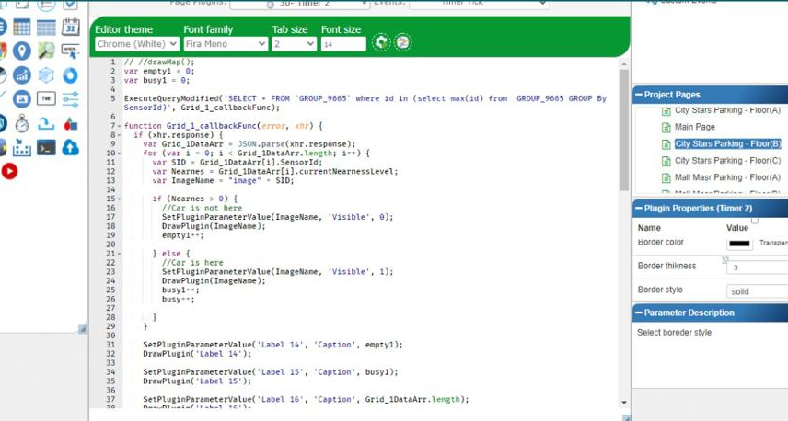
Pclick Backend

Slide 13

THANK YOU!

