Slide 1

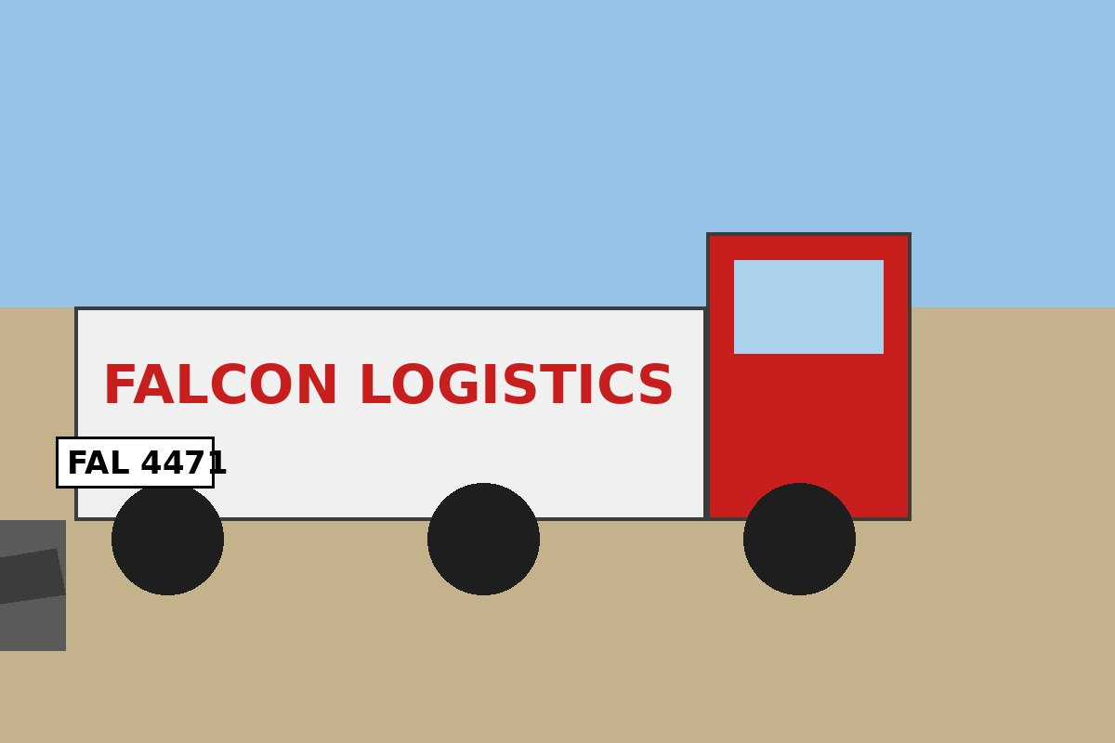
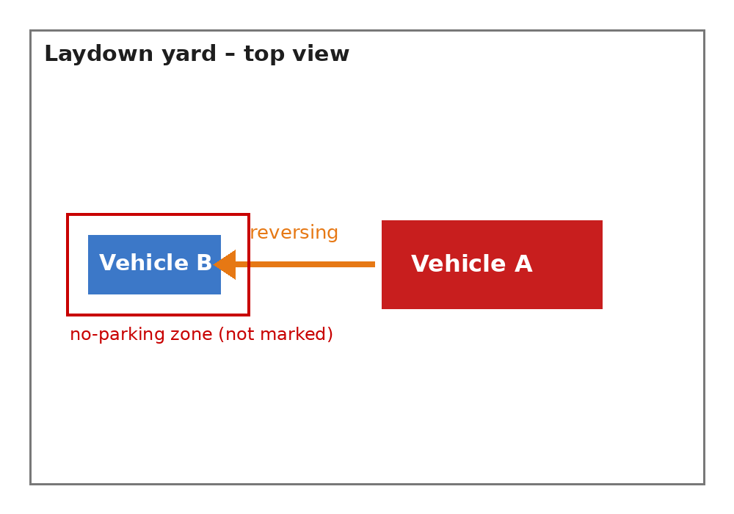
HSE FLASH – Learning From Incident
Ifadah# | 45821 | Date | 18-Aug-2026
Time | 07:45 | Risk Category | Driving / Vehicle Safety
Injury/Asset Damaged | Asset damage – rear door of light vehicle | Activity | Material delivery to laydown yard
Actual Severity | Minor (Level 1) | Potential Severity | Major (Level 4)
Location | Laydown yard, Desert Star Energy Field Camp 3 | Incident title | Reversing truck struck a parked light vehicle
What happened?
During a material delivery by Falcon Logistics LLC, a 10-tonne flatbed truck reversed into the laydown yard without a banksman. The driver, Rami Haddad, could not see a light vehicle parked behind the truck and struck its rear door at low speed. Nobody was inside the light vehicle and no one was injured.
Why it happened / Findings
• No banksman was assigned for the reversing manoeuvre.
• The truck's reversing camera was not working and had not been reported.
• The light vehicle was parked inside the truck manoeuvring area, which was not marked as a no-parking zone.
• The delivery was not covered in the morning toolbox talk (Permit WP-2209 listed offloading only).
No banksman, no reversing.
Reflective questions to discuss with your Team
• When do we need a banksman on our site?
• Do we check reversing aids before every trip, and how do we report defects?
• Where are the no-parking zones in our laydown areas?
How can this learning be sustained at site?
• Assign a trained banksman for every reversing manoeuvre.
• Add reversing camera and alarm checks to the daily vehicle pre-use inspection.
• Mark and enforce no-parking zones in truck manoeuvring areas.
• Brief all delivery drivers at the gate on site traffic rules.

