Slide 1
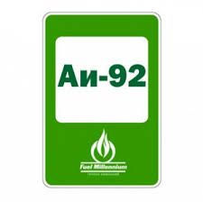
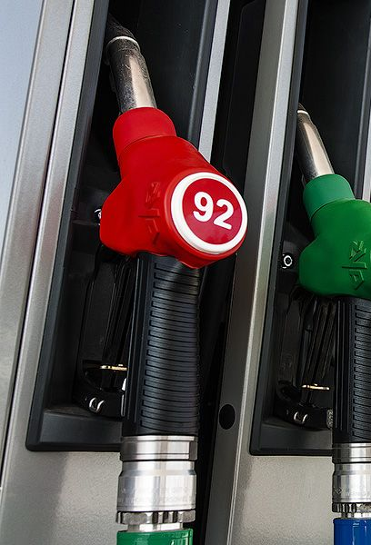
Products planned for development in localization program 2020-2021
1 | Manufacturer: | Bukhara Oil Refinery LLC
2 | Product name: | Petrol AI-92 brand
3 | TN VED code. | 2710124120
4 | Annual capacity: | 80,000 tn
5 | Specifications: | Octane number, not less, research method -91.0 Lead content, g / dm3, no more -0.010 Manganese content, mg / dm3, no more than -18 Actual resin content, mg / 100 cm3, - not more than 5.0 Gasoline induction period, min, not less -360 Mass fraction of sulfur,%, no more -0.05 Volume fraction of benzene,%, no more than -5 Density at 15 ° С, kg / m3 -725-780 Appearance - Clean, transparent
6 | GOSTs: | O'z DSt 989: 2010
7 | Main consumers: | Enterprises of JSC Uzbekneftegaz

Slide 2
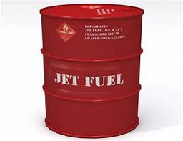
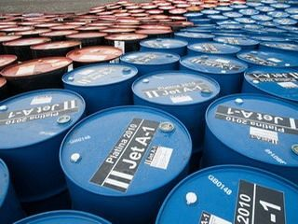
Products planned for development in localization program 2020-2021
1 | Manufacturer: | Bukhara Oil Refinery LLC
2 | Product name: | Pyrolysis distillate
3 | TN VED code. | 2710192100
4 | Annual capacity: | 72,000 tn
5 | Specifications: | Appearance- Clean, transparent, must not contain water Total acid number, mg KOH / g, no more - 0.1 Volume fraction of aromatic hydrocarbons,%, no more - 25.0 Mass fraction mercaptan sulfur,%, no more - 0.003 Mass fraction of total sulfur,%, no more - 0.25
6 | GOSTs: | GOST 32595-2013
7 | Main consumers: | Enterprises of JSC Uzbekneftegaz

Slide 3
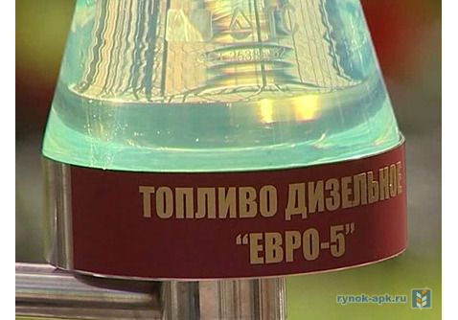
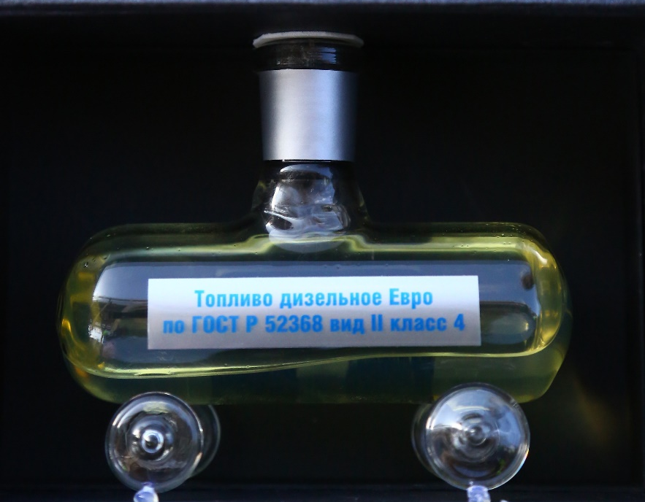
Products planned for development in localization program 2020-2021
1 | Manufacturer: | Bukhara Oil Refinery LLC
2 | Product name: | Diesel fuel according to EURO-4.5 standard
3 | TN VED code. | 2710192900
4 | Annual capacity: | 80,000 tn
5 | Specifications: | Diesel fuel(DT Euro-5), according to GOST standards, contains no more than 10 mg / kg sulfur, the content of hydrocarbons also meets the standard. This fuel is formulated to prevent premature wear of engine parts. Environmentally friendly: low hydrocarbon and sulfur content reduces flue gas emissions
6 | GOSTs: | O'z DSt 989: 2010
7 | Main consumers: | Enterprises of JSC Uzbekneftegaz

Slide 4
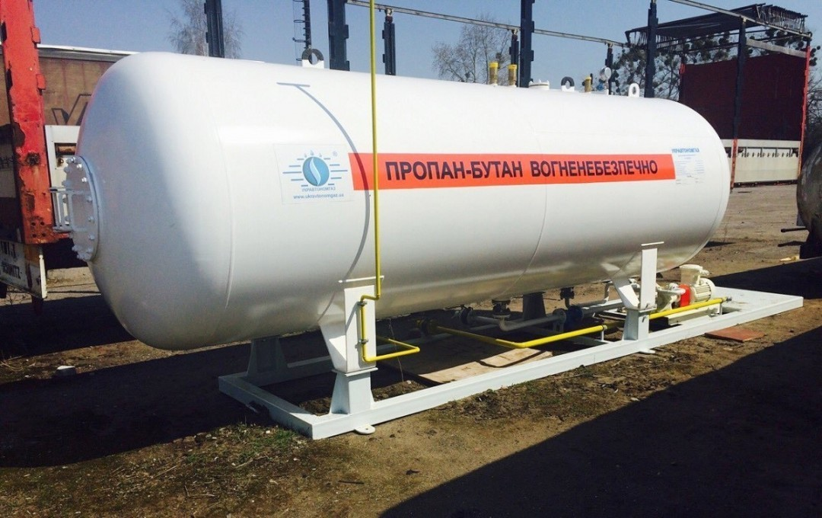
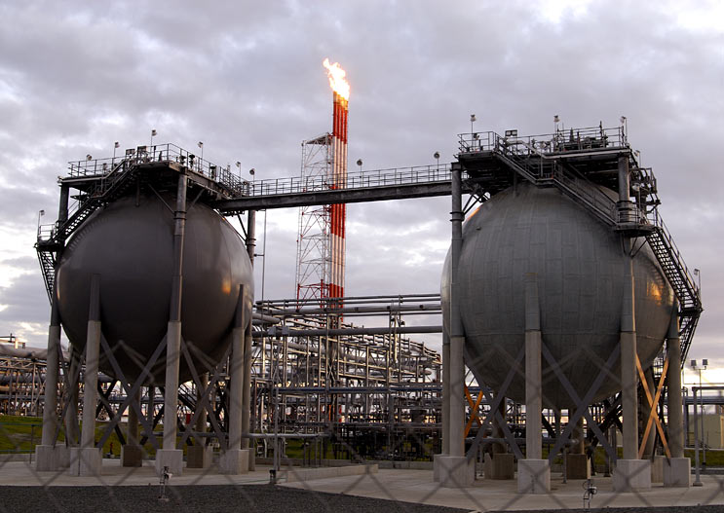
Products planned for development in localization program 2020-2021
1 | Manufacturer: | JV LLC Uzbekistan GTL And Mubarek GPP
2 | Product name: | Liquefied gas
3 | TN VED code. | 2711121900
4 | Annual capacity: | 11,000 tn
5 | Specifications: | Working pressure 1.6 MPa (16.0 kgf / cm2). Test pressure 2.5 MPa (25.0 kgf / cm2) The octane number of LPG is more favorable in comparison with gasoline and diesel fuel and varies in the range of 90 -110 combustion consumption by 10-20% Temperature melting -182.49 ° C boiling point -161.58 ° C self-ignition 537.8 ° C
6 | GOSTs: | O'z DSt 989: 2010
7 | Main consumers: | Enterprises of JSC Uzbekneftegaz

Slide 5
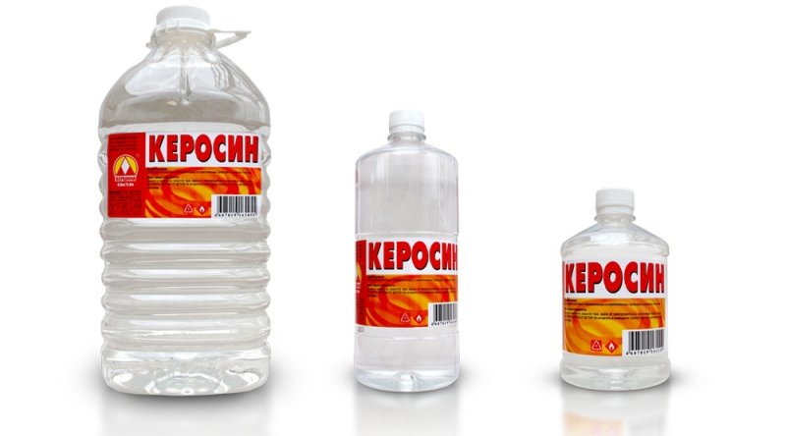
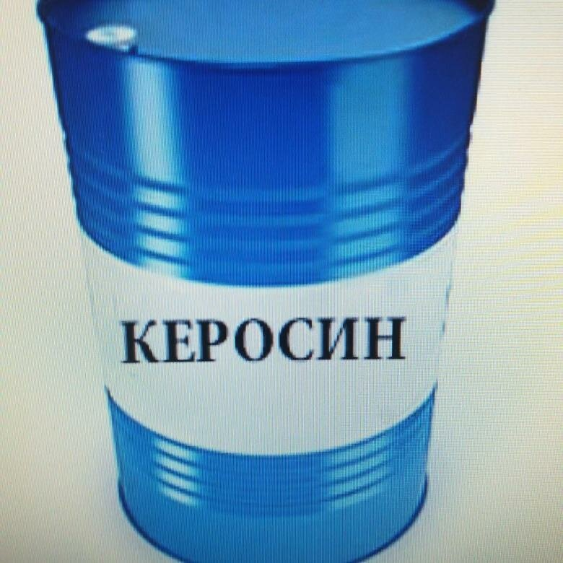
Products planned for development in localization program 2020-2021
1 | Manufacturer: | JV LLC Uzbekistan GTL
2 | Product name: | Synthetic aviation kerosene
3 | TN VED code. | 2710192500
4 | Annual capacity: | 80,000 tn
5 | Specifications: | density at 15 ˚С, kg / m3-814.8 fractional composition: 10% distillate, ˚С 98% distillate, ˚С -173.8 lower heat of combustion, MJ / kg -43.1 volumetric heat of combustion, MJ / m3 ‧10 * 3- 35.1 volume fraction of aromatic hydrocarbons,% - 18.3 mass fraction of total sulfur,% - 0.19
6 | GOSTs: | O'z DSt 989: 2010
7 | Main consumers: | Enterprises of JSC Uzbekneftegaz

Slide 6
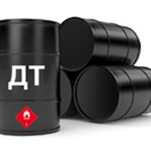
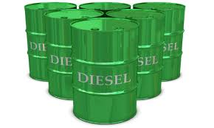
Products planned for development in localization program 2020-2021
1 | Manufacturer: | JV LLC Uzbekistan GTL
2 | Product name: | Synthetic diesel fuel
3 | TN VED code. | 2710194210
4 | Annual capacity: | 156,000 tn
5 | Specifications: | Cetane number <70 density at 15 ° C, kg / m3 - 0.77 mass fraction of total sulfur,% - 0.0 Polyaromatic hydrocarbons% < 0.1 Limiting temperature filterability, ˚С- (-27) Boiling rate 95%.,FROM - 340 Lubricating ability - 457 microns
6 | GOSTs: | O'z DSt 989: 2010
7 | Main consumers: | Enterprises of JSC Uzbekneftegaz

Slide 7
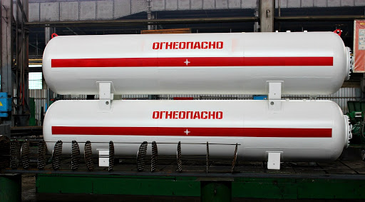
Products planned for development in localization program 2020-2021
1 | Manufacturer: | JV LLC Uzbekistan GTL
2 | Product name: | Naphtha
3 | TN VED code. | 2710124130
4 | Annual capacity: | 156,000 tn
5 | Specifications: | Molecular weight in the range of 100-215 g / mol; density in the range of 0.75-0.85 g / cm³ (0.785-0.795 for instrument naphtha in accordance with GOST 8863-76 [7]); boiling point range 120 ° C - 240 ° C; saturated vapor pressure <5 mmhg... (<5torr); sulfur content not more than 0.02% (for gas condensate naphtha); kinematic viscosity 1.1 mm² / s; cloud point not higher than -60 ° С. The naphtha is insoluble in water [8]. The refractive index of instrument naphtha at 20 ° C is 1.407-1.415
6 | GOSTs: | O'z DSt 989: 2010
7 | Main consumers: | Enterprises of JSC Uzbekneftegaz

Slide 8
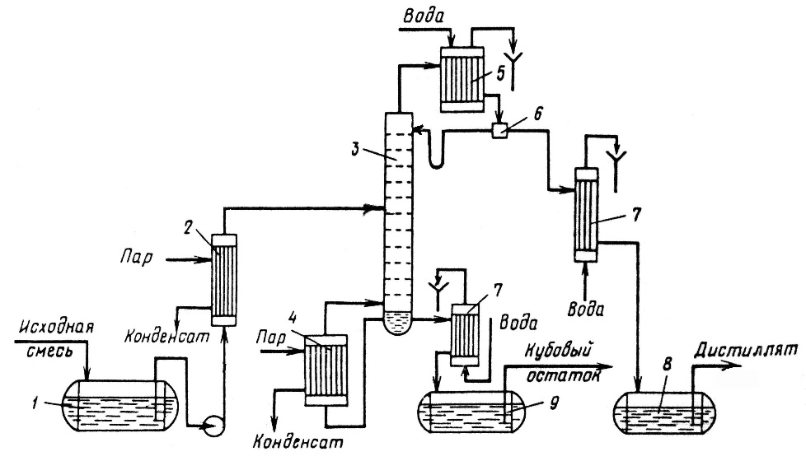
Pyrolysis distillates
Products planned for development in localization program 2020-2021
1 | Manufacturer: | JV LLC Uz-KorGaz Chemical
2 | Product name: | Pyrolysis distillate
3 | TN VED code. | 2710129000
4 | Annual capacity: | 23,000 tn
5 | Specifications: | density at 15 ˚С, kg / m3-0.0 Pressure saturated vapors not more-66.7 The total mass of Benzene in% - 32 volume fraction of aromatic hydrocarbons,% - 0.0 mass fraction of total sulfur mg / kg - 500 The total mass of alkali - 0.0 The share of mechanical solutions - 0.0 Mass fraction of water - 0.1
6 | GOSTs: | GOST 6307, 6370, 2177.
7 | Main consumers: | Enterprises of JSC Uzbekneftegaz

Slide 9
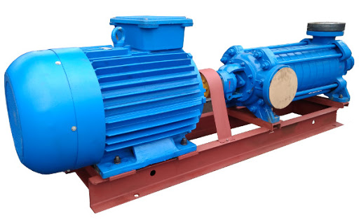
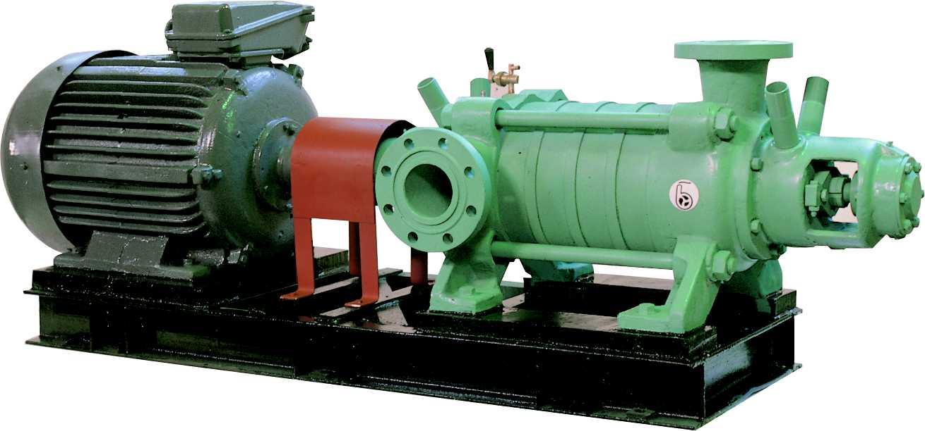
Products planned for development in localization program 2020-2021
1 | Manufacturer: | JSC "Plant Uzbekkhimmash"
2 | Product name: | Pump equipment
3 | TN VED code. | 8413910001
4 | Annual capacity: | 2 sets
5 | Specifications: | The operation stability of submersible oil pumps directly depends on the effects of cavitation. In order to avoid a destructive effect on the unit, it is recommended to install the pump with a head of 2 - 6 m. The volume of solid impurities in the pumped medium for oil pumps CNSN should not exceed 0.1%, and the particle size - 0.1 mm with an indicator microhardness no more than 1.46 hPa... The upper limit of the temperature of the pumped-over liquid is + 45 ° С, the lower one is + 1 ° С.
6 | GOSTs: | GOST, TU
7 | Main consumers: | Enterprises of JSC Uzbekneftegaz

Slide 10
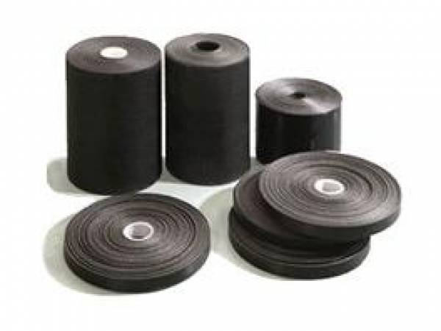
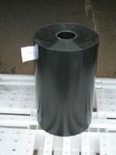
Products planned for development in localization program 2020-2021
1 | Manufacturer: | JSC "Makhsusenergogaz"
2 | Product name: | Insulating film "Polylene"
3 | TN VED code | 3920108900
4 | Annual capacity: | 40 tn
5 | Specifications: | - tensile strength (at 23 ° C) - 40 (N / 1 cm width); - adhesion to steel (at 20 ° C) and own surface in overlap (at 23 ° C) - from 20 and from 7 N / cm; - application temperature - from -40 to 60 ° C. The strip is wound on a dry and pre-cleaned pipe from the outside with overlap... Insulation is carried out according toprimed steel surface with wrap Polylene 40-OB-63...
6 | GOSTs: | TU 2245-003-01297859-99
7 | Main consumers: | Industry enterprises

