Slide 1
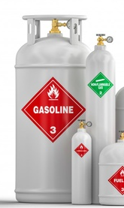
Products mastered within the localization program
1 | Manufacturer: | Bukhara Oil Refinery LLC
2 | Product name | Gasoline pyrolysis
3 | TN code Foreign economic activity | 2710129000
4 | Annual power | 15,000 tons
5 | Specifications | Pressure satedoops vapors kPa no more - 66.7 Research octane number - not less than 75 Mass fraction of sulfur mg / kg - no more than 2000 The volume fraction of benzene - 32
6 | GOSTs: | Technical conditions O'z DSt 3035: 2015
7 | Main consumers: | Supplied for export

Slide 2
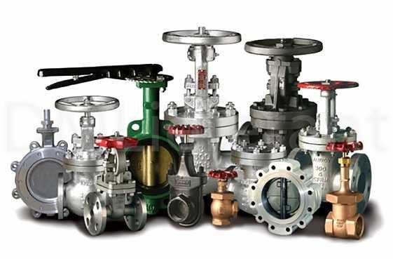
Products mastered within the localization program
1 | Manufacturer: | LTD "Uzpromarm"
2 | Product name | Locking and regulating fittings
3 | TN code Foreign economic activity | 8481807399
4 | Annual power | 40 billion sum
5 | Specifications | The shut-off and control valves, by changing the flow rate of the transported substance, block or distribute its flow by adjusting various parameters: pressure, head or temperature. Can be mounted on pipelines, tanks and other units.
6 | GOSTs: | Technical conditions TSh 64-23957887-004: 2014
7 | Main consumers: | Enterprises of JSC Uzbekneftegaz"

Slide 3
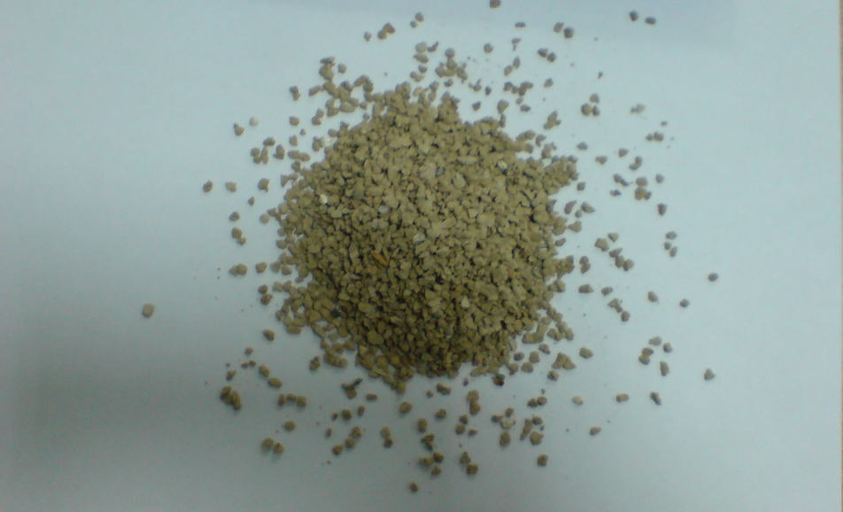
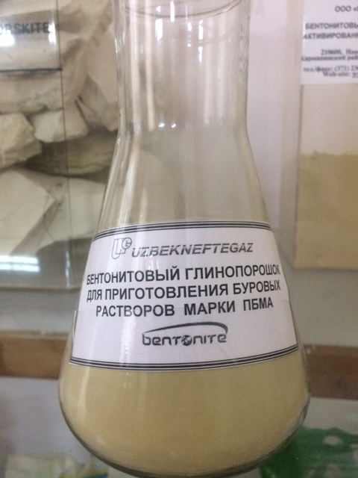
Products mastered within the localization program
1 | Manufacturer: | Ltd Bentonite
2 | Product name: | 1. Bentoniteth clay powder PBMA brands 2. Clay bentonite granular
3 | TN VED code (2012): | 2508100000 2508100000
4 | Annual capacity: | 700 tn 250 tn
5 | Specifications: | 1. Brand - PBMA Density g / cm3 - 1.039 Solution output m3 / t - 20-25 Viscosity sec - 25 Filtration, cm3 / 30min - 15.0 Peel thickness mm - 2.0 CHCf / 1002f - 38-45 Content sand% - 5 Humidity % - 6-10 PH -9.5 2. Mass fraction of moisture,%, no more - 9 Bulk weight, g / cm3, no more - 1.2 PH of aqueous suspension, no more - 8.0 Granule size (fractions) - 1.0-3.5 mm Swelling, ml per 2 g, not less - 28 Colloidality,%, not less - 60 Content of montmorillonite,% - 50-70
6 | GOSTs: | 1. TSh 64-18263094-01: 2012 2. Ts 18263094-03: 2014
7 | Certificates: | 1. No. 1711712 2. No. 1518984
8 | Main consumers: | Oil and gas enterprises Waterproofing

Slide 4
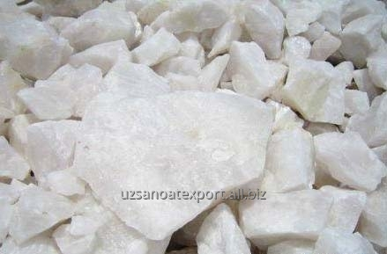
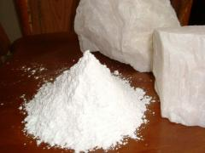
Products mastered within the localization program
1 | Manufacturer: | LTD "Neftegazmineral"
2 | Product name: | Barite concentrate
3 | TN VED code: | 2511100000
4 | Annual capacity: | 7,500 tn...
5 | Specifications: | Sulfate natural barium (barite): barite concentrate KB-3, powdery (used in drilling fluids), obtained by sorting / sieving rocks and subsequent grinding. Specific gravity - 4.07 g / m3 Density - 1.8-2.2 g / m3 Water loss - 5-6 cm3 Viscosity - 60-75 sec.
6 | GOSTs: | GOST 4682-84
7 | Certificates: | License TV-0028-F5, Hygienic Certificate No. 193609, ISO 9001: 2008
8 | Main consumers: | Drilling Societies Enterprises of JSCUzbekneftegaz"

Slide 5
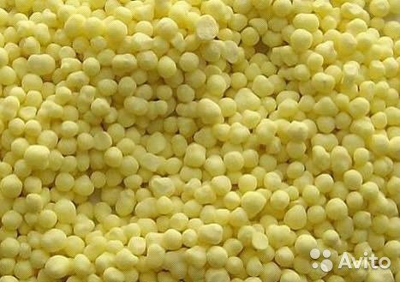
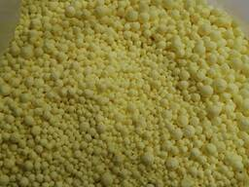
Products mastered within the localization program
1 | Manufacturer: | "Mubarek GPP "
2 | Product name: | Granular sulfur
3 | TN VED code | 2503 00 100 0
4 | Annual capacity: | 3000 tn
5 | Specifications: | Sulfur under normal conditions is brittle yellow crystals. Density - 2.07 g / cm3, Melting point - +112.8 ° C, Boiling point - +444.6 ° C.
6 | GOST: | GOST 127.1-93
7 | Main consumers: | Enterprises of JSC "Uzbekneftegaz"

Slide 6
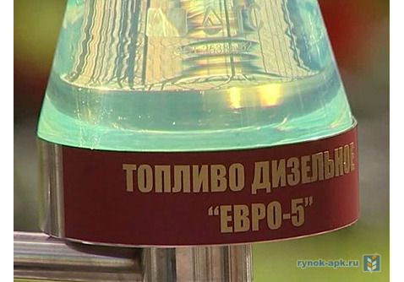
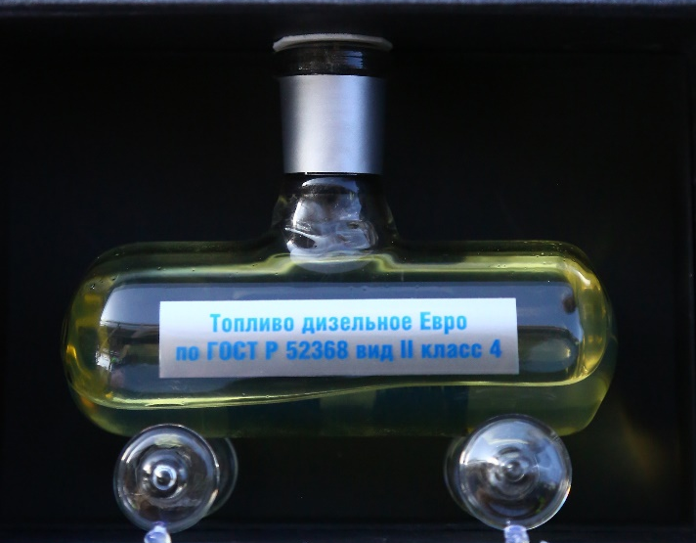
Products mastered within the localization program
1 | Manufacturer: | Bukhara Oil Refinery LLC
2 | Product name: | Diesel fuel according to EURO-4.5 standard
3 | TN VED code. | 2710192900
4 | Annual capacity: | 10,000 tn
5 | Specifications: | Diesel fuel(DT Euro-5), according to GOST standards, contains no more than 10 mg / kg sulfur, the content of hydrocarbons also meets the standard. When the engine runs on this fuel, its noise and vibration are reduced, engine starting is easier, and fuel consumption is reduced. This fuel is formulated to prevent premature wear of engine parts. Environmentally friendly: low hydrocarbon and sulfur content reduces flue gas emissions
6 | GOSTs: | O'z DSt 989: 2010
7 | Main consumers: | Enterprises of JSC Uzbekneftegaz

Slide 7
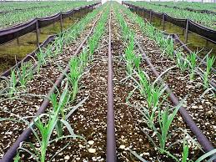
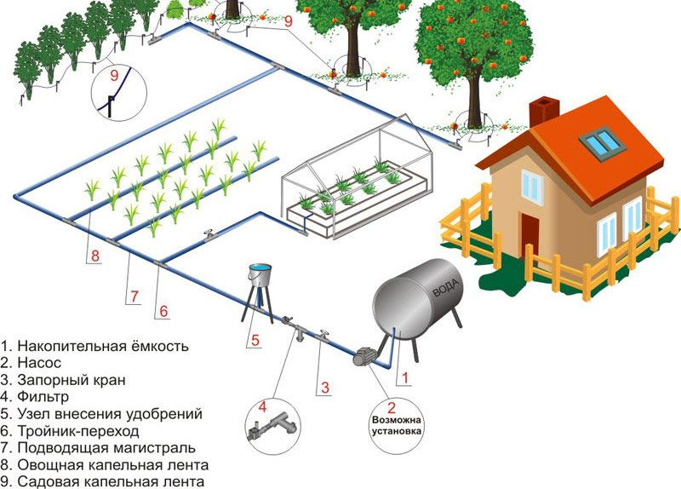
Products mastered within the localization program
1 | Manufacturer: | LTD "Shurtansky MCC "
2 | Product name: | Drip irrigation system (cotton growing, gardening, vineyards, greenhouses)
3 | TN VED code | 3917390008 3917400009 8424821000
4 | Annual capacity: | 400 tn
5 | Specifications: | System for supplying water and fertilizer directly to the root zone of the irrigated plant. Water is pumped to the filters, from them it flows through the main, distribution and irrigation piping to each plant through dropper and slowly penetrates root system. The system is completed pressure regulators that provide the necessary head for work of droppers. For fertilizing drip irrigation system completed hydropower...
6 | Main consumers: | Enterprises of JSC Uzbekneftegaz

Slide 8
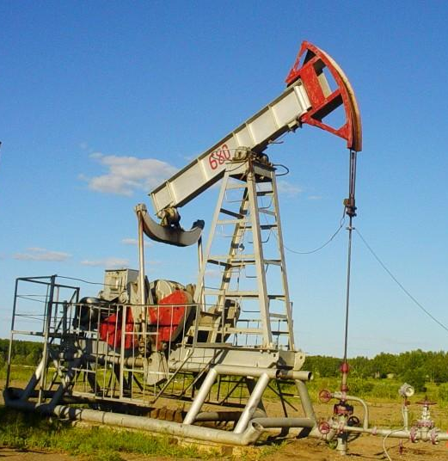
Products mastered within the localization program
1 | Manufacturer | JSC "Plant Uzbekkhimmash"
2 | Product name | High-performance pumping units
3 | TNVED code | 8413 7081 0000
4 | Annual capacity | 3 set... / 818,4 million soums
5 | Specifications | production-12 tn; 45sq. x 1000rpm
6 | GOST s | TSh 002 17231-008: 2015
7 | Main consumers | Enterprises of JSC Uzbekneftegaz

Slide 9
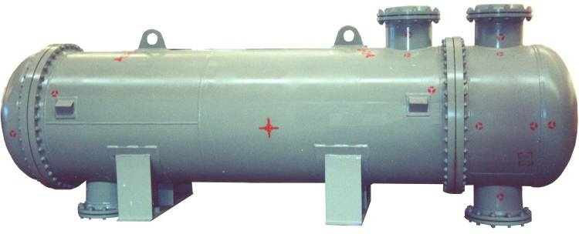
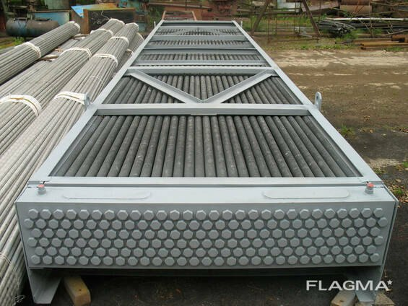
Products mastered within the localization program
1 | Manufacturer | JSC "Plant Uzbekkhimmash"
2 | Product name | Large-scale petrochemical equipment
3 | TNVED code | 8421290009, 8479820000, 8430490000
4 | Annual capacity | 20,000 million soums
5 | Specifications | According to the requirements of GOST and TU
6 | GOSTs | TSh 002 17231-008: 2015
7 | Main consumers | Enterprises of JSC Uzbekneftegaz

