Slide 1
LECTURE 8
CSS3
Features
Rounded corners, gradients, shadows, transforms, and animation — visual polish with pure CSS.
CSC336 Web Technologies
cuinotes.com · 1

Slide 2
OVERVIEW
In This Lecture
1
Rounded corners, gradients, shadows, and opacity
2
2D/3D transforms, transitions, and keyframe animations
3
Web fonts, icon fonts, and CSS custom properties (variables)
4
Media queries, feature queries, and cross-browser compatibility
5
Vendor prefixes, and why compatibility still matters
cuinotes.com · 2

Slide 3
SHAPES
border-radius
.card { border-radius: 12px; }
.avatar { border-radius: 50%; } /* a perfect circle */
.bubble { border-radius: 20px 20px 20px 0; }
A pixel value rounds by a fixed amount; a percentage rounds relative to the element's own size.
cuinotes.com · 3

Slide 4
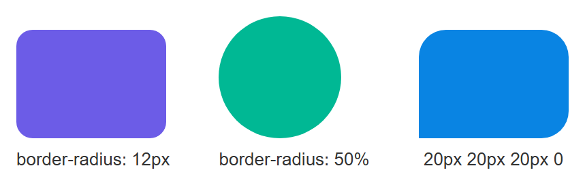
SHAPES
border-radius, Rendered
cuinotes.com · 4

Slide 5
GRADIENTS
Linear and Radial Gradients
.banner { background: linear-gradient(to right, #4facfe, #00f2fe); }
.spotlight { background: radial-gradient(circle, #fff, #333); }
.diagonal { background: linear-gradient(45deg, orange, red); }
cuinotes.com · 5

Slide 6
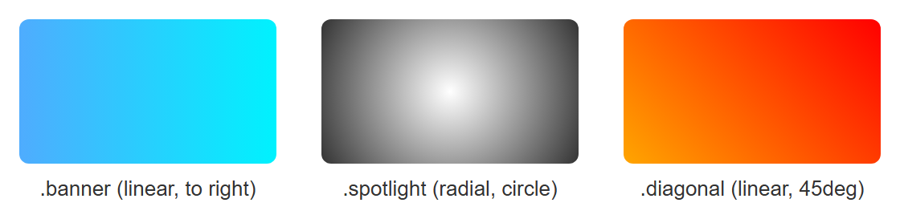
GRADIENTS
Gradients, Rendered
cuinotes.com · 6

Slide 7

GRADIENTS
Multiple Color Stops
.rainbow {
background: linear-gradient(
to right,
red 0%, yellow 25%, green 50%, blue 75%, violet 100%
);
}
cuinotes.com · 7

Slide 8
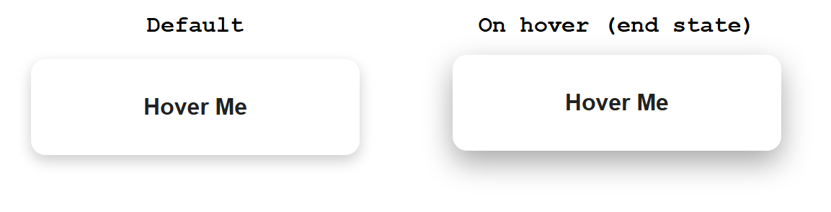
SHADOWS
box-shadow on Hover — Live
Genuinely live on the deployed page — shown here at both states.
.card {
box-shadow: 0 4px 10px rgba(0, 0, 0, 0.2);
}
.card:hover {
box-shadow: 0 8px 20px rgba(0, 0, 0, 0.35);
}
cuinotes.com · 8

Slide 9

SHADOWS
text-shadow
h1 {
text-shadow: 2px 2px 4px rgba(0, 0, 0, 0.5);
}
cuinotes.com · 9

Slide 10

SHADOWS
Multiple Shadows
box-shadow: 0 1px 2px #000, 0 0 20px gold;
/* stack shadows by separating them with commas */
cuinotes.com · 10

Slide 11
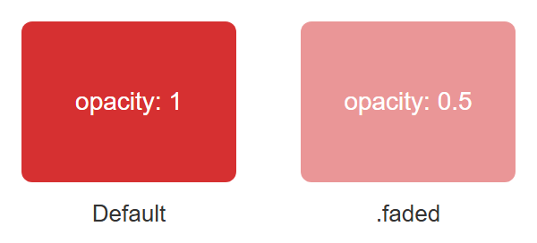
OPACITY
opacity
opacity fades EVERYTHING inside, including text; use rgba() for a transparent background with solid text.
.faded {
opacity: 0.5; /* 50% transparent */
}
cuinotes.com · 11

Slide 12
TRANSFORMS
2D and 3D Transform Functions
Function | What It Does
translate(x, y) / translateZ(z) | Moves an element
rotate(deg) / rotateX/Y/Z(deg) | Spins an element
scale(n) / scaleX/Y/Z(n) | Resizes an element
skew(deg) | Slants an element
cuinotes.com · 12

Slide 13
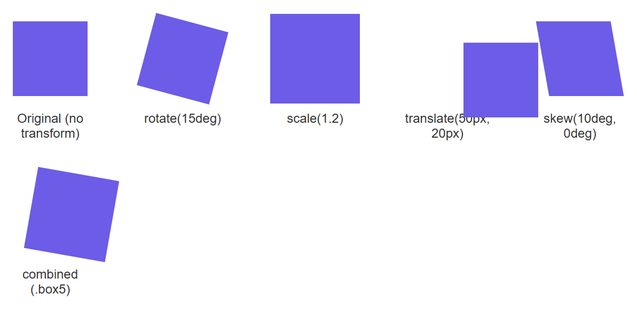
TRANSFORMS
2D Transforms, Compared
.box { transform: rotate(15deg); }
.box2 { transform: scale(1.2); }
.box3 { transform: translate(50px, 20px); }
.box4 { transform: skew(10deg, 0deg); }
.box5 { transform: translate(20px, 0) rotate(10deg) scale(1.1); }
cuinotes.com · 13

Slide 14
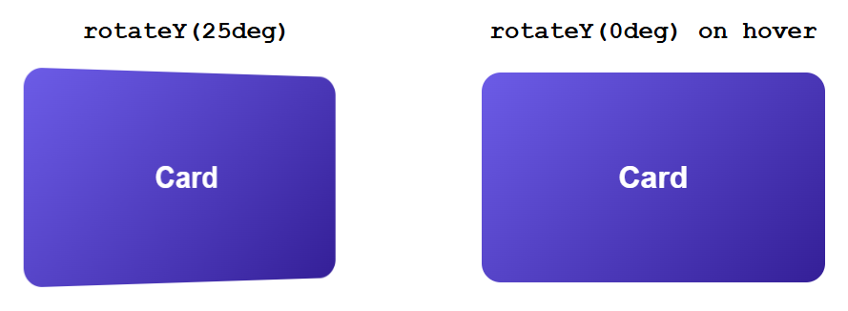
TRANSFORMS
A 3D Hover Flip — Live
.scene { perspective: 800px; }
.card-3d {
transform: rotateY(25deg);
transition: transform 0.4s ease;
}
.card-3d:hover { transform: rotateY(0deg); }
cuinotes.com · 14

Slide 15
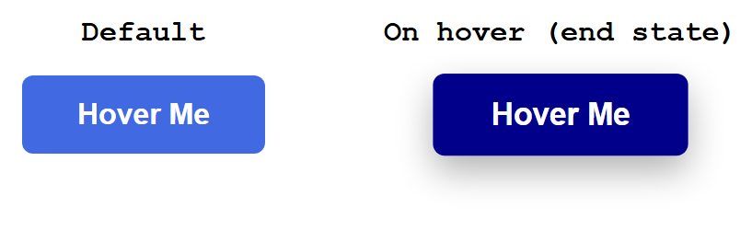
TRANSITIONS
A Smooth Hover Transition — Live
button {
background-color: royalblue;
transition: background-color 0.3s ease, transform 0.3s ease;
}
button:hover {
background-color: darkblue;
transform: scale(1.05);
}
cuinotes.com · 15

Slide 16
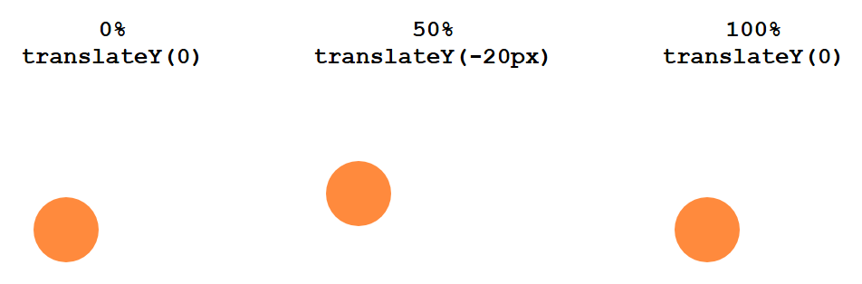
KEYFRAME ANIMATIONS
@keyframes — Live and Looping
@keyframes bounce {
0% { transform: translateY(0); }
50% { transform: translateY(-20px); }
100% { transform: translateY(0); }
}
.ball { animation: bounce 1s ease-in-out infinite; }
▶ Try it yourself
on W3Schools
cuinotes.com · 16

Slide 17
ANIMATION
Timing Functions
Value | Feel
linear | Constant speed, start to finish — feels mechanical
ease (default) | Starts slow, speeds up, ends slow — the most natural-feeling default
ease-in / ease-out | Slow start only / slow finish only
cubic-bezier(...) | A fully custom easing curve for a specific feel
cuinotes.com · 17

Slide 18
ANIMATION
transition vs. animation
TIP
Use a transition for simple state changes (hover, focus, a toggled class). Use a keyframe animation for anything that plays on its own, loops, or needs more than a start and end state.
cuinotes.com · 18

Slide 19
FONTS
Web Fonts and Icon Fonts
Web fonts (Google Fonts, or @font-face) let every visitor see the exact same typeface
Always end a font-family list with a generic fallback: sans-serif, serif, monospace
Icon fonts let you use icons like text — resizable, colorable — though many projects now prefer inline SVG
cuinotes.com · 19

Slide 20
CUSTOM PROPERTIES
CSS Variables
:root {
--main-color: #6c5ce7;
--spacing-unit: 8px;
}
.button {
background-color: var(--main-color);
padding: calc(var(--spacing-unit) * 2);
}
A live, real value in the browser — change it once in :root and every var(--main-color) usage updates instantly.
cuinotes.com · 20

Slide 21
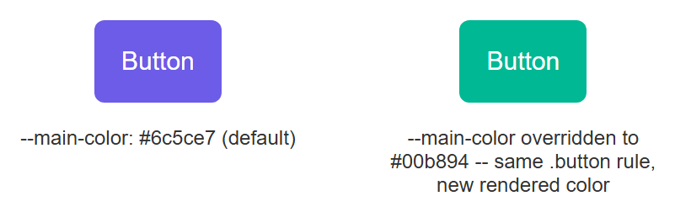
CUSTOM PROPERTIES
One Rule, Two Colors
Nothing changed except the value of --main-color in scope — proof the variable controls the rendered color.
cuinotes.com · 21

Slide 22
ADAPTING TO DEVICES
Media and Feature Queries
@media (min-width: 768px) { ... } adapts styles to screen size — the foundation of responsive design
@supports (display: grid) { ... } applies CSS only if the browser actually supports a feature
Both check something real about the current browser before applying their block
cuinotes.com · 22

Slide 23
COMPATIBILITY
Vendor Prefixes
Prefix | Browser Engine
-webkit- | Chrome, Safari, newer Edge
-moz- | Firefox
-ms- | old Internet Explorer / Edge
-o- | old Opera
Always place the unprefixed, standard property LAST — Autoprefixer automates this in real projects.
cuinotes.com · 23

Slide 24
COMPATIBILITY
The Vendor-Prefix Workflow
You write CSS3 code
New / experimental
feature?
Yes, experimental
No, well supported
Add vendor prefixes
(-webkit- -moz- -ms- -o-),
standard property last
Use the standard
property directly
Test in multiple browsers
Consistent look across Chrome, Firefox, Safari, Edge
cuinotes.com · 24

Slide 25
KEY TAKEAWAYS
Lecture 8 in Six Points
1
border-radius, gradients, box-shadow/text-shadow, and opacity build modern visual effects with no images.
2
transform repositions/rotates/resizes without disturbing layout; 3D transforms need perspective on a parent.
3
transition animates between two states; @keyframes + animation define multi-step, looping animations.
4
CSS custom properties (--name, read with var(--name)) power theming and dark mode from one place.
5
Media queries adapt to screen size; feature queries (@supports) adapt to what the browser can render.
6
Vendor prefixes exist for experimental features — always place the unprefixed property last.
cuinotes.com · 25

