Slide 1
LECTURE 10
Responsive Design
and Frameworks
Building one site that adapts to any screen — and the two major CSS frameworks that make it faster.
CSC336 Web Technologies
cuinotes.com · 1

Slide 2
OVERVIEW
In This Lecture
1
Mobile-first design, the viewport meta tag, and fluid units
2
Media queries and breakpoints — every combination, plus responsive images
3
Component-based (Bootstrap) vs. utility-first (Tailwind) frameworks
4
Bootstrap's grid system in depth: auto-layout, nesting, offsets, ordering
5
Tailwind's utility classes, config file, and dark mode
6
Extending either framework with your own custom classes
7
CSS preprocessors: Sass, SCSS, and LESS — and customizing Bootstrap with Sass
cuinotes.com · 2

Slide 3
MOBILE-FIRST
Mobile-First Design
1
Write base CSS for small screens FIRST, then add styling for larger screens with media queries
2
The opposite of "desktop-first," where you design big and cram it onto a phone afterward
3
Mobile traffic is the majority of web visits — adding complexity as space grows is easier than stripping it away
cuinotes.com · 3

Slide 4
THE VIEWPORT
The Viewport Meta Tag
<meta name="viewport" content="width=device-width, initial-scale=1.0">
width=device-width uses the real device width; initial-scale=1.0 starts at 100% zoom.
cuinotes.com · 4

Slide 5
THE VIEWPORT
Never Forget This Tag
WARNING
Without the viewport meta tag, none of your media queries will work correctly on a real phone — the browser will still pretend it has a much wider screen.
cuinotes.com · 5

Slide 6
FLUID UNITS
Units That Scale, Not Fixed Pixels
Unit | Relative To
% | The size of the parent element
rem | The root (<html>) element's font size
em | The current element's own font size
vw / vh | 1% of the viewport's width / height
cuinotes.com · 6

Slide 7
FLUID UNITS
Fluid Units in Practice
.hero {
width: 100vw; /* always fills the full screen width */
height: 60vh; /* always 60% of the visible screen height */
}
.card { width: 90%; } /* always 90% of its parent, whatever that is */
cuinotes.com · 7

Slide 8
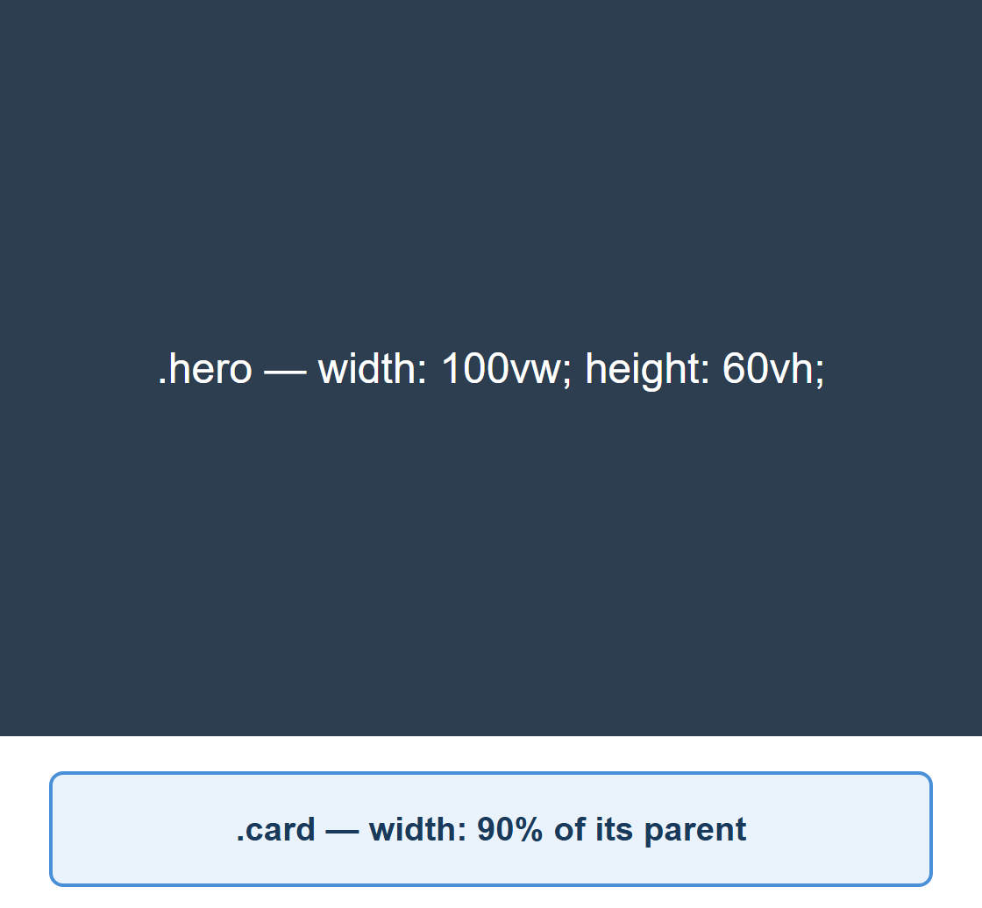
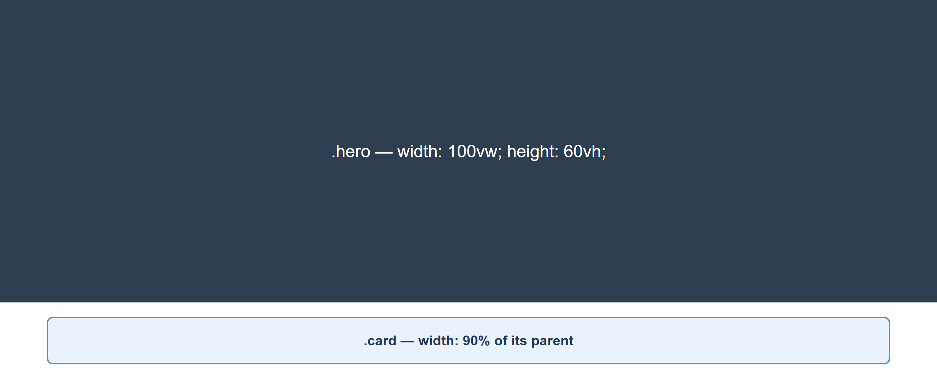
FLUID UNITS
The Same Page, Two Widths
WIDE
NARROW
cuinotes.com · 8

Slide 9
MEDIA QUERIES
A Mobile-First Breakpoint
.container { display: flex; flex-direction: column; }
@media (min-width: 768px) {
.container { flex-direction: row; }
}
cuinotes.com · 9

Slide 10
MEDIA QUERIES
Mobile-First Breakpoint Ladder
Base styles
(no media query)
small phones
min-width: 576px
large phones
min-width: 768px
tablets
min-width: 992px
laptops
min-width: 1200px
desktops
Mobile-first means the base (unqueried) styles target the smallest screen — each breakpoint only ADDS rules for wider viewports, never overrides them back down.
cuinotes.com · 10

Slide 11
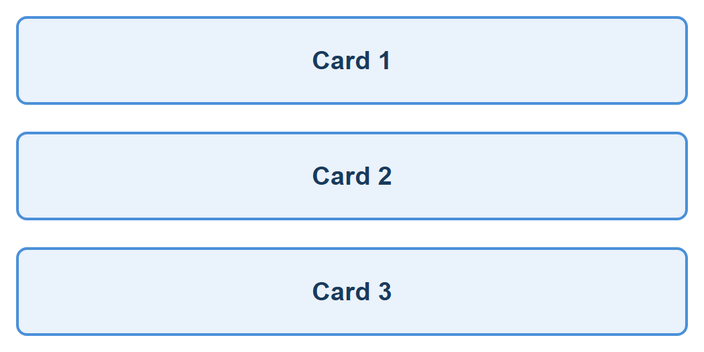
MEDIA QUERIES
Three Cards, Two Widths
WIDE (ROW)
NARROW (COLUMN)
cuinotes.com · 11

Slide 12
MEDIA QUERY SYNTAX
and, Comma, and not
Operator | Meaning
and | Combines conditions — ALL must be true
, (comma) | Works like OR — ANY one condition must be true
not | Inverts the entire media query (needs a media type)
orientation / prefers-color-scheme / print | Portrait vs. landscape / dark mode / printed page — same @media syntax
cuinotes.com · 12

Slide 13
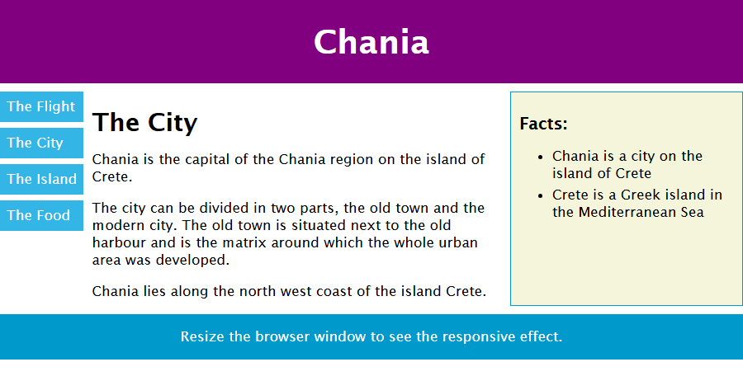
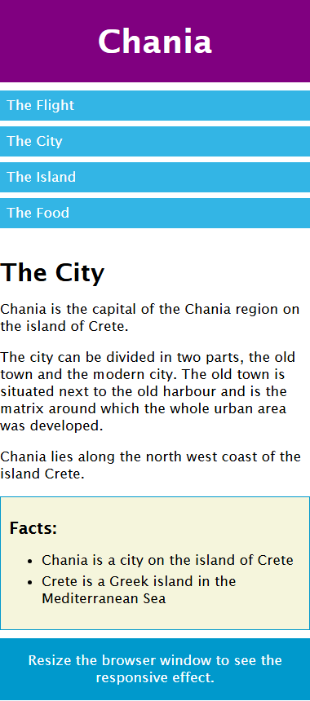
MEDIA QUERIES
min-width and max-width, for Responsiveness
On an element: min-width / max-width stop a box from shrinking or growing past a limit — a fluid container that is never too narrow or too wide.
In a media query: @media (min-width: …) and @media (max-width: …) apply CSS conditionally based on the viewport's width — the mechanism behind every breakpoint.
.container { width: 100%; max-width: 1100px; min-width: 300px; margin: 0 auto; }
@media (min-width: 600px) { /* mobile-first: layer on rules as the screen grows */ }
Wide — viewport ≥ 600px
Narrow < 600px
▶ Try it yourself
on W3Schools
cuinotes.com · 13

Slide 14
RESPONSIVE IMAGES
The One Rule That Matters
img {
max-width: 100%;
height: auto;
}
max-width: 100% keeps an image from ever growing wider than its container; height: auto preserves its aspect ratio.
cuinotes.com · 14

Slide 15
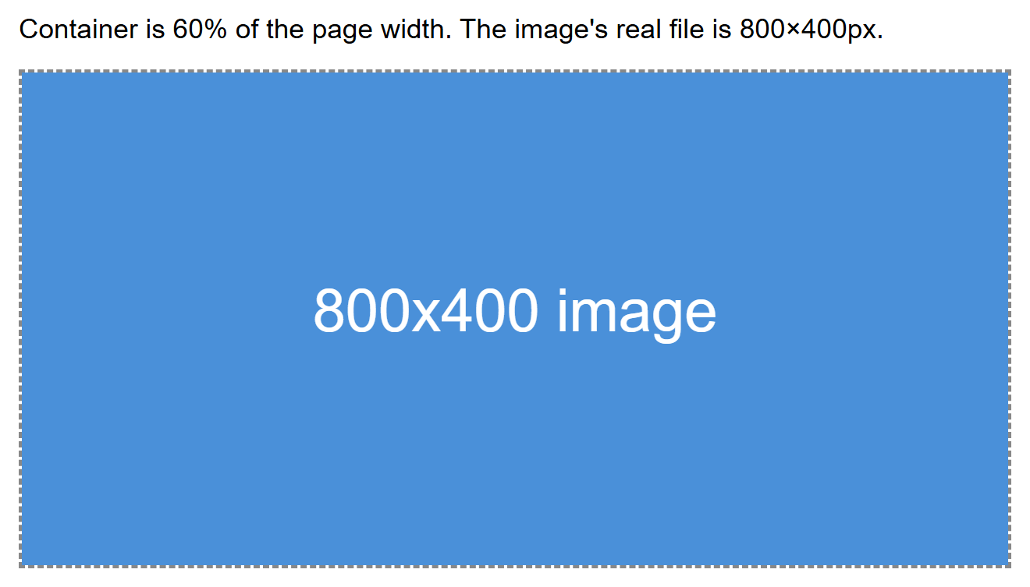
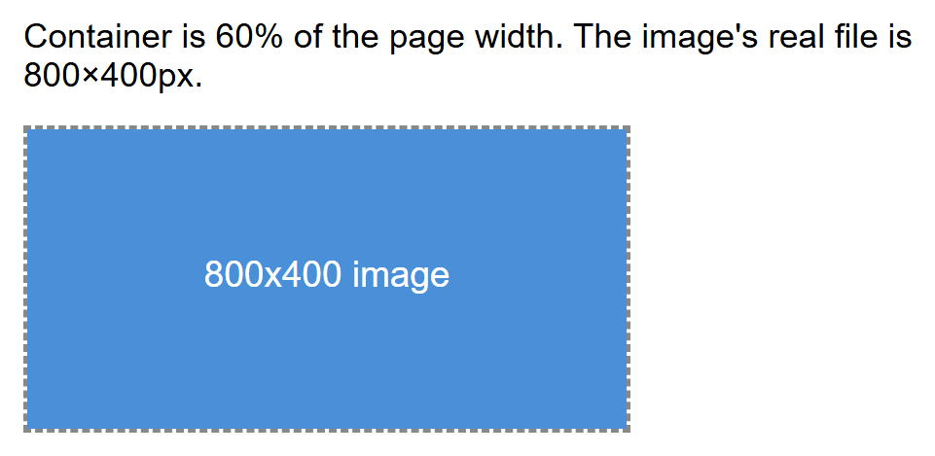
RESPONSIVE IMAGES
The Same Image, Two Widths
WIDE
NARROW
cuinotes.com · 15

Slide 16
FRAMEWORKS
Component-Based vs. Utility-First
BOOTSTRAP (COMPONENT-BASED)
TAILWIND (UTILITY-FIRST)
Ships pre-styled, ready-to-use components (.btn, .card, .navbar)
Fast to get a decent-looking page up quickly
Overriding built-in styles can fight the framework
Ships hundreds of tiny, single-purpose utility classes (flex, p-4)
Nothing looks "designed" until you style it yourself
Takes longer at first — many class names to learn
cuinotes.com · 16

Slide 17
BOOTSTRAP
What Is Bootstrap, and Where Do You Get It?
The most widely used CSS framework — originally built at Twitter; the current version, Bootstrap 5, needs no jQuery.
What it ships: a 12-column responsive grid, dozens of pre-styled components (buttons, cards, navbars, modals, forms, alerts), plus a small JS bundle for interactive behaviour.
Where to get it: getbootstrap.com — full documentation, live examples, and the exact CDN links to copy.
Also on npm as the “bootstrap” package, for projects that already use a build tool such as Vite or Webpack.
Free and open source (MIT licensed) — no signup, no cost, use it in any project.
cuinotes.com · 17

Slide 18
BOOTSTRAP
Setting Up Bootstrap
CDN (FASTEST, ZERO BUILD STEP)
NPM (FOR A BUNDLER-BASED PROJECT)
<link href="https://cdn.jsdelivr.net/npm/
bootstrap@5.3.3/dist/css/bootstrap.min.css"
rel="stylesheet">
<script src="https://cdn.jsdelivr.net/npm/
bootstrap@5.3.3/dist/js/bootstrap.bundle.min.js">
</script>
npm install bootstrap
@import "bootstrap/dist/css/bootstrap.min.css";
Import Bootstrap's JS in your entry file too, if you need dropdowns, modals, or other interactive components.
Load Bootstrap's CSS before your own stylesheet, so your own rules win the cascade.
The CSS link goes in <head>; the JS bundle goes just before </body>.
cuinotes.com · 18

Slide 19
BOOTSTRAP
The 12-Column Grid
<div class="container">
<div class="row">
<div class="col-md-8">Main content</div>
<div class="col-md-4">Sidebar</div>
</div>
</div>
cuinotes.com · 19

Slide 20
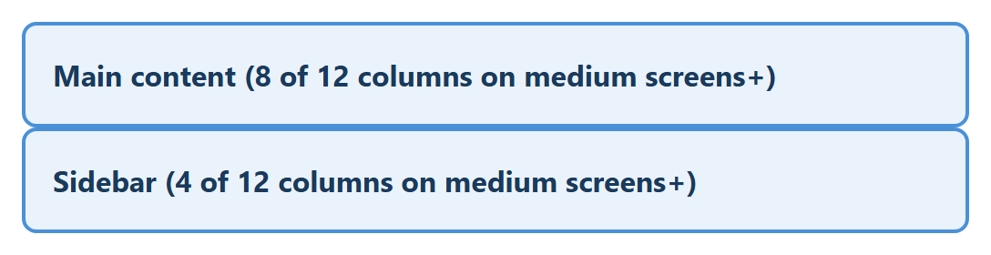
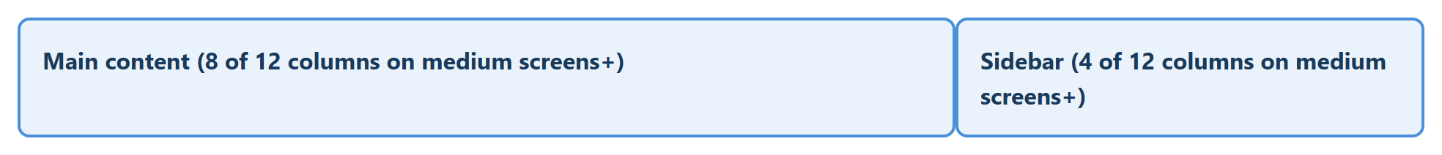
BOOTSTRAP
The Grid, Two Widths
WIDE (SIDE BY SIDE)
NARROW (STACKED)
cuinotes.com · 20

Slide 21
BOOTSTRAP GRID
Grid Modifier Classes
Class pattern | Effect
.col (no number) | Auto-layout: shares available width equally
.col-{n} | Exactly n of 12 columns, at all screen sizes
.col-{bp}-{n} | n columns from that breakpoint up (mobile-first)
.offset-{bp}-{n} | Pushes the column right by n empty columns
.order-{n} | Visual display order (0-5), independent of HTML order
.row-cols-{n} | Shorthand: every child column becomes 12/n wide
.g-{n} / .gx-{n} / .gy-{n} | Gutter size between columns — all / x / y
Every one of these is a thin wrapper around the Flexbox properties from Lecture 9 — .row is display:flex, .col is a flex item.
cuinotes.com · 21

Slide 22
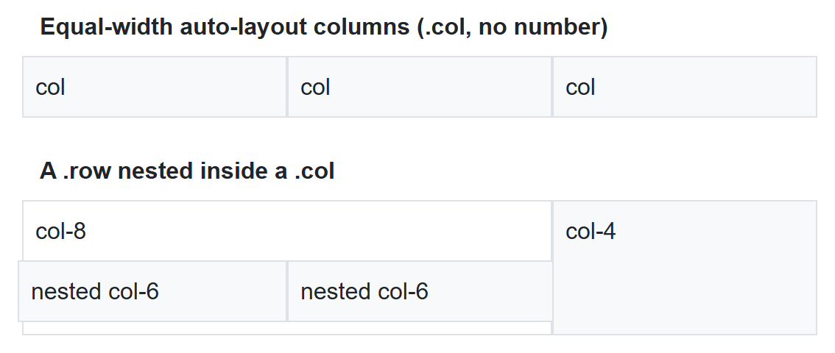
BOOTSTRAP GRID
Auto-Layout Columns and Nesting
<div class="row">
<div class="col">col</div>
<div class="col">col</div>
<div class="col">col</div>
</div>
<div class="row">
<div class="col-8">
col-8
<div class="row">
<div class="col-6">nested col-6</div>
<div class="col-6">nested col-6</div>
</div>
</div>
<div class="col-4">col-4</div>
</div>
cuinotes.com · 22

Slide 23
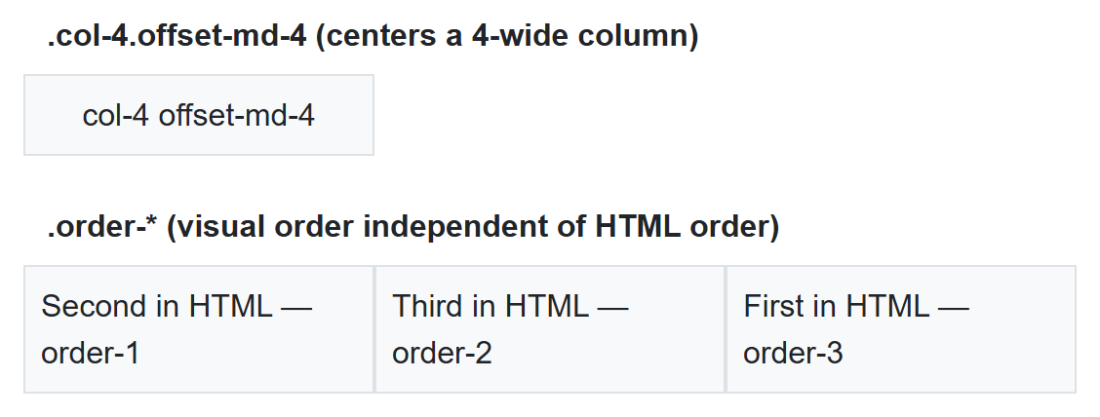
BOOTSTRAP GRID
Offsetting and Reordering Columns
offset-md-4 centers a 4-wide column; order-* rearranges visual order independent of HTML order.
<div class="col-4 offset-md-4">col-4 offset-md-4</div>
<div class="order-3">First in HTML — order-3</div>
<div class="order-1">Second in HTML — order-1</div>
<div class="order-2">Third in HTML — order-2</div>
cuinotes.com · 23

Slide 24
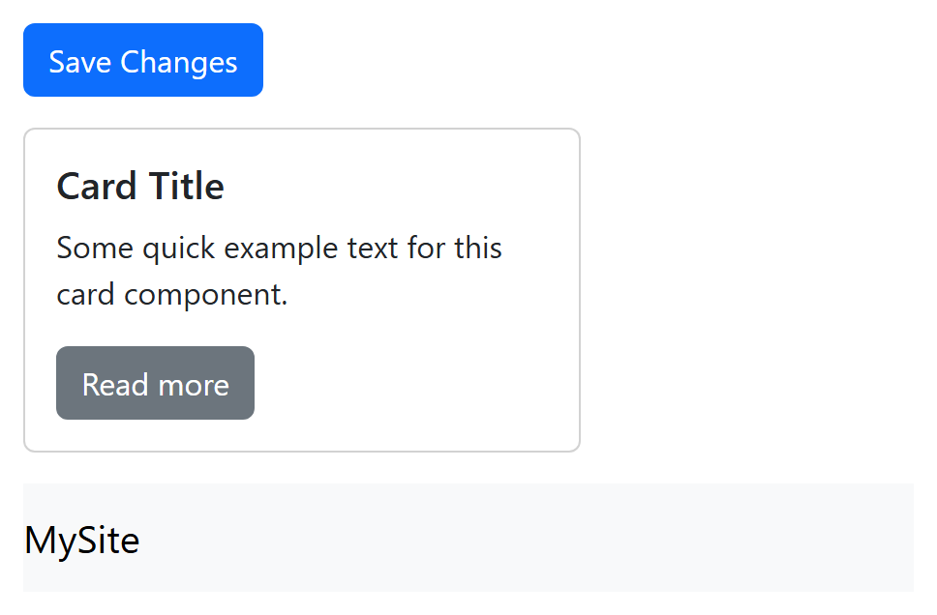
BOOTSTRAP
Components, Rendered
Three lines of HTML, zero custom CSS.
<button class="btn btn-primary">Save Changes</button>
<div class="card"><div class="card-body">
<h5 class="card-title">Card Title</h5>
</div></div>
<nav class="navbar navbar-expand-lg navbar-light bg-light">...</nav>
cuinotes.com · 24

Slide 25
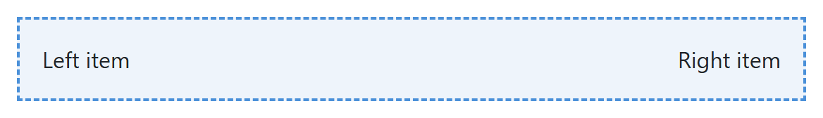
BOOTSTRAP
Utilities, Rendered
<div class="d-flex justify-content-between p-3">
<!-- d-flex: display:flex; justify-content-between: space-between; p-3: padding -->
</div>
cuinotes.com · 25

Slide 26
TAILWIND CSS
What Is Tailwind CSS, and How Do You Set It Up?
Utility-first: compose designs from small, single-purpose classes (flex, p-4, text-center) instead of writing custom CSS.
Where to get it: tailwindcss.com — docs, plus an interactive Play CDN for instant prototyping.
Production setup: npm install -D tailwindcss, then build with the Tailwind CLI/PostCSS so unused classes are purged and the shipped CSS stays small.
<!-- quick prototyping: one script tag, no build step -->
<script src="https://cdn.tailwindcss.com"></script>
# production build
npm install -D tailwindcss
npx tailwindcss -i input.css -o output.css --watch
cuinotes.com · 26

Slide 27
TAILWIND CSS
A Fully Styled Button
<button class="bg-blue-600 hover:bg-blue-700 text-white font-semibold
px-4 py-2 rounded-lg shadow">
Save Changes
</button>
cuinotes.com · 27

Slide 28
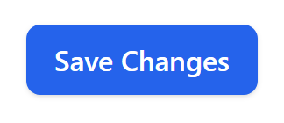
TAILWIND CSS
The Button, Rendered
cuinotes.com · 28

Slide 29
TAILWIND CSS
Responsive by Default
<div class="flex flex-col md:flex-row">
<!-- stacked by default, a row from md breakpoint up -->
</div>
cuinotes.com · 29

Slide 30
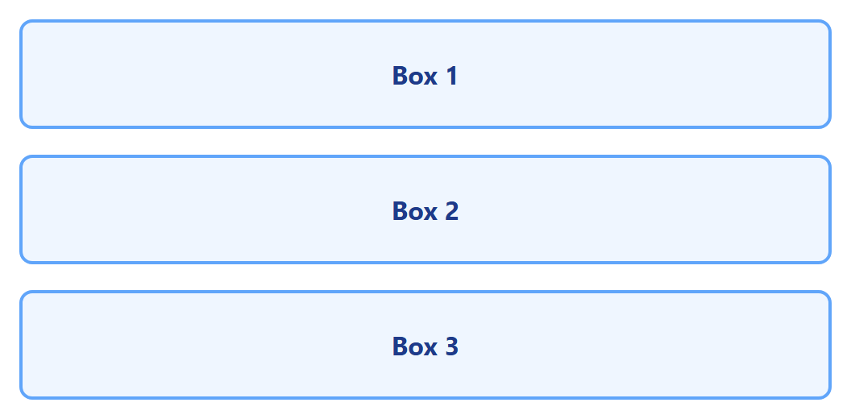
TAILWIND CSS
flex-col md:flex-row, Two Widths
WIDE (ROW)
NARROW (COLUMN)
cuinotes.com · 30

Slide 31
TAILWIND CSS
Responsive Width
<div class="w-full lg:w-1/3">
<!-- full width by default, one-third width from the "lg" breakpoint up -->
</div>
cuinotes.com · 31

Slide 32
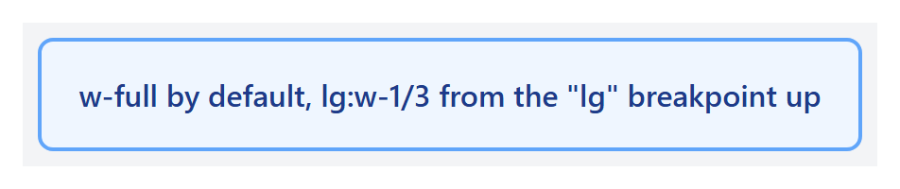
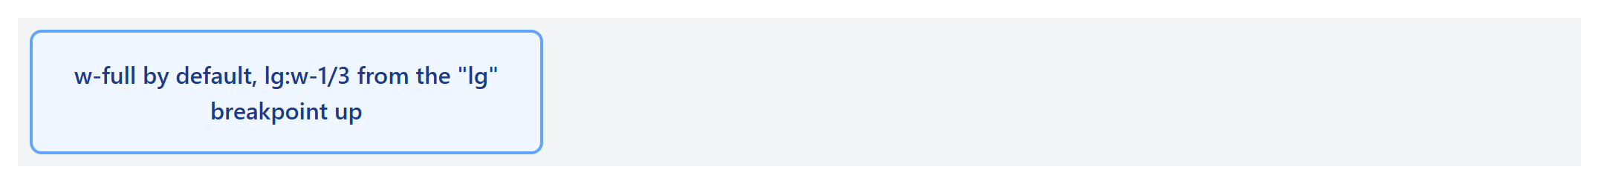
TAILWIND CSS
w-full lg:w-1/3, Two Widths
WIDE (1/3)
NARROW (FULL)
cuinotes.com · 32

Slide 33
TAILWIND CSS
More Utility Categories
Category | Example classes
Flexbox | flex, justify-center, items-center, gap-4
Grid | grid, grid-cols-3, col-span-2
Sizing | w-1/2, h-screen, max-w-md
Borders | border, border-2, rounded-full
Typography | text-lg, font-bold, truncate
State variants | hover:, focus:, active:, disabled: (prefix any utility)
The spacing/color scale is numeric and consistent — p-4 = 1rem, blue-100 (near-white) through blue-900 (near-black).
cuinotes.com · 33

Slide 34
TAILWIND CSS
Configuring Tailwind: theme.extend
module.exports = {
theme: {
extend: {
colors: { brand: '#ff6b35' }, // usable as bg-brand, text-brand...
},
},
};
cuinotes.com · 34

Slide 35

TAILWIND CSS
A Custom Color, Rendered
theme.extend adds to Tailwind's defaults, so bg-brand works with every state-variant prefix, just like a built-in color.
<button class="bg-brand hover:bg-orange-700 text-white font-semibold
px-4 py-2 rounded-lg">
Save Changes
</button>
cuinotes.com · 35

Slide 36
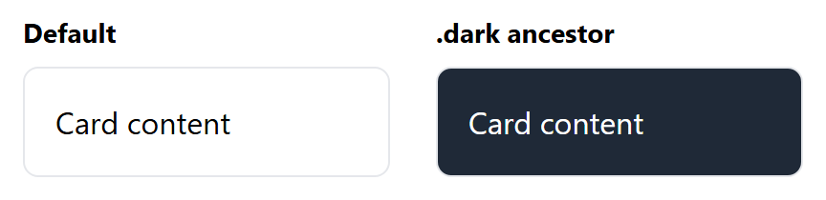
TAILWIND CSS
Dark Mode
darkMode: 'class' in the config activates dark: utilities for any element inside a .dark ancestor.
<div class="bg-white dark:bg-gray-800 text-black dark:text-white">
Card content
</div>
cuinotes.com · 36

Slide 37
TAILWIND CSS
The @apply Directive
.btn-primary {
@apply bg-blue-600 hover:bg-blue-700 text-white font-semibold
px-4 py-2 rounded-lg shadow;
}
<button class="btn-primary">Save Changes</button>
Produces the exact same button as writing all six utility classes by hand — @apply just names a repeated combination.
cuinotes.com · 37

Slide 38
CUSTOM CLASSES
Bootstrap + Your Own Class
<button class="btn btn-primary my-cta-button">Get Started</button>
.my-cta-button { text-transform: uppercase; letter-spacing: 1px; }
cuinotes.com · 38

Slide 39

CUSTOM CLASSES
Bootstrap + Custom, Rendered
cuinotes.com · 39

Slide 40
CUSTOM CLASSES
Tailwind + Your Own Class
<span class="text-blue-600 font-bold brand-underline">New!</span>
.brand-underline { text-decoration: underline wavy; text-underline-offset: 4px; }
cuinotes.com · 40

Slide 41

CUSTOM CLASSES
Tailwind + Custom, Rendered
cuinotes.com · 41

Slide 42
CSS PREPROCESSORS
What Is a CSS Preprocessor?
A separate language that adds variables, nesting, and mixins on top of CSS, then COMPILES to plain CSS the browser reads
Sass has two syntaxes: the indented .sass, and SCSS (.scss) — CSS-compatible braces/semicolons, by far the more common choice, including in Bootstrap's own source
LESS solves the same problems with a different syntax (@var instead of $var) — used by Bootstrap 3, before it switched to Sass
cuinotes.com · 42

Slide 43
CSS PREPROCESSORS
Getting Sass and LESS Running
SASS
LESS
sass-lang.com — official site and docs.
lesscss.org — official site and docs.
npm install -D sass
sass styles.scss styles.css
sass --watch styles.scss:styles.css
npm install -D less
lessc styles.less styles.css
A real project usually doesn't run these commands by hand — Vite or Webpack compiles Sass/LESS automatically through a loader or plugin.
cuinotes.com · 43

Slide 44
CSS PREPROCESSORS
Source vs. What the Browser Runs
your-styles.scss
(Sass source
you write)
compile
(sass CLI /
build tool)
your-styles.css
(plain CSS)
Browser
(links styles.css
normally)
The browser never sees Sass or LESS directly — it only ever loads the compiled, plain .css output, the same "source vs. what ships" split as modern JavaScript that gets compiled/bundled before it runs.
cuinotes.com · 44

Slide 45
CSS PREPROCESSORS
Sass Variables vs. CSS Custom Properties
 | Sass ($name) | CSS custom property (--name)
Resolved | At compile time — a fixed value | At runtime, in the browser
Changes after load? | No | Yes — JS or media queries can update it
Needs a build step? | Yes — must compile the .scss | No — works in a plain <style> tag
cuinotes.com · 45

Slide 46
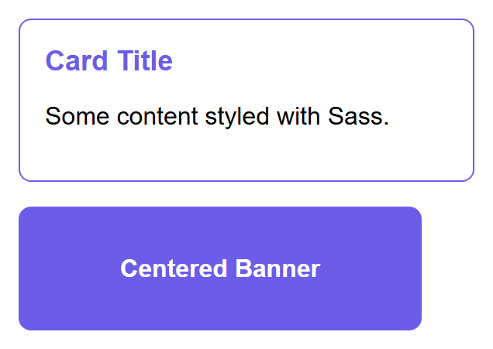
SASS FUNDAMENTALS
Variables, Nesting, and Mixins
$primary-color: #6c5ce7;
.card {
border: 1px solid $primary-color;
.title { color: $primary-color; }
&:hover { box-shadow: 0 4px 10px rgba(0,0,0,0.2); }
}
@mixin flex-center { display: flex; justify-content: center; align-items: center; }
.banner { @include flex-center; background: $primary-color; }
cuinotes.com · 46

Slide 47
SASS FUNDAMENTALS
Partials and @use
// _variables.scss
$primary-color: #6c5ce7;
// main.scss
@use 'variables' as v;
.card { border: 1px solid v.$primary-color; }
A filename starting with _ is a partial — Sass pulls it into whatever file imports it, instead of compiling it separately.
cuinotes.com · 47

Slide 48
LESS
Sass (SCSS) vs. LESS
Feature | Sass (SCSS) | LESS
Variable syntax | $name | @name
Mixin definition | @mixin name { ... } | .name() { ... }
Mixin use | @include name; | .name();
Used by | Bootstrap 4 and 5, most new projects | Bootstrap 3, older codebases
cuinotes.com · 48

Slide 49
CUSTOMIZING BOOTSTRAP
Override Variables Before Importing
// custom.scss — override BEFORE importing Bootstrap's source
$primary: #ff6b35;
$border-radius: 1rem;
$grid-gutter-width: 3rem;
@import "bootstrap/scss/bootstrap";
// sass custom.scss custom.css
Every component reading these variables picks up the new values everywhere, automatically — no HTML changes at all.
cuinotes.com · 49

Slide 50
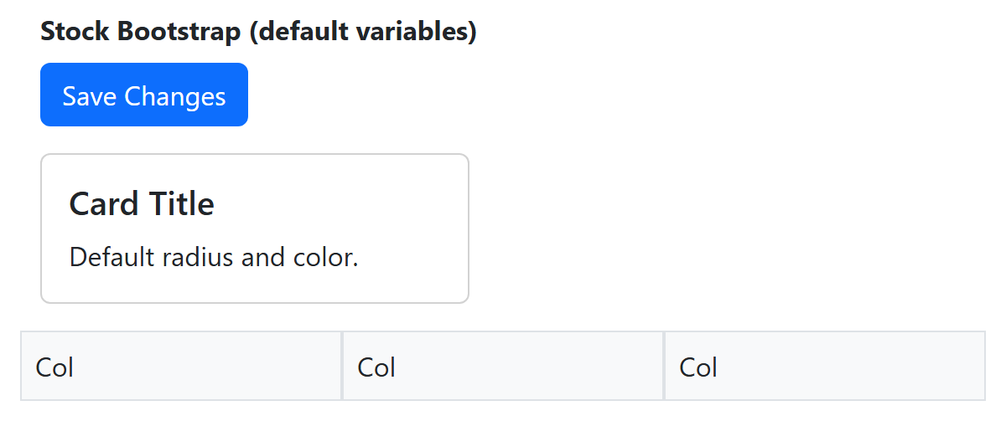
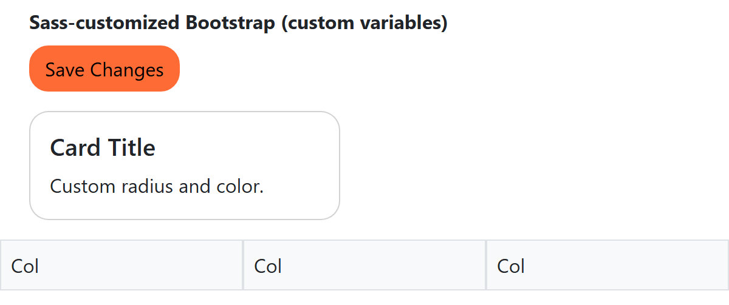
CUSTOMIZING BOOTSTRAP
Stock vs. Sass-Customized Bootstrap
STOCK BOOTSTRAP
SASS-CUSTOMIZED
cuinotes.com · 50

Slide 51
KEY TAKEAWAYS
Lecture 10 in Eight Points
1
Mobile-first: base styles for small screens, then add complexity with min-width media queries.
2
The viewport meta tag is required for media queries to work correctly on real phones.
3
Fluid units (%, rem, vw, vh) scale relative to something else, unlike fixed px.
4
Bootstrap's grid goes beyond col-md-*: auto-layout columns, nesting, offset-*, and order-* cover real layouts.
5
Bootstrap gives finished components; Tailwind gives composable utilities, configured via tailwind.config.js and dark:.
6
Sass/SCSS and LESS compile to plain CSS, adding variables (compile-time, unlike runtime CSS custom properties), nesting, and mixins.
7
Bootstrap's own source is Sass — overriding its variables before importing it recompiles the whole framework around your values.
8
Both frameworks expect your own custom CSS on top — they solve the common 80%, not the last 20% that makes a site unique.
cuinotes.com · 51

