Slide 1
LECTURE 3
HTML and HTML5
Fundamentals
The raw ingredients of every website: structure, text, links, images, tables, and lists.
CSC336 Web Technologies
cuinotes.com · 1

Slide 2
OVERVIEW
In This Lecture
1
Understand the role of markup languages, and the anatomy of an HTML tag
2
HTML's document structure, elements, attributes, nesting rules, and void elements
3
Headings, text formatting, and why the old <font> tag is obsolete
4
<pre>/<code> and other technical text tags, plus HTML entities
5
Hyperlinks (internal vs. external), images (including image links), audio, video
6
Tables, all three list types (including nested lists), and what HTML5 added
cuinotes.com · 2

Slide 3
FOUNDATIONS
What Is a Markup Language?
1
HyperText — text that contains links to other text or pages
2
Markup — the text is annotated with tags describing its structure
3
Language — a shared grammar every browser agrees to follow
4
HTML is NOT a programming language — no variables, loops, or conditions; it only describes structure and content
cuinotes.com · 3

Slide 4
START HERE
Anatomy of an HTML Tag
Part | Example | Meaning
Opening tag | <p> | Marks the start of an element
Attribute | class="intro" | Extra info, written inside the opening tag only
Content | Hello, World! | What sits between the opening and closing tag
Closing tag | </p> | Marks the end — note the forward slash
Comment | <!-- note --> | Ignored by the browser, visible only in the source
Void (self-closing) tag | <br> | No content, and so no closing tag at all
cuinotes.com · 4

Slide 5

START HERE
Your First Example: Hello, World!
<!-- This is a comment: the browser ignores it -->
<p class="intro" id="greeting">Hello, World!</p>
cuinotes.com · 5

Slide 6
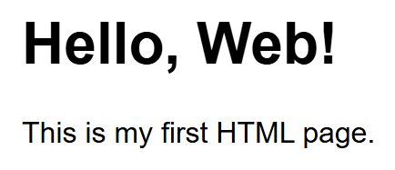
STRUCTURE
HTML Document Structure
<!DOCTYPE html>
<html lang="en">
<head>
<meta charset="UTF-8">
<title>My First Page</title>
</head>
<body>
<h1>Hello, Web!</h1>
<p>This is my first HTML page.</p>
</body>
</html>
cuinotes.com · 6

Slide 7
ELEMENTS
Void (Self-Closing) Elements
Element | What It Does
<br> | A single line break within text
<hr> | A thematic divider line between sections
<img> | Embeds an image
<input> | A form control
<meta> / <link> | Document metadata / an external resource, used inside <head>
Void elements have no content and therefore no closing tag — <div></div> is NOT void, it just happens to be empty.
cuinotes.com · 7

Slide 8
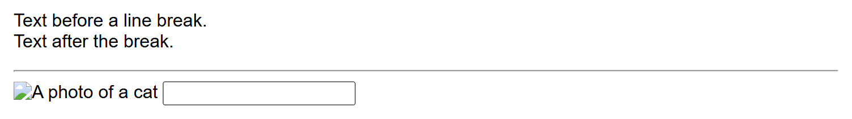
ELEMENTS
Void Elements, Rendered
<br>
<hr>
<img src="cat.jpg" alt="A photo of a cat">
<input type="text">
cuinotes.com · 8

Slide 9
LAYOUT BASICS
Block-Level vs. Inline Elements
 | Block-Level | Inline
Starts a new line? | Yes | No — flows with content
Full available width? | Yes, by default | No — only as wide as content
Examples | h1-h6, p, div, ul, table | a, strong, em, span, img
cuinotes.com · 9

Slide 10
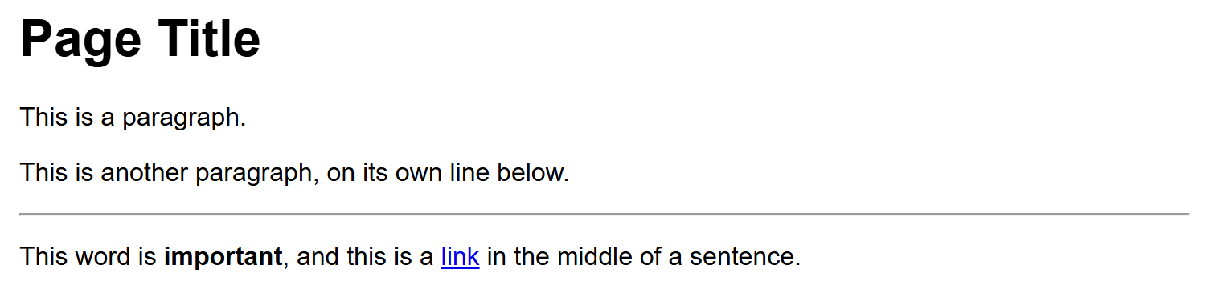
LAYOUT BASICS
Block vs. Inline, Rendered
<h1>Page Title</h1>
<p>This is a paragraph.</p>
<p>This is another paragraph, on its own line below.</p>
<p>This word is <strong>important</strong>, and this is a
<a href="#">link</a> in the middle of a sentence.</p>
cuinotes.com · 10

Slide 11
ATTRIBUTES
Global Attributes
Attribute | Purpose
id | A unique identifier for one specific element
class | Category name(s) shared by many elements, for CSS/JS
title | Extra info shown as a tooltip on hover
style | Inline CSS applied to just this one element
lang | The (human) language of this element's content
data-* | A custom attribute for attaching your own data
Boolean attributes (required, checked, disabled) need no ="value" — present means true, absent means false.
cuinotes.com · 11

Slide 12
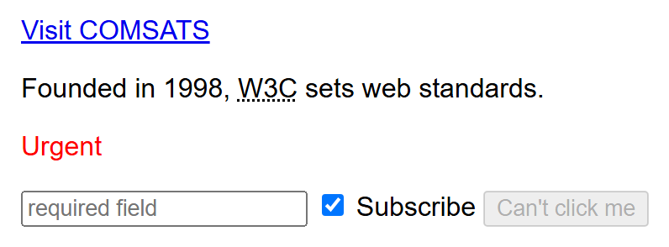
ATTRIBUTES
Attributes, Rendered
<a href="https://www.comsats.edu.pk" target="_blank">Visit COMSATS</a>
<p>Founded in 1998, <abbr title="World Wide Web Consortium">W3C</abbr> sets web standards.</p>
<p style="color: red;">Urgent</p>
<input type="text" required placeholder="required field">
<input type="checkbox" checked> Subscribe
<button disabled>Can't click me</button>
cuinotes.com · 12

Slide 13
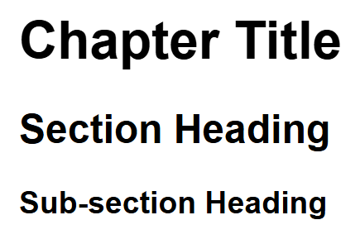
TEXT CONTENT
Headings
<h1>Chapter Title</h1>
<h2>Section Heading</h2>
<h3>Sub-section Heading</h3>
cuinotes.com · 13

Slide 14
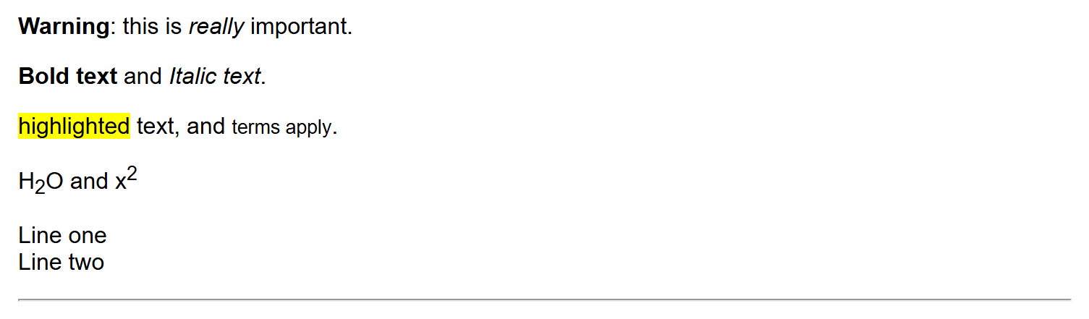
TEXT CONTENT
Text Formatting Elements
<strong>Warning</strong>: this is <em>really</em> important.
<b>Bold text</b> and <i>Italic text</i>.
<mark>highlighted</mark> text, and <small>terms apply</small>.
H<sub>2</sub>O and x<sup>2</sup>
Line one<br>Line two
<hr>
cuinotes.com · 14

Slide 15

A DEPRECATED TAG
The <font> Tag
<font color="red" size="5" face="Arial">
This text is red, size 5, Arial font.
</font>
cuinotes.com · 15

Slide 16
A DEPRECATED TAG
Why We Don't Use <font>
Mixes structure with appearance — HTML should describe what something is, not how it looks
Doesn't scale — changing 50 pages means editing 50 pages, not one CSS rule
No responsive or interactive ability — can't change on hover, on a smaller screen, or in dark mode
Fails validation — flagged as an error by the W3C Markup Validator
cuinotes.com · 16

Slide 17
TECHNICAL TEXT
<pre>, <code>, and Related Tags
Tag | Meaning
<pre> | Preformatted text — preserves every space and line break, monospace
<code> | An inline snippet of computer code, monospace
<kbd> | Keyboard input — a key the user should press
<samp> | Sample output from a program or command
<var> | A variable name or placeholder value
<blockquote> | A longer, block-level quotation
cuinotes.com · 17

Slide 18
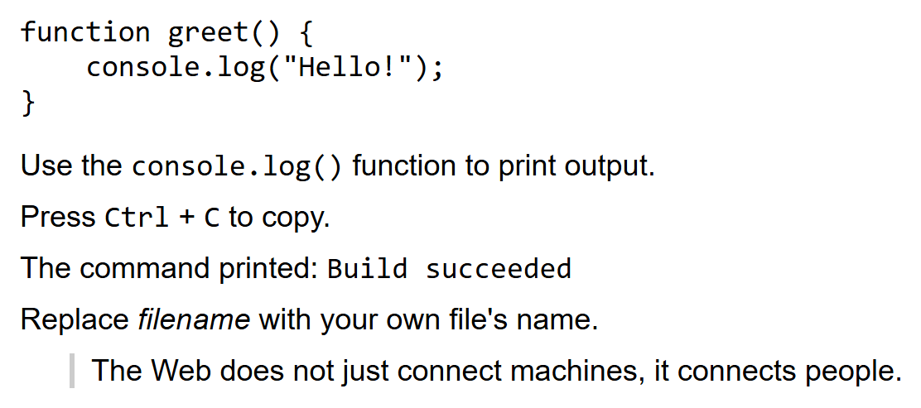
TECHNICAL TEXT
Technical Text Tags, Rendered
<pre>function greet() {
console.log("Hello!");
}</pre>
<p>Use the <code>console.log()</code> function.</p>
<p>Press <kbd>Ctrl</kbd> + <kbd>C</kbd> to copy.</p>
<p>Printed: <samp>Build succeeded</samp></p>
<p>Replace <var>filename</var> with your own.</p>
<blockquote>The Web connects people.</blockquote>
cuinotes.com · 18

Slide 19
SPECIAL CHARACTERS
HTML Entities
Entity | Renders As | Why You Need It
&lt; | < | A literal < would start a tag
&gt; | > | A literal > would end a tag
&amp; | & | A literal & would start another entity
&nbsp; | (a space) | A non-breaking space — never wraps a line
&copy; | © | Not on most keyboards
&mdash; | — | An em dash, longer than a hyphen
cuinotes.com · 19

Slide 20
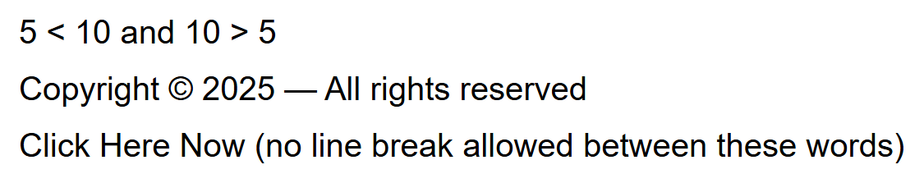
SPECIAL CHARACTERS
Entities, Rendered
<p>5 &lt; 10 and 10 &gt; 5</p>
<p>Copyright &copy; 2025 &mdash; All rights reserved</p>
<p>Click&nbsp;Here&nbsp;Now (no line break allowed)</p>
cuinotes.com · 20

Slide 21
HYPERLINKS
Internal and External Links
EXTERNAL (ABSOLUTE URL)
INTERNAL (RELATIVE URL)
The complete address, including https:// and the domain
Use for a page on a DIFFERENT website
target="_blank" + rel="noopener noreferrer" opens safely in a new tab
A path relative to the current page — no domain name
Use for pages within YOUR OWN site
Survives a domain move, since it never contained the domain
cuinotes.com · 21

Slide 22
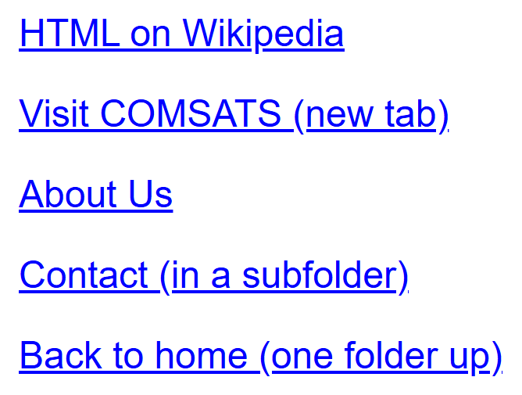
HYPERLINKS
Links, Rendered
<a href="https://en.wikipedia.org/wiki/HTML">HTML on Wikipedia</a>
<a href="https://www.comsats.edu.pk" target="_blank" rel="noopener noreferrer">Visit COMSATS (new tab)</a>
<a href="about.html">About Us</a>
<a href="pages/contact.html">Contact (in a subfolder)</a>
<a href="../index.html">Back to home (one folder up)</a>
cuinotes.com · 22

Slide 23

IMAGES
The <img> Element
<img src="images/logo.png" alt="COMSATS logo" width="200" height="80">
cuinotes.com · 23

Slide 24
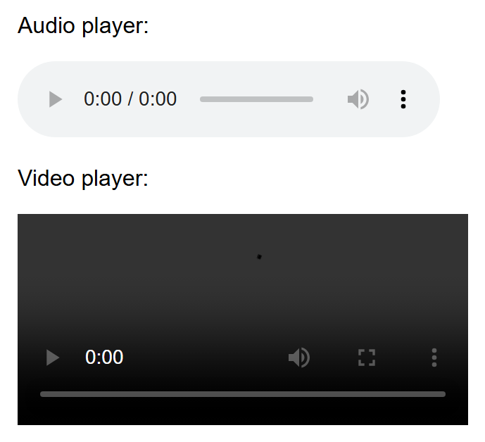
MEDIA
Audio and Video
<audio controls>
<source src="song.mp3" type="audio/mpeg">
Your browser does not support audio.
</audio>
<video width="480" controls>
<source src="movie.mp4" type="video/mp4">
Your browser does not support video.
</video>
cuinotes.com · 24

Slide 25
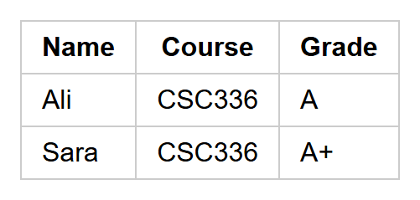
TABULAR DATA
Tables: <table>, <tr>, <th>, <td>
<table>
<thead>
<tr><th>Name</th><th>Course</th><th>Grade</th></tr>
</thead>
<tbody>
<tr><td>Ali</td><td>CSC336</td><td>A</td></tr>
<tr><td>Sara</td><td>CSC336</td><td>A+</td></tr>
</tbody>
</table>
cuinotes.com · 25

Slide 26
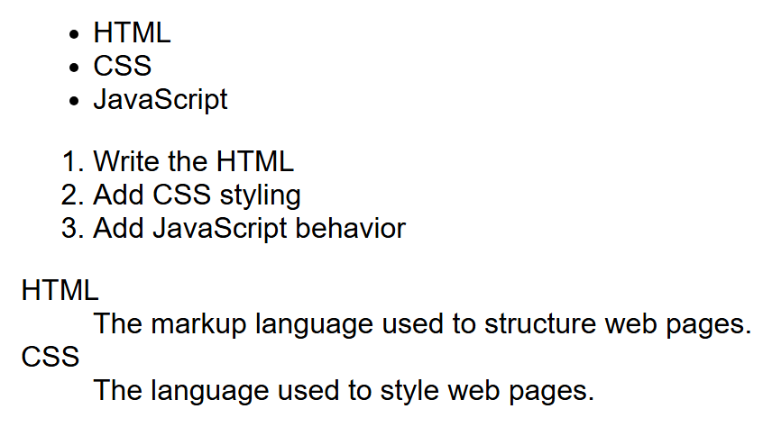
LISTS
Unordered, Ordered, and Description Lists
<ul>
<li>HTML</li><li>CSS</li><li>JavaScript</li>
</ul>
<ol>
<li>Write the HTML</li><li>Add CSS styling</li>
</ol>
<dl>
<dt>HTML</dt><dd>The markup language...</dd>
</dl>
cuinotes.com · 26

Slide 27
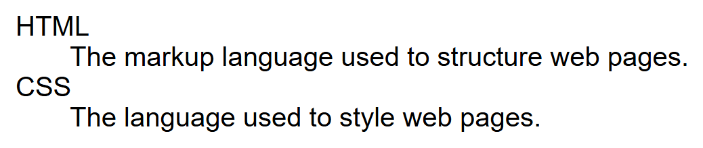
LISTS
A Closer Look: Description Lists
<dl>
<dt>HTML</dt>
<dd>The markup language used to structure web pages.</dd>
<dt>CSS</dt>
<dd>The language used to style web pages.</dd>
</dl>
cuinotes.com · 27

Slide 28
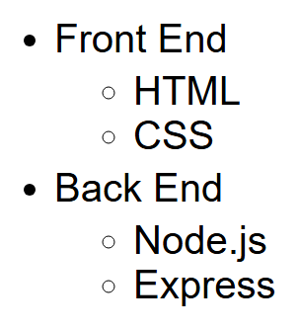
LISTS
Nested Lists
<ul>
<li>Front End
<ul>
<li>HTML</li>
<li>CSS</li>
</ul>
</li>
<li>Back End
<ul>
<li>Node.js</li>
<li>Express</li>
</ul>
</li>
</ul>
cuinotes.com · 28

Slide 29
LISTS
Nested List Rules
A nested <ul>/<ol> goes inside the <li> of the item it belongs under
A nested <ol> restarts its own numbering from 1, independent of the level above
Browsers change bullet style (disc → circle → square) at each nesting depth
cuinotes.com · 29

Slide 30
HTML5
What HTML5 Added
Semantic layout: header, nav, main, section, article, aside, footer
Media: audio, video, source, track — no plugins required
Graphics: canvas and native svg support
New attributes: placeholder, required, pattern, data-*, contenteditable, draggable
cuinotes.com · 30

Slide 31
BROWSER SUPPORT
Progressive Enhancement
TIP
Not every browser supports every HTML5 feature. Check caniuse.com before relying on a newer one, and design your page so it still works reasonably well in older browsers while enhancing the experience for those that support more.
cuinotes.com · 31

Slide 32
KEY TAKEAWAYS
Lecture 3 in Six Points
1
A tag has an opening tag, content, and a closing tag; attributes live inside the opening tag; comments and attributes never appear in the rendered page.
2
Void elements (br, img) have no closing tag; nesting must close in reverse order.
3
Block-level elements stack and fill width; inline elements flow within text.
4
The <font> tag is obsolete — use CSS for all styling instead.
5
<pre>/<code> handle technical text; entities (&lt; &nbsp;) represent characters HTML can't take literally.
6
HTML has three list types — unordered, ordered, description (<dl>) — and any of them can be nested.
cuinotes.com · 32

