Slide 1
LECTURE 4
Semantic HTML
and HTML Forms
Organizing a page so it means something — to humans, browsers, and search engines — and collecting user input.
CSC336 Web Technologies
cuinotes.com · 1

Slide 2
OVERVIEW
In This Lecture
1
Block-level vs. inline elements, and the generic <div>/<span>
2
HTML5 semantic elements, and why they matter for accessibility and SEO
3
Build forms: <form>, action/method — including a real Google search GET form
4
<input> types, <select>, <textarea>, <button>
5
Upload files with multipart/form-data
6
Client-side validation with required, pattern, min, max
cuinotes.com · 2

Slide 3
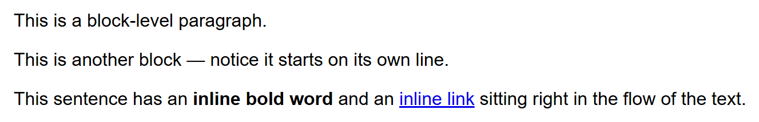
LAYOUT BASICS
Block-Level vs. Inline (Recap)
Block elements each claim their own line; inline elements flow within the surrounding text.
<p>This is a block-level paragraph.</p>
<p>This is another block — starts on its own line.</p>
<p>This sentence has an <strong>inline bold word</strong> and an
<a href="#">inline link</a> in the flow of the text.</p>
cuinotes.com · 3

Slide 4
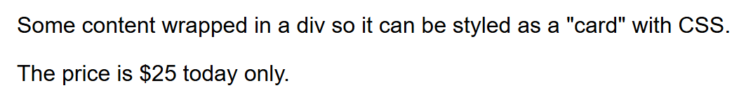
GENERIC CONTAINERS
The Generic <div> and <span>
<div> is a generic BLOCK container; <span> is a generic INLINE container — neither means anything on its own.
<div class="card">
<p>Some content wrapped in a div so it can be styled as a "card".</p>
</div>
<p>The price is <span class="highlight-price">$25</span> today only.</p>
cuinotes.com · 4

Slide 5
SEMANTIC HTML
Meaningless Divs vs. Semantic Tags
WITHOUT SEMANTICS (OLD STYLE)
WITH SEMANTICS (HTML5)
<div class="header">
<div class="nav">
<div class="main-content">
<div class="footer">
<header>
<nav>
<main>
<footer>
cuinotes.com · 5

Slide 6
SEMANTIC HTML
The Main Semantic Elements
Element | Represents
<header> | Introductory content — logo, title, nav
<nav> | A block of navigation links
<main> | The primary, unique content (only one per page)
<section> / <article> | A themed grouping / self-contained standalone content
<aside> | Content tangentially related (a sidebar)
<footer> | Closing content — copyright, contact links
cuinotes.com · 6

Slide 7
SEMANTIC HTML
A Full Page Skeleton
<header>
<h1>My Tech Blog</h1>
<nav><a href="/">Home</a> <a href="/about.html">About</a></nav>
</header>
<main>
<article><h2>Why Semantic HTML Matters</h2><p>Semantic tags help everyone.</p></article>
<aside><h3>Related Posts</h3></aside>
</main>
<footer><p>&copy; 2026 My Tech Blog.</p></footer>
cuinotes.com · 7

Slide 8
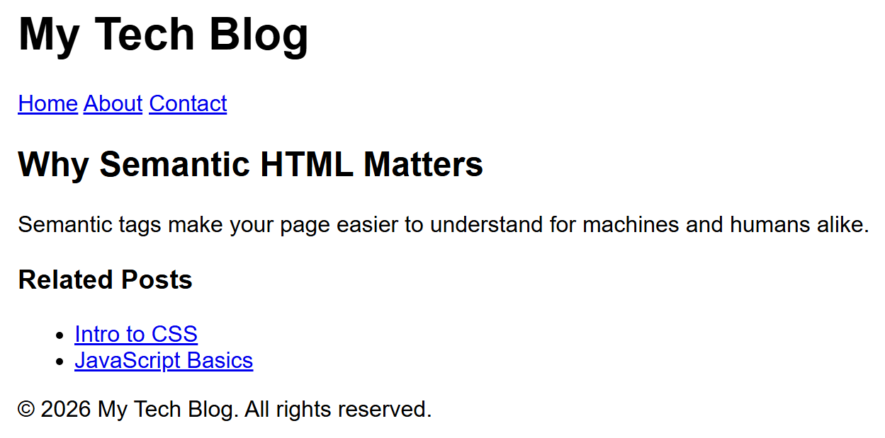
SEMANTIC HTML
A Full Page Skeleton, Rendered
Semantic elements have no built-in visual style — but every section genuinely exists in the markup.
cuinotes.com · 8

Slide 9
WHY IT MATTERS
Accessibility and SEO
Accessibility: screen readers use semantic tags to jump to navigation or skip to main content — a div-only page gives them nothing to work with
SEO: search engines weight content inside <article>/<main>/headings more than anonymous <div>s
Rule of thumb: reach for a semantic element first; fall back to <div>/<span> only when nothing else fits
cuinotes.com · 9

Slide 10
HTML FORMS
A Basic Form
<form action="/submit-login" method="POST">
<label for="username">Username:</label>
<input type="text" id="username" name="username">
<label for="password">Password:</label>
<input type="password" id="password" name="password">
<button type="submit">Log In</button>
</form>
cuinotes.com · 10

Slide 11
HTML FORMS
What Happens on Submit
User fills in
form fields
Clicks the
Submit button
Browser sends an
HTTP request to
the action URL
Server
processes
the data
Server sends
back a response
The action URL and the method (GET or POST) decide where the request goes and how the form's data is packaged inside it.
cuinotes.com · 11

Slide 12
HTML FORMS
The action and method Attributes
Attribute | Meaning
action | The URL the form's data is sent to on submit
method: GET | Appends data to the URL as a query string — for searches, not sensitive data
method: POST | Sends data in the request body — for anything that creates/changes data, or is sensitive
cuinotes.com · 12

Slide 13
SECURITY
Never Use GET for Passwords
WARNING
GET puts form values directly into the URL, where they can end up saved in browser history, server logs, and shared links. Always use POST for passwords and other sensitive information.
cuinotes.com · 13

Slide 14
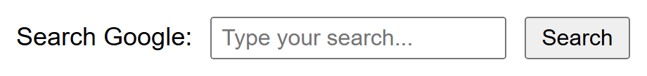
A REAL EXAMPLE
Searching Google with a GET Form
name="q" is the exact query-parameter name Google's search endpoint expects — submitting this form genuinely searches Google.
<form action="https://www.google.com/search" method="GET">
<label for="q">Search Google:</label>
<input type="text" id="q" name="q" placeholder="Type your search...">
<button type="submit">Search</button>
</form>
cuinotes.com · 14

Slide 15
INPUT TYPES
Common <input> Types
Type | Purpose
text / email / password | A line of text, checked for an email shape, or hidden as dots
number / date | Numeric input with arrows / a date picker
checkbox / radio | An on/off box / a mutually-exclusive choice (same name)
file | Lets the user pick a file to upload
range / color | A slider / a color picker
submit / hidden | Submits the form / not shown, but sent along with the data
cuinotes.com · 15

Slide 16
INPUT TYPES
Every <input> Type
<input type="text" name="fullname" placeholder="Full name">
<input type="email" name="email" placeholder="you@example.com">
<input type="password" name="password">
<input type="number" name="age" min="1" max="120">
<input type="date" name="birthday">
<input type="checkbox" name="subscribe" checked>
<input type="radio" name="gender" value="male"> Male
<input type="radio" name="gender" value="female"> Female
<input type="file" name="resume">
<input type="range" name="volume" min="0" max="100">
<input type="color" name="favcolor">
<input type="submit" value="Send">
cuinotes.com · 16

Slide 17
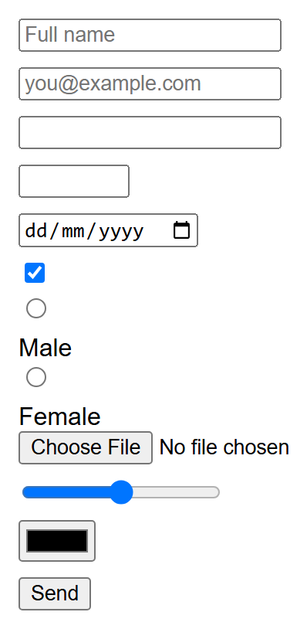
INPUT TYPES
Every Input Type, Rendered
Each type is a genuinely different native control — this is the browser doing most of the work for you.
cuinotes.com · 17

Slide 18
FILE UPLOADS
multipart/form-data
A file's raw bytes can't fit in a URL — file uploads require method="POST"
enctype="multipart/form-data" switches the request body format so text fields and raw file bytes can travel together
accept is a filter hint for the file picker, not a security check — the server must always re-validate the uploaded file
cuinotes.com · 18

Slide 19
FILE UPLOADS
What multipart/form-data Looks Like
POST /upload-resume HTTP/1.1
Content-Type: multipart/form-data; boundary=----Bnd123
------Bnd123
Content-Disposition: form-data; name="resume"; filename="cv.pdf"
%PDF-1.4 ...(raw binary bytes)...
------Bnd123--
Node.js/Express (with multer) parses this format for you automatically — you'll never write boundary-splitting code by hand.
cuinotes.com · 19

Slide 20
MORE CONTROLS
<select>, <textarea>, and <button>
1
<select> + <option> creates a dropdown; the selected attribute pre-picks one
2
<textarea> is a resizable, multi-line text box — its default text goes between the tags, not in a value attribute
3
<button> is more flexible than <input type="submit"> because it can contain other HTML
cuinotes.com · 20

Slide 21
MORE CONTROLS
<select> and <textarea> Markup
<select id="course" name="course">
<option value="csc336">Web Technologies</option>
<option value="csc337" selected>Advanced Web Technologies</option>
</select>
<textarea id="message" name="message" rows="5" cols="40">Type here...</textarea>
cuinotes.com · 21

Slide 22
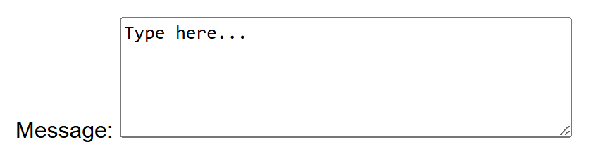

MORE CONTROLS
Dropdown and Textarea, Rendered
SELECT
TEXTAREA
cuinotes.com · 22

Slide 23

MORE CONTROLS
Three Button Types
submit submits the form, reset clears it, button does nothing on its own (wired up with JavaScript later).
<button type="submit">Submit</button>
<button type="reset">Clear Form</button>
<button type="button">Just a Button (does nothing by itself)</button>
cuinotes.com · 23

Slide 24
VALIDATION
HTML5 Client-Side Validation
Attribute | Effect
required | The field cannot be left empty
pattern | A regular expression the value must match (with title for a hint)
min / max / step | Lowest/highest acceptable value and allowed increment
maxlength / minlength | Character-count limits on a text field
cuinotes.com · 24

Slide 25
VALIDATION
A Validated Registration Form
<form action="/register" method="POST">
<label for="uname">Username (required):</label>
<input type="text" id="uname" name="uname" required>
<label for="cnic">CNIC (format 00000-0000000-0):</label>
<input type="text" id="cnic" name="cnic"
pattern="\d{5}-\d{7}-\d" title="Format: 00000-0000000-0">
<label for="age">Age (18–60):</label>
<input type="number" id="age" name="age" min="18" max="60">
<button type="submit">Register</button>
</form>
cuinotes.com · 25

Slide 26
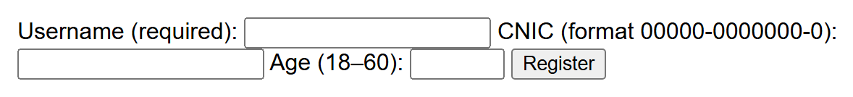
VALIDATION
A Validated Form, Rendered
The warning bubbles only appear live in a browser when you try to submit invalid or missing data.
cuinotes.com · 26

Slide 27
VALIDATION
Client-Side Validation Is Not Enough
WARNING
A user can disable JavaScript or edit HTML in dev tools. Client-side validation is a convenience for instant feedback — it is not security. Every submission must also be validated again on the server.
cuinotes.com · 27

Slide 28
KEY TAKEAWAYS
Lecture 4 in Six Points
1
Semantic elements (header, nav, main, article, footer) describe role, improving accessibility and SEO over generic divs.
2
action sets where form data goes; method (GET/POST) sets how — GET builds a query string, exactly how Google's search box works.
3
<input type="..."> covers most controls; <select>, <textarea>, and <button> cover the rest.
4
File uploads need method="POST" and enctype="multipart/form-data" — accept is a hint, not a security check.
5
required/pattern/min/max give instant feedback, but must always be backed by server-side validation.
6
Always pair inputs with <label>, connected via matching for/id attributes.
cuinotes.com · 28

