Slide 1
LECTURE 5
CSS
Fundamentals
The language that controls how HTML looks: colours, fonts, spacing, and layout.
CSC336 Web Technologies
cuinotes.com · 1

Slide 2
OVERVIEW
In This Lecture
1
CSS syntax, and the three ways to attach CSS to HTML
2
Selectors: element, class, id, attribute, grouping, descendant
3
Pseudo-classes and pseudo-elements
4
The cascade and specificity — every conflict case, and the real scoring method
5
Which properties inherit from parent to child, and which do not
6
The most common colour, font, text, and background properties
cuinotes.com · 2

Slide 3
FOUNDATIONS
What Is CSS?
1
A style sheet language: HTML says what something IS, CSS says how it should look
2
Separates content (HTML) from presentation (CSS)
3
Change a whole site's look by editing one CSS file
4
The same HTML can be restyled for print, mobile, or accessibility
cuinotes.com · 3

Slide 4
SYNTAX
A CSS Rule
p {
color: darkslategray;
font-size: 16px;
}
A selector (which elements) plus a declaration block (what style) — every declaration is a property: value pair, ending in a semicolon.
cuinotes.com · 4

Slide 5

ATTACHING CSS
1. Inline Styles
<p style="color: red; font-weight: bold;">This paragraph is styled inline.</p>
cuinotes.com · 5

Slide 6
ATTACHING CSS
2. Internal Style Sheets
<head>
<style>
body { font-family: Arial, sans-serif; }
h1 { color: navy; }
</style>
</head>
<body>
<h1>Welcome</h1>
</body>
cuinotes.com · 6

Slide 7

ATTACHING CSS
2. Internal Style Sheets, Rendered
A <style> block inside <head> — applies to the whole page, but stuck in that one HTML file.
cuinotes.com · 7

Slide 8
ATTACHING CSS
3. External Style Sheets — Preferred
TIP
One file, many pages: every page links the same styles.css, so the whole site looks consistent and you edit one file to restyle it. Separation of concerns keeps HTML focused on content. Browsers cache the file, so pages after the first load faster. Designers and developers can work on CSS and HTML independently.
cuinotes.com · 8

Slide 9
SELECTORS
Class Selector: .highlight
<p class="highlight">This text is important.</p>
.highlight {
background-color: yellow;
}
cuinotes.com · 9

Slide 10

SELECTORS
ID Selector: #main-header
<div id="main-header">Site Title</div>
#main-header {
font-size: 2rem;
text-align: center;
}
cuinotes.com · 10

Slide 11
SELECTORS
Class vs. ID
WARNING
Use a class when a style might apply to more than one element (most of the time). Use an id only for something that truly appears once on the page. Overusing ids makes CSS harder to reuse.
cuinotes.com · 11

Slide 12
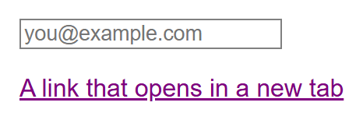
SELECTORS
Attribute Selector
input[type="email"] {
border: 1px solid gray;
}
a[target] {
color: purple;
}
cuinotes.com · 12

Slide 13
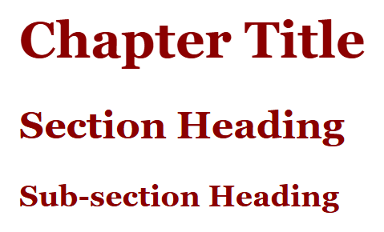
SELECTORS
Grouping Selector
h1, h2, h3 {
font-family: Georgia, serif;
color: darkred;
}
cuinotes.com · 13

Slide 14
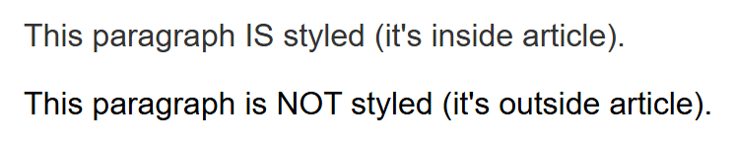
SELECTORS
Descendant Selector
article p {
color: #333;
}
<article>
<p>This paragraph IS styled (inside article).</p>
</article>
<p>This paragraph is NOT styled (outside article).</p>
cuinotes.com · 14

Slide 15
SELECTORS
The Universal Selector
* {
margin: 0;
padding: 0;
box-sizing: border-box;
}
* matches every single element on the page — most commonly seen in a "CSS reset" at the very top of a stylesheet.
cuinotes.com · 15

Slide 16
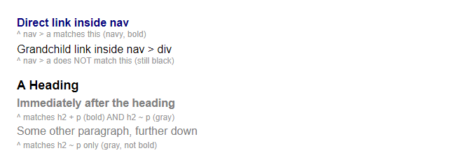
SELECTORS
Combinators: Child and Sibling
nav > a { color: navy; font-weight: bold; }
h2 + p { font-weight: bold; }
h2 ~ p { color: gray; }
<nav>
<a>Direct link</a>
<div><a>Grandchild link</a></div>
</nav>
<h2>A Heading</h2>
<p>Immediately after</p>
<p>Further down</p>
cuinotes.com · 16

Slide 17
STATES
Common Pseudo-Classes
Pseudo-class | Matches
:hover / :focus | Mouse over the element / the element is focused
:active | While the element is being clicked
:first-child / :last-child | First / last child of its parent
:nth-child(n) | The nth child of its parent
:not(selector) | Elements that do NOT match the given selector
cuinotes.com · 17

Slide 18
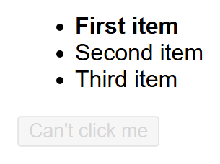
STATES
Pseudo-Classes, Rendered
li:first-child and button:disabled are states the browser can render up front.
li:first-child {
font-weight: bold;
}
button:disabled {
opacity: 0.5;
}
cuinotes.com · 18

Slide 19
PARTS
Pseudo-Elements
p::first-line { font-weight: bold; }
.quote::before { content: "\201C"; }
.quote::after { content: "\201D"; }
::before and ::after insert content that is not in the HTML at all — purely for decoration.
cuinotes.com · 19

Slide 20
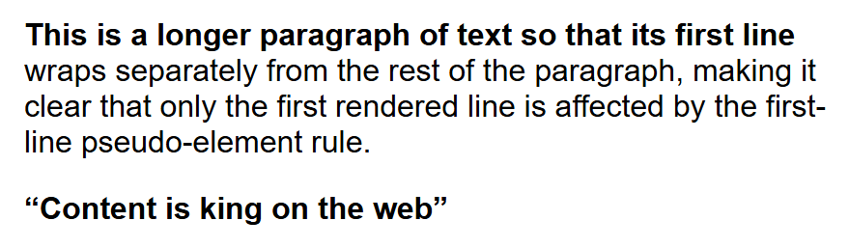
PARTS
Pseudo-Elements, Rendered
cuinotes.com · 20

Slide 21
THE CASCADE
Specificity, From Lowest to Highest
Selector Type | Example
Element / pseudo-element | p, ::before
Class / attribute / pseudo-class | .highlight, [type="text"], :hover
ID | #main-header
Inline style | style="..."
!important | Overrides everything else
cuinotes.com · 21

Slide 22

THE CASCADE
Specificity Decides the Winner
p { color: black; } /* low specificity */
.intro { color: green; } /* medium */
#lead-paragraph { color: blue; } /* high */
<p id="lead-paragraph" class="intro">What colour am I?</p>
cuinotes.com · 22

Slide 23
EVERY CONFLICT CASE
How the Browser Resolves Conflicts
Case | The Winner
1. Different specificity | The more specific rule, regardless of order
2. Equal specificity | The rule written LATER in the source
3. One rule is !important | The !important rule, regardless of specificity
4. Both rules !important | Falls back to specificity, then order
5. Inline style vs. stylesheet | The inline style — unless the stylesheet rule is !important
cuinotes.com · 23

Slide 24
EVERY CONFLICT CASE
The Resolution Flowchart
Conflicting declarations
on the same property
Differ in
!important status?
One is !important
Both / neither
The !important
declaration wins
Compare specificity
One higher
Equal specificity
More specific
rule wins
Rule written LATER wins
(equal specificity)
Every cascade conflict resolves through exactly these branches, in this order — importance first, then specificity, then source order.
cuinotes.com · 24

Slide 25
EVERY CONFLICT CASE
Case 5 in Code
<p id="lead" style="color: purple;">...</p>
#lead { color: blue; } /* loses to inline */
#lead { color: green !important; } /* beats inline */
Without the !important line, the paragraph is purple. With it, green — one of the few times !important is the right tool.
cuinotes.com · 25

Slide 26
THE REAL FORMULA
The 4-Part Specificity Score
Column | Counts
Inline | 1 if the style is inline, else 0
IDs | Number of ID selectors
Classes / attrs / pseudo-classes | Number of these
Elements / pseudo-elements | Number of these
#nav .item a:hover -> (0,1,2,1) beats nav ul li a -> (0,0,0,4) — one ID always outweighs any number of elements, no matter how long the other selector looks.
cuinotes.com · 26

Slide 27
THE REAL FORMULA
How Specificity Is Calculated
Part of the Selector | Category | Column It Counts Toward
#nav | ID selector | IDs: +1
.item | Class selector | Classes / attrs / pseudo-classes: +1
:hover | Pseudo-class | Classes / attrs / pseudo-classes: +1
a | Element selector | Elements / pseudo-elements: +1
#nav .item a:hover totals to (0 inline, 1 ID, 2 classes/pseudo, 1 element) = (0,1,2,1). Every part of nav ul li a is a plain element, so it totals to (0,0,0,4). Compare column by column, left to right: the IDs column differs first (1 vs. 0), so #nav .item a:hover wins outright — the comparison never even reaches the Elements column.
cuinotes.com · 27

Slide 28
INHERITANCE
An Example Where Inheritance Does NOT Happen
.parent {
border: 4px solid crimson;
padding: 20px;
color: darkblue;
}
<div class="parent">
Parent text is dark blue.
<p>Child paragraph is dark blue too.</p>
</div>
color inherits, so the <p> is dark blue too. border and padding do NOT inherit — only .parent itself gets the crimson outline and padding.
cuinotes.com · 28

Slide 29
INHERITANCE
Inherited vs. Not Inherited
Inherited by Default | Not Inherited by Default
color | margin
font-family, font-size, font-weight | padding
line-height | border
text-align | width, height
visibility | background / background-color
cuinotes.com · 29

Slide 30
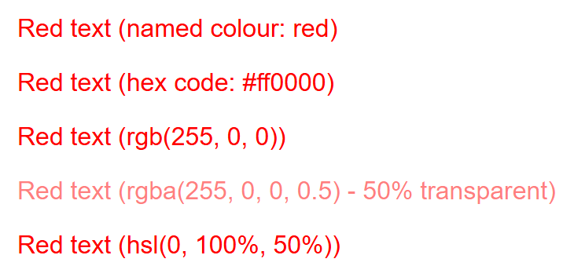
COLOUR
Five Ways to Write a Colour
.a { color: red; } /* named colour */
.b { color: #ff0000; } /* hex code */
.c { color: rgb(255, 0, 0); } /* red, green, blue */
.d { color: rgba(255, 0, 0, 0.5); } /* rgb + alpha */
.e { color: hsl(0, 100%, 50%); } /* hue, sat, lightness */
cuinotes.com · 30

Slide 31
FONTS
Font Properties
font-family (a fallback list), font-size, font-weight, font-style — combined via the font shorthand too.
p {
font-family: "Helvetica Neue", Arial, sans-serif;
font-size: 16px;
font-weight: bold;
font-style: italic;
}
cuinotes.com · 31

Slide 32
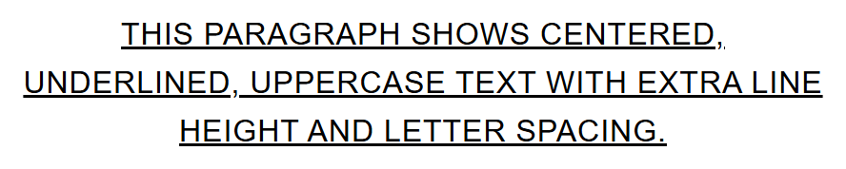
TEXT
Text Properties
p {
text-align: center;
text-decoration: underline;
text-transform: uppercase;
line-height: 1.6;
letter-spacing: 0.5px;
}
cuinotes.com · 32

Slide 33
BACKGROUNDS
Background Properties
.card {
background-color: #f5f5f5;
background-image: url("pattern.png");
background-repeat: no-repeat;
background-position: center;
background-size: cover;
}
A background shorthand combines several of these into one declaration, just like font does.
cuinotes.com · 33

Slide 34
KEY TAKEAWAYS
Lecture 5 in Six Points
1
CSS separates presentation from content; external style sheets are preferred for real projects.
2
Selectors decide what gets styled: element, class, id, attribute, grouping, descendant.
3
The cascade resolves conflicts in order: importance, then specificity, then source order — every time.
4
Specificity is a 4-part score compared column by column; one ID beats any number of classes or elements.
5
!important should be a last resort — it breaks normal specificity reasoning.
6
Text properties like color inherit from parent to child; box properties like border and margin do not.
cuinotes.com · 34

