Slide 1
LECTURE 6
The CSS Box Model
and Display
Every element is a rectangular box — understanding its size and behavior is the core of CSS layout.
CSC336 Web Technologies
cuinotes.com · 1

Slide 2
OVERVIEW
In This Lecture
1
The four layers of the box model: content, padding, border, and margin
2
Margin collapsing, and why it surprises beginners
3
box-sizing: content-box vs. border-box
4
Controlling size with width, height, and min-/max- constraints
5
The display property: block, inline, inline-block, and none
6
A real technique: turning a <ul> into a horizontal menu with display
cuinotes.com · 2

Slide 3
THE BOX MODEL
Four Nested Layers
1
Content — the actual text, image, or other content
2
Padding — transparent space inside the border, colored by the background
3
Border — a line (or nothing) drawn around the padding
4
Margin — transparent space outside the border, never filled with color
cuinotes.com · 3

Slide 4
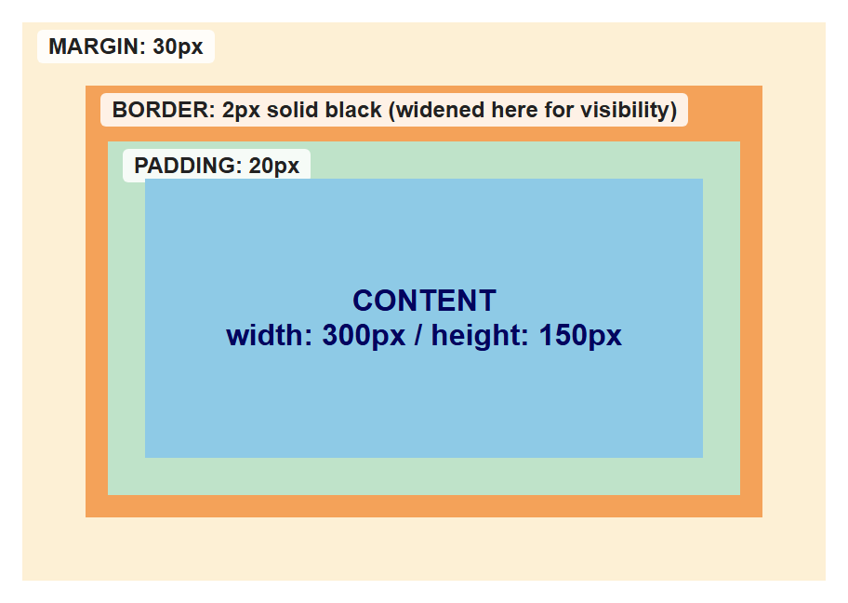
THE BOX MODEL
The Four Layers, Rendered
.content { width: 300px; height: 150px; background: steelblue; }
.padding { padding: 20px; background: seagreen; }
.border { border: 20px solid darkorange; }
.margin { margin: 20px; background: wheat; }
cuinotes.com · 4

Slide 5
MARGIN COLLAPSING
Two Adjacent Vertical Margins
.box-one { margin-bottom: 30px; }
.box-two { margin-top: 20px; }
You might expect a 50px gap — but margin collapsing means the actual gap is only 30px, the LARGER of the two.
cuinotes.com · 5

Slide 6
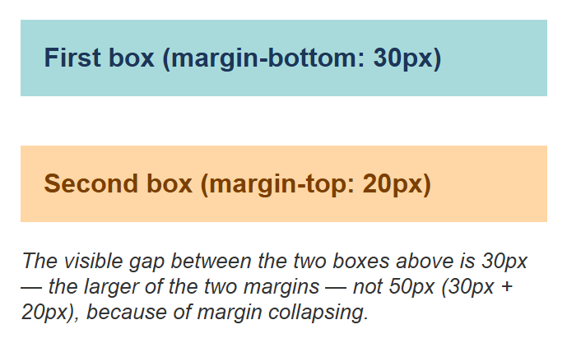
MARGIN COLLAPSING
Margin Collapsing, Rendered
cuinotes.com · 6

Slide 7
MARGIN COLLAPSING
Only Happens Vertically
WARNING
Margin collapsing applies only to top/bottom margins of block elements in normal flow. It never happens with left/right margins, or with flex, grid, floats, or absolute positioning.
cuinotes.com · 7

Slide 8
BOX-SIZING
content-box (Default) vs. border-box
/* content-box: padding + border ADD to width */
.a { box-sizing: content-box; width: 300px; padding: 20px; border: 2px solid; }
/* actual rendered width = 344px */
/* border-box: padding + border are INCLUDED in width */
.b { box-sizing: border-box; width: 300px; padding: 20px; border: 2px solid; }
/* actual rendered width = exactly 300px */
cuinotes.com · 8

Slide 9
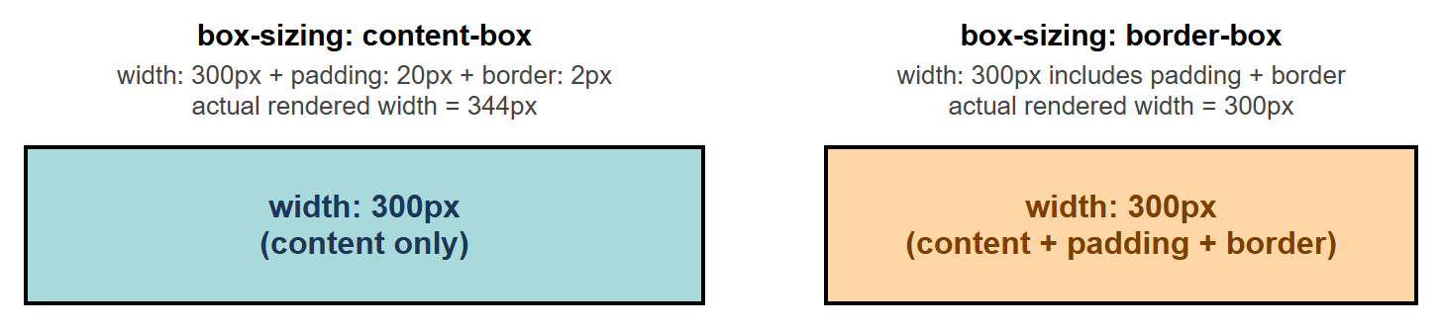
BOX-SIZING
Same Width, Different Sizing
Same width, padding, and border on both — content-box renders visibly wider than border-box.
cuinotes.com · 9

Slide 10
BOX-SIZING
border-box: The Practical Default
TIP
Because border-box makes sizing far more predictable, most real style sheets start with *, *::before, *::after { box-sizing: border-box; } as a site-wide reset.
cuinotes.com · 10

Slide 11
SIZING
min-/max- Constraints
max-width caps how wide a box can grow — never wider than 1000px, even on a huge screen
min-width / min-height set a floor the box will never shrink below
Together they let a box scale down on narrow screens but stop growing past a sensible limit on wide monitors
cuinotes.com · 11

Slide 12
THE DISPLAY PROPERTY
block, inline, inline-block, none
1
block — starts a new line, fills the full available width (div, p, h1-h6, ul)
2
inline — flows within text, width/height are ignored (span, a, strong)
3
inline-block — flows inline, but respects width/height/vertical margin (nav links, buttons)
4
none — removed from the page entirely, taking up no space at all
cuinotes.com · 12

Slide 13
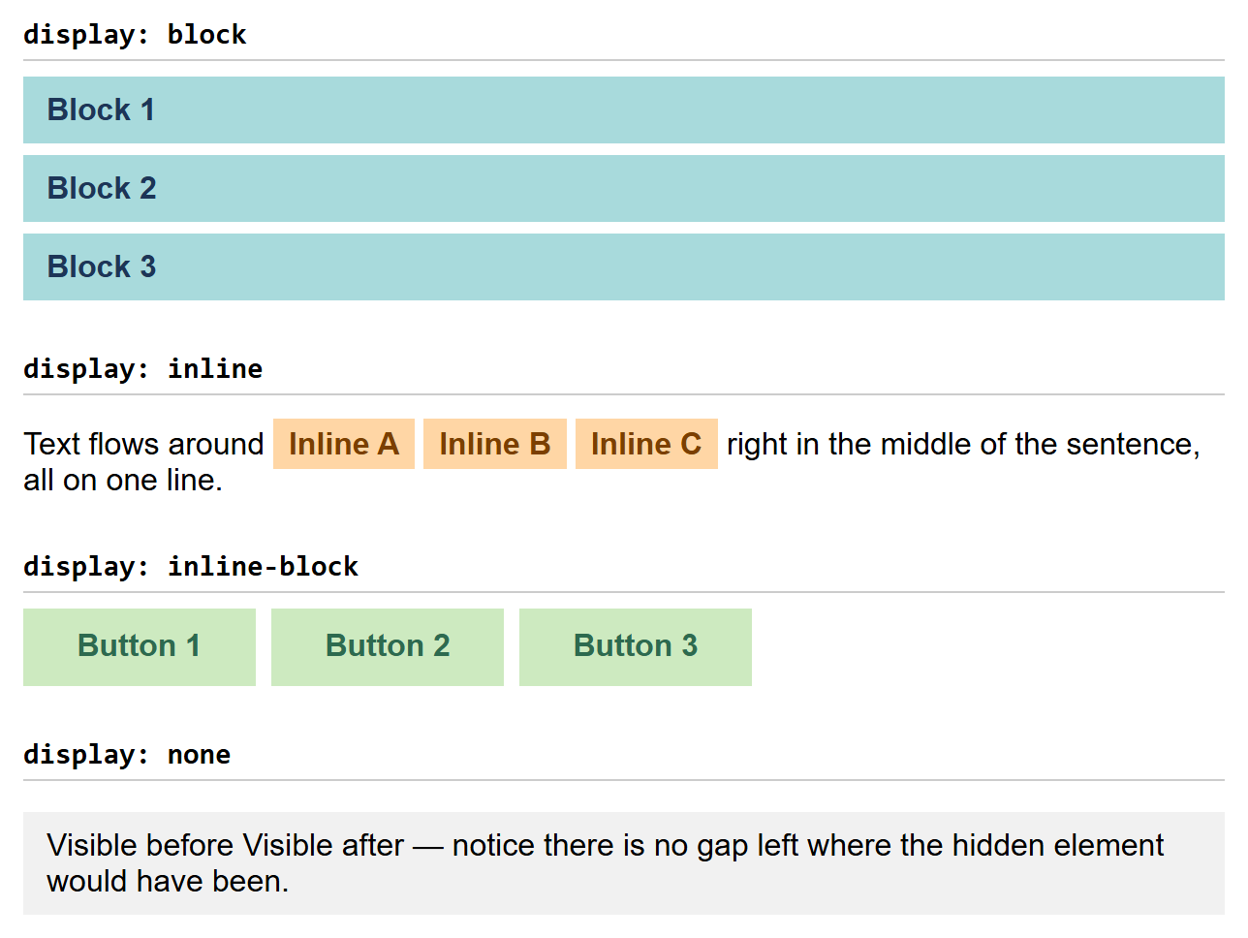
THE DISPLAY PROPERTY
All Four Values, Compared
.section { display: block; } /* new line, full width */
.tag { display: inline; } /* flows in text, no w/h */
.button { display: inline-block; /* inline + respects w/h */
width: 120px; height: 40px; }
.hidden-panel { display: none; } /* removed entirely */
cuinotes.com · 13

Slide 14
A COMMON MIX-UP
display: none vs. visibility: hidden
.gone { display: none; } /* removed entirely — no space reserved */
.invisible { visibility: hidden; } /* invisible, but still takes up its space */
Toggling display: none with JavaScript reflows the page (neighbors shift to fill the gap); visibility: hidden leaves a blank gap where the element used to be.
cuinotes.com · 14

Slide 15
INLINE-BLOCK IN PRACTICE
A Row of Equal-Sized Buttons
.btn {
display: inline-block;
width: 120px;
text-align: center;
padding: 10px 0;
margin-right: 8px;
}
inline-block is what lets several fixed-width buttons sit on one line, side by side, without giving up width/height control the way plain inline would.
cuinotes.com · 15

Slide 16
A PRACTICAL EXAMPLE
Turning a <ul> Into a Horizontal Menu
.menu { list-style: none; margin: 0; padding: 0; }
.menu li { display: inline-block; margin-right: 20px; }
li is block by default — this one change turns a vertical list into a horizontal menu, with no HTML change at all.
cuinotes.com · 16

Slide 17
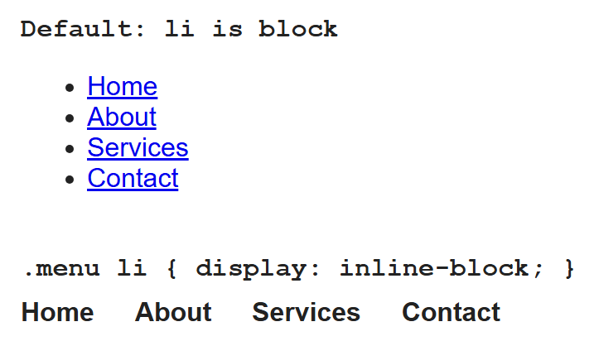
A PRACTICAL EXAMPLE
Before and After, Rendered
cuinotes.com · 17

Slide 18
A PRACTICAL EXAMPLE
Why Build a Menu This Way?
A nav menu IS, conceptually, a list of links — that's exactly what it is to a screen reader and a search engine
Screen readers announce it as a list, telling users how many links there are
The HTML never has to change later — redesign to a dropdown or hamburger menu by changing only CSS
cuinotes.com · 18

Slide 19
FINISHING TOUCHES
Borders, Radius, and Shadow
.card {
border: 2px solid #333;
border-radius: 8px;
box-shadow: 0 4px 8px rgba(0,0,0,0.2);
}
.avatar { border-radius: 50%; } /* a circle */
cuinotes.com · 19

Slide 20
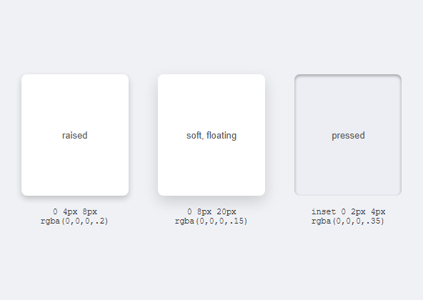
FINISHING TOUCHES
Box Shadow: Raised, Soft, and Inset
.raised {
box-shadow: 0 4px 8px rgba(0,0,0,.2);
}
.soft {
box-shadow: 0 8px 20px rgba(0,0,0,.15);
}
.pressed {
box-shadow:
inset 0 2px 4px rgba(0,0,0,.35);
}
cuinotes.com · 20

Slide 21
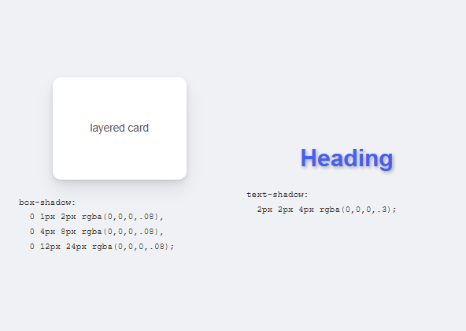
FINISHING TOUCHES
Layered Shadows and Text Shadow
.card {
box-shadow:
0 1px 2px rgba(0,0,0,.08),
0 4px 8px rgba(0,0,0,.08),
0 12px 24px rgba(0,0,0,.08);
}
h1 {
text-shadow: 2px 2px 4px rgba(0,0,0,.3);
}
cuinotes.com · 21

Slide 22
FINISHING TOUCHES
Consistent Spacing Techniques
A spacing scale — pick a small set of values (4px, 8px, 16px, 24px) and only ever use those
CSS custom properties — define --space-md: 16px once in :root, reuse everywhere with var(--space-md)
Change the whole site's spacing rhythm by editing one value in :root
cuinotes.com · 22

Slide 23
KEY TAKEAWAYS
Lecture 6 in Six Points
1
Every box has four layers: content, padding, border, margin — vertically adjacent margins can collapse to the larger value.
2
box-sizing: border-box makes padding and border count inside your width, and is the practical default.
3
min-/max-width/height add flexible constraints on top of a base size.
4
display controls layout behavior: block fills width, inline flows in text, inline-block combines both, none removes the element entirely.
5
A <ul> styled with li { display: inline-block; } is a real way to build a menu without losing list semantics.
6
border-radius, box-shadow, and CSS custom properties keep a design finished and consistent.
cuinotes.com · 23

