Slide 1
LECTURE 7
CSS Positioning
and Stacking
Taking elements out of normal flow — moving, pinning, and layering them — plus floats, an older tool you'll still see.
CSC336 Web Technologies
cuinotes.com · 1

Slide 2
OVERVIEW
In This Lecture
1
Normal document flow and static positioning
2
The four positioning schemes: relative, absolute, fixed, and sticky — with a worked example of each
3
Offset properties, the containing block, and a common mistake
4
z-index and stacking contexts
5
Floats — left, right, side-by-side columns, clearing, and common gotchas
cuinotes.com · 2

Slide 3
THE DEFAULT
Normal Flow and Static Positioning
1
Normal flow: elements are placed one after another, in source order
2
Every element's position defaults to static — "follow normal flow, nothing special"
3
Offset properties (top/right/bottom/left) have NO effect on a static element
cuinotes.com · 3

Slide 4
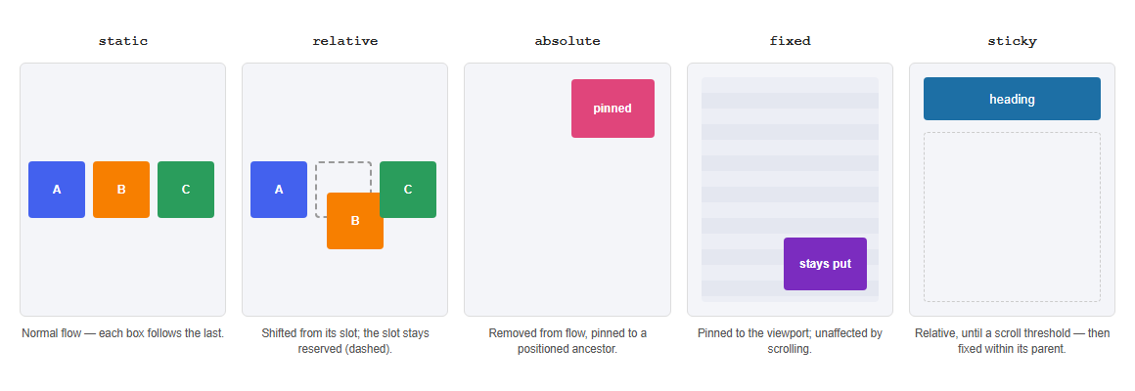
THE POSITIONING SCHEMES
Five Ways to Lay Out an Element
Static flow, relative (shifted but reserved), absolute (pinned to an ancestor), fixed (pinned to the viewport), sticky (relative, then fixed).
.static { position: static; }
.relative { position: relative;
top: 10px; left: 20px; }
.absolute { position: absolute;
top: 0; right: 0; }
.fixed { position: fixed;
bottom: 20px; right: 20px; }
.sticky { position: sticky; top: 0; }
cuinotes.com · 4

Slide 5
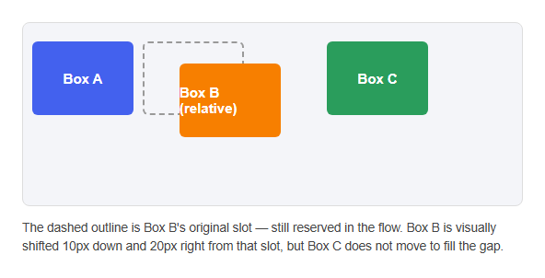
SCHEME 1 OF 4
relative
.box {
position: relative;
top: 10px;
left: 20px;
}
cuinotes.com · 5

Slide 6
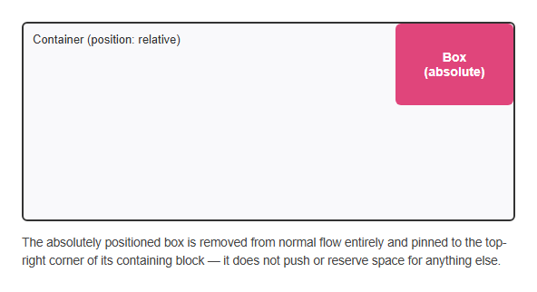
SCHEME 2 OF 4
absolute
.box {
position: absolute;
top: 0;
right: 0;
}
cuinotes.com · 6

Slide 7
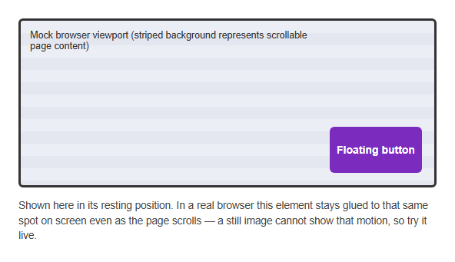
SCHEME 3 OF 4
fixed
.back-to-top {
position: fixed;
bottom: 20px;
right: 20px;
}
cuinotes.com · 7

Slide 8
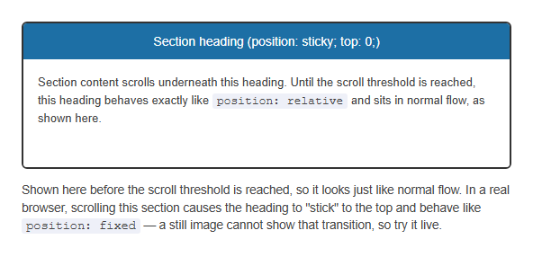
SCHEME 4 OF 4
sticky
.section-heading {
position: sticky;
top: 0;
}
cuinotes.com · 8

Slide 9
QUICK RECAP
relative, absolute, fixed, sticky
Value | Behavior
relative | Stays in normal flow (space still reserved), then shifts visually via offsets
absolute | Removed from flow; positioned against its nearest positioned ancestor
fixed | Removed from flow; positioned against the browser viewport, stays put when scrolled
sticky | Behaves like relative until a scroll threshold, then like fixed within its parent
cuinotes.com · 9

Slide 10
A COMMON PATTERN
Relative Parent, Absolute Child
.card { position: relative; }
.card .badge {
position: absolute;
top: 8px; right: 8px;
}
.card becomes the containing block, so the badge is pinned to the card's corner, not the whole page.
cuinotes.com · 10

Slide 11
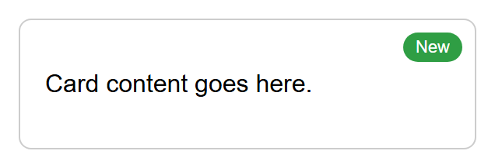
A COMMON PATTERN
The Badge, Rendered
cuinotes.com · 11

Slide 12
A COMMON MISTAKE
Absolute Without a Positioned Ancestor
<div class="card"> <!-- position NOT set -->
<span class="badge">New</span> <!-- position: absolute; top:8px; right:8px; -->
</div>
Without position: relative on .card, .badge's containing block becomes the whole page — it jumps to the page's top-right corner, not the card's.
cuinotes.com · 12

Slide 13
STACKING ORDER
z-index
.back { position: absolute; z-index: 1; }
.front { position: absolute; z-index: 2; } /* drawn on top */
z-index only works on positioned elements (not static) — a higher value draws on top among overlapping elements.
cuinotes.com · 13

Slide 14
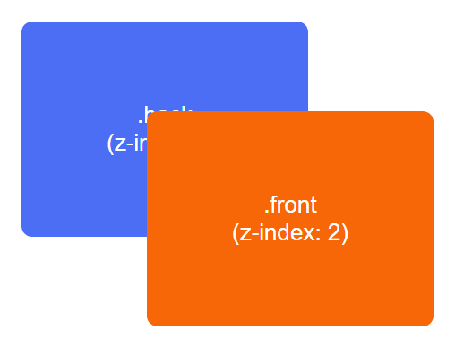
STACKING ORDER
z-index, Rendered
cuinotes.com · 14

Slide 15
STACKING ORDER
Stacking Contexts
A stacking context is a self-contained layer for z-index comparisons
position + z-index, opacity < 1, or transform can create a new stacking context
z-index values only compare WITHIN the same stacking context — a huge z-index can still lose if it's trapped inside an ancestor's context
cuinotes.com · 15

Slide 16
FLOATS
float: left
.image { float: left; margin-right: 15px; }
Originally for text wrapping around an image. A floated element shifts to one edge; other content flows around it.
cuinotes.com · 16

Slide 17
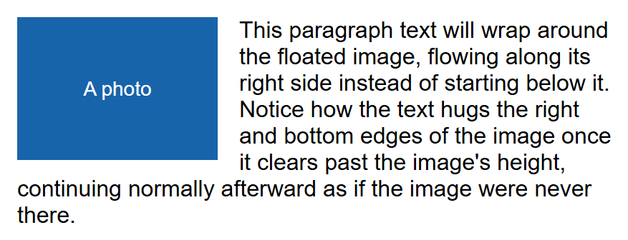
FLOATS
Text Wrapping a Float, Rendered
cuinotes.com · 17

Slide 18
FLOATS
float: right — the Mirror Image
.image {
float: right;
margin-left: 15px;
}
Exactly the same idea, flipped: the image sits at the right edge, and text wraps along its left side instead.
cuinotes.com · 18

Slide 19
FLOATS
A Classic Two-Column Layout
.sidebar { float: left; width: 25%; }
.main { float: left; width: 75%; }
<div class="sidebar">...</div>
<div class="main">...</div>
Before flexbox and grid existed, this float + matching-width pattern was the standard way to place two columns side by side.
cuinotes.com · 19

Slide 20
FLOATS
Float Gotchas Worth Knowing
A floated element needs an explicit width — without one, it can shrink to fit its content unpredictably
Floating an inline element (like a <span>) makes it behave like a block for sizing purposes
A float only affects the elements AFTER it in the HTML — it never moves content that comes before it
cuinotes.com · 20

Slide 21
FLOATS
The clear Property
Value | Behavior
left / right | Moves below any preceding left- / right-floated elements
both | Moves below floats on either side — by far the most common value
none (default) | No clearing — free to sit beside a float
cuinotes.com · 21

Slide 22
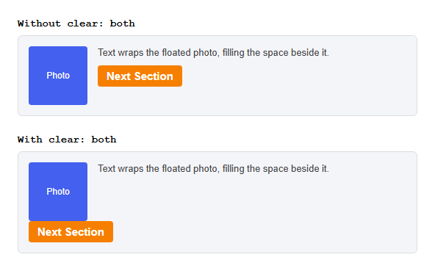
FLOATS
clear, on Its Own
<img class="photo" style="float:left;">
<p>Text wraps the photo.</p>
<h2 style="clear: both;">Next Section</h2>
cuinotes.com · 22

Slide 23
FLOATS
The Collapsing Parent Problem
.clearfix::after {
content: "";
display: block;
clear: both;
}
If every child is floated, a container collapses to zero height. .clearfix adds an invisible element with clear: both to force the parent to contain its floated children again.
cuinotes.com · 23

Slide 24
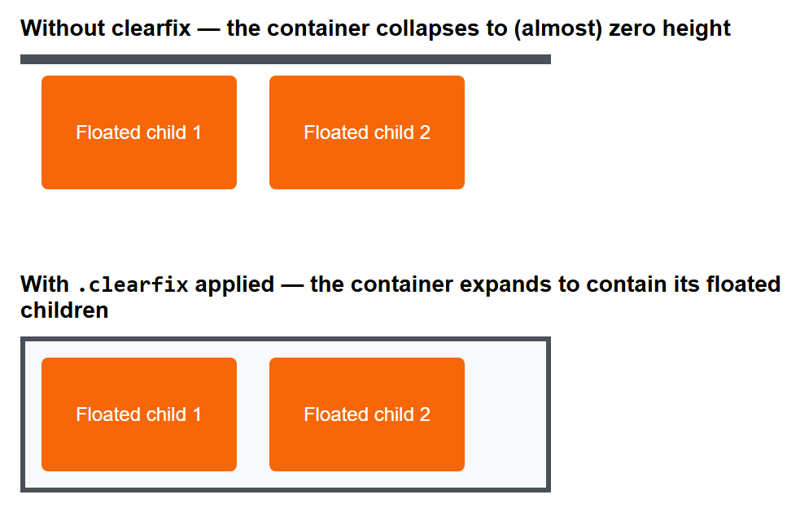
FLOATS
Clearfix, Before and After
cuinotes.com · 24

Slide 25
OVERFLOW
Containing Floats — a Simpler Alternative
Value | Behavior
visible (default) | Content spills outside the box, still visible
hidden | Content that doesn't fit is clipped and hidden
scroll / auto | Adds scrollbars always / only when content actually overflows
cuinotes.com · 25

Slide 26
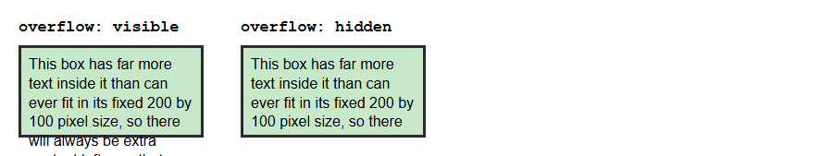
OVERFLOW
Visible vs. Hidden, Rendered
.box {
width: 200px;
height: 100px;
overflow: visible; /* default: extra content spills out */
/* overflow: hidden; clips content that doesn't fit */
}
cuinotes.com · 26

Slide 27
OVERFLOW
A One-Line Clearfix Alternative
TIP
overflow: hidden (or auto) on a float's parent fixes the collapsing-parent problem too, in one line. Trade-off: it also clips any OTHER content that overflows that container, like a dropdown or tooltip — the .clearfix trick is the safer, general-purpose tool.
cuinotes.com · 27

Slide 28
PITFALLS
Common Layout Pitfalls
position: absolute without a relative ancestor jumps relative to the whole page
z-index "not working" is almost always a stacking-context issue on an ancestor
A position: fixed element is fixed to the viewport, not to a scrolling div — you likely want sticky instead
A floated element with no explicit width, or an un-cleared float, are the two most common float bugs
cuinotes.com · 28

Slide 29
KEY TAKEAWAYS
Lecture 7 in Six Points
1
Normal flow places elements in source order; position: static means "stay in flow," and offsets do nothing on it.
2
relative shifts an element while reserving its space; absolute/fixed remove it from flow entirely; sticky is a hybrid.
3
The containing block for absolute is the nearest positioned ancestor — forgetting it sends the element to the whole page.
4
z-index only compares within the same stacking context.
5
float: left/right pulls an element aside and wraps content around it — give it a width, and clear or contain its parent.
6
Prefer flexbox and grid for modern layout; understand floats mainly to read older code.
cuinotes.com · 29

