Slide 1
LECTURE 9
Flexbox and
Grid Layout
The two modern CSS layout systems — one-dimensional alignment, and two-dimensional page structure.
CSC336 Web Technologies
cuinotes.com · 1

Slide 2
OVERVIEW
In This Lecture
1
Flexbox: container, items, and the two axes
2
flex-direction, justify-content, align-items, flex-wrap, flex-grow/shrink/basis
3
CSS Grid: rows, columns, and the fr unit
4
Grid line placement, spanning multiple cells, and named grid areas
5
Choosing Flexbox vs. Grid — and using both together
cuinotes.com · 2

Slide 3
FLEXBOX
Container and Items
.nav { display: flex; }
One declaration turns every direct child of .nav into a flex item, laid out in a single row by default.
cuinotes.com · 3

Slide 4
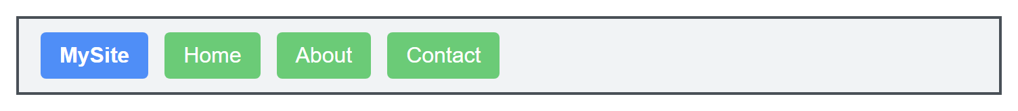
FLEXBOX
A Flex Nav Bar, Rendered
cuinotes.com · 4

Slide 5
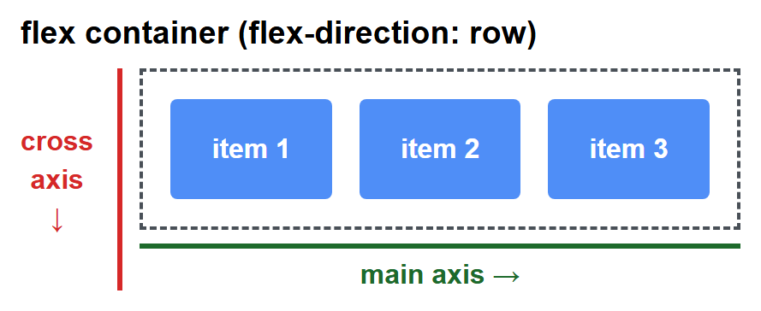
FLEXBOX
The Main Axis and the Cross Axis
The main axis runs in the flex direction (row, by default); the cross axis runs perpendicular to it.
.flex-row {
display: flex; /* main axis: horizontal, left to right */
}
cuinotes.com · 5

Slide 6
FLEXBOX PROPERTIES
flex-direction
.container { flex-direction: row | row-reverse | column | column-reverse; }
cuinotes.com · 6

Slide 7
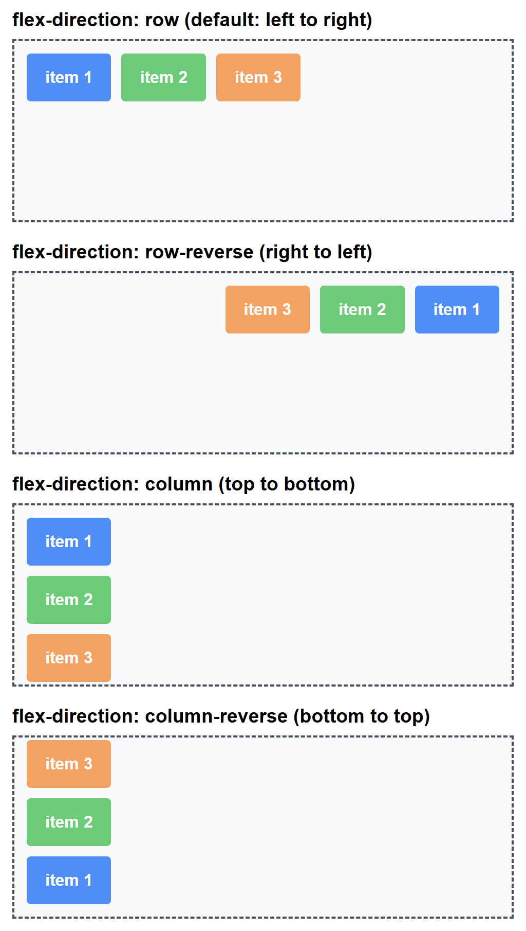
FLEXBOX PROPERTIES
flex-direction, Compared
flex-direction: row (default: left to right)
flex-direction: row-reverse (right to left)
item 1
item 2
item 3
item 3
item 2
item 1
flex-direction: column (top to bottom)
flex-direction: column-reverse (bottom to top)
item 1
item 3
item 2
item 2
item 3
item 1
cuinotes.com · 7

Slide 8
FLEXBOX PROPERTIES
justify-content (Main Axis)
.container { justify-content: flex-start | flex-end | center |
space-between | space-around | space-evenly; }
cuinotes.com · 8

Slide 9
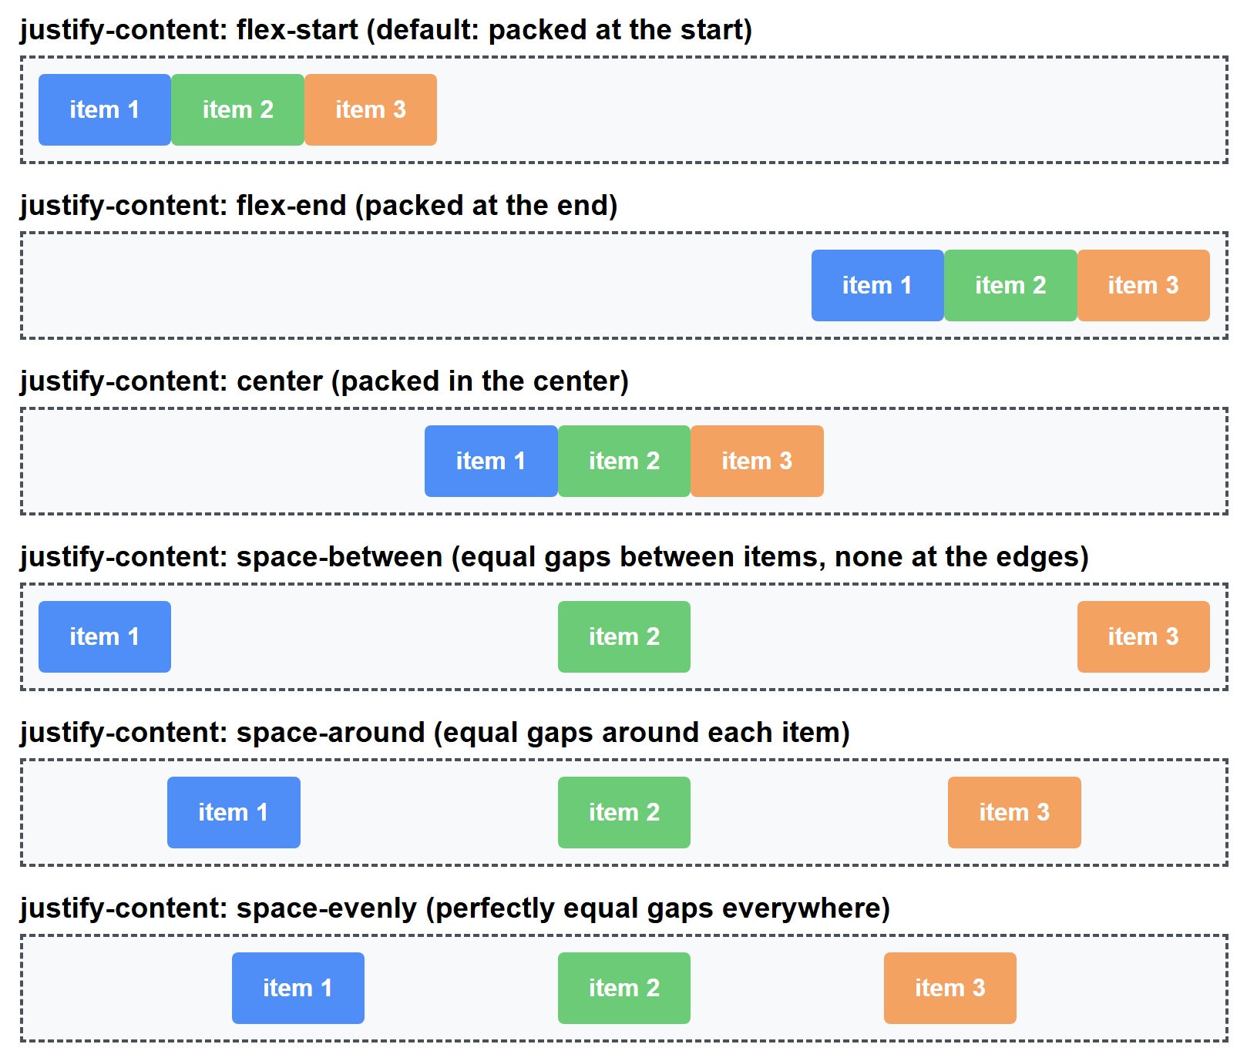
FLEXBOX PROPERTIES
justify-content, Compared
justify-content: flex-start (default: packed at the start)
justify-content: flex-end (packed at the end)
item 1
item 2
item 3
item 1
item 2
item 3
justify-content: center (packed in the center)
justify-content: space-between (equal gaps between items)
item 1
item 2
item 3
item 1
item 2
item 3
justify-content: space-around (equal space around each item)
justify-content: space-evenly (perfectly equal gaps)
item 1
item 2
item 3
item 1
item 2
item 3
cuinotes.com · 9

Slide 10
FLEXBOX PROPERTIES
align-items (Cross Axis)
.container { align-items: stretch | flex-start | flex-end | center; }
cuinotes.com · 10

Slide 11
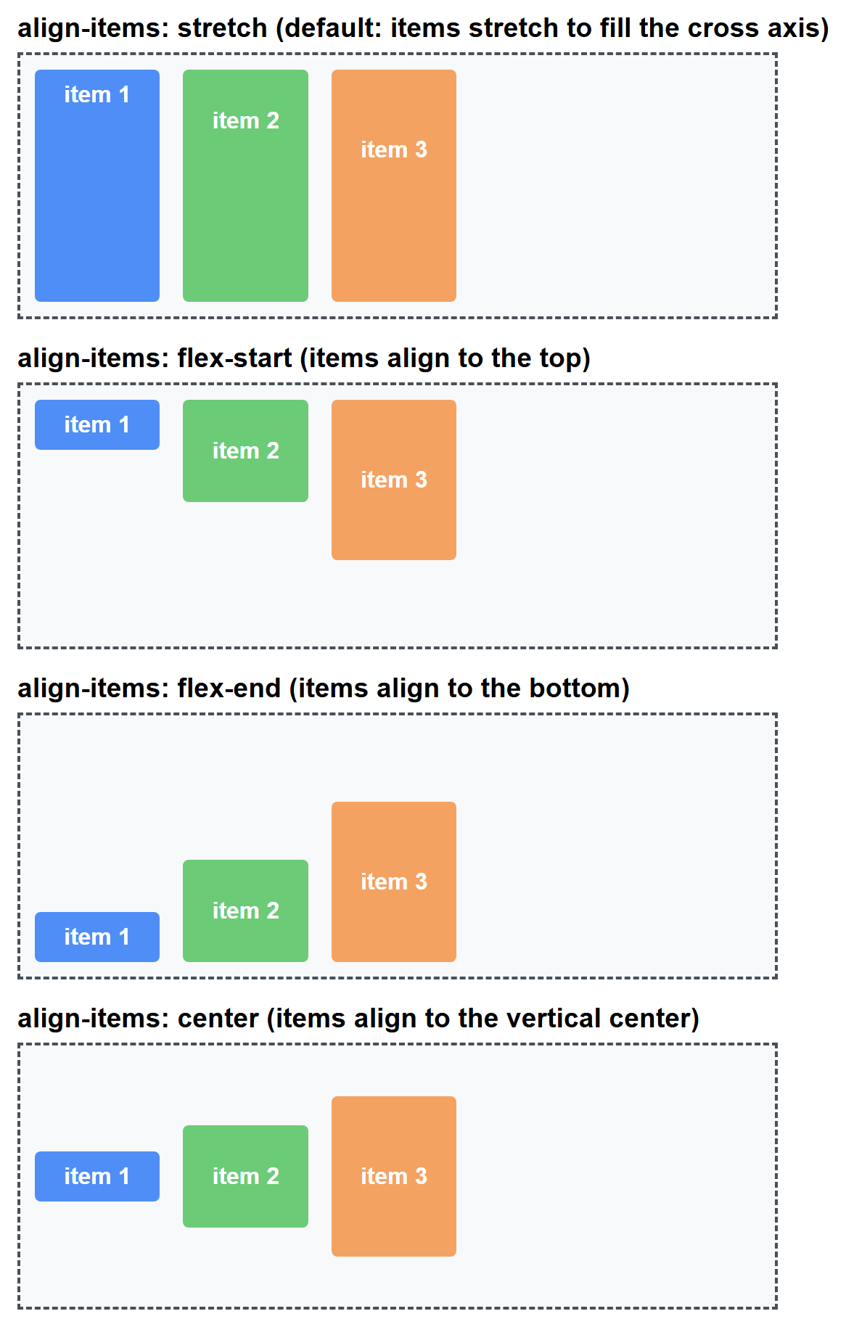
FLEXBOX PROPERTIES
align-items, Compared
align-items: stretch (default: fill the cross axis)
align-items: flex-start (items align to the top)
item 1
item 2
item 3
item 1
item 2
item 3
align-items: flex-end (items align to the bottom)
align-items: center (items align to the vertical center)
item 3
item 3
item 2
item 2
item 1
item 1
cuinotes.com · 11

Slide 12
A FAMOUS TRICK
Perfect Centering
.container {
display: flex;
justify-content: center;
align-items: center;
}
The classic answer to "how do I center a div" — both axes at once.
cuinotes.com · 12

Slide 13
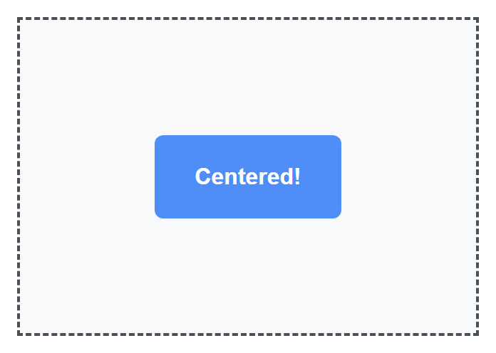
A FAMOUS TRICK
Centering, Rendered
cuinotes.com · 13

Slide 14
FLEXBOX PROPERTIES
flex-wrap
.container { flex-wrap: nowrap | wrap; }
nowrap squeezes everything onto one line, even past the container's edge; wrap breaks items onto multiple lines.
cuinotes.com · 14

Slide 15
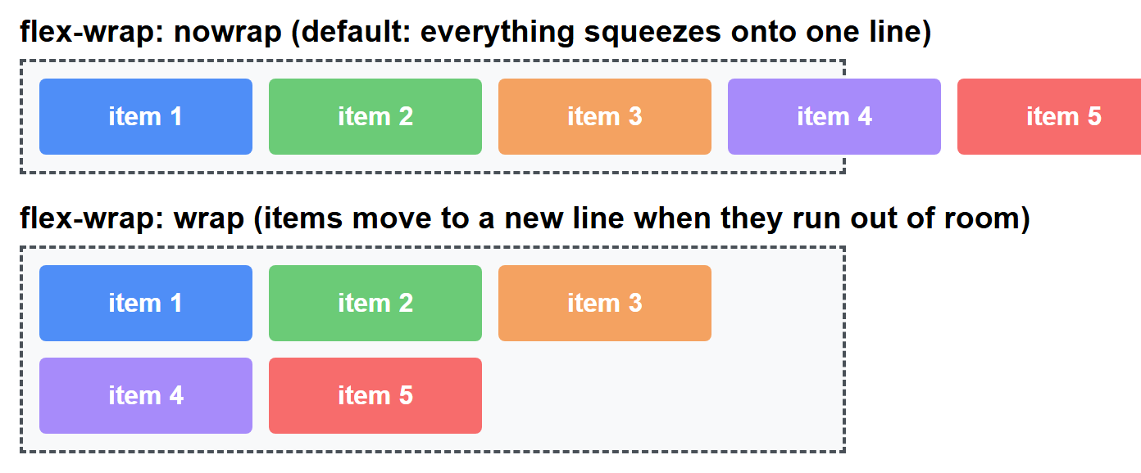
FLEXBOX PROPERTIES
flex-wrap, Compared
cuinotes.com · 15

Slide 16
FLEXBOX PROPERTIES
flex-grow, flex-shrink, flex-basis
.item { flex-basis: 200px; } /* starting size before growing/shrinking */
.item { flex: 1; } /* grow to fill equally */
.item { flex-grow: 2; } /* grow twice as fast as flex-grow: 1 */
cuinotes.com · 16

Slide 17
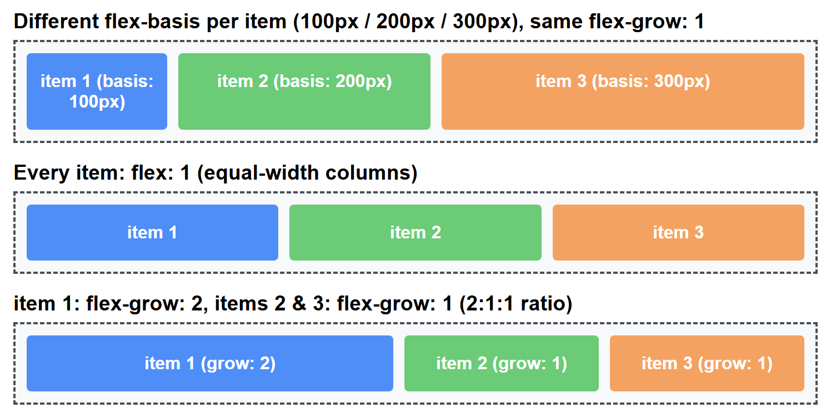
FLEXBOX PROPERTIES
Growing and Shrinking, Rendered
cuinotes.com · 17

Slide 18
CSS GRID
Rows and Columns
.grid {
display: grid;
grid-template-columns: 200px 200px 200px;
grid-template-rows: 150px 150px;
gap: 10px;
}
cuinotes.com · 18

Slide 19
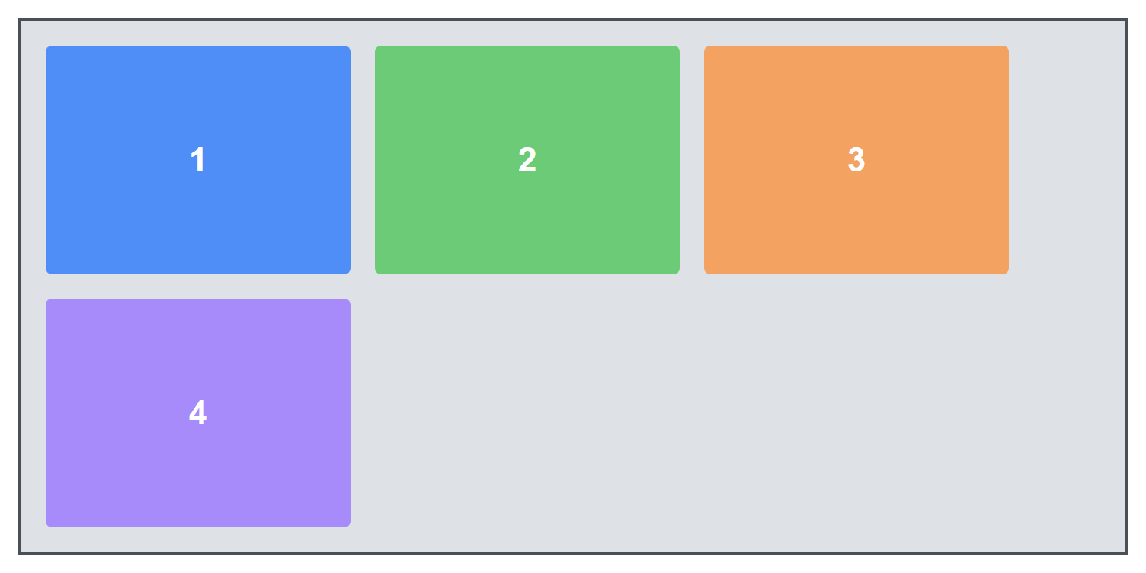
CSS GRID
A Basic Grid, Rendered
cuinotes.com · 19

Slide 20
CSS GRID
The fr Unit
grid-template-columns: 1fr 1fr 1fr; /* three equal columns */
grid-template-columns: 2fr 1fr; /* left column twice as wide */
grid-template-columns: 250px 1fr; /* fixed sidebar + flexible main */
fr distributes remaining space as a FRACTION — it's Grid's equivalent of flex-grow.
cuinotes.com · 20

Slide 21
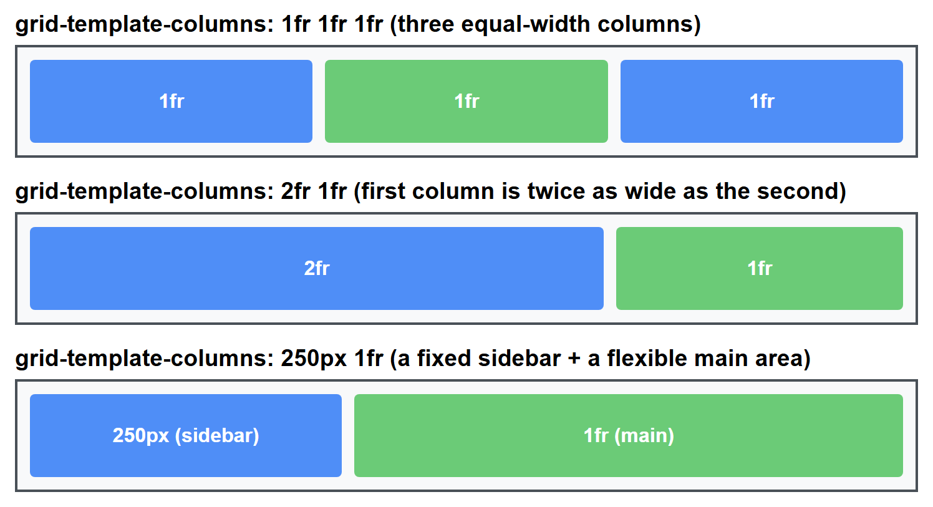
CSS GRID
The fr Unit, Compared
cuinotes.com · 21

Slide 22
CSS GRID
gap
.grid {
display: grid;
grid-template-columns: repeat(3, 1fr);
gap: 20px;
}
gap replaces the old margin-hack for spacing grid (and flex) items evenly, without extra space at the edges.
cuinotes.com · 22

Slide 23
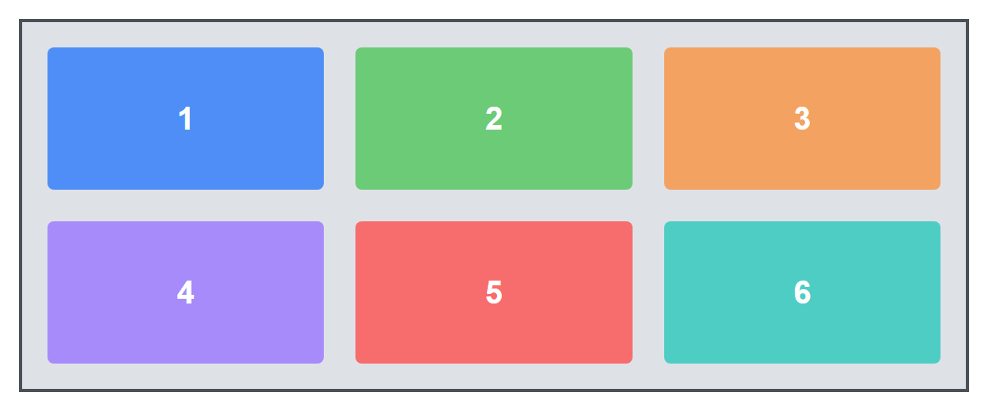
CSS GRID
gap, Rendered
cuinotes.com · 23

Slide 24
GRID PLACEMENT
Placing Items on Grid Lines
.item-a { grid-column: 1 / 3; grid-row: 1; }
.item-b { grid-column: 3; grid-row: 1; }
Grid lines are numbered starting at 1 — an item can be placed at exact, specific cells.
cuinotes.com · 24

Slide 25
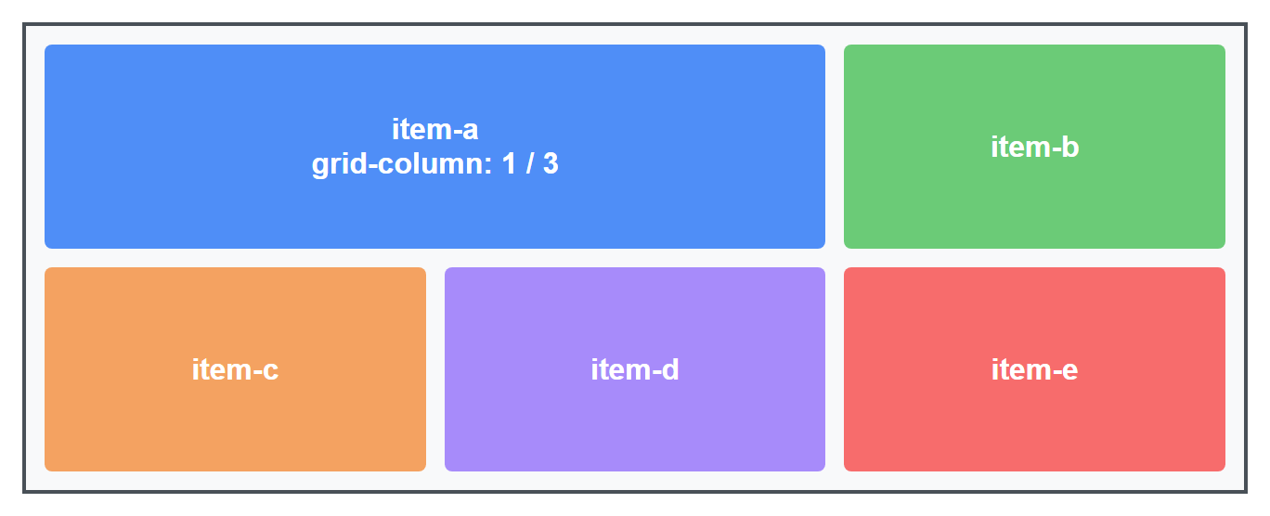
GRID PLACEMENT
Line Placement, Rendered
cuinotes.com · 25

Slide 26
GRID PLACEMENT
Spanning Multiple Cells
.featured {
grid-column: span 2;
grid-row: span 2;
}
A photo-gallery-style layout: one featured cell occupies a 2x2 block while others fill in around it.
cuinotes.com · 26

Slide 27
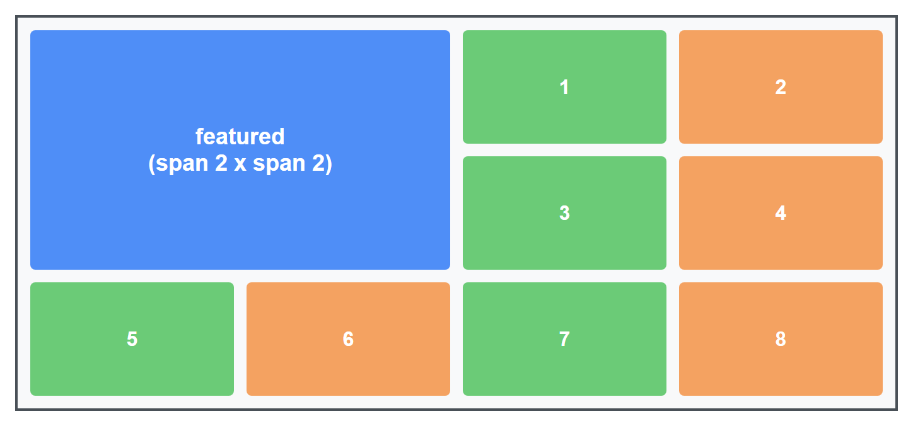
GRID PLACEMENT
Spanning, Rendered
cuinotes.com · 27

Slide 28
GRID PLACEMENT
Named Grid Areas
.page {
grid-template-areas:
"header header"
"sidebar main"
"footer footer";
}
.header { grid-area: header; }
Naming areas makes a whole-page layout genuinely readable straight from the CSS.
cuinotes.com · 28

Slide 29
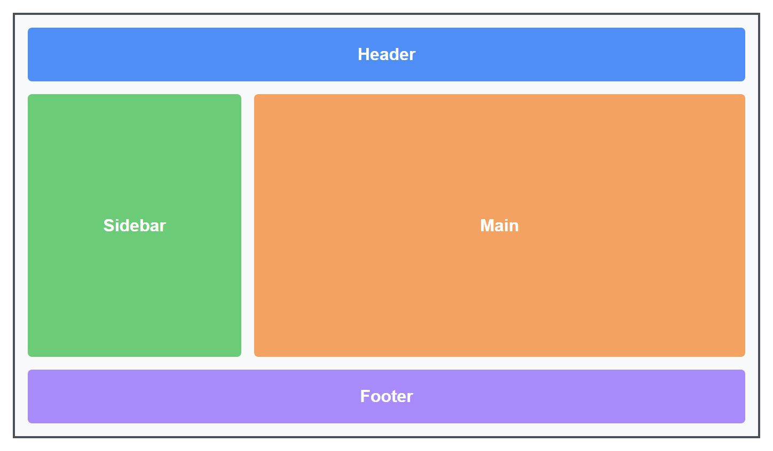
GRID PLACEMENT
Named Areas, Rendered
cuinotes.com · 29

Slide 30
DECISION TIME
Choosing Flexbox vs. Grid
 | Flexbox | Grid
Dimensions | One-dimensional (a row OR a column) | Two-dimensional (rows AND columns)
Best for | Nav bars, button groups, aligning items | Whole-page layouts, photo galleries
Item placement | Items flow in order | Items placed at exact grid cells
cuinotes.com · 30

Slide 31
DECISION TIME
The Simple Rule of Thumb
TIP
Arranging things in ONE direction (a row of buttons, a horizontal menu)? Reach for Flexbox. Need to control rows AND columns together (an overall page layout, a gallery)? Reach for Grid. In real projects you'll use both together constantly.
cuinotes.com · 31

Slide 32
USING BOTH TOGETHER
Grid for Skeleton, Flexbox Inside It
.page {
display: grid;
grid-template-columns: 220px 1fr;
grid-template-areas: "sidebar main";
}
.header {
display: flex;
justify-content: space-between;
align-items: center;
}
cuinotes.com · 32

Slide 33
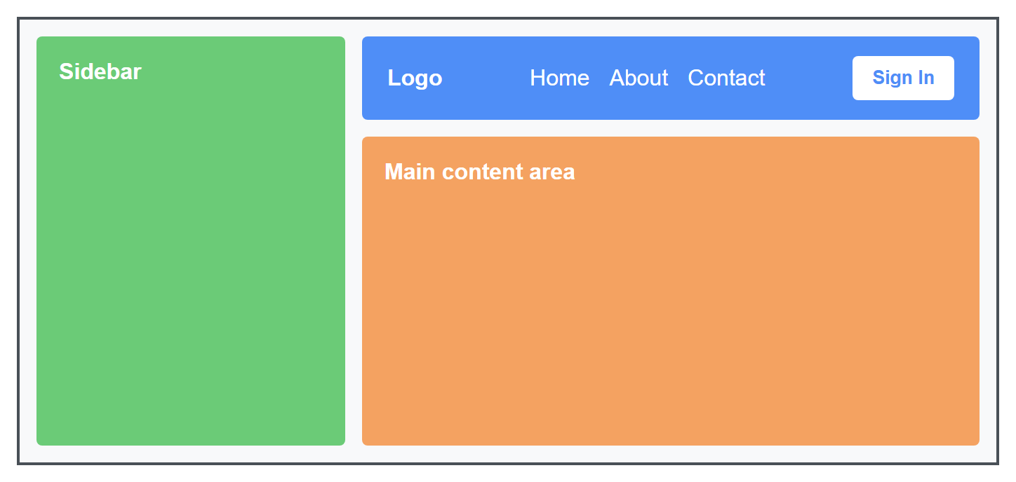
USING BOTH TOGETHER
Grid + Flexbox, Rendered
cuinotes.com · 33

Slide 34
KEY TAKEAWAYS
Lecture 9 in Six Points
1
Flexbox lays out items along a main axis and a cross axis, one dimension at a time.
2
justify-content aligns along the main axis; align-items aligns along the cross axis — together they center anything.
3
flex-grow/shrink/basis control how items expand, shrink, and start sized within the available space.
4
CSS Grid lays out rows AND columns together; the fr unit distributes remaining space as flexible fractions.
5
Grid items can be placed on exact lines, span multiple cells, or use named grid-template-areas for a readable layout.
6
Use Flexbox for one-dimensional alignment; use Grid for the overall page skeleton — and combine both in real projects.
cuinotes.com · 34

