Slide 1
LECTURE 13
DOM Manipulation
and Event Handling
How JavaScript reads, changes, and reacts to the structure of a web page — the engine behind every interactive site.
CSC336 Web Technologies
cuinotes.com · 1

Slide 2
OVERVIEW
In This Lecture
1
What the DOM tree, nodes, and the document object actually are
2
Selecting elements with getElementById, querySelector, and querySelectorAll
3
Creating, updating, and removing elements
4
Working with classList and inline styles
5
Handling events with addEventListener and the event object
6
Event bubbling, capturing, delegation, preventDefault, and stopPropagation
cuinotes.com · 2

Slide 3
THE DOM
A Page, Before It Becomes a Tree
<!DOCTYPE html>
<html>
<body>
<h1>My Page</h1>
<p>Hello <strong>world</strong></p>
</body>
</html>
The DOM (Document Object Model) is a live, in-memory, tree-shaped representation of this HTML that the browser builds after parsing it.
cuinotes.com · 3

Slide 4
THE DOM
Every Tag Becomes a Node
document
html
body
h1: 'My Page'
p
Text: 'Hello '
strong: 'world'
Node: any single item in the tree. Element: a node representing an HTML tag. body is the PARENT of h1 and p; h1 and p are SIBLINGS.
cuinotes.com · 4

Slide 5
THE DOM
The DOM Is Not the Same as Your HTML File
NOTE
The DOM is what the browser builds from your HTML -- and JavaScript can change it after the fact. "View Page Source" shows the original file; "Inspect Element" (DevTools) shows the CURRENT DOM, which may look very different after scripts have run.
cuinotes.com · 5

Slide 6
SELECTING ELEMENTS
getElementById and querySelector
// By id -- a single element, or null if not found
const title = document.getElementById("main-title");
// By CSS selector -- the FIRST matching element, or null
const firstButton = document.querySelector(".btn");
const firstInput = document.querySelector("input[type='email']");
// By CSS selector -- ALL matching elements, as a NodeList
const allButtons = document.querySelectorAll(".btn");
querySelector/querySelectorAll accept ANY valid CSS selector -- by class, tag, attribute, or combinations -- far more flexible than getElementById.
cuinotes.com · 6

Slide 7
SELECTING ELEMENTS
NodeList Supports forEach
allButtons.forEach(btn => console.log(btn.textContent));
cuinotes.com · 7

Slide 8
SELECTING ELEMENTS
A NodeList Is Not an Array
TIP
A NodeList supports forEach, but not map or filter directly. Convert it first if you need those: Array.from(allButtons) or [...allButtons].
cuinotes.com · 8

Slide 9
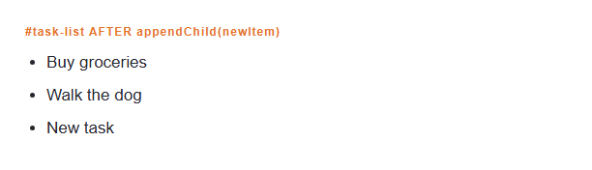
CREATING NODES
Creating and Inserting Elements
const newItem =
document.createElement("li");
newItem.textContent = "New task";
const list =
document.querySelector("#task-list");
list.appendChild(newItem);
// list.prepend(newItem);
// list.insertBefore(newItem,
// list.children[1]);
cuinotes.com · 9

Slide 10
UPDATING NODES
Updating Content and Attributes
const heading = document.querySelector("h1");
heading.textContent = "Updated Title"; // sets plain text (safe)
heading.innerHTML = "<em>Updated</em> Title"; // parses the string AS HTML
const link = document.querySelector("a");
link.setAttribute("href", "https://example.com");
console.log(link.getAttribute("href"));
link.removeAttribute("target");
cuinotes.com · 10

Slide 11
UPDATING NODES
innerHTML and Security (XSS)
WARNING
innerHTML parses whatever string you give it as real HTML. If that string comes from user input and you insert it with innerHTML, a malicious user could inject a <script> tag -- this is Cross-Site Scripting (XSS). Prefer textContent unless you specifically need to insert markup.
cuinotes.com · 11

Slide 12
REMOVING NODES
Removing an Element
const item = document.querySelector("#task-3");
item.remove(); // modern, simplest way
// Older way, still seen in existing code:
item.parentNode.removeChild(item);
cuinotes.com · 12

Slide 13
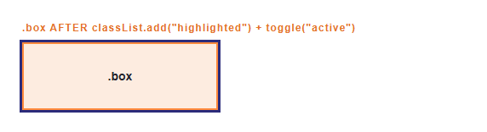
CLASSLIST
classList vs. Raw Style Strings
const box =
document.querySelector(".box");
box.classList.add("highlighted");
box.classList.remove("hidden");
box.classList.toggle("active");
box.classList.contains("active");
// true or false
cuinotes.com · 13

Slide 14
INLINE STYLES
Setting Individual CSS Properties
box.style.backgroundColor = "yellow";
box.style.display = "none";
box.style.fontSize = "18px";
The style property writes INLINE styles -- CSS applied directly on the element, with the highest priority.
cuinotes.com · 14

Slide 15
INLINE STYLES
Prefer classList Over style
TIP
Toggling a class keeps "what it should look like" (CSS) separate from "when it should look that way" (JavaScript), and it's easier to change the look later without touching your script.
cuinotes.com · 15

Slide 16
EVENTS
addEventListener
const button = document.querySelector("#save-btn");
button.addEventListener("click", function () {
console.log("Button was clicked!");
});
// Arrow function version
button.addEventListener("click", () => console.log("Clicked!"));
function handleClick() { console.log("Handled once"); }
button.addEventListener("click", handleClick);
button.removeEventListener("click", handleClick); // same function reference
addEventListener is preferred over onclick=... because it allows MULTIPLE listeners on the same event, and a specific one can be removed later.
cuinotes.com · 16

Slide 17
EVENTS
The Event Object
document.querySelector("input").addEventListener("keydown", (event) => {
console.log(event.key); // which key was pressed, e.g. "Enter"
console.log(event.target); // the exact element the event happened on
console.log(event.type); // "keydown"
});
document.querySelector("form").addEventListener("submit", (event) => {
event.preventDefault(); // stop the page reload
console.log("Form data captured without reloading the page");
});
cuinotes.com · 17

Slide 18
EVENTS
Common Events You Will Use Constantly
Category | Events
Mouse / pointer | click, mouseover, mouseout
Keyboard | keydown, keyup
Forms | submit, input, change
Page lifecycle | load, DOMContentLoaded
cuinotes.com · 18

Slide 19
BUBBLING & CAPTURING
Two Phases of Every Event
1. Capturing (top to bottom)
document
body
ul
li (target)
2. Bubbling (bottom to top)
li (target)
ul
body
document
By default, addEventListener listens during the BUBBLING phase. Pass true as a third argument to listen during capturing instead.
cuinotes.com · 19

Slide 20
EVENT DELEGATION
One Listener, Many Children
const list = document.querySelector("#task-list");
// One listener on the parent handles clicks on ANY current or future <li>
list.addEventListener("click", (event) => {
if (event.target.tagName === "LI") {
event.target.classList.toggle("done");
}
});
event.target is the specific element clicked; event.currentTarget is the element the listener is attached to (list itself).
cuinotes.com · 20

Slide 21
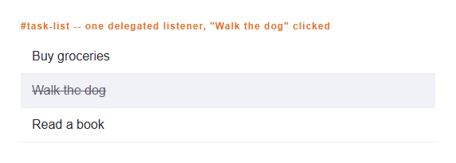
EVENT DELEGATION
Event Delegation, Rendered
list.addEventListener("click",
(event) => {
if (event.target.tagName ===
"LI") {
event.target.classList
.toggle("done");
}
});
cuinotes.com · 21

Slide 22
EVENT DELEGATION
Why Event Delegation Matters
TIP
If you add 100 new <li> items after the page loads, a delegated listener on the parent <ul> automatically handles clicks on all of them -- no need to attach or re-attach 100 separate listeners.
cuinotes.com · 22

Slide 23
PREVENTDEFAULT / STOPPROPAGATION
Two Very Different Methods
document.querySelector("a.disabled-link").addEventListener("click", (event) => {
event.preventDefault(); // the link will NOT navigate anywhere
});
document.querySelector(".dropdown-toggle").addEventListener("click", (event) => {
event.stopPropagation(); // won't also trigger a parent's listener
});
preventDefault() stops the browser's default behavior. stopPropagation() stops the event from continuing to bubble/capture.
cuinotes.com · 23

Slide 24
PREVENTDEFAULT / STOPPROPAGATION
Don't Confuse the Two
WARNING
preventDefault() cancels what the browser would have done. stopPropagation() cancels the event from reaching other listeners further up (or down) the tree. A single handler can call both when needed.
cuinotes.com · 24

Slide 25
KEY TAKEAWAYS
Lecture 13 in Seven Points
1
The DOM is a live, tree-shaped, in-memory representation of the page; document is your entry point into it.
2
getElementById selects by id; querySelector/querySelectorAll select by any CSS selector and are more flexible.
3
Prefer textContent over innerHTML unless you specifically need to insert HTML, to avoid XSS security risks.
4
classList.add/remove/toggle/contains is the preferred way to change appearance; reserve direct style for one-off values.
5
addEventListener registers handlers and supports multiple listeners per event; every handler receives an event object.
6
Events bubble up (and can capture down) the DOM tree -- this enables event delegation, one listener for many children.
7
preventDefault() stops the browser's default action; stopPropagation() stops the event reaching other listeners.
cuinotes.com · 25

