Slide 1
LECTURE 15
Asynchronous JavaScript:
Promises and Fetch
How JavaScript waits on things that take time — without ever freezing the page.
CSC336 Web Technologies
cuinotes.com · 1

Slide 2
OVERVIEW
In This Lecture
1
Synchronous vs. asynchronous execution, the event loop, task queue, and "callback hell"
2
Promises: their three states, .then/.catch/.finally, chaining, and Promise.all
3
async/await, and error handling with try...catch
4
Making real network requests with the Fetch API: GET/POST, headers, response parsing, and CORS
cuinotes.com · 2

Slide 3
SYNCHRONOUS EXECUTION
One Line at a Time
console.log("1");
console.log("2");
console.log("3");
// Always prints: 1, 2, 3 -- in that exact order, with no gaps
Each instruction must finish before the next one starts. This is how almost all the code you've written so far behaves.
cuinotes.com · 3

Slide 4
ASYNCHRONOUS EXECUTION
Some Things Happen "Later"
console.log("1");
setTimeout(() => console.log("2"), 1000); // scheduled, doesn't block
console.log("3");
// Prints: 1, 3, 2 -- "2" appears about a second later!
JavaScript starts the operation, moves on immediately, and comes back to handle the result once it's ready.
cuinotes.com · 4

Slide 5
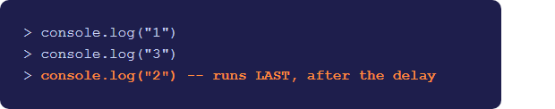
ASYNCHRONOUS EXECUTION
The Exact Code, Live
console.log("1");
setTimeout(() =>
console.log("2"), 150);
console.log("3");
cuinotes.com · 5

Slide 6
WHY THIS MATTERS
JavaScript Is Single-Threaded
1
The browser can only do one thing at a time on that one thread
2
A blocking operation would freeze buttons, scrolling, and animations until it finished
3
Timers, network requests, and file reads are handed off so the thread stays free to keep the page responsive
cuinotes.com · 6

Slide 7
THE EVENT LOOP
How setTimeout(fn, 1000) Actually Runs
console.log("1")
runs on the
call stack
setTimeout
handed off to the
Browser / Web APIs
console.log("3")
runs -- stack
is now empty
After 1000ms, the
callback is placed
in the task queue
Event loop moves it
to the stack --
logs "2"
The event loop constantly checks: is the call stack empty? If yes, it takes the next item from the queue and runs it.
cuinotes.com · 7

Slide 8
THE EVENT LOOP
Microtasks Run Before Macrotasks
NOTE
Promise callbacks (.then, async/await) go into a special microtask queue that the event loop always empties completely before it looks at the regular task queue (where setTimeout callbacks live). This is why Promise.resolve().then(...) scheduled after setTimeout(..., 0) usually still runs first.
cuinotes.com · 8

Slide 9
BEFORE PROMISES
Callback Hell
1
Before Promises existed, async code was handled with callbacks -- functions passed in to be called later
2
When one async step depends on the result of the previous one, callbacks nest deeper and deeper
3
Nicknamed "callback hell" or the "pyramid of doom" -- hard to read, hard to maintain
cuinotes.com · 9

Slide 10
BEFORE PROMISES
The Pyramid of Doom
getUser(userId, function (user) {
getOrders(user.id, function (orders) {
getOrderDetails(orders[0].id, function (details) {
console.log(details);
// ...and it keeps growing to the right with every extra step
}, handleError);
}, handleError);
}, handleError);
cuinotes.com · 10

Slide 11
PROMISES
What Is a Promise?
1
An object representing a value that isn't available yet, but will be at some point -- either successfully, or with an error
2
Think of it as a receipt for a value that's still being prepared
cuinotes.com · 11

Slide 12
PROMISES
The Three States
Pending
operation
succeeds
operation
fails
Fulfilled
Rejected
A promise is settled once it becomes fulfilled or rejected, and it can never change state again after that.
cuinotes.com · 12

Slide 13
PROMISES
Creating and Using a Promise
function delay(ms) {
return new Promise((resolve, reject) => {
if (ms < 0) { reject(new Error("Delay cannot be negative")); return; }
setTimeout(() => resolve(`Waited ${ms}ms`), ms);
});
}
delay(1000)
.then(result => console.log(result)) // fulfilled
.catch(error => console.error(error)) // rejected
.finally(() => console.log("Done, either way")); // always runs
cuinotes.com · 13

Slide 14

PROMISES
delay().then/.catch/.finally, Live
delay(150)
.then(result =>
log(result))
.catch(error =>
log("ERROR: " +
error.message))
.finally(() =>
log("Done, either way"));
cuinotes.com · 14

Slide 15
PROMISES
Chaining Promises
getUser(userId)
.then(user => getOrders(user.id)) // after getUser resolves
.then(orders => getOrderDetails(orders[0].id)) // after getOrders resolves
.then(details => console.log(details)) // after getOrderDetails resolves
.catch(error => console.error("Something failed:", error)); // catches ANY step
Each .then() returns a NEW promise, which is what makes chaining possible -- one .catch() at the end catches an error from any step.
cuinotes.com · 15

Slide 16
PROMISES
Promise.all
const promise1 = delay(1000).then(() => "First");
const promise2 = delay(500).then(() => "Second");
const promise3 = delay(1500).then(() => "Third");
Promise.all([promise1, promise2, promise3]).then(results => {
console.log(results); // ["First","Second","Third"] -- after ~1500ms, not 3000ms
});
Fulfills only once ALL promises have fulfilled, or rejects immediately if any ONE of them rejects -- ideal for independent data loaded in parallel.
cuinotes.com · 16

Slide 17
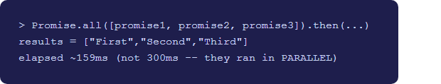
PROMISES
Promise.all, Live
const promise1 =
delay(100).then(() => "First");
const promise2 =
delay(50).then(() => "Second");
const promise3 =
delay(150).then(() => "Third");
Promise.all(
[promise1, promise2, promise3]
).then(results => { ... });
cuinotes.com · 17

Slide 18
ASYNC/AWAIT
Two Rules
1
async before a function makes it always return a Promise, and allows await inside it
2
await pauses execution of THAT function (not the whole program) until the promise settles, then unwraps the resolved value -- or throws if it rejected
cuinotes.com · 18

Slide 19
ASYNC/AWAIT
Reads Like Synchronous Code
async function loadOrderDetails(userId) {
const user = await getUser(userId); // "pause" until the promise settles
const orders = await getOrders(user.id);
const details = await getOrderDetails(orders[0].id);
return details;
}
cuinotes.com · 19

Slide 20
ASYNC/AWAIT
Error Handling with try...catch
async function loadOrderDetails(userId) {
try {
const user = await getUser(userId);
const orders = await getOrders(user.id);
const details = await getOrderDetails(orders[0].id);
return details;
} catch (error) {
console.error("Failed to load order details:", error.message);
throw error; // re-throw if the caller also needs to know
}
}
cuinotes.com · 20

Slide 21
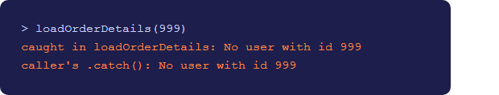
ASYNC/AWAIT
try...catch, Live (getUser rejects)
async function loadOrderDetails(id) {
try {
const user =
await getUser(id);
return user;
} catch (error) {
log("caught: " +
error.message);
throw error;
}
}
cuinotes.com · 21

Slide 22
ASYNC/AWAIT
async/await vs. .then Chains
TIP
They do the same job -- async/await is just easier to read, especially with multiple sequential steps and conditional logic. You will see both styles in real codebases, but prefer async/await for new code you write.
cuinotes.com · 22

Slide 23
AJAX AND FETCH
What Is AJAX?
1
The general technique of a web page requesting data from a server in the background, without a full page reload
2
The name is historical (Asynchronous JavaScript and XML) -- today it almost always means JSON, not XML
3
The modern, built-in tool for doing this is the Fetch API
cuinotes.com · 23

Slide 24
FETCH API
A GET Request
async function loadStudents() {
const response = await fetch("https://api.example.com/students");
const students = await response.json(); // parses the body as JSON
console.log(students);
}
fetch(url) resolves with a Response once headers arrive -- it resolves even for 404s; it only REJECTS on a genuine network failure.
cuinotes.com · 24

Slide 25
FETCH API
Always Check response.ok
async function loadStudents() {
const response = await fetch("https://api.example.com/students");
if (!response.ok) {
throw new Error(`Request failed with status ${response.status}`);
}
const students = await response.json();
return students;
}
cuinotes.com · 25

Slide 26
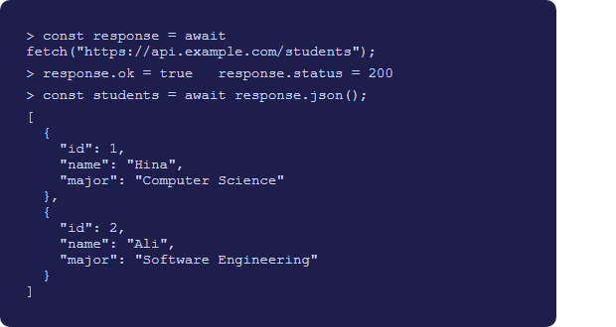
FETCH API
The Exact GET Code, Live
const response =
await fetch(url);
response.ok;
response.status;
const students =
await response.json();
cuinotes.com · 26

Slide 27
FETCH API
A POST Request with Headers
async function createStudent(newStudent) {
const response = await fetch("https://api.example.com/students", {
method: "POST",
headers: { "Content-Type": "application/json" },
body: JSON.stringify(newStudent), // JS object -> JSON text
});
if (!response.ok) throw new Error(`Failed to create student: ${response.status}`);
return response.json();
}
Content-Type: application/json tells the server "the body I'm sending is JSON text," so it knows how to parse it.
cuinotes.com · 27

Slide 28
FETCH API
Parsing Different Response Types
Method | Parses the body as
response.json() | JSON -- the most common case
response.text() | Plain text
response.blob() | Raw binary data (e.g. an image)
You can only read a response body ONCE -- call one parsing method per response.
cuinotes.com · 28

Slide 29
FETCH API
Putting It Together with Promise.all
async function fetchAllPages() {
try {
const [usersRes, postsRes] = await Promise.all([
fetch("https://api.example.com/users"),
fetch("https://api.example.com/posts"),
]);
const users = await usersRes.json();
const posts = await postsRes.json();
console.log(users, posts);
} catch (error) {
console.error("Network error:", error.message);
}
}
cuinotes.com · 29

Slide 30
CORS BASICS
Cross-Origin Resource Sharing
1
A browser security rule restricting JS on one origin (protocol + domain + port) from freely reading responses from a different origin
2
The server decides who is allowed, via an Access-Control-Allow-Origin response header
3
CORS is enforced by the BROWSER, not your JavaScript -- you cannot "fix" a CORS error from the frontend
cuinotes.com · 30

Slide 31
CORS BASICS
How the Browser Checks CORS
Browser
fetch("https://api.example.com/data")
request
api.example.com
response + header
Access-Control-
Allow-Origin
allows this origin?
No
Yes
JS can read the response
Browser BLOCKS the JS
from reading it (CORS error)
The network request may technically succeed either way -- CORS only controls whether your JavaScript is allowed to read the response.
cuinotes.com · 31

Slide 32
CORS BASICS
CORS Is Not Something You Can Bypass
WARNING
If you see a CORS error, the fix belongs on the server (adding the right Access-Control-Allow-Origin header), not in your fetch call. You'll work with server configuration, including CORS, starting in Unit 5.
cuinotes.com · 32

Slide 33
KEY TAKEAWAYS
Lecture 15 in Six Points
1
Synchronous code blocks the single JS thread; asynchronous code lets long operations happen in the background without freezing the page.
2
The event loop moves finished tasks from the queue onto the call stack whenever it's empty -- this is how setTimeout and Promise callbacks run.
3
A Promise moves through pending, fulfilled, and rejected; chaining .then() calls replaces nested callback hell.
4
Promise.all runs multiple promises in parallel and waits for all of them, or fails fast if any one rejects.
5
async/await is Promise-based syntax that reads like synchronous code; errors are handled with ordinary try...catch.
6
fetch() rejects only on true network failure, not on HTTP error codes -- always check response.ok; CORS is a browser rule enforced via response headers, fixable only on the server.
cuinotes.com · 33

