Slide 1
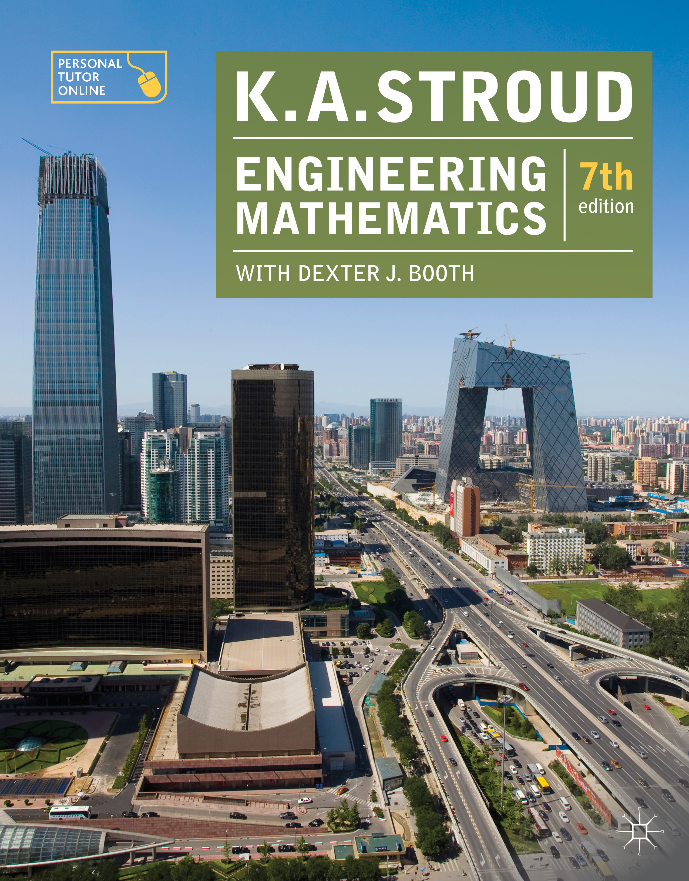
PROGRAMME F2
INTRODUCTION
TO
ALGEBRA

Slide 2
Programme F2: Introduction to algebra
Algebraic expressions
Powers
Logarithms
Multiplication of algebraic expressions of a single variable
Fractions
Division of one expression by another
Factorization of algebraic expressions

Slide 3
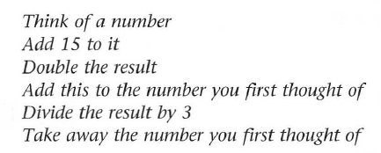


Slide 4
Algebraic expressions
Symbols other than numerals
An unknown number can be represented by a letter of the alphabet which can then be manipulated just like an ordinary numeral within an arithmetic expression. Manipulating letters and numerals within arithmetic expressions is referred to as algebra.

Slide 5
Algebraic expressions
Constants and variables
Sometimes a letter represents a single number. Such a letter is referred to as a constant. Other times a letter may represent one of a collection of numbers. Such a letter is referred to as a variable.

Slide 6
Algebraic expressions
Rules of algebra
The rules of arithmetic, when expressed in general terms using letters of the alphabet are referred to as the rules of algebra. Amongst these rules are those that deal with:
Commutativity
Associativity
Distributivity

Slide 7


Algebraic expressions
Rules of algebra
Commutativity
Both addition and multiplication are commutative operations. That is, they can be added or multiplied in any order without affecting the result:
Note that the multiplication sign is suppressed:

Slide 8

Algebraic expressions
Rules of algebra
Associativity
Both addition and multiplication are associative operations. That is, they can be associated in any order without affecting the result:

Slide 9
Algebraic expressions
Rules of algebra
Distributivity
Multiplication is distributive over addition and subtraction from both the left and the right:

Slide 10
Algebraic expressions
Rules of algebra
Distributivity
Division is distributive over addition and subtraction from the right but not from the left:

Slide 11
Algebraic expressions
Rules of precedence
The familiar rules of precedence continue to apply when algebraic expressions involving mixed operations are to be manipulated

Slide 12

Algebraic expressions
Terms and coefficients
An algebraic expression consists of alphabetic characters and numerals linked together with the arithmetic operations. For example:
Each component of this expression is called a term of the expression. Here there are two terms, namely the x term and the xy term.
The numbers 8 and –3 are called the coefficients of their respective terms.

Slide 13


Algebraic expressions
Collecting like terms
Terms that have the same variables are called like terms and like terms can be collected together by addition and subtraction. In this manner, expressions can be simplified.

Slide 14




Algebraic expressions
Similar terms
Terms that have variables in common are called similar terms and similar terms can be collected together by factorization. The symbols the terms have in common are called common factors. For example:
Here, b is a common factor that has been factorized out by the introduction of brackets.

Slide 15


Algebraic expressions
Expanding brackets
Sometimes it is desired to reverse the process of factorizing an expression
by removing the brackets (called expanding the brackets). This is done by:

Slide 16

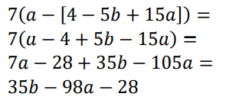

Algebraic expressions
Nested brackets
In expanding brackets where an algebraic expression contains brackets nested within other brackets the innermost brackets are removed first.

Slide 17
Algebraic expressions
Powers
Logarithms
Multiplication of algebraic expressions of a single variable
Fractions
Division of one expression by another
Factorization of algebraic expressions

Slide 18
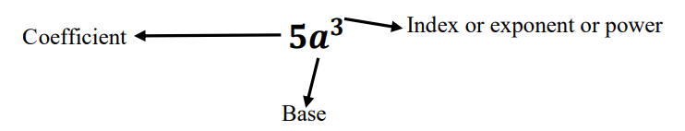
Powers
Powers
The use of powers in the first instance (also called indices or exponents) provides a convenient form of algebraic shorthand for repetitive multiplication.

Slide 19
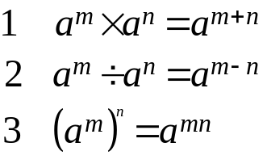
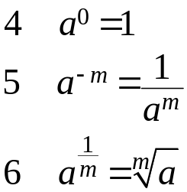
Powers
Rules of indices
Three basic rules are:
These lead to:

Slide 20





Powers
Rules of indices
Now try to apply the rules:

Slide 21


Powers
Rules of indices
Now try to apply the rules:

Slide 22
Algebraic expressions
Powers
Logarithms
Multiplication of algebraic expressions of a single variable
Fractions
Division of one expression by another
Factorization of algebraic expressions

Slide 23

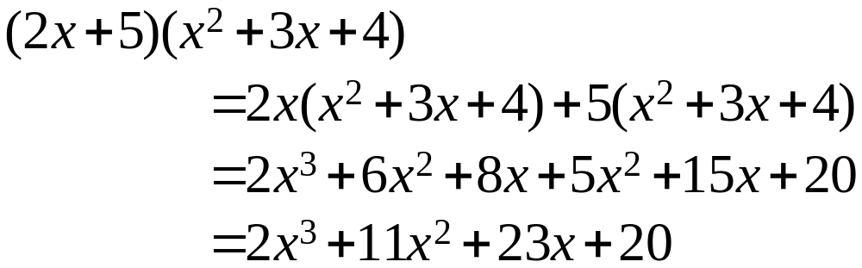
Multiplication of algebraic expressions of a single variable

Slide 24
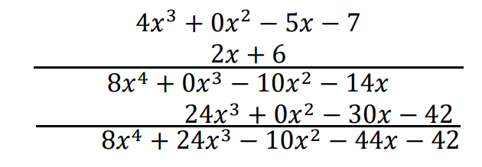
Multiplication of algebraic expressions of a single variable

Slide 25
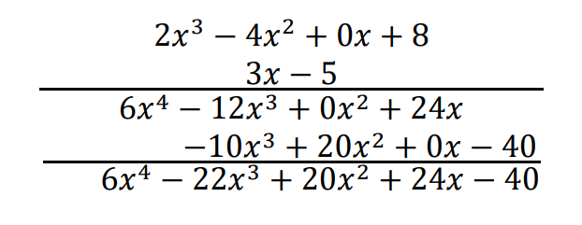
Multiplication of algebraic expressions of a single variable

Slide 26
Algebraic expressions
Powers
Logarithms
Multiplication of algebraic expressions of a single variable
Fractions
Division of one expression by another
Factorization of algebraic expressions

Slide 27
Fractions
Algebraic fractions
A numerical fraction is represented by one integer divided by another. Division of symbols follows the same rules to create algebraic fractions. For example,

Slide 28
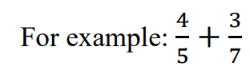

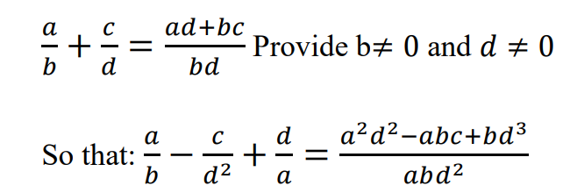
Fractions
Addition and subtraction
The addition and subtraction of algebraic fractions follow the same rules as the addition and subtraction of numerical fractions – the operations can only be performed when the denominators are the same.

Slide 29
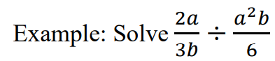

Fractions
Multiplication and division
Just like numerical fractions, algebraic fractions are multiplied by multiplying their numerators and denominators separately.
To divide by an algebraic fraction multiply by its reciprocal.

Slide 30
Algebraic expressions
Powers
Logarithms
Multiplication of algebraic expressions of a single variable
Fractions
Division of one expression by another
Factorization of algebraic expressions

Slide 31
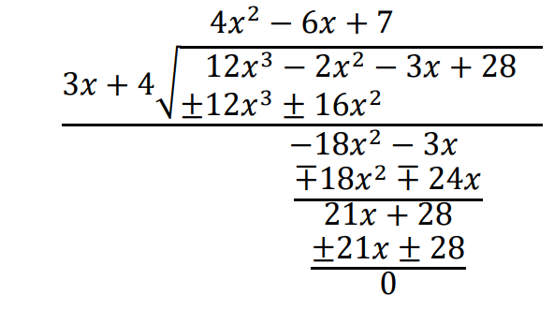
Division of one expression by another

Slide 32
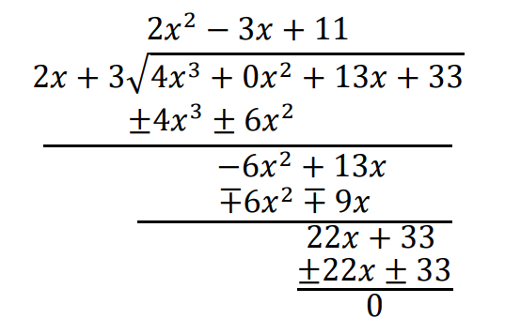
Division of one expression by another

Slide 33
Algebraic expressions
Powers
Logarithms
Multiplication of algebraic expressions of a single variable
Fractions
Division of one expression by another
Factorization of algebraic expressions

Slide 34






Factorization of algebraic expressions
Common factors
The simplest form of factorization is the extraction of highest common factors from a pair of expressions. For example:

Slide 35
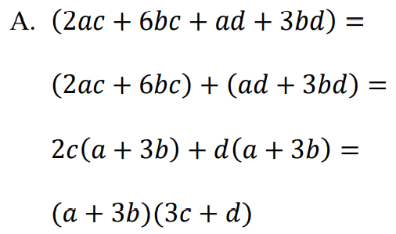
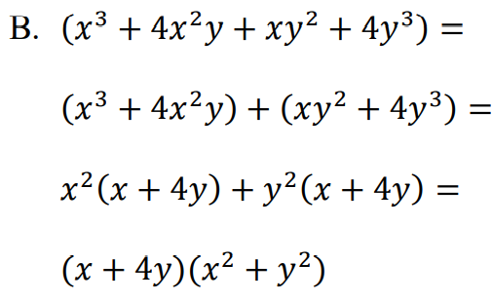
Factorization of algebraic expressions
Common factors by grouping
Four termed expressions can sometimes be factorized by grouping into two binomial expressions and extracting common factors from each. For example:
(a+3b)(2c+d)

Slide 36
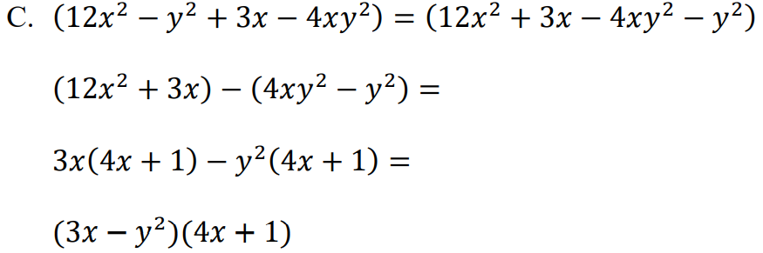
Factorization of algebraic expressions
Common factors by grouping
In some cases, it might be necessary to rearrange the order of the original four terms:

Slide 37
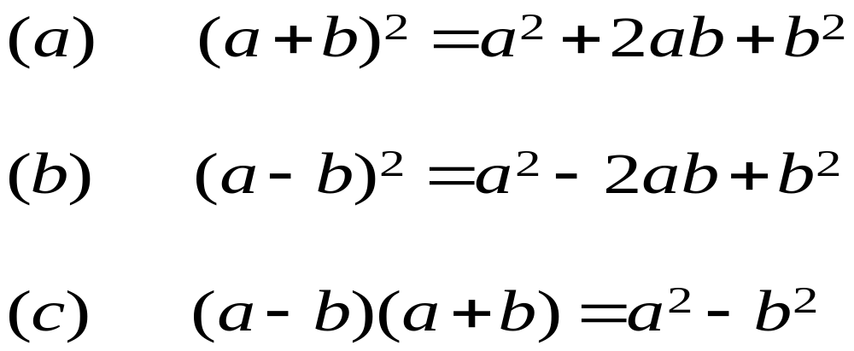
Factorization of algebraic expressions
Useful products of two simple factors
A number of standard results are worth remembering:

Slide 38




Factorization of algebraic expressions
Useful products of two simple factors
1)
2)
3)

Slide 39
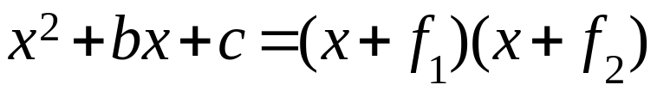
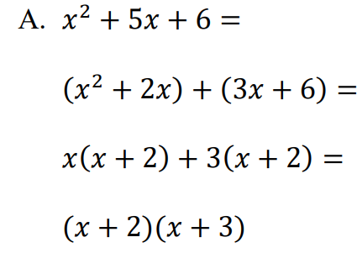

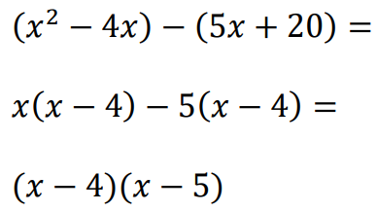
Factorization of algebraic expressions
Factorization of a quadratic expression ax² + bx + c when a = 1
The factorization is given as:

Slide 40



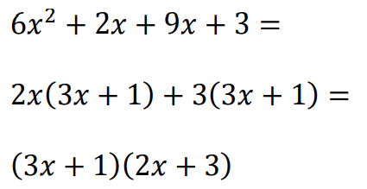
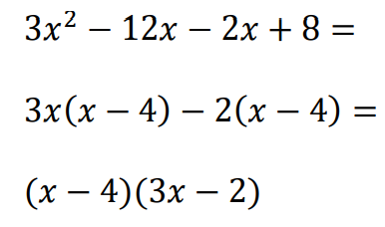
Factorization of algebraic expressions
Factorization of a quadratic expression ax² + bx + c when a ≠ 1
The factorization is given as:

Slide 41


Factorization of algebraic expressions
Test for simple factors
The quadratic expression:
Has simple factors if, and only if:

Slide 42
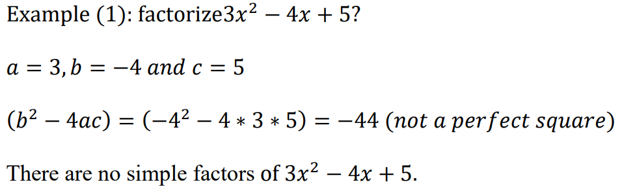
Factorization of algebraic expressions
Test for simple factors

Slide 43
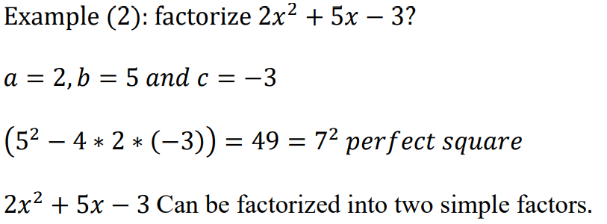
Factorization of algebraic expressions
Test for simple factors

Slide 44
Learning outcomes
Use alphabetic symbols to supplement the numerals and to combine these symbols using all the operations of arithmetic
Simplify algebraic expressions by collecting like terms and abstracting common factors from similar terms
Remove brackets and so obtain alternative algebraic expressions
Manipulate expressions involving powers and multiply two expressions together
Manipulate logarithms both numerically and symbolically
Manipulate algebraic fractions and divide one expression by another
Factorize algebraic expressions using standard factorizations
Factorize quadratic algebraic expressions

