Slide 1
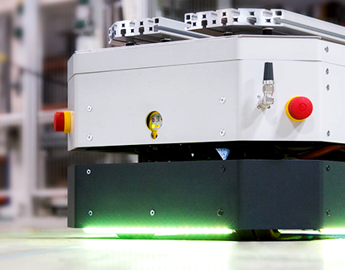
AUTOMATED GUIDED VEHICLE
KHAIRYL MUADZ
BIN ROSLAN

Slide 2
HISTORY & BACKGROUND
HISTORY
BACKGROUND
The first automated guided vehicle arrived in the early 1950s by Barret Electronics of Northbrook, and was little more than a glorified tow truck, albeit one that did not require a driver, navigating instead by following a track of wires embedded in the factory floor generated by a magnetic field.
Wires gave way to magnetic tape, optical strips and eventually laser guidance and other more sophisticated navigation systems, but the job of the AGV remains the same.
AGVs are typically used to safely transport bulky items such as stacks of pallets, rolls of paper or metal, and auto parts from one location to another.
Since they don’t deviate from their set course, AGVs don’t require much in the way of onboard computing power, aside from collision avoidance sensors.

Slide 3
AGV HARDWARE STUDY
Physical Design for various application
Locomotion system and actuators
Navigation system and control
Data collection
Data transmission
Power management

Slide 4
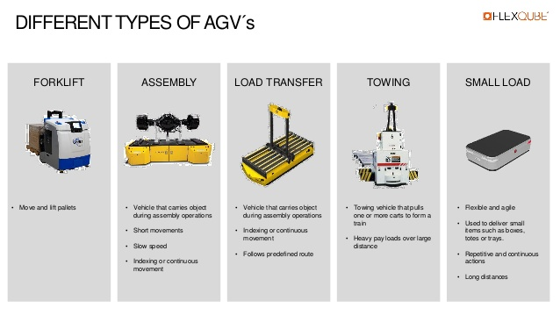
TYPES OF AGV

Slide 5
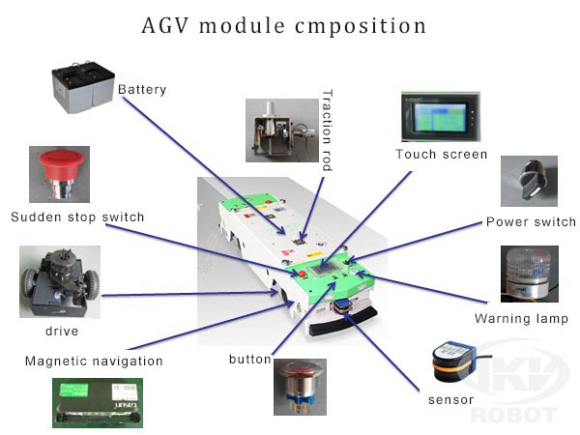
OVERVIEW
General view and labelling of AGV components

Slide 6

PHYSICAL DESIGN
Design of common AGV
The AGV consists of a robust outer frame.
Robust design allows engineers to develop reliable and durable products and processes which perform as wanted and with the needed products life cycle.

Slide 7
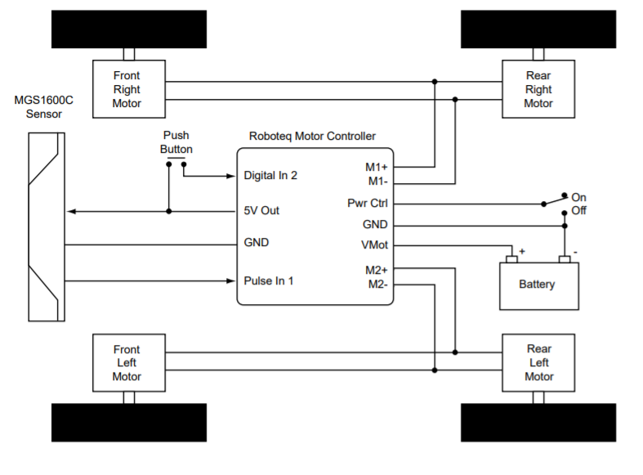
LOCOMOTION SYSTEM AND ACTUATORS
Locomotion to destination and actuator to lift the object
The locomotion system uses magnetic sensor.
Actuators are dc motors to move the tires and to lift and unload the objects.
The AGV lifts and unloads objects at specific stations. The vehicle understands the stations using sensors.
Material transfer components consists of PLC, electrical components and linear actuator.
Pneumatics system can also be used to lift and unload the object.

Slide 8
DATA COLLECTION
Laser receiver from transmitter and data of the object to lift and unload
Laser receiver receives signal from the laser reflectors attached at the landmarks and destinations.
The information about each station is stored in the database of the host controller unit. Before the AGV is dispatched to a station, this information is loaded to the guiding unit so that the AGV adjusts the turning priorities as well as the lifter height adequate to the height of the station.
It uses wi-fi to obtain data from host controller unit.
iPad and main computer is used to notify the AGVs regarding their tasks with IoT

Slide 9
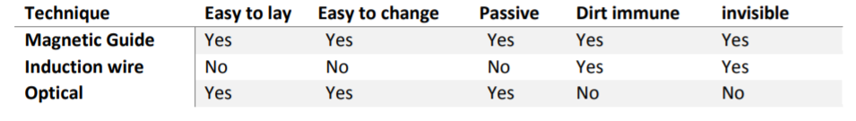
NAVIGATION SYSTEM AND CONTROL
Path Guidance & Obstacle Avoidance
Magnetic tapes are used where the AGV follows the magnetic tape attached on the floor.
Another option is laser guidance system, which has transmitter and receiver of the laser. One attached to the landmarks and destination, the other attached to the AGV.
Front and rear-sensing Ultrasonic or optic sensor.
Zone-sensing using computer.
A sensor will detect a certain distance and the AGV responds by slowing down or stopping.
Bumper sensor is also used in case of accidents.
In order to operate an AGV system efficiently, AGVs require an extensive controller system like gyroscope.

Slide 10
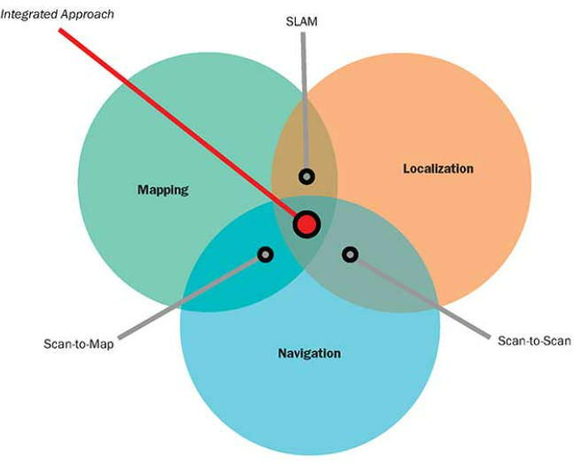
DATA TRANSMISSION
Laser transmitter to indicate presence of AGV and to transmit the data of object to lift
Laser reflectors attached to the walls to give information.
Use a technology known as simultaneous localization and mapping (SLAM).
Creating a map of an unknown environment while simultaneously maintaining a location within that map. The map will constantly be optimized
SLAM can use many sensors as input, with lidar being the most common and readily available at present.

Slide 11

POWER MANAGEMENT
Use of rechargeable batteries with fast-charging stations available
Use fast-charging long lasting batteries.
AGVs that are low on battery will automatically recharge itself at the charging stations.
The batteries can be monitored through software.
As an alternative for fast charging stations, we use Staubli battery management system.

Slide 12
HARDWARES
ITEMS | LINK
Roboteq BMS Battery | https://www.roboteq.com/all-products/battery-management-systems
LIDAR Sensor | https://sea.banggood.com/SLAMTEC-RPLIDAR-A2-2D-360-12-Meters-Scanning-Radius-Lidar-Sensor-Scanner-for-Obstacle-Avoidance-and-Navigation-of-A-G-V-UAV-p-1596727
Magnetic Tape | https://www.labfriend.com.my/agv-aspure-induction-magnetic-tape
Magnetic Sensor | https://www.roboteq.com/all-products/magnetic-guide-sensors
Optical Flow Sensor | https://www.roboteq.com/all-products/optical-flow-sensor-for-mobile-robots
Charging Station | https://www.roboteq.com/all-products/robopads-charge-system
Motor and Wheels | https://www.roboteq.com/all-products/motors-wheels

Slide 13
HARDWARES #2
ITEMS | LINK
Motor Controller | https://www.roboteq.com/products/products-brushless-dc-motor-controllers/fbl-family
Long Range Wi-Fi | https://my.cytron.io/p-wireless-nrf24l01-plus-pa-lna-with-antenna?r=1&gclid=Cj0KCQjw3duCBhCAARIsAJeFyPWLPalYlCnDdwAcQTEZSiFKg6IpCpvoNolzftTVaT0B9wqo9ajNCVIaAoItEALw_wcB
Lifting motor | https://www.directindustry.com/industrial-manufacturer/motor-lifting-applications-137891.html

Slide 14
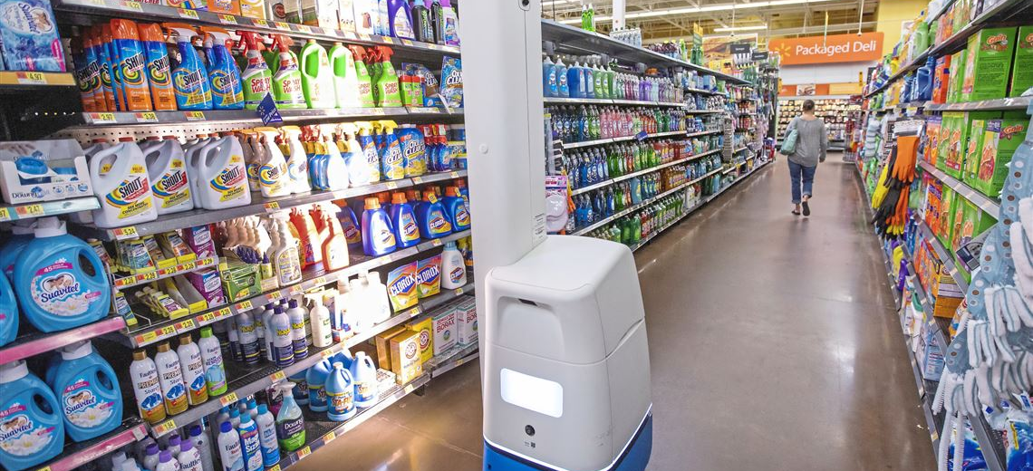
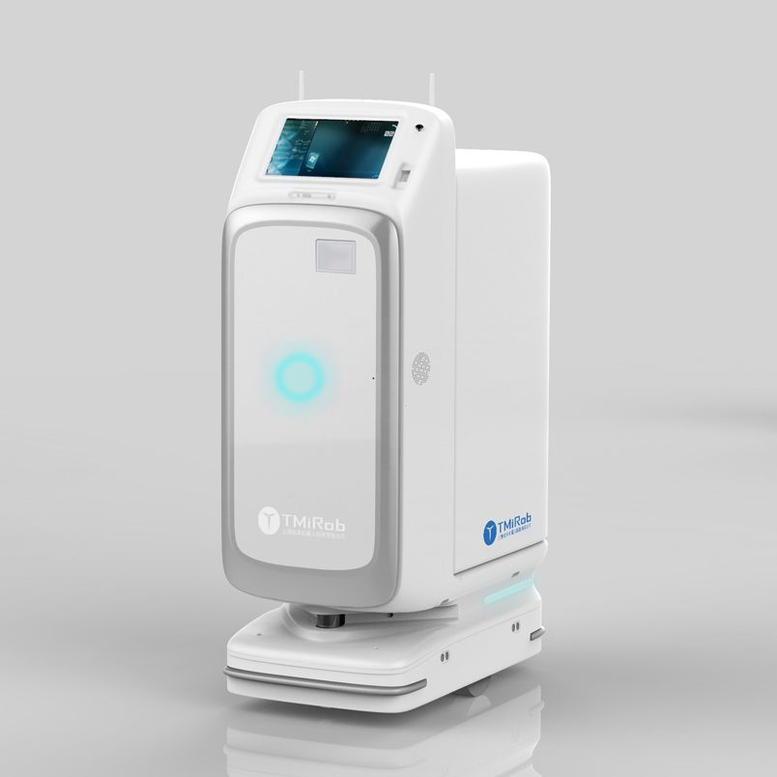
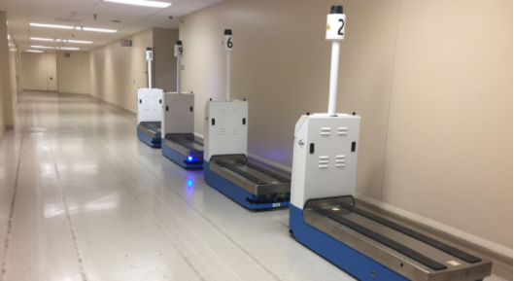
BIG IMAGE
OTHER CURRENT DAY APPLICATIONS OF AGV

Slide 15

THANK YOU!
Khairyl Muadz bin
Roslan

