Slide 1
Html & CSS Course
By Systemduo & Irhad OmanoviC

Slide 2
What is CSS
CSS stands for Cascading Style Sheets
Describes how html elements should show on screen, paper or in other media
External stylesheets are stored in css files

Slide 3
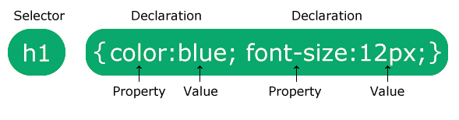
CSS syntax
Selector points to the element that you want to style
Declarations block contains rules that you want to apply, separated by semicolons

Slide 4
How to add css
There is three ways to insert CSS:
External CSS
Internal CSS
Inline CSS

Slide 5
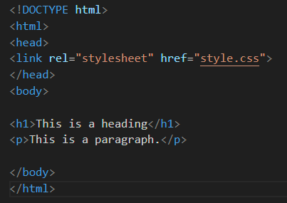
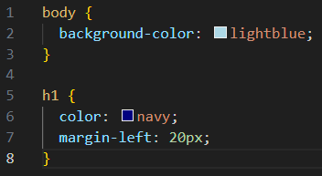
External css example
Create 2 files: index.html and style.css
index.html code: style.css code:

Slide 6
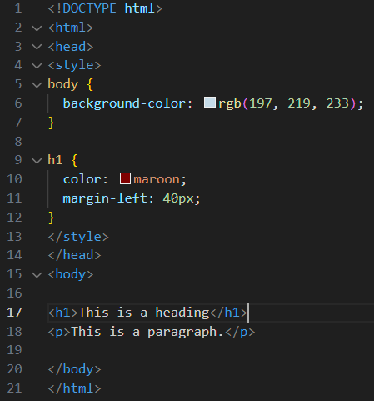
Internal css example
Create index.html file and fill it up with this code:

Slide 7
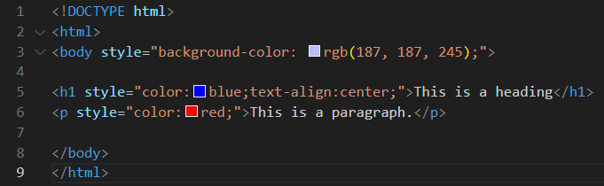
Inline css
Again, create index.html and paste this code:

Slide 8
CSS selectors
They are used to mark all elements that we want to style(that we want to join with specific style rulings)
We can divide CSS selectors into 5 categories:
Simple selectors (based on name, class, id)
Combinator selectors (based on specific relationship between them)
Pseudo-class selectors (select elements based on certain state)
Pseudo-elements selectors (select and style part of an element)
Attribute selectors (select elements based on an attribute or attribute value)

Slide 9
Simple SLECTORS
We have element, id, class, universal, grouped selectors
Element selectors are styling all elements of certain name
ID selectors are styling all elements that have certain ID
Class selectors – same as ID: styles all elements that belongs to certain class
Universal selectors – applies style to all elements
Grouped selectors – applies same style to several different selectors

Slide 10
ELEments selectors
Syntax: elementName { attribute : value }
Example: p { text-align: center; color: red; }

Slide 11
ID and class selectors
ID syntax selectors: #ID { attribute: value }
Example: #main-headline { attribute: value }
Class syntax selectors: .class { attribute: value }
Example: .card { padding: 1rem }

Slide 12
Universal and Group selectors
Universal syntax: * { attribute: value}
Example: * { font-family: Arial, Helvetica, sans-serif; }
Group selectors syntax: selector1, selector2, selector3 { attribute: value }
Example: p, div, .card { padding: 0.5rem }

Slide 13




Combinator Selectors
Descendant selector(space)
Child selector(>)
Adjacent selector(+)
General sibling selector(~)

Slide 14
Pseudo-class selector
Syntax: selector:pseudo-class { property : value }
Defines special interactions with an element
Some examples: p:first-child, p:last-child, p:visited, p:focus, p:active…

Slide 15
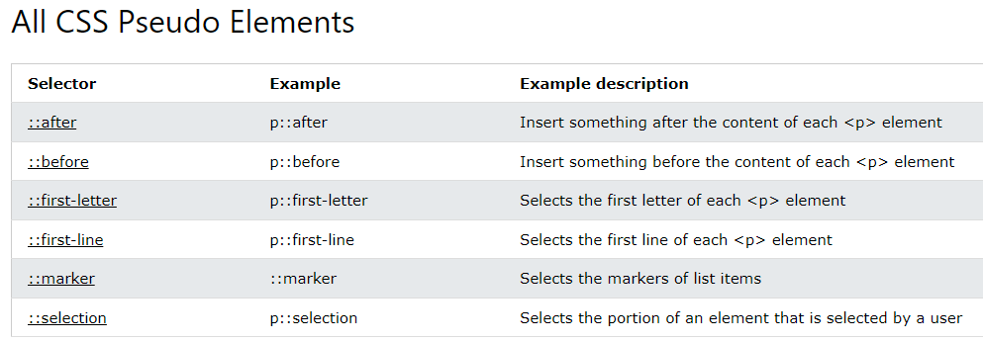
CSS PSEUDO ELEMENTS SELECTORS
Style specific parts of an element(s)
It can be used to insert elements at start or end of an element
Style first letter or line of an element
Syntax: selector::pseudo-element { property: value }

Slide 16
CSS ATTRIBUTE SELECTORS
Style elements with specific attribute or attribute value
Syntax: selector[attribute=attributeValue] { attribute : value }
Example: a[target] { color : yellow }, a[target=“_blank”] { color : yellow }

Slide 17
CSS COLORS
Can be specified by predefined color names or RGB, HEX, HSL, RGBA, HSLA values.
There is 140 predefined color names: https://www.w3schools.com/colors/colors_names.asp
There is several attributes that can have color value: background-color, text color, border color
rgb(red, green, blue), #rrggbb, hsl(hue, saturation, lightness)

Slide 18
Css background
For adding background effects for elements
Background color – for coloring background
Opacity – specifies opacity of an element
Background image – for setting image to serve as background: selector { background-image: url(“image.png”) }
Background repeat – specify if image will be repeated both horizontally and vertically: selector { background-repeat: repeat-x }, also values can be: no-repeat, repat-y, space, round, space repeat. More on: https://developer.mozilla.org/en-US/docs/Web/CSS/background-repeat

Slide 19
Css background
Background attachment – scroll, fixed, local
Scroll – image will scroll with the page, fixed – image will stay fixated during scroll and local – image will scroll with the element’s content
Background position – top, bottom, right, left. Also, we can add values to specify exactly where we want to position image inside div
There is shorthand for specifying all background properties with single line: background value1 value2 value3 …

Slide 20
CSS background
When using shorthand property the order of property values are:
background-color
background-image
background-repeat
background-attachment
background-position
It doesn’t matter if one of the properties is missing as long as other are present in this order

Slide 21
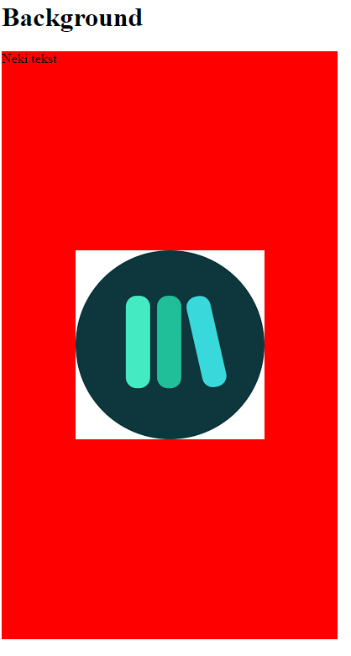
TASK no 1
Create page with background.
Background should have color.
Image should scroll with content.
It should be positioned at bottom right of the container.
On hover, background should apply image (centered).

Slide 22
CSS borders
CSS border properties allows you to specify the style, width, and color of an element’s border
So we have several border properties including: border-style, border-width, border color, border-radius

Slide 23
Border style
We have several border styles that we can use:
dotted - Defines a dotted border
dashed - Defines a dashed border
solid - Defines a solid border
double - Defines a double border
groove - Defines a 3D grooved border. The effect depends on the border-color value
ridge - Defines a 3D ridged border. The effect depends on the border-color value
inset - Defines a 3D inset border. The effect depends on the border-color value
outset - Defines a 3D outset border. The effect depends on the border-color value
none - Defines no border
hidden - Defines a hidden border

Slide 24
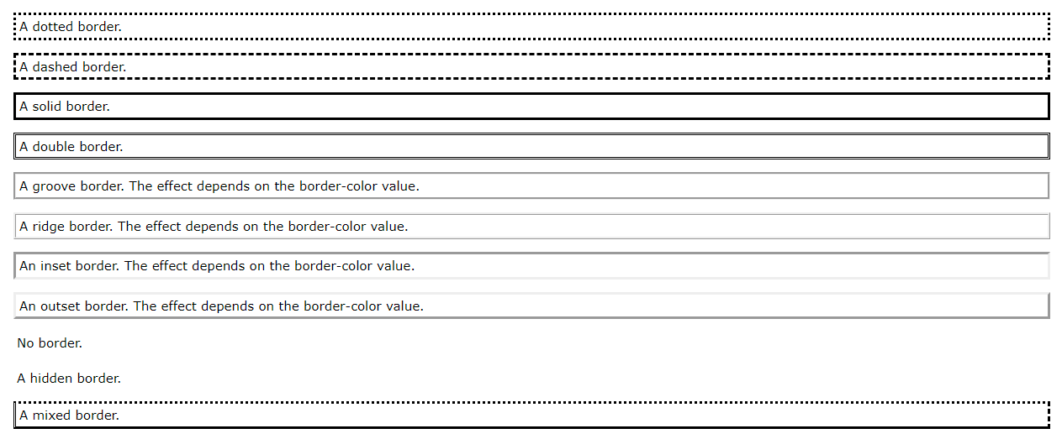
BORDER STYLE

Slide 25
BORDER WIDTH
The border-width property specifies the width of the four borders.
The width can be set as a specific size (in px, pt, cm, em, etc) or by using one of the three pre-defined values: thin, medium, or thick
Can have from 1 to four values, seperated by space. Top, right, bottom, left. If we specify only 2, then first will be for top and bottom, second will be for left and right, if we specify 3 values then first will be for top, second for right, and left, and third will be for bot.

Slide 26
CSS Border COLOR
Used to set border color
Color can be set by name (red), hex(#ffffff), rgb(rgb(0,0,0)), hsl(hsl(0,100%,50%))
By default it inherits the color of the element
Also. Can have from 1 to 4 values

Slide 27
BORDER SIDES
Border-top, border-bottom, border-left, border-right.
Also we can add them postfix –style to edit border style

Slide 28
Border SHORTHAND
We can also use border shorthand with 3 parameters. First is for width, second is for style, and third is for color.
Example: { border : 1px solid red }, also we can use this shorthand for one specific side: border-top: { 1px sold blue }

Slide 29




Task no 2
Make button
Colors: red and black
Use focus, active, hover state

Slide 30
MARGINS
Used to create space outside of an element’s borders.
We can define space margin space for specific side, or we can use margin shorthand.
Margin: 2px 3px 4px 5px, or margin-top: 2px, margin-bottom, margin-left, margin-right
We can center(horizontally) element with margin value set to auto.
Margins of two elements might collapse in favor of larger margin. This is the case only with bottom and top margin. Left and right margin do not collapse.
https://www.joshwcomeau.com/css/rules-of-margin-collapse/

Slide 31
Css pading
As margin, it creates space, but this time, space is created inside of an element, from border inwards.
Padding-(top, bottom, left, right) or just padding with 4, 3, 2, or one value.
If element has width specified(lets say 300px) and we add to it padding of 25px, then whole element will have with of 350px. To limit element with to 300px while having padding of 25px we need to set box-sizing attribute to border-box.
Box-sizing: border-box | content-box

Slide 32
Css (MAX) width and height
Used to set (max)width and height of an element
Several possible values: auto(by default), length (in px, cm, rem etc), percentage, initial, inherit
Initial – sets to its default value,
Inherit – inherits from the parent
Max width can be set to length value, percentage or to none

Slide 33

Css Box model
It is essentially box that wraps every element.
Important to understand in order to set width adequately.

Slide 34
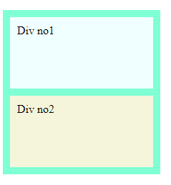
Task no3
Create one parent div and 2 divs inside of it
All divs have padding of 10px
Parent div should have max-width of 200px
Child divs should have height of 100px (with padding)
Try to do it using element selectors and pseudo class selectors

Slide 35
CSS outline
Drawn outside of an element’s border
Several outline properties including:
Outline-style
Outline-color
Outline-width
Outline-offset
outline

Slide 36
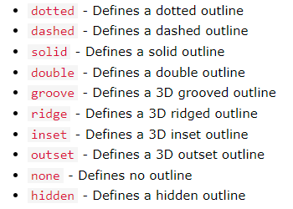
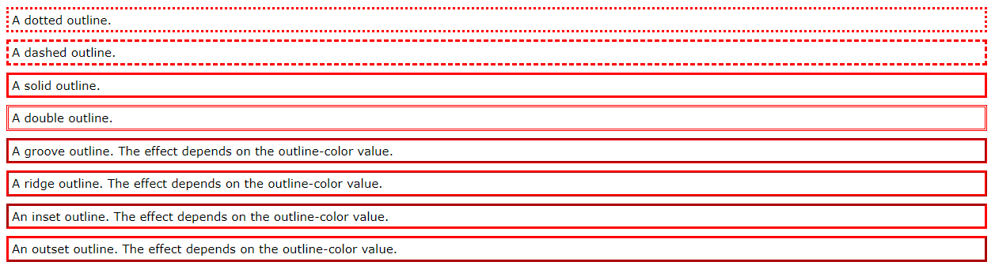
CSS outline style

Slide 37
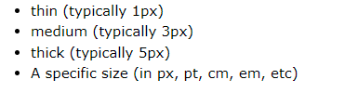
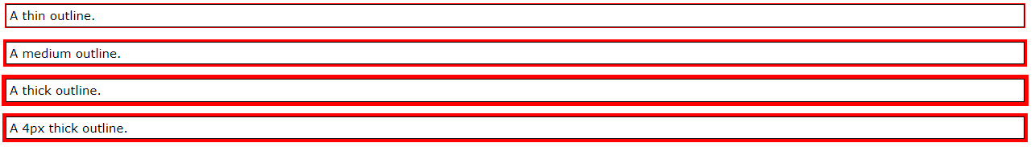
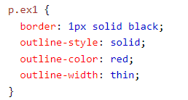
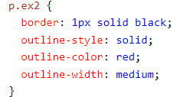
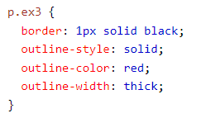
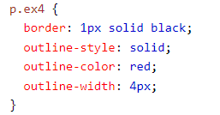
CSS OUTLINE WIDTH

Slide 38
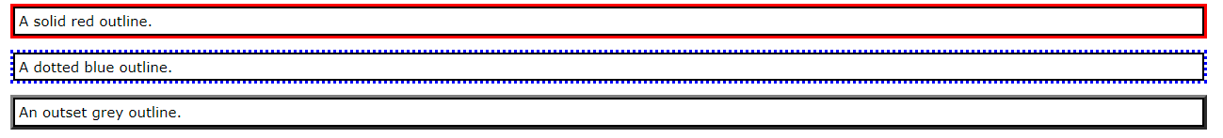
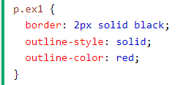
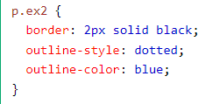
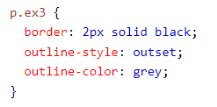
CSS OUTLINE COLOR
Just like it is the case with other colors, color can have name, hex, rgb or hsl value, with addition of invert which performs color inversion(which ensures that outline is visible regardless of color background).

Slide 39
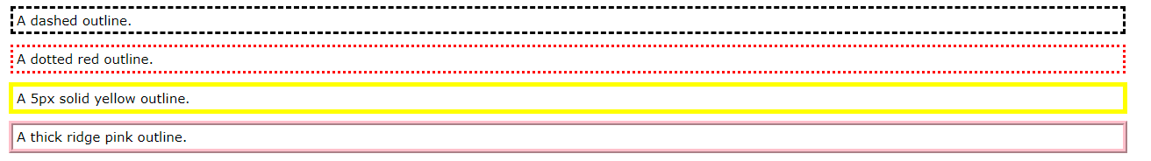
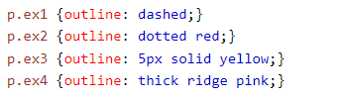
Css outline shorthand
Outline: outline-width outline-style(required) outline-color

Slide 40
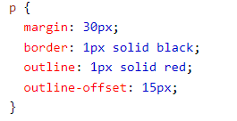
Css outline offset
Adds space between element’s border and outline

Slide 41
Css text
There is lot of properties for formatting text
Some of them that we will mention in this course: text color, text-alignment, text-decoration, text-decoration, text-transformation, text-spacing, text-shadow.
Text-color used to set text color
Text-transformation: uppercase, lowercase, capitalize

Slide 42
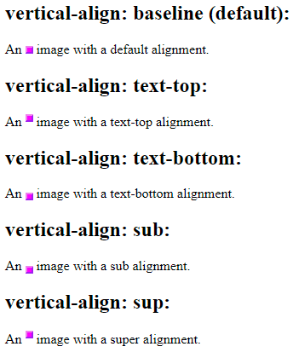
Css text alignment
Text-alignment: left, right, center, justify
Text-alignment-last: how to align last line of a text. Same values as text-alignment
Text-direction used to change text direction: rtl, ltr
Vertical-align: baseline, text-top, text-bottom, sub, super

Slide 43
CSS text decoration
Text-decoration-line: overline, line-through, underline, overline underline
Text-decoration-color
Text-decoration-style: solid, double, dotted, dashed, wavy
Text-decoration-thickness: 5px, rem, cm, auto, 5%
Shorthand property: text-decoration followed by 4 values:
Text-decoration-line(required)
Text-decoration-color(optional)
Text-decoration-style(optional)
Text-decoration-thickness(optional)

Slide 44
Css text spacing
text-indent (self-explanatory)
Letter-spacing – to specify space between characters in a text
Line-height – to specify space between lines
Word-spacing – to define space between words
Text-shadow – to set text shadow: text-shadow: 2px 2px red; - to specify horizontal and vertical shadow of red color

Slide 45
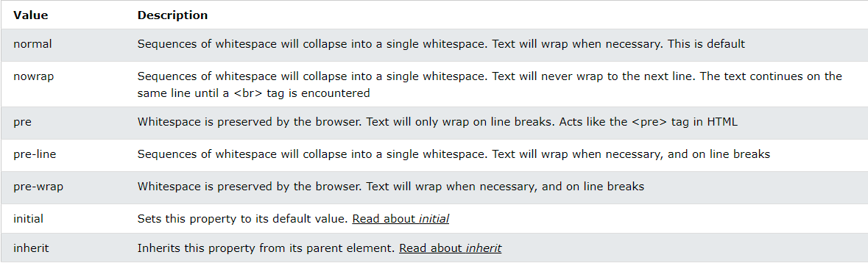
Css WHITE SPACE
White-space – can have these values:

Slide 46
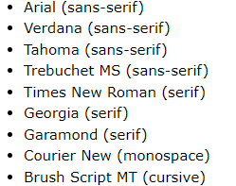
Css fonts
Font-family : “Times New Roman”, Times, Serif;
Always use fallback font in case browser can’t read font you want. Fallback font should be generic one.

Slide 47
CSS FONTS
Font-style: normal|italic|oblique
Font-wight: normal|lighter|bold|value(100-1000)
Font-wariant: normal|small-caps(all text is written in capital letters, but smaller ones)
Font-size – can be set in percentage, pixels, em(rem), vw.
Font: font-style font-variant font-weight font-size/line-height font-family
More on fonts: https://www.w3schools.com/css/css_font.asp

Slide 48
icons
It is enough to import icons with script tag in head of our html
<script src="https://kit.fontawesome.com/a076d05399.js" crossorigin="anonymous"></script>
https://fontawesome.com/
Create account and get script tag – copy it in head tag in order to use icons

Slide 49

CSS LINKS
To style link we use selector a { property: value }
In addition we can use 4 states: link, visited, hover, active
When setting the style for several link states, there are some order rules:
a:hover MUST come after a:link and a:visited
a:active MUST come after a:hover

Slide 50
CSS LISTS
List-style-type: https://www.w3schools.com/cssref/pr_list-style-type.php
Some type examples: circle, square, upper-roman, lower-alpha
List-style-image: url(‘link_to_image.gif’)
List style position: outside|inside
List-style: list-style-type list-style-position list-style-image

Slide 51
Css DISPLAY
Display: block – takes full width and starts in newline
Display: inline – takes only as much space as needed and doesn’t necessarily start in newline
Display: none – to hide element, not to remove it from the DOM

Slide 52
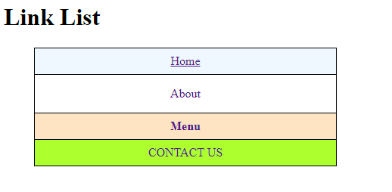
Task no4
Add unordered list of links
Style it to look like image provided
Limit width to 200 px
CONTACT US – don’t write it like that.
Instead, write it like Contact us and then use css to make it look like on the image provided.

Slide 53
Css POSITION
Position: static, relative, fixed, absolute, sticky
Then we position element with bot, top, left, right properties
Static is not positioned in any specific way; it is always positioned according to the normal flow of the page
Position: relative – positioned relative to its normal positions
Position: fixed – positioned relative to the viewport(always in the same place even if the page is scrolled)
Position: absolute – is positioned relative to the nearest positioned ancestor (nearest parent container that has property position set to relative)
Position: sticky – mix of relative and fixed position. It starts as relative, but if you scroll so that element with sticky property should get out of a viewport, then it becomes fixed.
Z-index: value – this property is used to determine which element has priority to be displayed when multiple elements are overlapping

Slide 54
CSS overflow
Specifies if the content of the element will be clipped or shown if it gets outside of element’s border
Overflow: visible|hidden|scroll|auto
Visible – this is the default value. Overflow content is not clipped and fully shown
Hidden – overflow content is clipped
Scroll – content does not go outside of the element, but it is not clipped. Rather, we now have the scrollbar to see the rest of the content
Auto – similar to scroll, but it only adds scroll when necessary

Slide 55
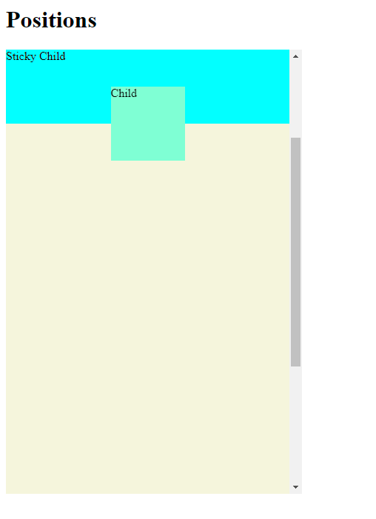

Task no5
Container: inside 4 containers.
One sticky, one centered, one empty but huge height (to make parent div scrollable), and one is fixed(red one)

Slide 56
CSS FLOAT
Is used to format and position content inside element.
Float: left|right|inherit|none
Left – element “floats” to the left side of it’s parent container
Right – element “floats” to the right side of it’s parent container
Inherit – element inherits float value of its parent
None – element does not float

Slide 57
CSS CLEAR
When we use float and want next element to not float
Clear: left|right|both|none|inherit
If the floated element is taller than containing element then we can add overflow: auto to containing element and floated element will stay inside containing elemnt

Slide 58
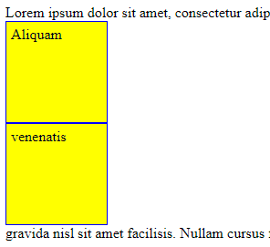

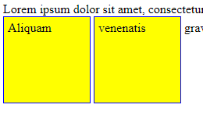
Css inline block
Allows you to set width and height of an element, padding and margin compared to display inline
It does not add line break after the element unlike display block

Slide 59
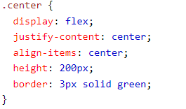
Css align
To horizontally center block elements we can use margin: auto property.
To center text we can use text-align: center propery.
To center vertically add padding
To align to left-or right: use float or use position absolute and left or right property and set it to 0px
Best way without flexbox: parent container position relative, height and then child element: { position: absolute; top: 50%; left: 50%; transform: translate(-50%, -50%);
Best way: with flexbox:

Slide 60
FLEXbox
Ideal for responsive(and non responsive) webpages
Display: flex
Flex properties:
Flex-direction
Flex-wrap
Flex-flow - Is a shorthand property for flex-direction and flex-wrap
Justify-content
Align-items
Align-content

Slide 61
Flex direction
Row – default value: items are displayed horizontally as a row
Row-reverse – same as row but items are displayed in reverse
Column – items are displayed one below another
Column-reverse – same as column, but items are displayed in reverse
Initial – sets property to default value
Inherit – inherits property value from parent

Slide 62
Flex wrap
Nowrap – elements will not be wrapped
Wrap – elements will be wrapped
Wrap-reverse – elemnts will be wrapped but in reverse order
Initial – sets property to its default value
Inherit - inherits property value from its parent

Slide 63
Justify content
Flex-start – default value. Content positioned at the start of the container
Flex-end – content positioned at the end of the container
Center - content is centered inside container
Space-between – items will have space between them
Space-around – items will have space before, between and after them
Space-evenly – items will have equal space around them
Initial
Inherit

Slide 64
Align items
Normal – Default value. Behaves like “stretch” for flexbox and grid items
Stretch – items are stretched to fit container
Center – items are positioned at the center of the container
Flex-start – items are positioned at the beginning of the container
Flex-end – items are positioned at the end of the container
Start – items are positioned at the beginning of their individual grid cells in the block direction
End – items are positioned at the end of their individual grid cells in the block direction
Baseline – items are positioned at the baseline of the container

Slide 65
Align content
Stretch – default value: lines stretch to take up the remaining space
Center – lines are packed towards the center of the flex container
Flex-start – lines are packed towards the start of the flex container
Flex-end - lines are packed towards the end of the flex container
Space-between – lines are evenly distributed in the flex container
Space-around - lines are evenly distributed in the flex container with half sized on either end
Space-evenly - lines are evenly distributed in the flex container with equal space between them
Initial
inherit

Slide 66
Flex items
Order – sets order of the flex item(numeric value)
Flex-grow – defines priority of flex item and how much will it grow compared to other items
Flex-shrink - defines priority of flex item and how much will it shrink compared to other items
Flex-basis – defines initial length of flex item
Flex – shorthand for flex-grow flex-shrink flex-basis
Align-self – defines alignment of item inside flex container(overrides align-items property)

Slide 67
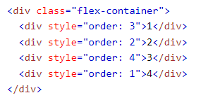
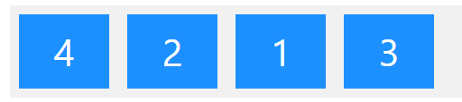
Flex order

Slide 68
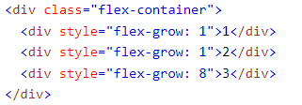

Flex grow

Slide 69
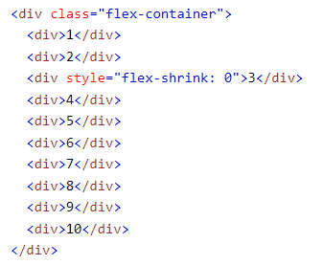
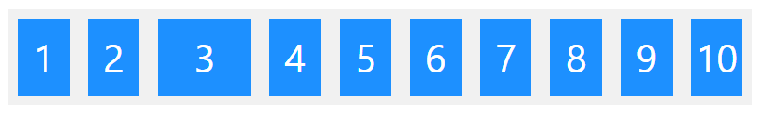
Flex shrink

Slide 70
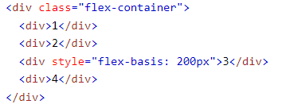
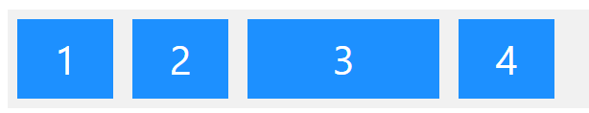
Flex-basis
Sets initial width of flex item.
In this example all divs have width value of 100px while third div has property of flex basis of 200px.
Width will scale in case we resize our screen

Slide 71
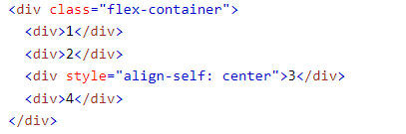
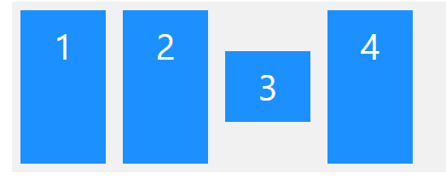
Flex align-self

Slide 72
Task no6
Create nav list, padding 0.5rem on every item
Use flex, list. Make it responsive.
Add hover, active and focus effects

