Slide 1
Html & CSS Course
By Systemduo & Irhad OmanoviC

Slide 2
What is HTML
HTML stands for Hyper Text Markup Language
HTML is the standard markup language for creating Web pages
HTML describes the structure of a Web page
HTML consists of a series of elements
HTML elements tell the browser how to display the content
HTML elements label pieces of content such as "this is a heading", "this is a paragraph", "this is a link", etc.

Slide 3
Example
<!DOCTYPE html> <html> <head> <title>First Page</title> </head> <body> <h1>My First Heading</h1> <p>My first paragraph.</p> </body> </html>

Slide 4
Example explained
The <!DOCTYPE html> declaration defines that this document is an HTML5 document
The <html> element is the root element of an HTML page
The <head> element contains meta information about the HTML page
The <title> element specifies a title for the HTML page (which is shown in the browser's title bar or in the page's tab)
The <body> element defines the document's body, and is a container for all the visible contents, such as headings, paragraphs, images, hyperlinks, tables, lists, etc.
The <h1> element defines a large heading
The <p> element defines a paragraph

Slide 5
What is an HTML Element?
An HTML element is defined by a start tag, some content, and an end tag:
<tagname > Content goes here... </tagname>

Slide 6
How to make html page
Step 1: Open editor(Notepad/TextEdit on widnows/mac)
Step 2: Write some HTML
Step 3: Save this file as HTML file
Step 4: View Page in browser by typing saved file’s location in browser

Slide 7
HTML Documents
All HTML documents must start with a document type declaration: <!DOCTYPE html>.
The HTML document itself begins with <html> and ends with </html>.
The visible part of the HTML document is between <body> and </body>.
The <!DOCTYPE> declaration represents the document type, and helps browsers to display web pages correctly.
It must only appear once, at the top of the page (before any HTML tags).
The <!DOCTYPE> declaration is not case sensitive.

Slide 8
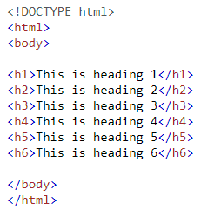
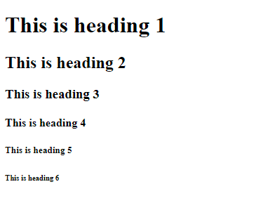
HTML Headings
HTML headings are defined with the <h1> to <h6> tags.
<h1> defines the most important heading. <h6> defines the least important heading:

Slide 9
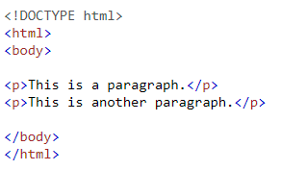
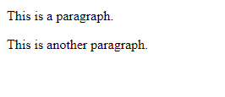
HTML Paragraphs
HTML paragraphs are defined with the <p> tag

Slide 10
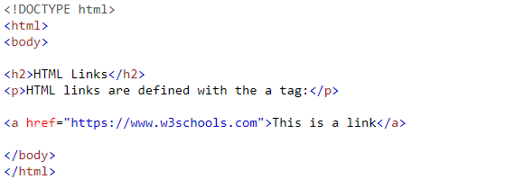
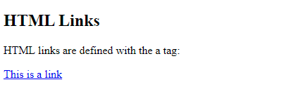
HTML Links
HTML links are defined with the <a> tag:

Slide 11
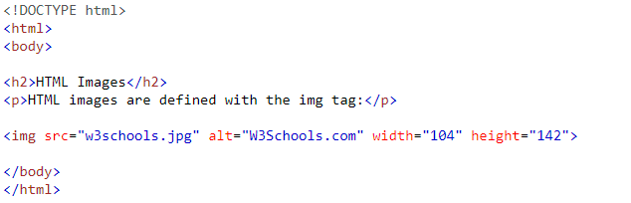
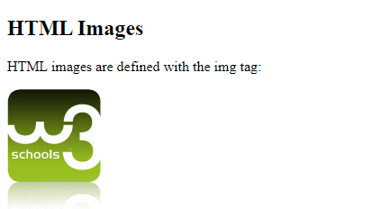
HTML images
HTML images are defined with the <img> tag.
The source file (src), alternative text (alt), width, and height are provided as attributes:

Slide 12
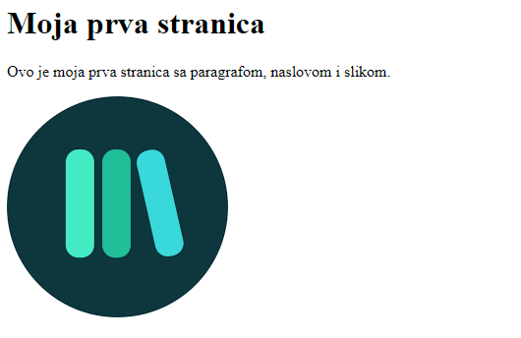
Task no1
Make webpage look like image below:
You can choose whatever image you like.

Slide 13
How to View HTML Source
Click CTRL + U in an HTML page, or right-click on the page and select "View Page Source". This will open a new tab containing the HTML source code of the page.
Right-click on an element (or a blank area), and choose "Inspect" to see what elements are made up of (you will see both the HTML and the CSS). You can also edit the HTML or CSS on-the-fly in the Elements or Styles panel that opens.

Slide 14
Nested HTML Elements
HTML elements can be nested (this means that elements can contain other elements).
All HTML documents consist of nested HTML elements.

Slide 15
Empty HTML Elements
Most of the elements needs closing tag in order to work
Some of them do not require it (<br> or <br />, <hr> or <hr />)

Slide 16
HTML Attributes
All HTML elements can have attributes
Attributes provide additional information about elements
Attributes are always specified in the start tag
Attributes usually come in name/value pairs like: name="value"
<a href="https://www.w3schools.com">Visit W3Schools</a>

Slide 17
The src Attribute <img src="img_girl.jpg">
There are two ways to specify the URL in the src attribute:
1. Absolute URL - Links to an external image that is hosted on another website. Example: src="https://www.w3schools.com/images/img_girl.jpg".
Notes: External images might be under copyright. If you do not get permission to use it, you may be in violation of copyright laws. In addition, you cannot control external images; it can suddenly be removed or changed.
2. Relative URL - Links to an image that is hosted within the website. Here, the URL does not include the domain name. If the URL begins without a slash, it will be relative to the current page. Example: src="img_girl.jpg". If the URL begins with a slash, it will be relative to the domain. Example: src="/images/img_girl.jpg".
Tip: It is almost always best to use relative URLs. They will not break if you change domain.

Slide 18
Other image Attributes
The <img> tag should also contain the width and height attributes, which specify the width and height of the image (in pixels).
The required alt attribute for the <img> tag specifies an alternate text for an image, if the image for some reason cannot be displayed. This can be due to a slow connection, or an error in the src attribute, or if the user uses a screen reader.
<img src="img_typo.jpg" width="500" height="600“ alt="Girl with a jacket">

Slide 19
The style attribute is used to add styles to an element, such as color, font, size, and more.
<p style="color:red;">This is a red paragraph.</p>
The title attribute defines some extra information about an element.
The value of the title attribute will be displayed as a tooltip when you mouse over the element
Common practice: Use lowercase letters for most of the stuff, and double quotes

Slide 20
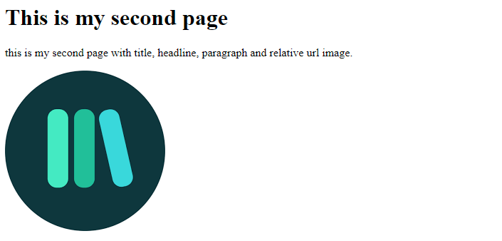
Task no2
Make webpage which contains image with relative url. Also, include head, title, heading and paragraph as well. Heading and image should have title tag included as well.
Page could look like this:

Slide 21
Headings
HTML headings are titles or subtitles that you want to display on a webpage.
HTML headings are defined with the <h1> to <h6> tags.
Tag <h1> defines the most important heading. <h6> defines the least important heading.
Used by search engine to index structure and content of your page
They come with default size(even so they can be adjusted as user prefers)

Slide 22
Pharagraph
A paragraph always starts on a new line, and is usually a block of text.
The HTML <p> element defines a paragraph.

Slide 23
Html horizontal rules
The <hr> tag defines a thematic break in an HTML page, and is most often displayed as a horizontal rule.
The <hr> element is used to separate content (or define a change) in an HTML page.

Slide 24
HTML line breaks
The HTML <br> element defines a line break.
Use <br> if you want a line break (a new line) without starting a new paragraph.

Slide 25
Pre tag
The HTML <pre> element defines preformatted text.
The text inside a <pre> element is displayed in a fixed-width font (usually Courier), and it preserves both spaces and line breaks:

Slide 26
<b> and <strong>
<b> tag is for bold text
<strong> is also for bold text, although it suggests that text inside is text of importance

Slide 27
<i> and <em>
<i> element defines text in alternate voice or mood.
It is typically displayed in italic
Used to indicate technical term, phrase from another language, a thought (something that steps up from current way of expression)
<em> displays emphasized text.
Also, typically in italic
Used to give emphasis to the word, using verbal stress

Slide 28
<small>
<defines some smaller text

Slide 29
<mark>
Defines text that should be marked or highlighted

Slide 30
<del>
Text with line through it
Indicates text that has been removed

Slide 31
<ins>
Defines text that have been inserted into document
Usually is underlined

Slide 32
<sub>
Defines subscript text
Useful for formulas (mathematical or chemicals)

Slide 33
<sup>
Superscript text
Appears half above the normal line

Slide 34
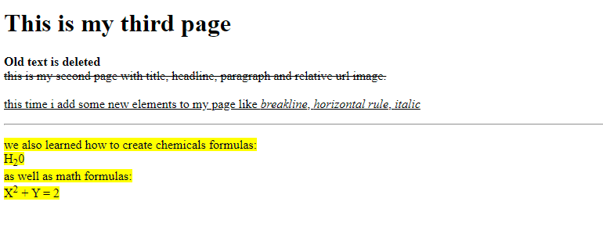
Task no3
Create page that will look like this:
Page should have deleted, inserted, bolded, italic, marked, superscript and subscript text

Slide 35
Quotations and citations
<blockquote> goes with cite attribute
Usually is indented
Cite attribute points to a page from which text was quoted

Slide 36
<q>
Short quotation
No indent, normal quotes

Slide 37
<abbr>
Defines abbreviations or acronym like HTML, CSS, Dr.
Can be combined with attribute title

Slide 38
<address>
Defines contact information for author or owner of the page/document
Email, phone, address, name etc

Slide 39
<cite>
Defines creative work like book, music, art etc.
Usually renders in italic

Slide 40
<bdo>
Stands for bi-directional override
Overrides current text direction

Slide 41
HTML Comments
Text that makes no impact on render and is of no significance to the machine
Used to make comments about section of code/text to improve code readability
<!-- <p>This is another paragraph </p> -->

Slide 42
HTML LINKS
<a href=“url”>Text link<a>
Href – links destination

Slide 43
HTML IMAGES
<img src=“image_url” alt=“text to show if image cant be loaded” />
Can be combined with map to define parts of the image where you can specify different url to go to on click
<picture><source media=“(min-width: 650px)” srcset=“imgurl” /> </picture>
When to use picture tag? When we use small screens where we load first specified image or when we want to specify different format supports for browsers

Slide 44
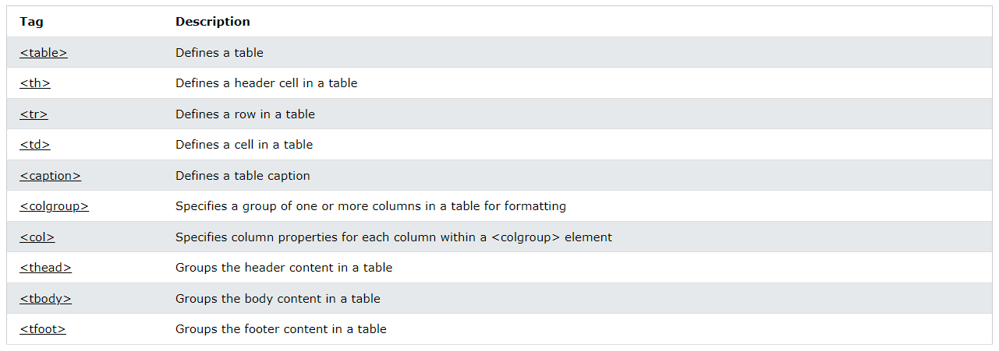
HTML tables

Slide 45
Table tag attributes
Colspan – to make one cell span over multiple columns
Rowspan – to make one cell span over multiple rows
Span(for col tag) – to specify column span for column group

Slide 46
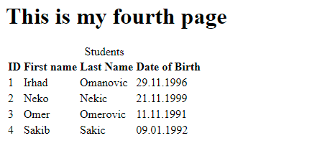
Task no4
Make table with 4 rows and columns so that it looks like this:

Slide 47
Lists
Unordered list - <ul></ul>
Ordered list - <ol></ol>
<li></li> - element of the list
<dl></dl> - description list
<dt> - term name
<dd> - describes each term

Slide 48
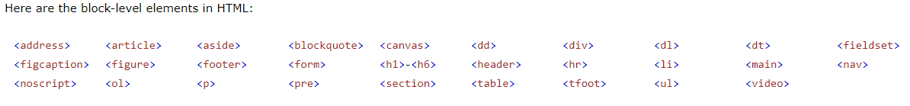
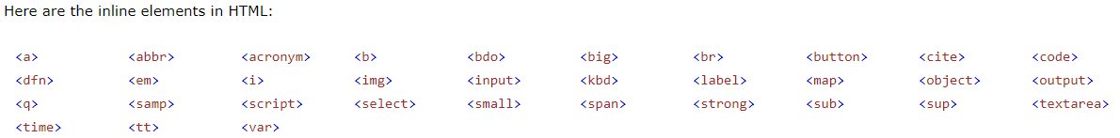
Block and inline elements
Inline elements take up only as much width as necessary, while block elements can take more and start in newline – they take all available width.

Slide 49
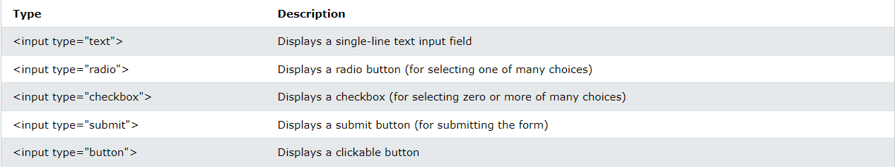
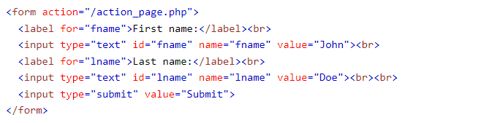
FORMS
<form></form>
<input></input>
<label></label>
<select><option> </option></select>
<textarea></textarea>
<button></button>
<fieldset></fieldset>
<legend></legend>
<datalist></datalist>
<optgroup></optgroup>

Slide 50
input and label Elements
Main attribute: type (checkbox, submit, number, text, datetime…)
Label mainly connected with input
Gives better description, and if you click on it works as if you have clicked on connected input element

Slide 51
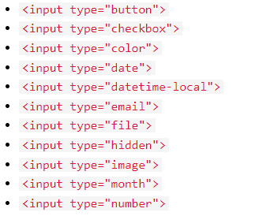
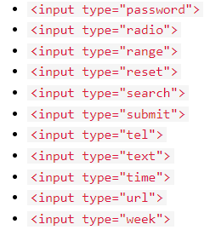
Input types

Slide 52
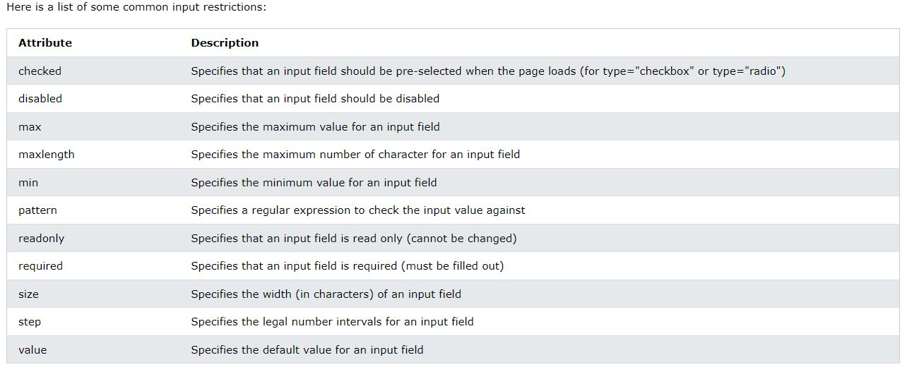
Input restrictions

Slide 53
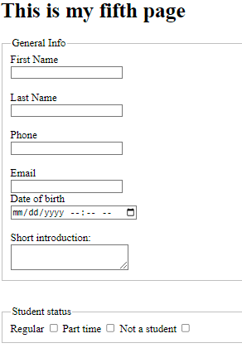
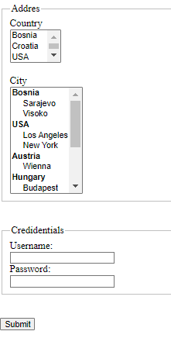
Task no5
Create form which will look like form on images provided
Use form, label, input, select, optgroup, option, fieldset, legend, br, textarea tags to create it.
Input types: submit, text, password, email, phone, datetime-local

Slide 54
Html head
The <head> element is a container for metadata (data about data)
The <head> element is placed between the <html> tag and the <body> tag
The <title> element is required and it defines the title of the document
The <style> element is used to define style information for a single document
The <link> tag is most often used to link to external style sheets
The <meta> element is typically used to specify the character set, page description, keywords, author of the document, and viewport settings
The <script> element is used to define client-side JavaScripts
The <base> element specifies the base URL and/or target for all relative URLs in a page

Slide 55
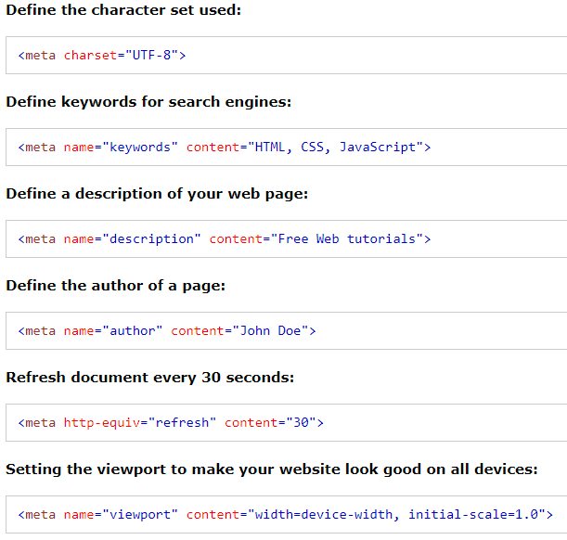
Meta examples

Slide 56
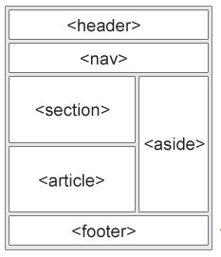
Html layout elements
<header> - Defines a header for a document or a section
<nav> - Defines a set of navigation links
<section> - Defines a section in a document
<article> - Defines an independent, self-contained content
<aside> - Defines content aside from the content (like a sidebar)
<footer> - Defines a footer for a document or a section
<details> - Defines additional details that the user can open and close on demand
<summary> - Defines a heading for the <details> element

Slide 57
Html semantic elements
Clearly describes its meaning to browser and developer
Useful for reuse of data across platforms and search engines
Article, aside, details, figure, figcaption, footer, header, main, mark, nav, section, summary, time

Slide 58
Further reading
https://www.w3schools.com/tags/default.asp
https://www.w3schools.com/html/html5_svg.asp

