Slide 1
Event Sourcing & CQRS
with
Axon Framework

Slide 2
Agenda
Axon Framework Overview
Basics
  DDD Concepts
  Events
    Domain Events
    Event Sourcing
    Event Store
  CQRS

Slide 3
Agenda
Advanced Concepts
  Business Transactions (SAGA Pattern)
  Eventual Consistency
  Conflict Resolution
  Snapshots
  Event Processors & Replay
  Event Revisioning

Slide 4
Axon Framework
Aggregate
Event Store
Command
Event Bus
Projection
Query
Database

Slide 5
Domain Driven Design
Domain Object
  Entities
  Value Objects
Aggregate: Cluster of domain objects
  Aggregate Root: Entry point for an aggregate
Bounded Context

Slide 6
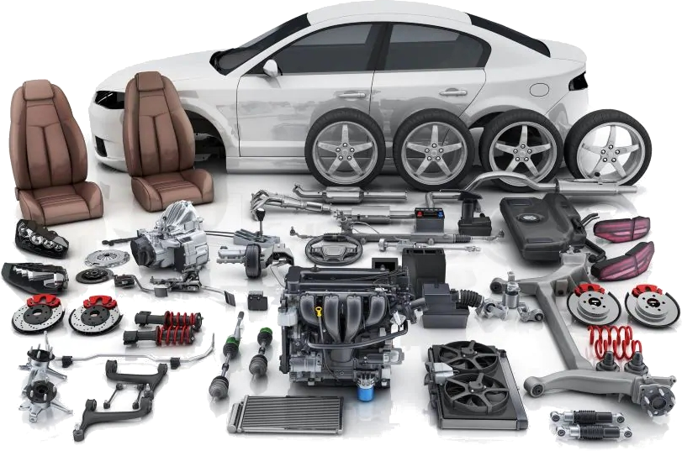
Domain Objects & Aggregate

Slide 7
Domain Events
Update State
+
Publish Event

Slide 8
Event Sourcing
re-hydrate
the state
Update State
+
Publish Event

Slide 9
Bank Account - Example
Current State
Events
ID | ... | BALANCE
123 | ... | 15
Account created → 0 USD
Deposited (10 USD) → 10 USD
Withdrawn (5 USD) → 5 USD
Deposited (20 USD) → 25 USD
Sent (15 USD) → 10 USD
Received (5 USD) → 15 USD
Balance
After Event

Slide 10
Event Sourcing - Benefits
Subscribing to changes
Historical reads
Analytics
“What if” scenarios
Undo-redo
Correction Events
Audit Logging

Slide 11
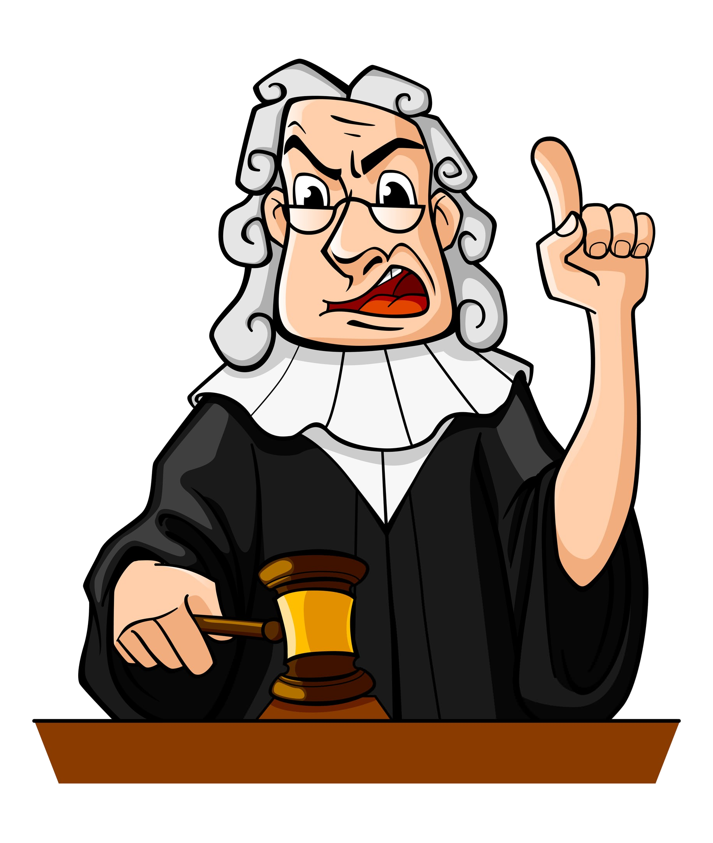
Immutable Events
the truth
the whole truth
nothing but the truth

Slide 12
Commands & Events
Single source
of truth
Aggregate
Event Store
Events
Commands
Event Sourcing

Slide 13
Event Store
Single source of truth
Append only
Preserve event order
Query by aggregate
Consistent write
Optimization

Slide 14
CQRS
(Command Query Responsibility Segregation)
COMMAND
QUERY
Create
Read
Update
Delete
Read
- all
- by account ID
- by customer name
- balances greater than 100
- all, order by date desc
- ...

Slide 15
Querying
Point-to-point Queries
Scatter/Gather Queries
Subscription Queries

Slide 16
Demo
“Talk is cheap. Show me the code.”
Linus Torvalds

Slide 17
Agenda
Advanced Concepts
  Business Transactions (SAGA Pattern)
  Eventual Consistency
  Conflict Resolution
  Snapshots
  Event Processors & Replay
  Event Revisioning

Slide 18
Business Transactions - SAGA
Order
Created
Payment
Completed
Shipped
Delivered
Order Mgmt.
Service
Payment
Service
Shipment
Service
Cargo & Delivery
Service

Slide 19
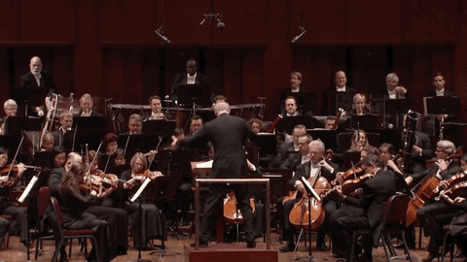
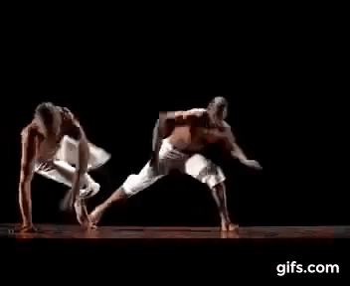
SAGA
Orchestration
Choreography

Slide 20
Agenda
Advanced Concepts
  Business Transactions (SAGA Pattern)
  Eventual Consistency
  Conflict Resolution
  Snapshots
  Event Processors & Replay
  Event Revisioning

Slide 21
CAP Theorem
Consistency
Availability
Partition
Tolerance

Slide 22
Eventual Consistency

Slide 23
ACID vs BASE
Atomic
Consistent
Isolated
Durable
Basic Availibility
Soft-state
Eventually Consistent

Slide 24
Agenda
Advanced Concepts
  Business Transactions (SAGA Pattern)
  Eventual Consistency
  Conflict Resolution
  Snapshots
  Event Processors & Replay
  Event Revisioning

Slide 25
Conflict Resolution - CRUD
SELECT * FROM USER WHERE ID = 100
Name
Muammer
Surname
Yucel
ID | VERSION | NAME | SURNAME
100 | 7 | Muammer | Yucel
Version
7
Save
Cancel
UPDATE USER SET NAME = ‘X’, SURNAME = ‘Y’,
VERSION = VERSION + 1 WHERE ID = 100 AND
VERSION = 7

Slide 26
Conflict Resolution - CQRS
SELECT * FROM USER WHERE ID = 100
ID | VERSION | NAME | SURNAME
100 | 7 | Muammer | Yucel
Name
Muammer
Surname
Yucel
Version
7
0
User Created Event
User Activated Event
...
Password Changed Event
Save
Cancel
1
7
User Updated Event
- Target Aggr. Identifier : 100
- Target Aggr. Version : 7

Slide 27
Agenda
Advanced Concepts
  Business Transactions (SAGA Pattern)
  Eventual Consistency
  Conflict Resolution
  Snapshots
  Event Processors & Replay
  Event Revisioning

Slide 28
Without Snapshots
Event Store
0
Account Created
Account Activated
Money Deposited
Money Withdrawn
...
Money Sent
Money Deposited
Money Received
1
2
Aggregate
3
Loading...
100
101
102

Slide 29
With Snapshots
Event Store
0
Account Created
Account Activated
Money Deposited
Money Withdrawn
...
Money Sent
Money Deposited
Money Received
1
Snapshot
2
3
100
Aggregate
101
Loading...
102

Slide 30
Agenda
Advanced Concepts
  Business Transactions (SAGA Pattern)
  Eventual Consistency
  Conflict Resolution
  Snapshots
  Event Processors & Replay
  Event Revisioning

Slide 31
Event Processors & Replay
Event Queue
Subscribing
Event Processor
Push Event
E
D
C
B
A
Pop Event
Event Queue
Tracing
Event Processor
Push Event
E
D
C
B
A

Slide 32
Agenda
Advanced Concepts
  Business Transactions (SAGA Pattern)
  Eventual Consistency
  Conflict Resolution
  Snapshots
  Event Processors & Replay
  Event Revisioning

Slide 33
Event Revisions
Event Store
Account Created
Account Activated
Money Deposited - V1
Money Withdrawn
...
Money Deposited - V1
Money Deposited - V2
Money Deposited - V2
Event Upcaster
(Accepts V1, converts to V2)
V2
Aggregate
(Handles V2)

Slide 34
Summary
truth,
whole,
nothing but
Immutable
Domain Events
Aggregate
Event Store
Handles commands
Event Sourcing
Single source
of truth
CQRS
Queries
Conflicts
- P2P
- Scatter – Gather
- Subscription
SAGA
Snapshots
Eventual Consistency
Replay
CAP Theorem
Revisions
Event Processors
Upcasting

