Slide 1

Track Mate: The Technological Ally for the Visually Impaired
Group Members:
Zainab Azeem (21P-8025)
Muawiya Kaleem (21P-8030)
Project Supervisor:
Dr. Ali Sayyed

Slide 2
Introduction
Understanding Blindness
WHO defines blindness as having a visual acuity of less than 3/60 in the better eye with the best possible correction.
Need for Assistive Technologies
Traditional canes provide limited detection of obstacles and cannot identify stairs or water hazards.
There is a growing demand for advanced, affordable solutions to support safe and confident navigation for the visually impaired.

Slide 3
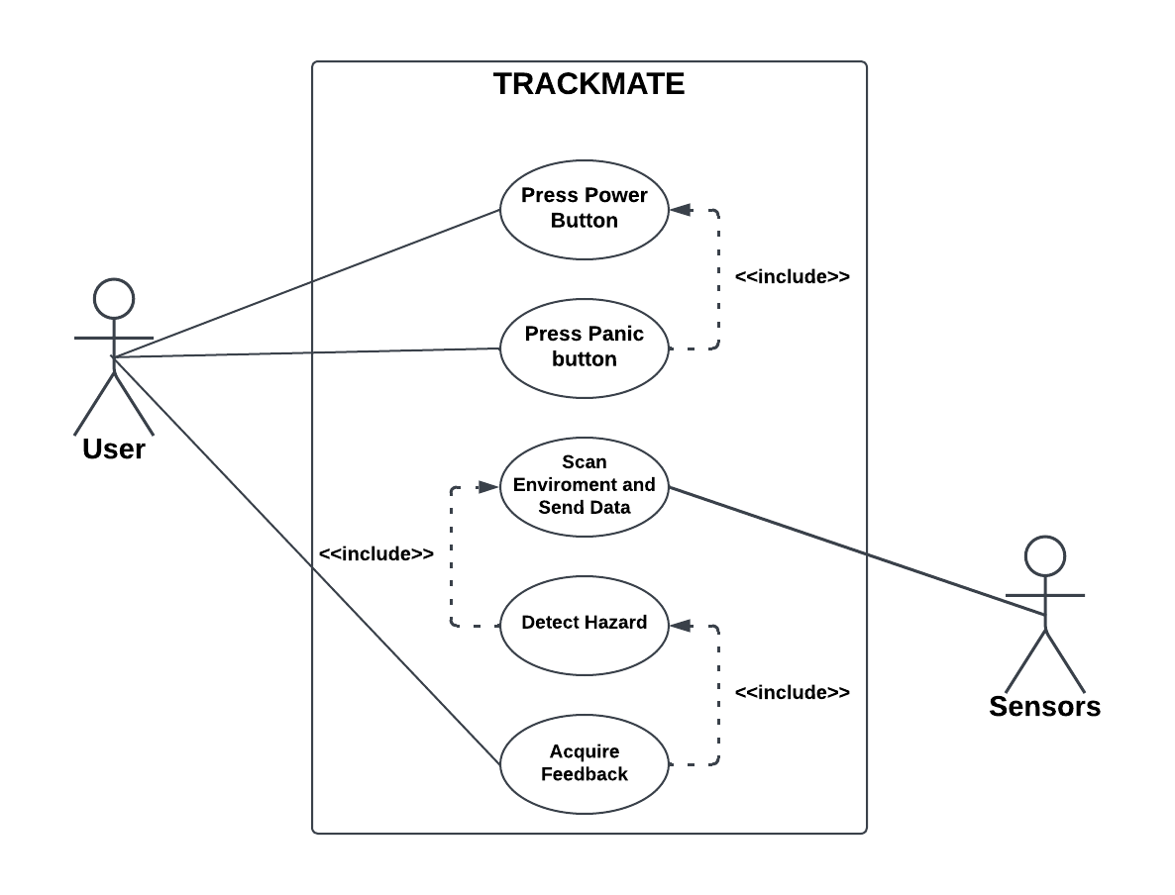
Use Case Diagram

Slide 4
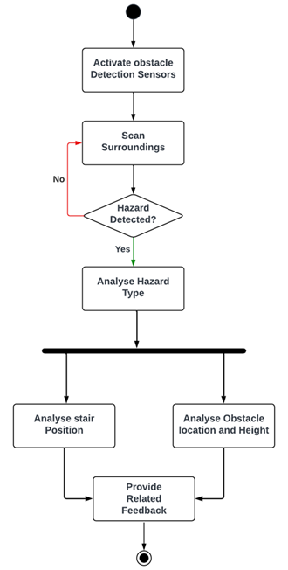
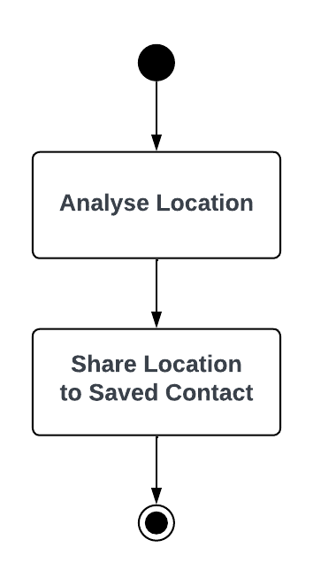
Activity Diagram
Panic Button Activity Diagram
Hazard Detection Activity Diagram

Slide 5
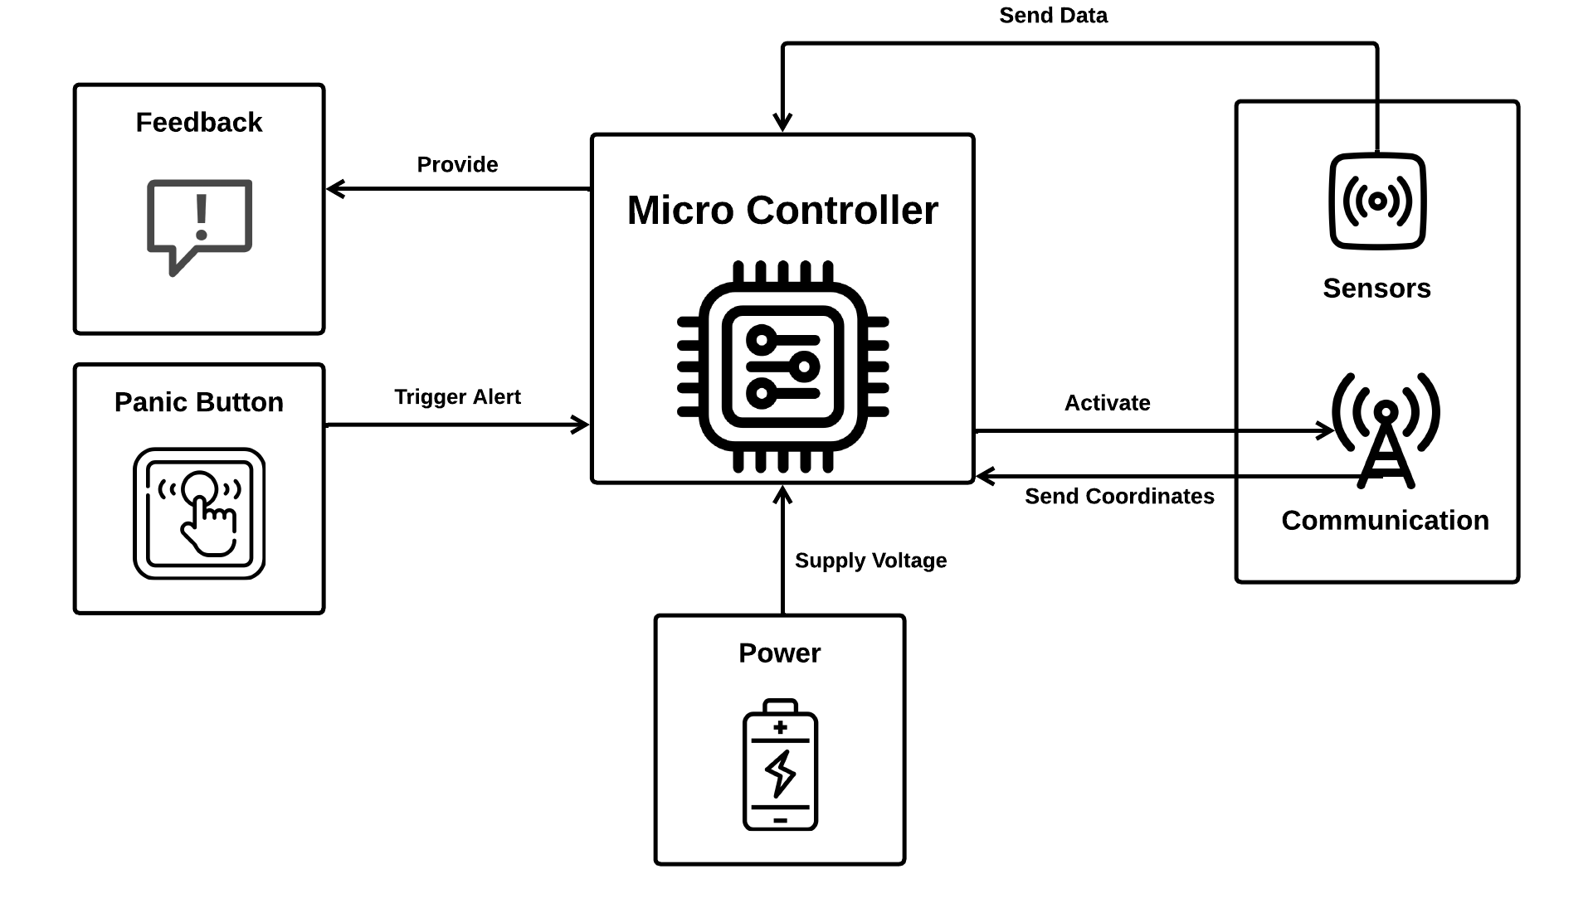
Architecture Diagram

Slide 6
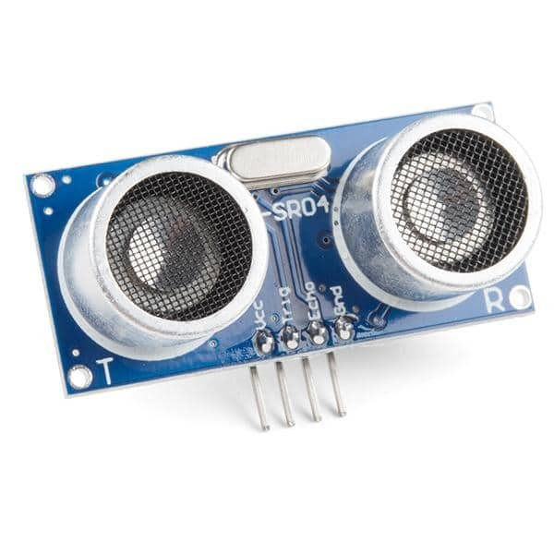
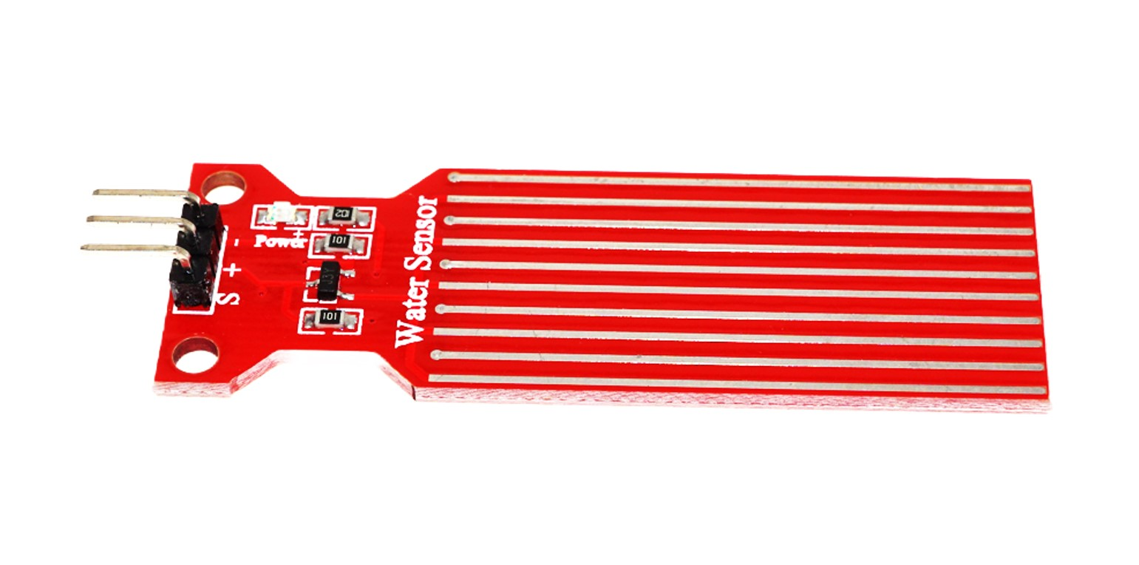
Sensors Used:
Ultrasonic Sensors: (HC-SR04 sensor):
Detect obstacles and stairs.
Provide auditory feedback for proximity warnings.
Water Sensor:
Identify water hazard on the ground.
Enhance safety in wet environments.

Slide 7
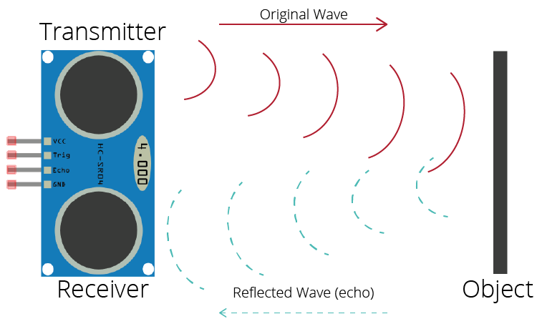
Ultrasonic Sensor:
Mechanism:
Emit high-frequency sound waves.
Reflect off objects and return to the sensor.
Measure round-trip time to calculate distance.
Range and Accuracy:
Range: 2 cm to 400 cm..
Applications:
Obstacle detection and Stairs detection

Slide 8
Water Sensor:
Mechanism:
Detects water by sensing when it touches the sensor.
Sends an output signal immediately upon water contact.
Applications:
Water hazard detection(slippery surface) to alert users upon contact with water.

Slide 9
Interfacing Sensors with Arduino:
Ultrasonic Sensor Connections:
Trigger Pin → Digital Pin
Echo Pin → Digital Pin
Water Sensor Connections:
Signal Pin → Analog Pin
Workflow:
Sensor data → Evaluate conditions → Trigger buzzer or Vibrator

Slide 10
Algorithm for Detecting UpStairs
and Obstacle
Approach:
Use ultrasonic sensors to detect distance changes.
Identify a series of small, consistent drops in distance, indicating a staircase.
Apply a pattern-recognition algorithm to differentiate stairs from obstacles.
Provide real-time alerts through vibration or auditory signals

Slide 11
Algorithm for Detecting UpStairs
and Obstacle
Key Assumptions:
The stick is held vertically with the bottom near the ground or touching the ground.
Safe distance is 24 inches; anything closer requires an alert.
The ground is assumed flat unless there's a step.

Slide 12
Algorithm for Detecting UpStairs
and Obstacle
Algorithm Steps:
Read distances from S1, S2, and S3.
Check if any distance is below the safe threshold (24 inches).
Compare the distances:
If all are similar (within tolerance), classify as an obstacle.
If distances show a stepped pattern (e.g., S1 < S2 < S3), analyze for stairs.
For stair detection:
Check if the difference between consecutive sensors aligns with the steps pattern.
Estimate the number of steps based on how many sensors detect close distances.
Output the result.

Slide 13
Algorithm for Detecting UpStairs
and Obstacle
Possible cases:
Obstacle Detection : If all sensors report roughly the same distance (within a tolerance, e.g., ±3 inches), and it’s less than 24 inches, it’s likely a regular obstacle (e.g., a wall).
B. Stair Detection: Stairs will show a stepped pattern in the distances:
One step: S1 detects the step, while S2 and S3 detect farther
Two steps: S1 detects the first step, S2 detects the second step, and S3 detects farther.
Pattern Analysis: Compare the differences between S1, S2, and S3 distances and check if they align with the stair geometry (rise ≈ 6 inches, run ≈ 12 inches).
Safe Distance Check: If any sensor reads less than 24 inches(2feet), trigger an appropriate alert.

Slide 14
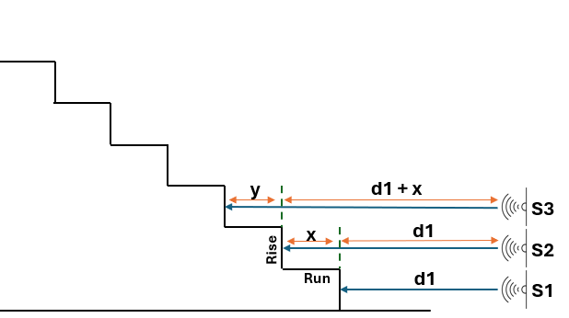
Algorithm for Detecting UpStairs
and Obstacle
Technique:
3 Ultrasonic sensors placed on a stick
Placing on 3 , 9, 15 inches of stick from bottom respectively
Stair dimensions: 6 inches rise
12 inches run

Slide 15
Algorithm for Detecting Downstairs
Ultrasonic sensor at a height of 13 inches from the ground.
Fixed at an angle of θ = 45° downward.
Assuming a standard stair dimension:
Run = 12 inches
Rise = 6 inches
The length of the beam hitting the ground (when flat) can be predicted using geometry.
If there is a downward stair (drop), the sensor will not detect the ground at the same distance.
If Detected distance > 18.38 inches ​⇒ Possible downstep
Smart stick
Using c² = 13² + 13²
c= 18.38 inches ~ tolerance of +2,-2
45°
18.38 inches
13 inches
13 inches
Down step

Slide 16
Coding Styles
Descriptive variable names (safeDistance, buzzer, waterSensorPin.)
Modular functions (measureDistance() and checkWater())
Constants used instead of hard-coded values
Well-indented code with inline comments
Used built-in Arduino functions (digitalRead, tone(), analogRead())

Slide 17
Application of Test Cases
Tests were applied in both controlled and real-life environments.
Obstacle tests used objects at varying distances: 10 cm, 20 cm, 30 cm, etc.
Stair detection tested on 1-step and 2-step stairs.
Water detection tested on dry and wet surfaces using moisture sensors.
5 test rounds per case ensured consistency.

Slide 18
Formal Testing Techniques/ Outcomes
Test Case ID | Test Case Description | Input | Expected Result | Actual Result
TC1 | Detect object at close range | Object placed at 20 cm | Vibrator turns ON | Vibrator turns ON
TC2 | No obstacle in range | No object within 100 cm | No alert | No alert
TC3 | Detect closest object among many | Objects at 10 cm and 50 cm | Vibrator turns ON for closest object | Vibrator turns ON
TC4 | Detect water presence | Wet surface under moisture sensor | Buzzer turns ON | Buzzer turns ON
TC5 | Dry surface test | Dry floor under moisture sensor | No alert | No alert

Slide 19
Formal Testing Techniques/ Outcomes
Test Case ID | Test Case Description | Input | Expected Result | Actual Result
TC6 | Stair pattern detection | Reading capture according to algorithm | Vibration and buzzer turns ON | Vibration and buzzer turns ON
TC7 | Flat ground condition | All sensors read 100cm | No alert | No alert
TC8 | Varying stair heights | Uneven steps (real stairs) | Vibration and buzzer turns ON | Inconsistent due to run change than standard
TC9 | Downward stair detection | S4>47 approx. | buzzer turns ON | Alert ON
TC10 | No false alarm on clear path | Sensors face an open, dry path with no object | No vibration or buzzer alert should trigger | No alert

Slide 20
Formal Testing Techniques/ Outcomes
Test Case ID | Test Case Description | Input | Expected Result | Actual Result
TC11 | Check response time | Rapid hand motion toward sensor | Alert within 0.5 second | Alert in 1 seconds
TC12 | Ultrasonic interference check | All sensors running together | Stable readings, no interference | Some times garbage values
TC13 | Power reset recovery | Arduino manually reset during run | System reinitializes and resumes | System rebooted successfully
TC14 | Humid air without water contact | Moist air around sensor (no wet surface) | No water alert | No alert
TC15 | Irregular stairs detection | Steps with different rise and run | Some detection delay possible | Detected with minor delay or inconsistency

Slide 21
Testing Outcomes
Obstacle detection accuracy: 80%
Water detection accuracy: 100%
Stair detection reliability: 7/10 when proper alignment maintained
Average response time: 1 seconds
False positives: Downstairs

Slide 22
Demo!

Slide 23
Technical Difficulties
Sensor giving noisy values
Water sensor over-sensitivity
Placement of hardware components

Slide 24
Goals Achieved
Obstacle detection
Stair detection
Water hazard alert
Real-time alerts via buzzer/vibration
Prototype completed and demonstrated successfully.

Slide 25
Deployment
Fully assembled on a physical stick (prototype form).
Integrated all components: Arduino, sensors, buzzer, vibration motor.
Real-time response tested in live scenarios.
Successfully detects stairs, obstacles, and water on real surfaces.
Prototype ready for field testing and user evaluation.

Slide 26
Time Line for FYP-II
Weeks | 1 | 2 | 3 | 4 | 5 | 6 | 7 | 8 | 9 | 10 | 11 | 12 | 13 | 14 | 15 | 16
Development Phase 2
Testing
Validation
Report & final presentation
Documentation

Slide 27
Teamwork
Muawiya Kaleem
Zainab Azeem
Dr Ali Sayyed
Research
System Design
Hardware development
Design algorithm
Testing
Documentation
Research
Software
development
Design algorithm
Validation
Documentation
Constantly Supervising
Maintaining Discipline
Helping in understanding the project domain
Keep motivating if gets lazy

Slide 28
References
Habib, M. M. Islam, M. N. Kabir, M. B. Mredul, and M. Hasan, "Staircase Detection to Guide Visually Impaired People:
A Hybrid Approach," Revue d'Intelligence Artificielle, vol. 33, no. 5, pp. 327-334, 2019, doi: 10.18280/ria.330501
M. Ashrafuzzaman, S. Saha, N. Uddin, P. K. Saha, S. Hossen, and K. Nur, "Design and Development of a
Low-cost Smart Stick for Visually Impaired People," presented at the International Conference on Science & Contemporary
Technologies (ICSCT), 2021, doi: 10.1109/ICSCT53883.2021.9642500
B. K. T. P. Wickramasinghe, K. K. V. S. Anjana, G. D. S. T. Ratnasekara, and D. U. Vidanagama,
"Smart Cane for Staircase and Water Detection," Faculty of Computing, General Sir John Kotelawala Defence University,
Ratmalana, Sri Lanka, 2020
N. Loganathan, K. Lakshmi, N. Chandrasekaran, S. R. Cibisakaravarthi, R. Hari Priyanga, and K. Harsha Varthini,
"Smart Stick for Blind People," presented at the IEEE International Conference on Communication and Information
Processing, 2020K. Jivrajani, S. K. Patel, C. Parmar, J. Surve, K. Ahmed, F. M. Bui, and F. A. Al-Zahrani, "AIoT-Based
Smart Stick for Visually Impaired Person," IEEE Transactions on Instrumentation and Measurement, vol. 72, 2023,
doi: 10.1109/TIM.2022.3227988
A. A. Elsonbaty, "Smart Blind Stick Design and Implementation," International Journal of Engineering and
Advanced Technology (IJEAT), vol. 10, no. 5, pp. 17-20, June 2021, doi: 10.35940/ijeat.D2535.0610521​.
B. H. Kumar, G. Anusha, S. Haritha, and S. U. Sri, "Low-Cost Walking Stick for Obstacle and
Stair Detection Using Arduino," Science & Technology Development Journal - Engineering and Technology,
vol. 12, no. 5, pp. 614-623, May 2023.

